Slide 1


Introduction to Open Stack & Vagrant
Under Guidance Of
Prof. Sri Krishnamurthy
Compiled By:
Mohit Mittal
Https://Www.Linkedin.Com/In/Mohit-mittal-552a66108/
Sneha Ravikumar
Https://Www.Linkedin.Com/In/Sneha-ravikumar-a8925b113/
Taj Poovaiah
Https://Www.Linkedin.Com/In/Taj-poovaiah-75ab2731/

Slide 2
Demo on Vagrant

Slide 3

Vagrant
Vagrant sits on top of virtualization software as a wrapper and helps the developer interact easily with the providers
Vagrant is an open-source software product for building and maintaining portable virtual development environments
Vagrant installation commands
https://www.vagrantup.com/
$ vagrant ssh. SSH into virtual machine
$ vagrant up. Start virtual machine
Difference between Vagrant and VirtualBox
VirtualBox (the software that creates
virtual machines)
Vagrant (our hero, the software that
deploys virtual machines and runs provisioning scripts)

Slide 4
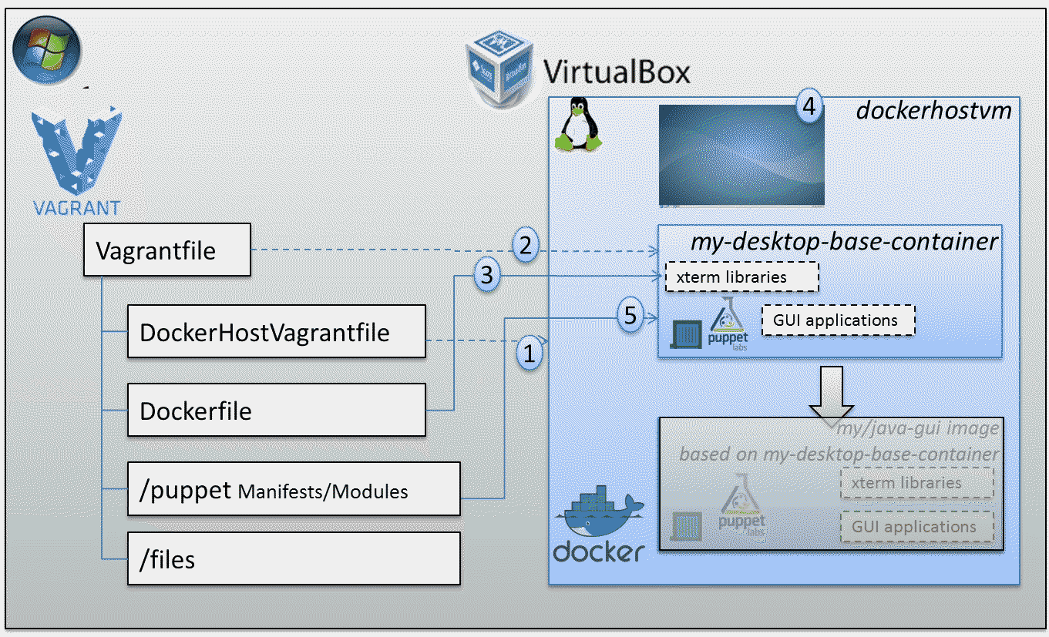
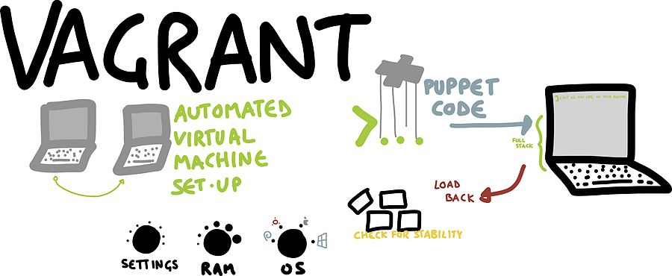
Vagrant Architecture

Slide 5
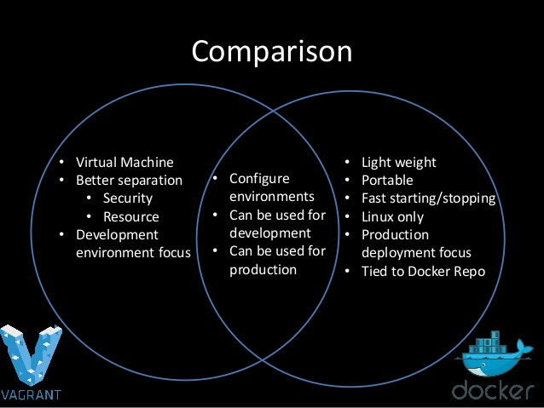
Vagrant vs Docker

Slide 6
Demo on TryStack

Slide 7

OpenStack
Open Source Cloud Computing Operating System
Founded in July 2010 BY Rackspace and NASA
Why OpenStack?
To create and offer cloud computing services running on standardized hardware
Pros
Data Sovereignty :Data is on premise
Private cloud
Vendor Neutral API
Cons
Stability
Expertise

Slide 8
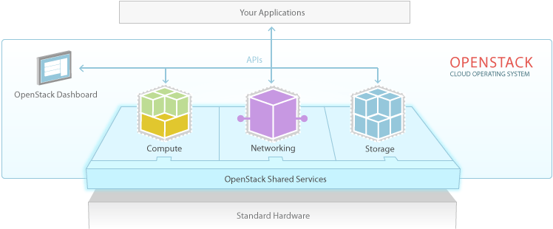
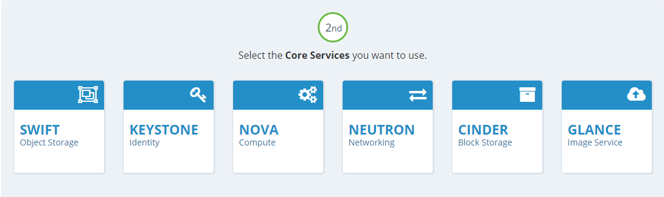
Open Stack Architecture

Slide 9
Useful Links and References
https://www.vagrantup.com/ - Vagrant Installation
https://en.wikipedia.org/wiki/Vagrant_(software) – More Vagrant
https://docs.openstack.org/mitaka/install-guide-ubuntu/ OpenStack Installation (Ubuntu)
http://trystack.org
https://www.rdoproject.org/install/quickstart/ RedHat OpenStack

Slide 10

OpenStack Summit

Slide 11
THANK YOU

