Slide 1
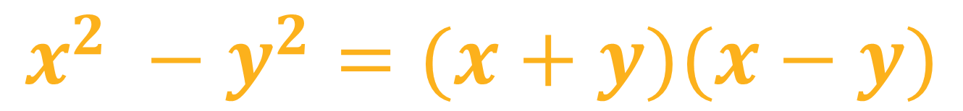
A Visual Proof That
$$x^{2} −y^{2}=(x+y)(x−y)$$
Notes:
A visual proof for x squared minus y squared equals the quantity x plus y multiplied by the quantity x minus y

Slide 2
Notes:
Let's begin by considering two squares.

Slide 3


$$x$$
$$x$$
Notes:
One has a side length of x

Slide 4


$$x$$
$$y$$
$$x$$
$$y$$
Notes:
And the other has a side length of y

Slide 5

$$x$$
$$y$$
$$x$$
$$x^{2}$$
$$y$$
Notes:
The area of the larger square is simply x squared.

Slide 6

$$x$$
$$y$$
$$x$$
$$x^{2}$$
$$y^{2}$$
$$y$$
Notes:
The area of the smaller square is simply y squared.

Slide 7




$$x$$
$$y$$
$$x$$
$$x^{2}$$
$$y^{2}$$
$$y$$
Notes:
Visually, x squared minus y squared equals removing the smaller square from the larger square

Slide 8





$$x$$
$$x$$
$$x^{2}$$
$$y^{2}$$
$$y$$
Notes:
We can see that this leftover area can be grouped into two rectangles

Slide 9



$$x$$
$$x−y$$
$$a^{2}$$
$$y^{2}$$
$$y$$
Notes:
one with dimensions x by x minus y

Slide 10


$$x$$
$$x−y$$
$$a^{2}$$
$$y$$
$$y^{2}$$
$$y$$
$$x−y$$
Notes:
Another with dimensions y by x minus y

Slide 11

$$x$$
$$x−y$$
$$a^{2}$$
$$y$$
$$x−y$$
Notes:
We can rearrange the two rectangles

Slide 12

$$x$$
$$y$$
$$x−y$$
$$a^{2}$$
Notes:
We will get a new triangle with dimensions x plus y by x minus y

Slide 13

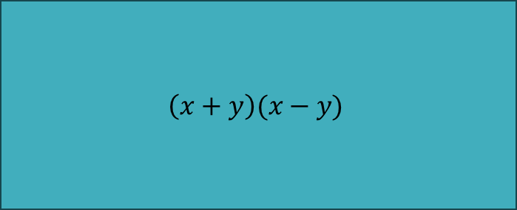
$$x+y$$
$$\left(x+y\right)(x−y)$$
$$x−y$$
$$a^{2}$$
Notes:
The area of this rectangle is exactly the quantity x plus y multiplied by the quantity x minus y

Slide 14
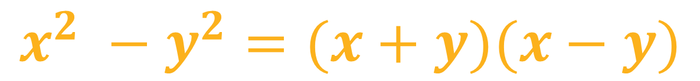
$$x+y$$
$$\left(x+y\right)(x−y)$$
$$x−y$$
$$a^{2}$$
$$x^{2} −y^{2}=(x+y)(x−y)$$
Notes:
Which is equivalent to the original expression for the difference of squares

Slide 15
$$x+y$$
$$\left(x+y\right)(x−y)$$
$$x−y$$
$$a^{2}$$
$$x^{2} −y^{2}=(x+y)(x−y)$$
Notes:
x squared minus y squared equals the quantity x plus y multiplied by the quantity x minus y

