Slide 1
Git training
Péter Veres
peter_veres2@epam.com

Slide 2
Git
„Git is based on basic computer science. If it's too hard for you, perhaps you're in the wrong industry.”
(Stuart Herbert, 2013)
Notes:
https://twitter.com/stuherbert/status/382824711660781568

Slide 3
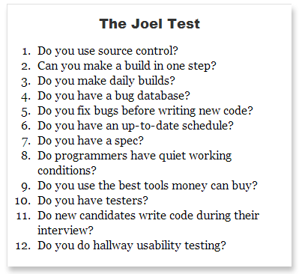
How to measure the quality of a software team?
Git introduction
Notes:
http://www.joelonsoftware.com/articles/fog0000000043.html

Slide 4
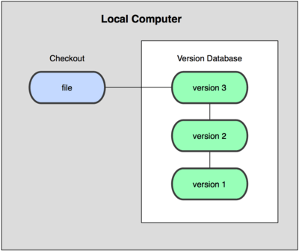
About version control
Git introduction
Local database

Slide 5

About version control
Git introduction
Centralized Version Control Systems

Slide 6
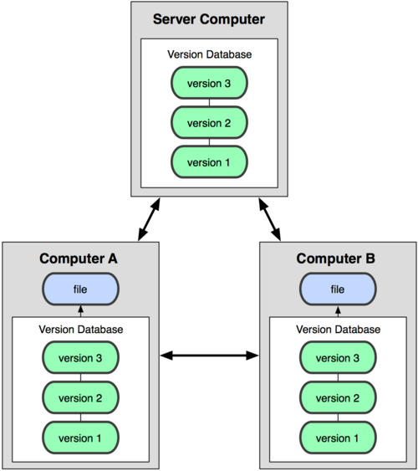
About version control
Git introduction
Distributed Version Control Systems

Slide 7

Short story of git
Git introduction
Linux
Before 2002 patch emailing system
BitKeeper between 2002 and 2005
git from April of 2005
git:
“I’m an egotistical bastard, and I name all my projects after myself. First Linux, now git.” – Linus
Notes:
git: „an unpleasant or contemptible person.”

Slide 8
What is git?
Git introduction
distributed revision control and
source code management system
git != SVN + Magic
Stupid content tracker
Content-addressable
Snapshots
Trees
Blobs
Pointers
No diff! (like SVN)
„There may be a lot of things that Git is not good at, but these things are what Git is very good at.”

Slide 9
Essentials
Git introduction
Non-linear development
Distributed development
Efficiency
Example Ruby on Rails
9 MB
115 MB in SVN
13 MB in git
Efficient network operations

Slide 10
Prerequisites
Git introduction
MysysGit
http://msysgit.github.io/
Registration
github.com
git.epam.com
Import public keys
https://help.github.com/articles/generating-ssh-keys/ (step #1, #2 and #4)
https://git.epam.com/help/ssh/ssh
P4 Merge: Visual Merge Tool (Perforce)
http://www.perforce.com/product/components/perforce-visual-merge-and-diff-tools
Select FREE DOWNLOAD P4 Merge
Select Visual Merge Tool

Slide 11
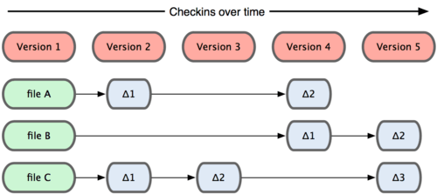
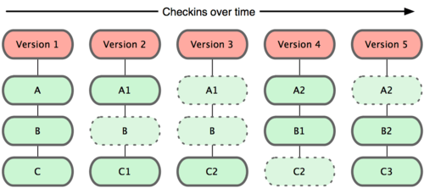
Basics - snapshots
Git BASICS

Slide 12
Versioning with git
Git basics
Working directory
single checkout of one version of the project
Staging area/Index
stores information about what will go into your next commit. It is a simple binary file.
Repository
where Git stores the metadata and object database for your project, .git directory

Slide 13

Basics – the tree states
Git BASICS

Slide 14
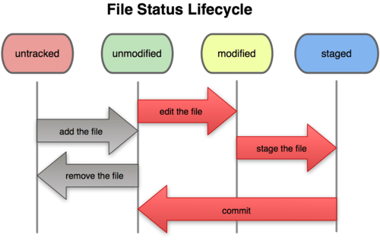
Basics – file status lifecycle
Git BASICS

Slide 15
Exercise
Versioning with git
Notes:
http://www.thegeekstuff.com/2014/04/git-log/
ET:
git init
git status
git add .
git commit –m
git log
git log --pretty=oneline
git show
git diff – compare repo and working dir
.gitignore
git rm
git rm --staged
File modes:
040000: Directory
100644: Regular non-executable file
100664: Regular non-executable group-writeable file
100755: Regular executable file
120000: Symbolic link
160000: Gitlink
EA:
Test the commands above

Slide 16

Configuring git
Git configuration
Three levels of configuration
System
/etc/gitconfig
Global
~/.gitconfig
Local
.git/config
Notes:
git config --list
git config --list --system
git config --list --global
git config --list --local

Slide 17
Exercise
Configuring git
Notes:
Tasks:
git config --global core.editor "'C:/Program Files (x86)/Notepad++/notepad++.exe' -multiInst -notabbar -nosession -noPlugin"
- Set your merge tool
git config --global merge.tool p4merge
git config --global mergetool.p4merge.path "C:/Program Files/Perforce/p4merge.exe„
Set your editor:
# git config --global core.editor "'C:/Program Files (x86)/Notepad++/notepad++.exe' -multiInst -notabbar -nosession -noPlugin"
[core]
editor = 'C:/Program Files (x86)/Notepad++/notepad++.exe' -multiInst -notabbar -nosession –noPlugin
- Add user.name and user.email to global (it should be added earlier)
$ git config --global user.name "John Doe"
$ git config --global user.email johndoe@example.com

Slide 18
Object database
Git objects
Git Object Database, which is kept in the Git Directory
Each object is compressed (with Zlib) and referenced by the SHA-1 value (40 chars) of its contents plus a small header.
Types
Blob
Tree
Commit
…

Slide 19
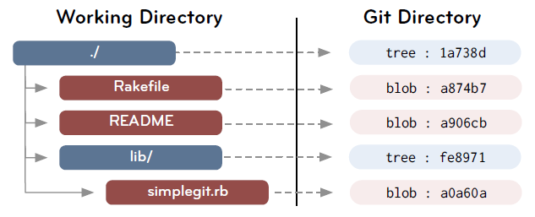
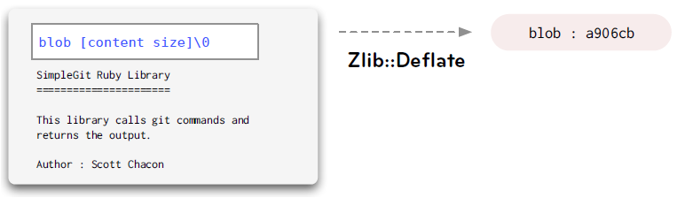
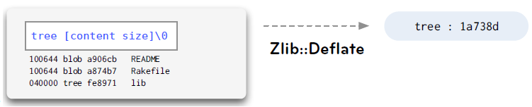
Blob, tree
Git objects

Slide 20
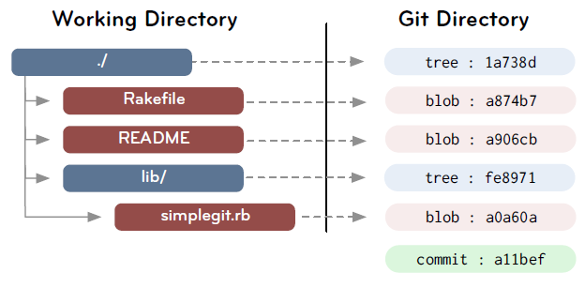
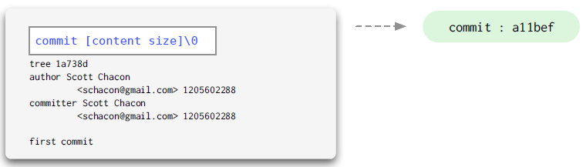
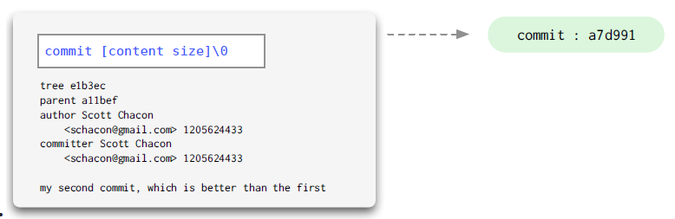
Commit
Git objects
Points to a tree
Keeps author, committer, message, parent commits

Slide 21
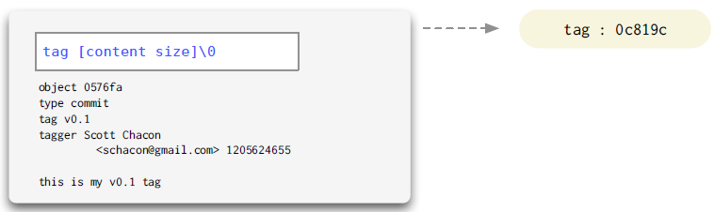
Tag
Git objects
We’ll talk about it later…

Slide 22
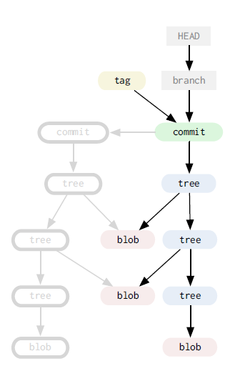
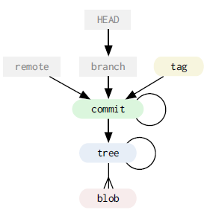
Data model
Git objects
Grey: “cheap” objects
Color: immutable

Slide 23
Data model
Git objects
DAG
Objects are immutable
References can constantly change

Slide 24
Exercise
git cat-file
Notes:
Create commit
git cat-file -> -t, -p
Commit
tree (git cat-file master{tree})
File
Task
Find the previous commit
Revert the previous content of a file with git cat-file

Slide 25

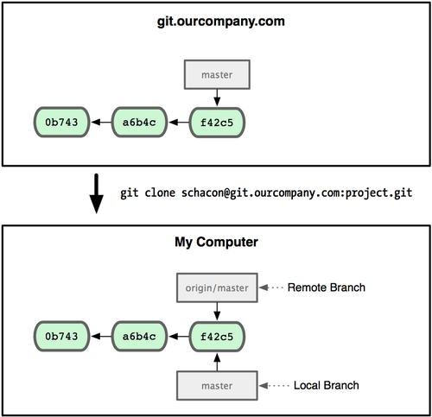
Git remotes
Git remotes
Remote branches

Slide 26
Git remotes
Git remotes
We’ll talk more about branches later
git remote add:
Remote branches are in .git/refs/remotes
Remote branches could be tracked by local branches
Remote branch can be fetched/rebased/merged
Local branch can be committed/pushed (rebased/merged to another local branch)
Remote branch can be checked out, but HEAD will be in detached state
You can commit to a detached HEAD, but it will be detached
Notes:
ET:
remote repositories
git remote
git fetch
git push – push should be fast forwarded, non-fastforwarded is not recommended (--force)
git push -u
git pull
git pull --rebase
git rebase

Slide 27
Git on the Server
Git On the Server
Web-based hosting services for software development projects that use the Git revision control system
Central repository
Collaboration
Issue tracking
Pull requests
Examples
github
bitbucket
Atlassian Stash
Gitlab (eg. git.epam.com)
…
Notes:
Free student accounts:
http://www.jetbrains.com/student/
https://education.github.com/

Slide 28
Git on the Server
Git On the Server
Protocols
Local
SSH – anonymous access not supported
git – own protocol, no authentication
http(s)

Slide 29

Pull request
Git in the Server
Not the part of the git
Pull requests are between branches, not commits!

Slide 30
Exercise
Git remotes
Notes:
EA
Find a project, push it to your repo (create another remote)
Find a project from my projects, fork it, create commit, and add pull request

Slide 31

Git Branching
Git branching
What is a branch?
A branch is only a new pointer (40 bytes)
Commands
git branch
git checkout
git merge

Slide 32
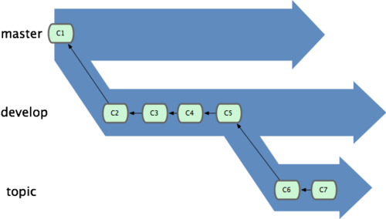
Git Branching
Git branching
Branch management
Long running branches
master: code that has been or will be released
develop (next): used to work from or test stability
Short-lived branches
topic: used for a single particular feature or related work
Notes:
Topic branch is something you’ve likely never done with a VCS before because it’s generally too expensive to create and merge branches.

Slide 33
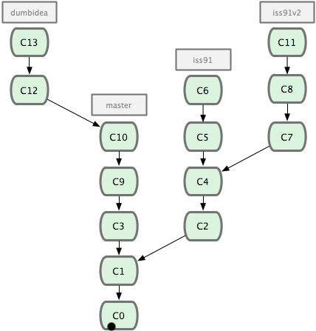
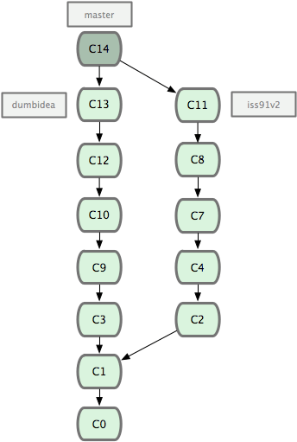
Git Branching
Git branching
Notes:
Iss91 is dropped away

Slide 34
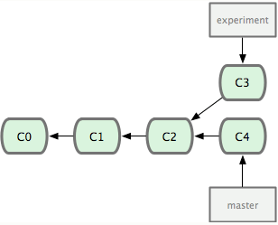
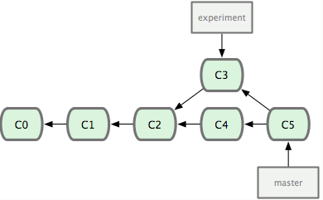
Merging
Git branching
Fast-forward merge
Non-fast forward merge
Merge with conflicts
2-way merge vs 3-way merge
Which merge tool should be used?

Slide 35
Exercise
Git Branching
Notes:
- git branch iss53; git checkout iss53 / OR git checkout -b iss53
- git commit -a -m 'added a new footer [issue 53]'
- show a fast-forward
- show an automatic merge
- show a conflict
- git branch -v
- git branch --merged
git branch --no-merged
git branch -d OR –D
git branch –a
git branch –r
git branch –m rename
git show-branch

Slide 36
Merge tools
Git branching
P4merge
Meld
Diffuse
KDiff3
Vimdiff

Slide 37

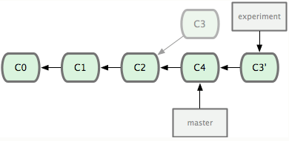
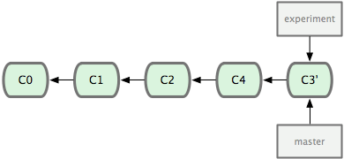
Rebasing
Git REbasing
rewinding head
replay your work on top
of it

Slide 38
Exercise
Git Rebasing

Slide 39
Remote branches
Git remotes #2
git remote add:
Remote branches are in .git/refs/remotes
Remote branch can be fetched/rebased/merged
Local branch can be committed/pushed/rebased/merged
→ local and remote branches are independent
→ but remote branches can be tracked by a local branch
Push branch:
git push [remote] [branch]
git push [remote] [branch_local]:[branch_remote]
git push [remote] :[branch_remote] – this removes the remote branch

Slide 40
Exercise
Git Remote Branching
Notes:
create a remote repo
git remote add origin …
git fetch
git pull
git pull –rebase
git merge

Slide 41
Rebase vs merge
Git branching
Rebase
Pros:
Code history is flat and readable
Manipulate a single commit is easy (eg. revert)
Cons:
Can hide context
Does not work very well with pull requests
Rewriting history
You will need a force push on remote branches → BREAKAGE

Slide 42
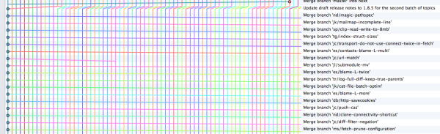
Rebase vs merge
Git branching
Merge
Pros:
Traceability
Cons:
History can become intensely polluted by lots of merge commits

Slide 43
Rebase vs merge
Git branching
Guideline
Do not rebase commits that you have pushed to a public repository.

Slide 44
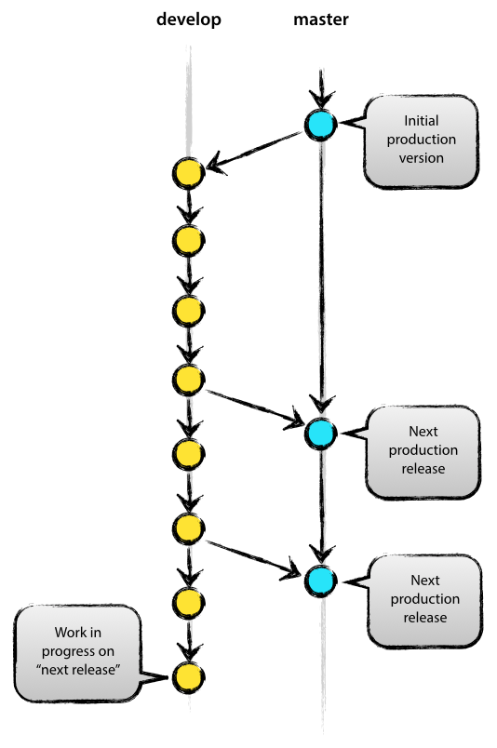
Git branching model example 1/5
Git branches #2
Main branches
Master
Develop
Notes:
Source:
http://nvie.com/posts/a-successful-git-branching-model/

Slide 45
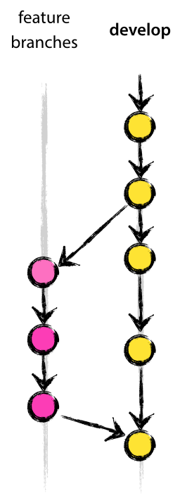
Git branching model example 2/5
Git branches #2
Supporting branches
Feature branches
Release branches
Hotfix branches
Notes:
Mention git-merge –no-ff

Slide 46
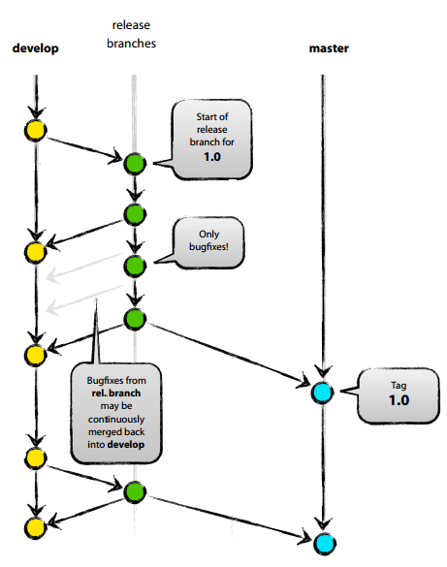
Git branching model example 3/5
Git branches #2
Supporting branches
Feature branches
Release branches
Hotfix branches

Slide 47
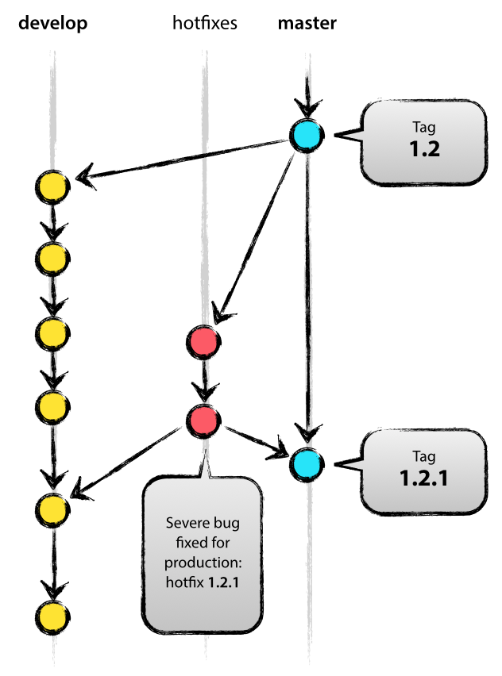
Git branching model example 4/5
Git branches #2
Supporting branches
Feature branches
Release branches
Hotfix branches

Slide 48
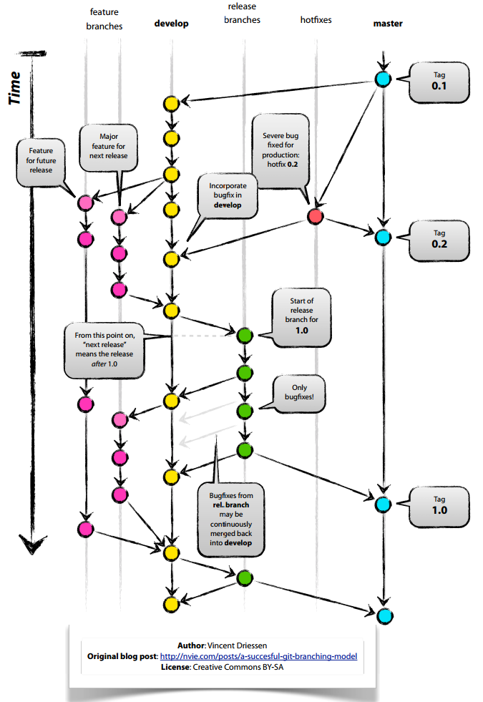
Git branching model example 5/5
Git branches #2
Notes:
TODO: checkout Atlassian Stash workflow

Slide 49
Ancestry references
git
^ (caret)
git show HEAD^: 1st parent of the commit
git show HEAD^2: 2nd parent of the commit
…
~ (tilde)
git show HEAD~: 1st parent of the commit
git show HEAD~2: 1st parent of the 1st parent
…
Notes:
Example on the next slide!

Slide 50
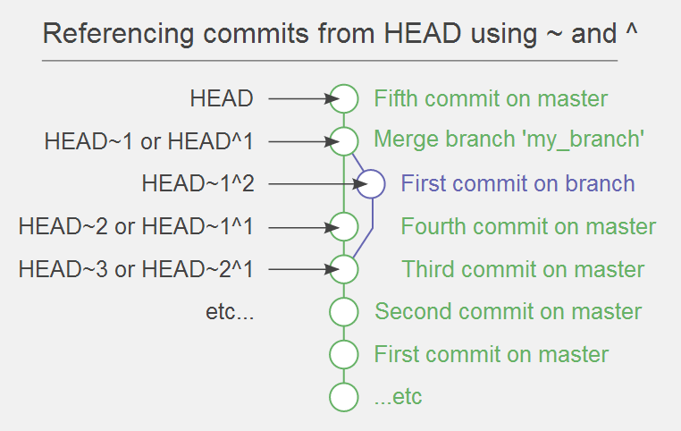
Ancestry references
git
Example
Notes:
http://www.paulboxley.com/blog/2011/06/git-caret-and-tilde

Slide 51
Exercise
Ancestry references
Notes:
ET:
Try ^ and ~
Create file and test

Slide 52

Undoing things
git
Change your last commit
git commit –-amend
Revert: reverts the specified commit with a new commit
git revert HEAD – rarely used
Reset: resets the head to the specified commit
Soft: Does not touch the index file nor the working tree at all
Mixed: Resets the index but not the working tree (default)
Hard: Resets the index and working tree.
Un-modifying a modified file
git checkout – filename
git checkout . – restore working copy but do no touch index nor HEAD

Slide 53
Exercise
Undoing things
Notes:
ET:
Create and commit a file
Edit and commit file
Create tag
git rebase savepoint
Show mixed, soft and hard reset
git reset –hard/soft/mixed HEAD^
git rebase savepoint

Slide 54
Stashing
git
to switch branch for a little bit of work
don’t want to do a commit of half-done work
you can get back to this point later
play with the change on different branches
branch can be created from a stash

Slide 55
Exercise
Git stashing
Notes:
ET:
Modify an existing file
git stash / git stash save ’message’
git stash list
git stash apply / git stash apply stash@{0}

Slide 56
Tagging
git
Tag specific points in the history
Types
Lightweight
Like a branch, but cannot be changed
Annotated
Object in the git database (name, e-mail, date)
Branch can be created from a tag
Commands
git tag [tag]
git tag –a [tag] –m message
git push [remote] [tagname]
Notes:
ET
git tag name
git tag –l
git push origin name
git push origin :name
git tag –d name

Slide 57
Exercise
Git tagging
Notes:
EA:
Create a tag on the master
Create commit on the master
Checkout tag
Create branch from tag
Checkout branch
Create commit on the branch
Merge branch to master

Slide 58
Housekeeping
git
Objects
„loose” object format
pack file: a single binary file in order to save space and be more efficient
When do the files packed?
Too many loosed objects/existing packs around
git push, … (calls git gc –auto)
git gc / git repack
Notes:
http://git-scm.com/book/en/Git-Internals-Packfiles
Config:
gc.auto=250
gc.autopacklimit=30
ET:
find .git/objects -type f
git gc
find .git/objects -type f

Slide 59
Housekeeping
git
git fsck --unreachable
git prune
Removing unreachable objects (eg. Created by git add)
git repack
Compressing file revisions (packing files)
git gc --aggressive
Compressing file revisions (packing files)
Removing unreachable objects (eg. Created by git add)
Notes:
http://www.vaseltior.com/blog/2012/01/28/housekeeping-your-git-repository-deadblog/
fsck:
git add
git fsck --unreachable
git reset HEAD –hard
git prune

Slide 60
.git dir
Git internals
hooks/ - client-side hooks (server side hooks can be defined as well)
info/ - global ignored patterns
logs/
objects/ - stores the database
info, packs – packed files
refs/ - pointer into commit objects
heads – last commit hashs of the branches
tags
remotes / <remote_name> / <branch_name>
HEAD – branch currently checked out (pointer to a file in refs/…)
config – project specific config
Remotes
index – staging area
Notes:
Hooks:
http://git-scm.com/book/be/v2/Customizing-Git-Git-Hooks

Slide 61
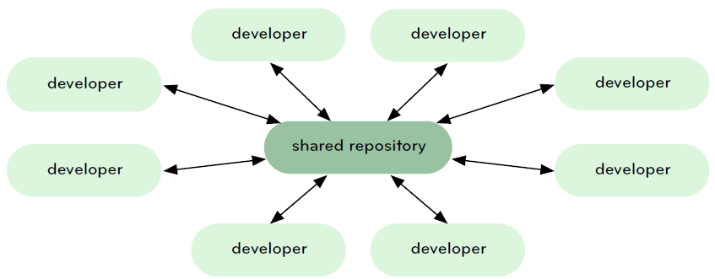
Central repository workflow
Git workflows
Notes:
https://www.kernel.org/pub/software/scm/git/docs/everyday.html

Slide 62
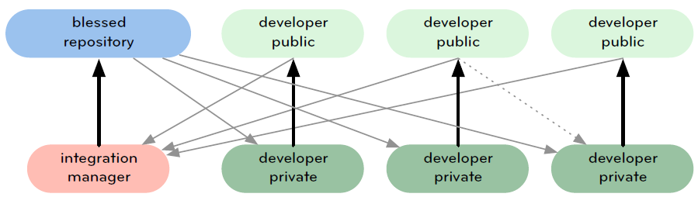
Integration-manager workflow
Git workflows

Slide 63
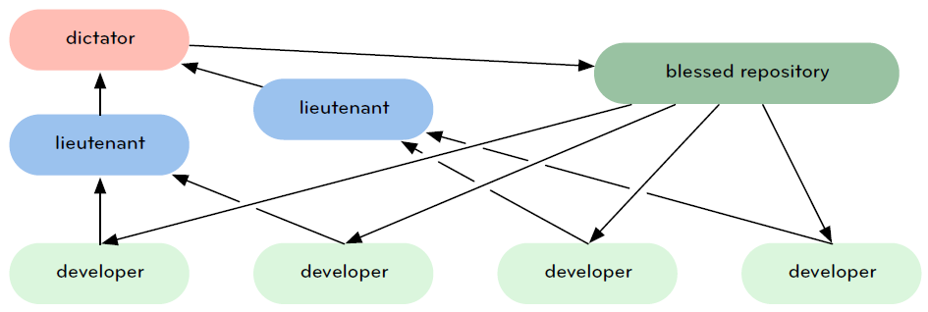
Dictator and Lieutenants Workflow
Git workflows

Slide 64
Commands
Git internals
Commands
Plumbing commands
to low-level work (UNIX style, called from scripts)
they give access to the inner workings of git
Porcelain commands (e.g. commit, push, etc.)

Slide 65
Major git commands
Git workflows
git-show-branch(1)
to see where you are.
git-log(1)
to see what happened.
git-checkout(1) and git-branch(1)
to switch branches.
git-add(1)
to manage the staging area
git-diff(1) and git-status(1)
to see what you are in the middle of doing.

Slide 66
Major git commands
Git workflows
git-commit(1)
to advance the current branch.
git-reset(1) and git-checkout(1) (with pathname parameters)
to undo changes.
git-merge(1)
to merge between local branches.
git-rebase(1)
to maintain topic branches.
git-tag(1)
to mark known point.

Slide 67
Major git commands
Git workflows
git-clone(1)
from the upstream to prime your local repository.
git-pull(1) and git-fetch(1)
from "origin" to keep up-to-date with the upstream.
git-push(1)
to update remote

Slide 68

Git benefits
Git
Very simple
You can make commits any time (offline) you like it
Cheap branching and merging
Usage of flexible workflows
Data redundancy, replication
High availability
One .git directory per repository
Collaboration
Use it not just for code!
Notes:
http://www.gitology.com/chapter/benefits-of-using-git

Slide 69

Git drawbacks
Git
Revision number is a hash (40 chars)
very long
Not predictable
Partial checkout not supported
Versioning is always from the root
„Add” before „commit”
No diffs
Do not store big files with git
Initial cloning is slower (commits, branches, …)
Lock not supported (local operations)

Slide 70
Useful materials #1
Git
Github resources
https://help.github.com/articles/what-are-other-good-resources-for-learning-git-and-github
Git cheat sheet
www.ndpsoftware.com/git-cheatsheet.html
Git immersion – guided tour of git fundamentals
www.gitimmersion.com
Git book
git-scm.com/book/
Git internals
opcode.org/peepcode-git.pdf

Slide 71
Useful materials #2
Git
Git reference
git-scm.com/book
Git in 15 minutes
try.github.io
Learn git branching
pcottle.github.io/learnGitBranching/
A successful Git branching model
http://nvie.com/posts/a-successful-git-branching-model/

Slide 72
Home work
http://pcottle.github.io/learnGitBranching/

Slide 73
Thank you!

