Slide 1
BIG READ framework
Interactive, ad-hoc query and analysis

Slide 2
Question?

Slide 3
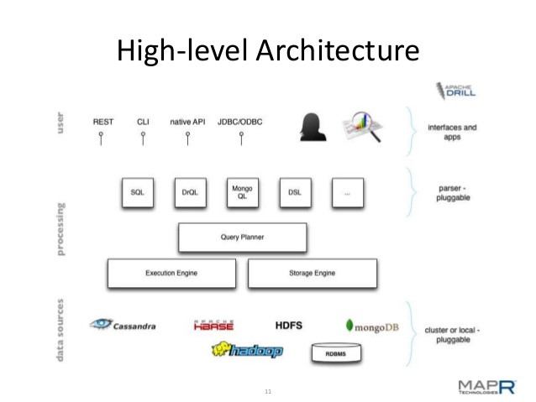

Slide 5
DEMO

Slide 6
Value addition to P&E
Interactive, ad-hoc query and analysis
Faster and right decision make
No dependency on engineering
No data duplication …….

Slide 7
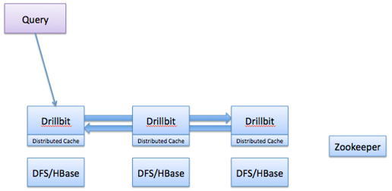

Slide 8


