Slide 1

Optimizing Ticket Assignment through Group Role Assignment with Agents’ Busyness Degree
Evan Wells
Department of Computer Science and Mathematics
Nipissing University
North Bay, Canada
edwells522@my.nipissingu.ca
Dr. Haibin Zhu
Department of Computer Science and Mathematics
Nipissing University
North Bay, Canada
haibinz@nipissingu.ca
Sponsors: SSHRC Insight Grant (IG 435-2023-1056), and NSERC Discovery Development Grant (DDG-2024-00036)

Slide 2




Problem specification
With the rapid pace of technological evolution, Information Technology (IT) departments are often found understaffed and overwhelmed.

Slide 3

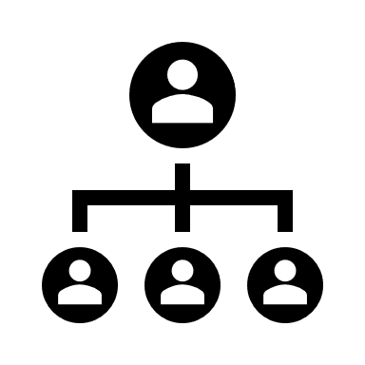


Problem specification (cont’d)
When it comes to IT ticketing, it is often a generalization (bottom up) or a specialization (top-down)
Generalization
Specialization

Slide 4

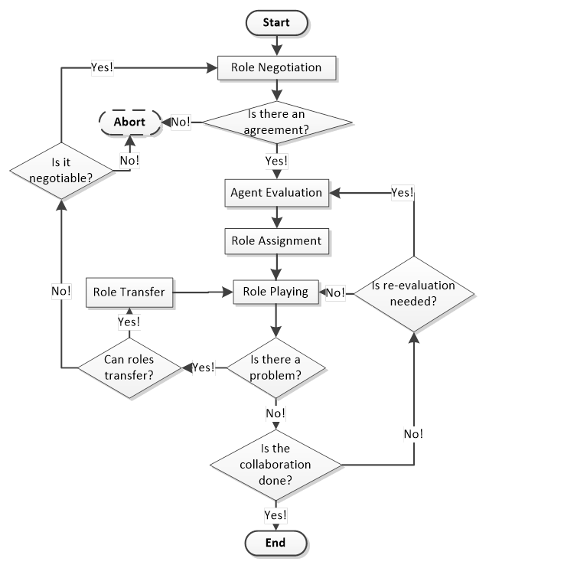
Role Based Collaboration (RBC)
Role Based Collaboration, a framework used to model complex real-world systems, is utilized throughout the creation of a solution.

Slide 5
Proposed Solution
Utilizing the principles of RBC and GRA, the solution proposed is a program that automatically assigns tickets based on the following:
Agents’ workloads
Agents’ skillsets
Agents’ fitness to a specific task

Slide 6
Proposed Solution (cont’d)
Workloads
Skillsets
Fitness to Task
Giving a numerical value to the staff for generic skills required in an IT environment can create values for which the GRA algorithm can base its ticket assignment decisions.
Using the skillset values, an IT staff’s fitness to a certain ticket or task can be derived. This fitness can include numerous skills, as a ticket usually requires prowess in numerous fields.
A staff member's busyness can be determined by summing the number of open tickets assigned to them and the total estimated time required for their completion.

Slide 7
Proposed Solution (cont’d)
Workloads
Skillsets
Fitness to Task
Giving a numerical value to the staff for generic skills required in an IT environment can create values for which the GRA algorithm can base its ticket assignment decisions.
Using the skillset values, an IT staff’s fitness to a certain ticket or task can be derived. This fitness can include numerous skills, as a ticket usually requires prowess in numerous fields.
A staff member's busyness can be determined by summing the number of open tickets assigned to them and the total estimated time required for their completion.

Slide 8
Proposed Solution (cont’d)
Workloads
Skillsets
Fitness to Task
Giving a numerical value to the staff for generic skills required in an IT environment can create values for which the GRA algorithm can base its ticket assignment decisions.
Using the skillset values, an IT staff’s fitness to a certain ticket or task can be derived. This fitness can include numerous skills, as a ticket usually requires prowess in numerous fields.
A staff member's busyness can be determined by summing the number of open tickets assigned to them and the total estimated time required for their completion.

Slide 9
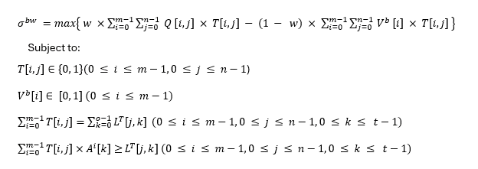
Proposed Solution (cont’d)
The solution aims to maximize the value returned by the following equation:
(1)
(2)
(3)
(4)

Slide 10
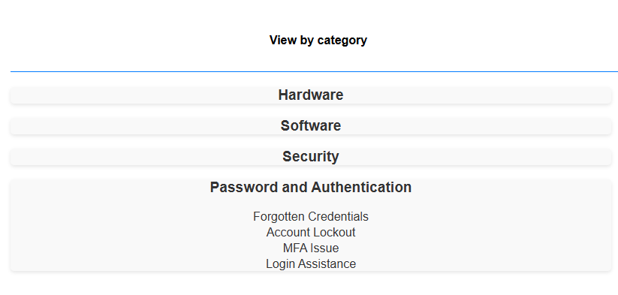
Modeling the System – Role Negotiation
Defining roles are crucial to modeling any system using Role Based Collaboration. In this system, the roles are the tickets. Defining tickets is a two-step process:
Create a category-subcategory mapping
Assign required skills to the mapping

Slide 11

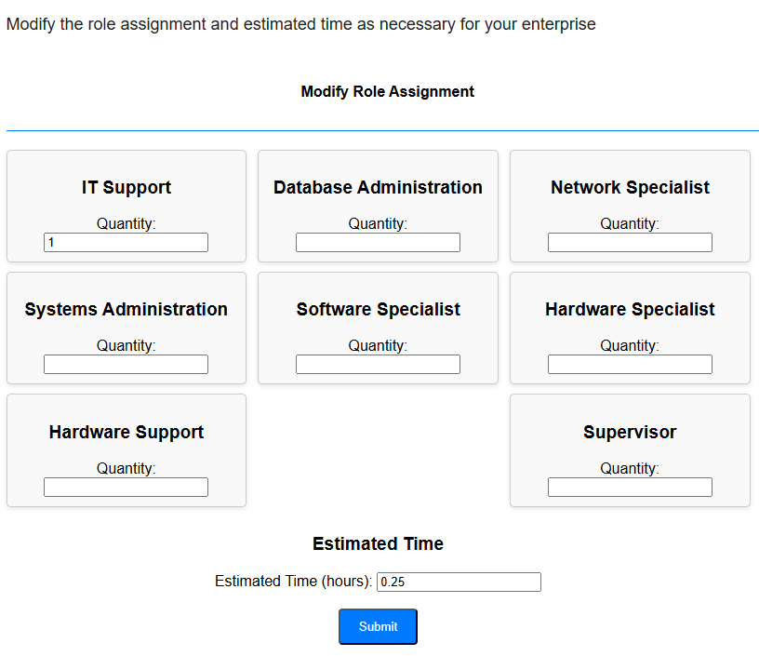
Modeling the System – Role Negotiation (cont’d)
For each category-subcategory mapping, the administration must define the role (ticket)

Slide 12

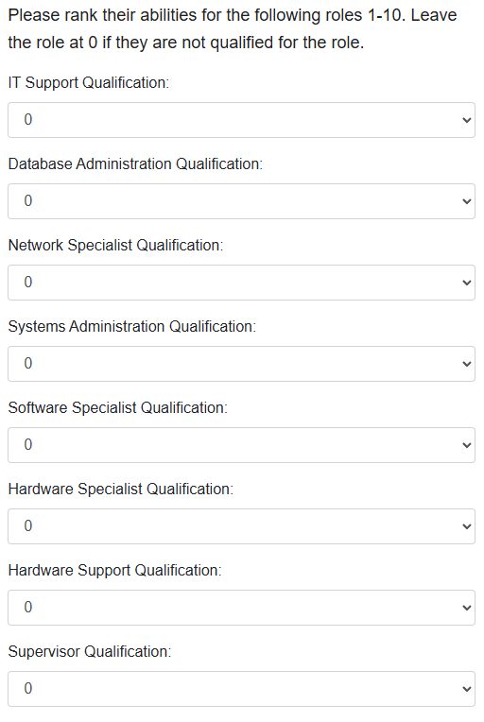
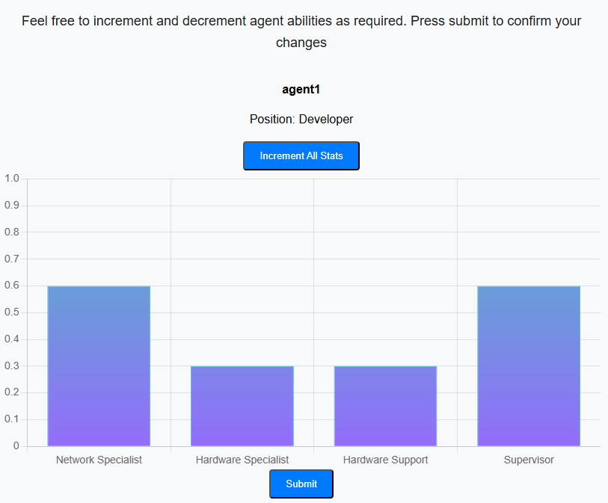
Modeling the System – Agent Evaluation
Agent Evaluation is a necessary step to properly model the system. Evaluating agents’ skillsets enables the calculation of an agent’s fitness to a ticket.

Slide 13
Modeling the System – Role Assignment
Now that roles have been defined and agents have been evaluated, Role Assignment can occur.
It will be done through Group Role Assignment with Agents’ Busyness Degree as defined in the proposed solution. There are two primary use cases for this assignment process:
Batch Ticket Assignment – Assigning multiple tickets simultaneously
Manager-Initiated Assignment – A manager creating and assigning a ticket

Slide 14
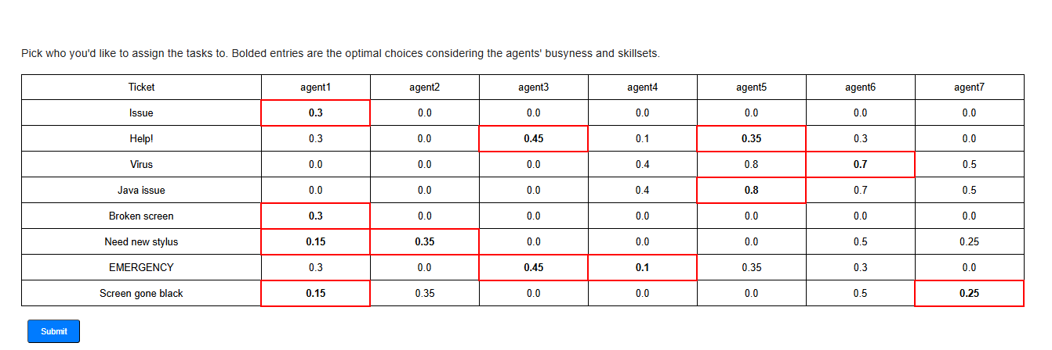
Modeling the System – Role Assignment (cont’d)
Company X has 7 members of their IT staff. They receive an influx of tickets that must be assigned.

Slide 15
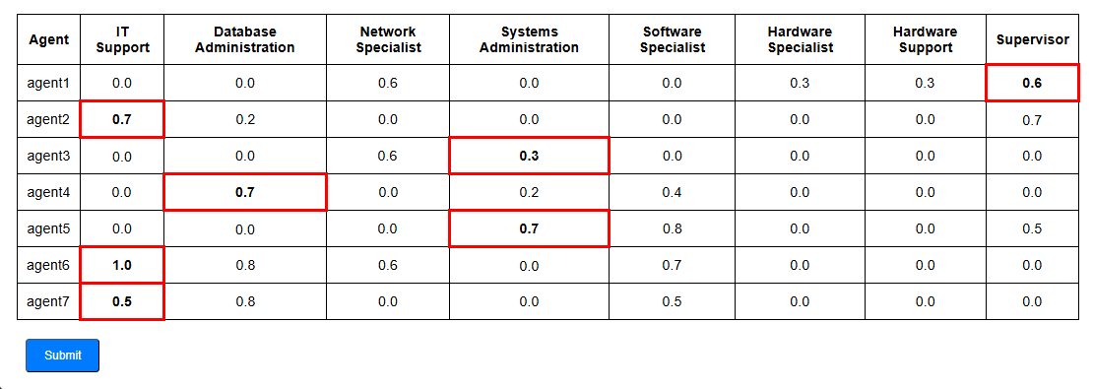
Modeling the System – Role Assignment (cont’d)
The CTO of Company X wants to rollout a new project, installing new security measures on the company computers and educating the staff of Company X on how to use it.

Slide 16
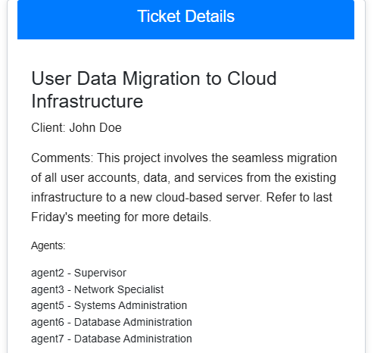
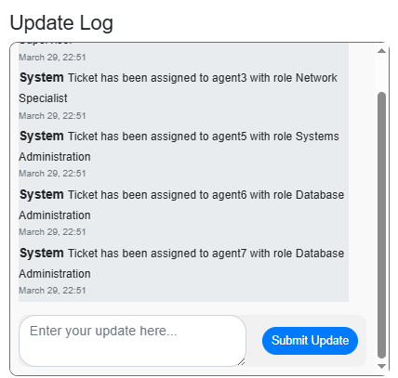
Modeling the System – Role Playing
The Role Playing step involves resolving the issue described in the ticket. However, in a Role-Based Collaboration system, it is pivotal that agents clearly understand the specific roles they need to fulfill to ensure efficient and effective problem resolution.

Slide 17
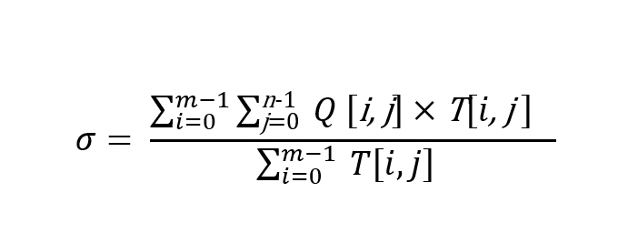
Results
To determine the effectiveness of the GRAABD algorithm, we can evaluate a group score. It is defined as follows:

Slide 18
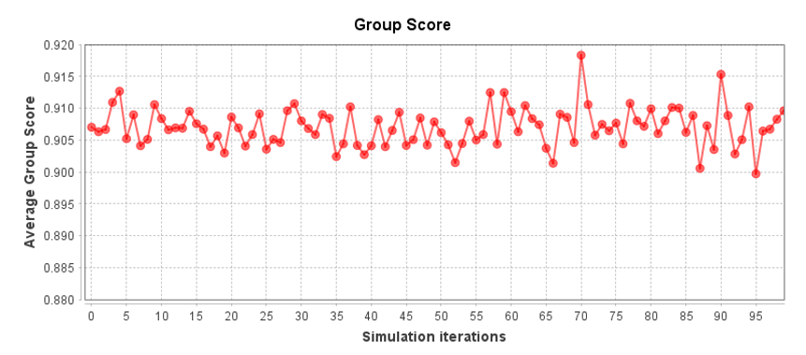
Results (cont’d)
With the previous definition, we can evaluate the algorithm.

Slide 19
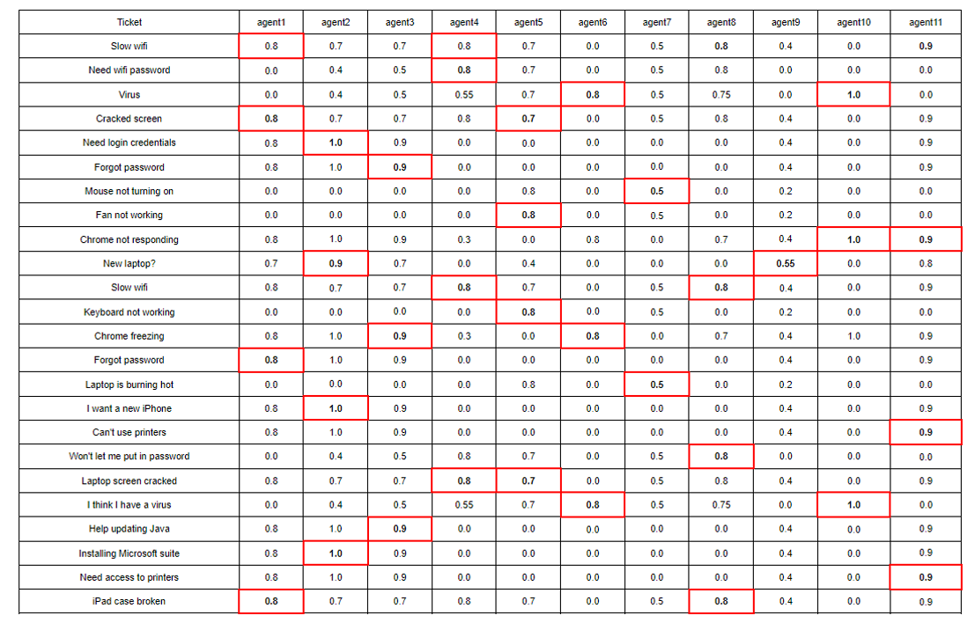
Results (cont’d)

Slide 20
Conclusion
In sum, modelling an IT department using the Role Based Collaboration framework and administering tickets using Group Role Assignment with Agents’ Busyness Degree, the following occurs:
Data-Driven Decision Making
Optimal Ticket Resolution
Workload balance

Slide 21
Conclusion
Questions?

