Slide 1

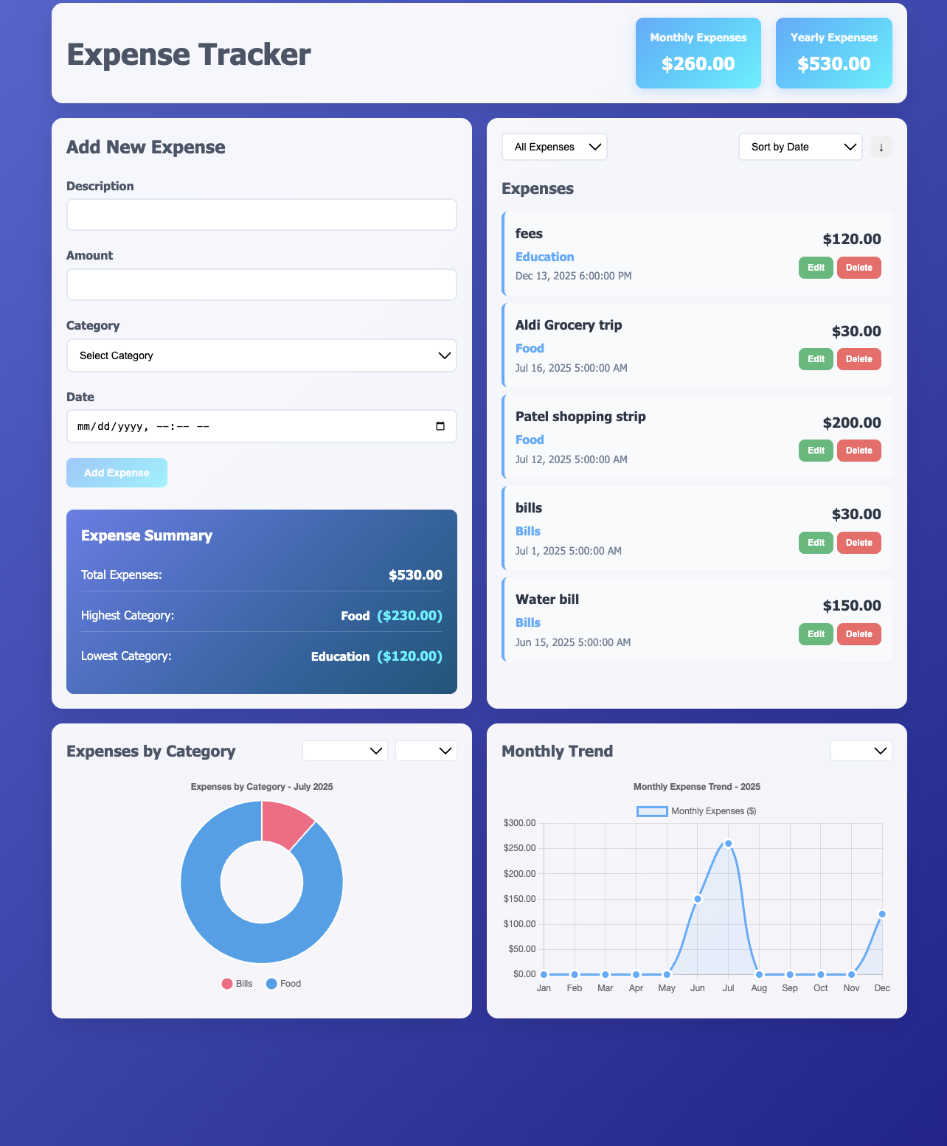
Expense Tracker presentation
Pradnya Wani

Slide 2

Project Overview
A full-featured expense tracking web application.
Tech Stack: Java 17, Spring Boot, AngularJS, Maven
Architecture: RESTful API with responsive frontend
Storage: In-memory (Java Collections)
Testing: JUnit 5 for backend

Slide 3
Functional Requirements
Core Features
Analytics
CRUD for expenses
Filtering by date, range, or last 50 entries
Sorting by date, category, or amount
Real-time UI updates
Full validation (frontend + backend)
Monthly and yearly totals
Category-based breakdown
Trend charts
Highlight highest/lowest spending categories

Slide 4
Key Features
Interface:
Clean, modern layout
Real-time validation in forms
Animated charts for trends and categories
Data Handling:
Smart filtering and sorting
Instant UI updates
In-memory persistence
Error feedback for user actions

Slide 5
High Level Architecture
Design Patterns:
Layered architecture for separation of concerns
Dependency Injection with Spring IoC
Repository and DTO patterns
MVC structure on the frontend

Slide 6
Installation and Setup
Backend
Frontend
cd expense-tracker/backend
mvn clean install
mvn spring-boot:run # http://localhost:8080
cd expense-tracker/frontend
python –m http.server 3000 # http://localhost:3000

Slide 7
Testing
Backend Testing
Frontend testing
Unit/integration testing with JUnit 5
cURL scripts for manual API testing
Manual and responsive UI testing
Browser compatibility and user flow validation

Slide 8
Thank you for your time!!
Any questions?

