Slide 1
Project 4: Machine Learning model & visualizations
Group5: Patrick Yau & Sharanjit Singh

Slide 2
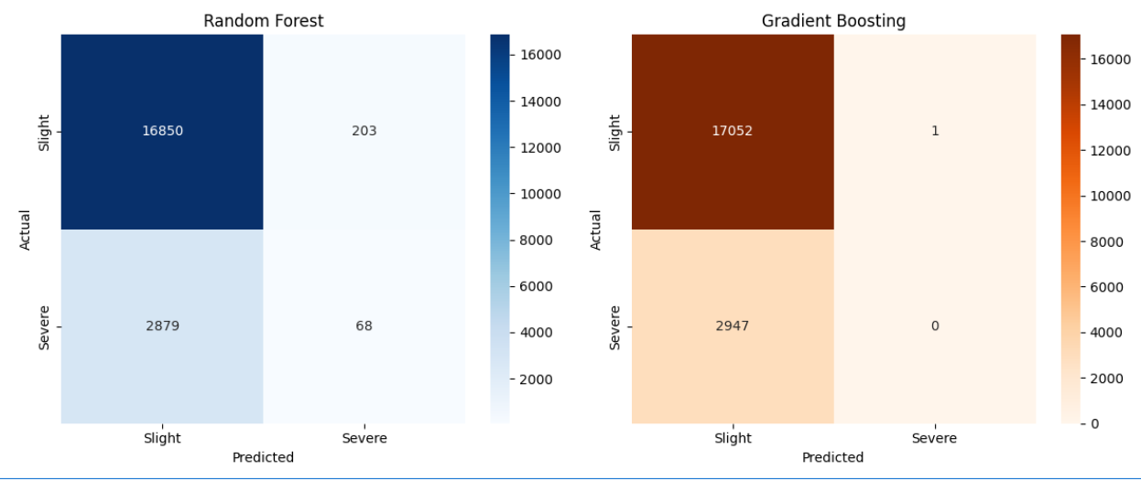
1. Predicting Accident Severity Model: ML Type: Classification Models: Scikit-learn (Random Forest, Gradient Boosting & XGBoost)
Key Takeaways
Random Forest slightly struggles with false negatives but still detects some Severe accidents correctly.
Gradient Boosting almost never predicts Severe accidents correctly, leading to high false negatives (Severe misclassified as Slight).
If Severe accident detection is important, Random Forest might be the better choice, but if Slight accident classification is the priority, Gradient Boosting performs better.

Slide 3
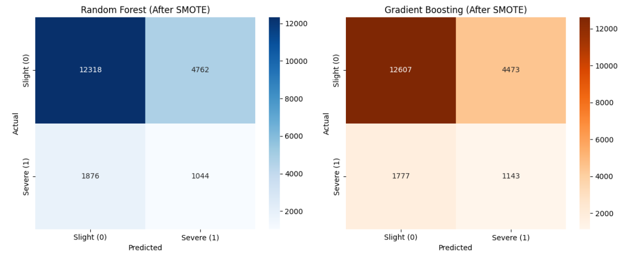
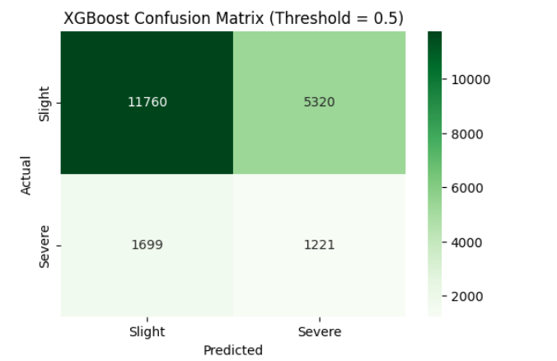
Improvement to model: 🔹 Balance Classes: Since the model is struggling with Serious/Fatal accidents, it may be biased toward Slight accidents (class imbalance). Using SMOTE (Synthetic Minority Over-sampling Technique): This will increase Serious/Fatal cases synthetically and improve classification Using another model XGBoost as it works well on imbalanced data

Slide 4
Comparison result between different models
Model | True Slight (TN) | False Severe (FP) | False Slight (FN) | True Severe (TP) | Key Insight
Random Forest (SMOTE) | 12,318 | 4,762 | 1,876 | 1,044 | Good at detecting slight cases, lower recall for severe cases
Gradient Boosting (SMOTE) | 12,607 | 4,473 | 1,777 | 1,143 | More balanced performance, slightly improved severe recall
XGBoost (Threshold=0.5) | 11,760 | 5,320 | 1,699 | 1,221 | Best at identifying severe cases, but with more false positives
🔹 Conclusion: Best Overall Model
| ✅ XGBoost is the best overall model as our priority is detecting severe accidents (highest recall). It trades a few more false positives (slight misclassified as severe) to catch more actual severe accidents, which is often a worthwhile tradeoff in safety-critical scenarios.

Slide 5
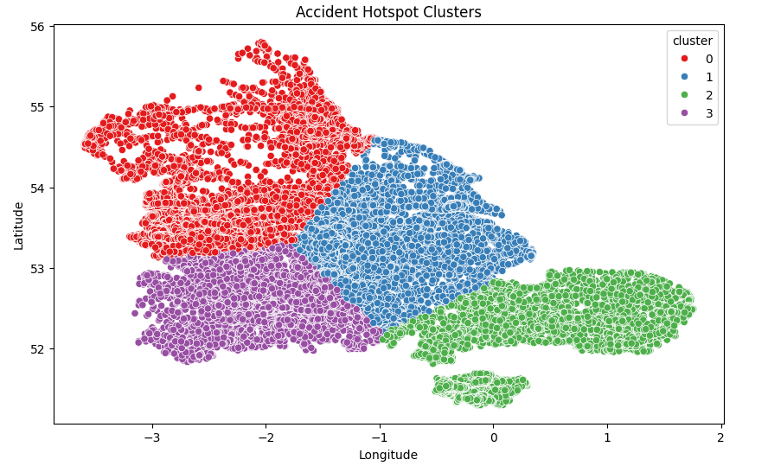
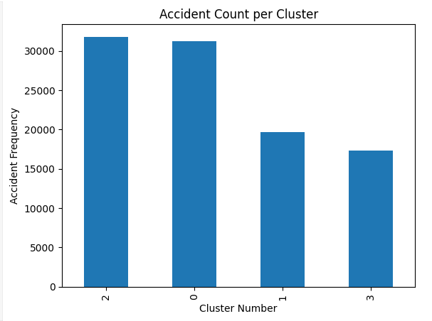
2. Identify High-Risk Accident Zones Using K-means with 4 clusters
Accident Hotspot Clusters scatter plot provides valuable insights into high-risk zones where accidents frequently occur
Interpretation of the Clusters
✔ Cluster 0 (Red) → This region has high accident density, likely indicating urban congestion, busy intersections, or poor visibility. ✔ Cluster 1 (Blue) → These accidents may be spread across major roads or highways, suggesting speed-related or lane-merging risks. ✔ Cluster 2 (Green) → This cluster might show localized accident hotspots, possibly near residential or commercial areas. ✔ Cluster 3 (Purple) → Typically found in less densely populated regions, meaning accidents here may be influenced by weather conditions or rural road designs.

Slide 6
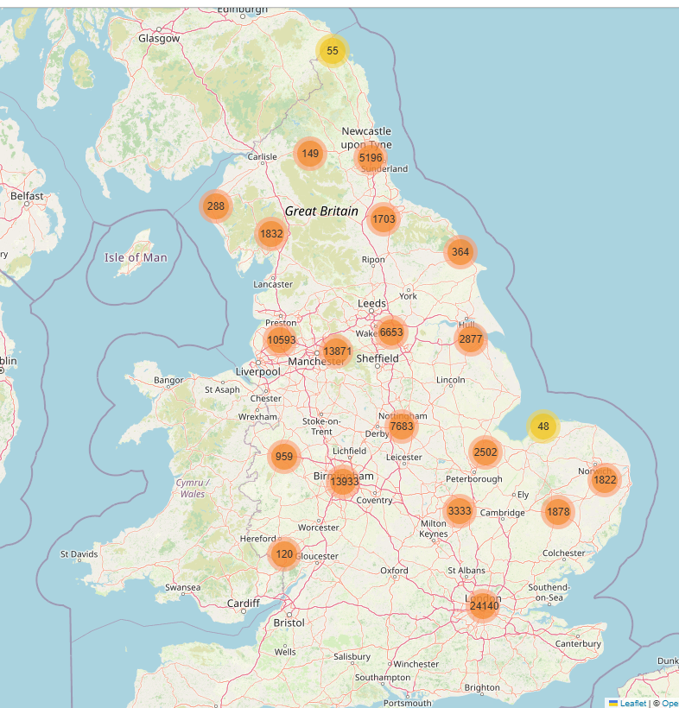
2 (a) Unsupervised learning: Identify High-Risk Accident Zones ML Type: Clustering Models: DBSCAN
Feature Selection
- Used Latitude & Longitude for spatial clustering
Result: What This Signifies:
Identifying High-Risk Zones: The clusters highlight areas with frequent accidents, helping pinpoint locations needing better safety measures.
Traffic & Urban Planning Insights: This can assist city planners in making informed decisions about road improvements, traffic regulations, or infrastructure changes.
Accident Pattern Analysis: By examining severity, time of day, and other factors within clusters, authorities can implement targeted interventions for accident prevention.

Slide 7
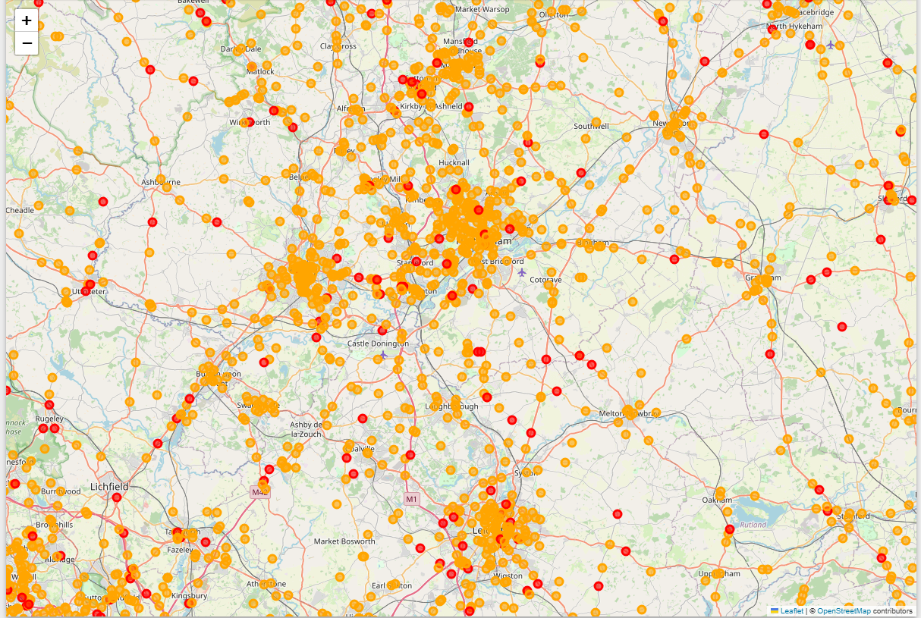
2 (b) Unsupervised learning Overlaying Accident Severity onto the cluster map will help prioritize high-risk zones
DBSCAN, which detects clusters based on density
Visualize clusters with severity-based color coding including filtered Fatal & Serious accidents, cluster identification, and interactive map.
Extracts relevant accident data (latitude, longitude, severity).
Result: It is analyzing patterns & identifying existing high-risk zones.

