Slide 1
Project 4: Machine Learning model & visualizations
Group5: Patrick Yau & Sharanjit Singh

Slide 2
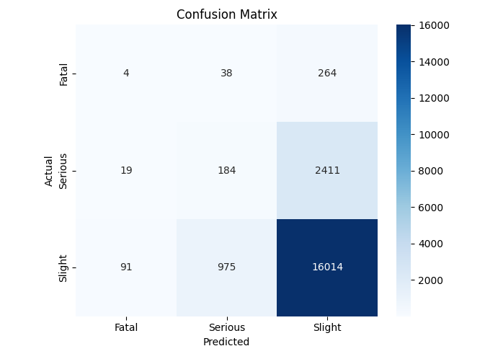
1. Predicting Accident Severity Model: ML Type: Classification Models: Scikit-learn (Random Forest)
- Fatal accidents are often misclassified as Serious or Slight, leading to underestimation of severity.
- Serious accidents are frequently misclassified as Slight, reducing the model’s ability to differentiate between higher-risk scenarios.
- Slight accidents are predicted well overall, but there's occasional misclassification into Fatal or Serious.

Slide 3
Improvement to model: Switching to Balanced Random Forest
Balanced Random Forest enhances standard Random Forest by adjusting tree weights to improve minority class prediction. This helps the model better distinguish Fatal and Serious cases without overfitting
Why This Works Best:
Handles imbalanced classes well Improves precision for Fatal and Serious cases Optimized hyperparameters via GridSearchCV for better tuning

Slide 4
What to Expect
✅ Improved accuracy in Fatal & Serious cases ✅ Reduced misclassification between Serious & Slight ✅ Better recall & precision for underrepresented accident severities

Slide 5
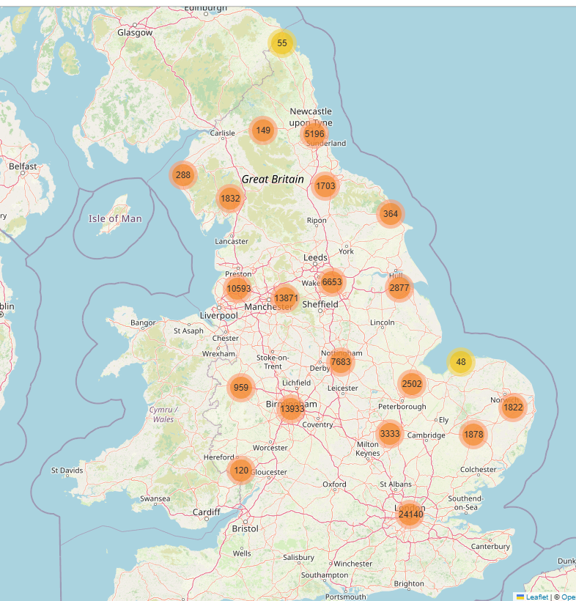
2 (a) Unsupervised learning: Identify High-Risk Accident Zones ML Type: Clustering Models: DBSCAN
Feature Selection
- Used Latitude & Longitude for spatial clustering
Result: What This Signifies:
Identifying High-Risk Zones: The clusters highlight areas with frequent accidents, helping pinpoint locations needing better safety measures.
Traffic & Urban Planning Insights: This can assist city planners in making informed decisions about road improvements, traffic regulations, or infrastructure changes.
Accident Pattern Analysis: By examining severity, time of day, and other factors within clusters, authorities can implement targeted interventions for accident prevention.

Slide 6
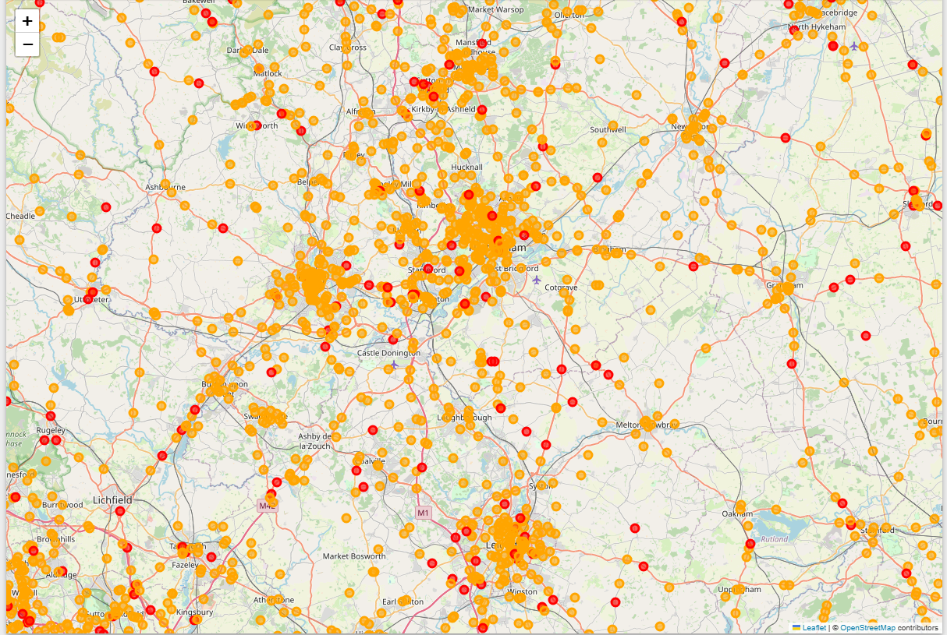
2 (b) Unsupervised learning Overlaying Accident Severity onto the cluster map will help prioritize high-risk zones
DBSCAN, which detects clusters based on density
Visualize clusters with severity-based color coding including filtered Fatal & Serious accidents, cluster identification, and interactive map.
Extracts relevant accident data (latitude, longitude, severity).
Result: It is analyzing patterns & identifying existing high-risk zones.

Slide 7
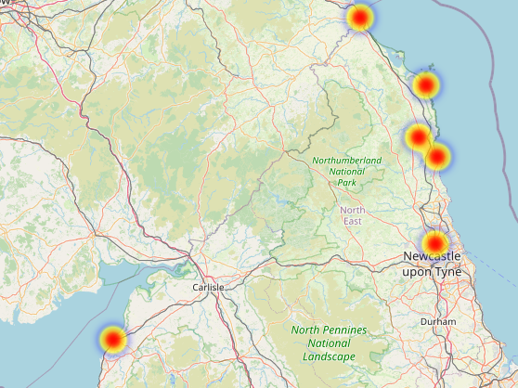
Predictive accident risk model Model: RandomForestClassifier
Uses machine learning to predict accident severity dynamically Heatmap visually highlights high-risk areas Helps traffic authorities and city planners identify danger zone
Key Findings
🚦 High-risk accident zones identified using machine learning.
🔴 Red areas → Severe accident hotspots, requiring intervention.
🟨 Yellow areas → Moderate risk, common urban accident zones.
🟦 Blue areas → Low-risk locations, safer driving conditions.
Influencing Factors Speed Limits, Road Type & Junctions & Weather

