Slide 1
Linux Emulator - MobaXTerm
Go Start “MobaXterm from the windoze start menu.
Login to arc2:
ssh –Y –l username arc2
You will now have a terminal window that you can type in!
You can drag and drop files from the windoze box to arc2 using the “sftp” tab on the left hand side.

Slide 2
Your Starting Structure: PDB Search
Go to the protein data bank (type pdb into google).
Before you start, scroll down and have a look at “Molecule of the month”. If you click on “Structural view of biology” you can access the archive. This is highly recommended reading!
In the pdb search facility, find human ubiquitin 1UBQ.pdb (X-ray crystal structure)
1D3Z.pdb (NMR) by typing in the codes.
Download the files as “pdb format”. They will go into the “downloads” directory on the windoze machine.
Move them to arc2 using MobaXterm.

Slide 3
VMD for Visualisation ~ X-ray Structure
Start VMD on arc2.
$ module load VMD
(To see all available software, type:
$module avail
What do all the packages do? Can you recognise any of the software?)
$VMD
2. Load your X-ray pdb file into VMD

Slide 4
VMD ~ “Hot” Keys
VMD has particular “hot keys” that make the program easy to use.
“r” Rotate structure
“t” Translate structure
“s” Scale structure (eg zoom in or out)
“1” Label an atom
“2” Measure a bond between 2 atoms
“3” Measure the angle between 3 atoms
“4” Measure the dihedral between 4 atoms

Slide 5
3. Play with the different representations (eg VdW, cartoon). Display the backbone only.
4. When you colour the structure by “name” (default), notice which elements have which colours (eg hydrogens are white).
What else is there in the file, apart from the protein?

Slide 6
4. In cartoon representation, colour the protein by “secondary structure”.
5. Make the LYS residues VdW while the rest of the protein is licorice.
6. Make LYS 63 and 48 green but LYS 27 red.
7. Put the molecule in cartoon representation and then display all of the charged residues in VdW.
8. What do you notice? Be sure to rotate the molecule and look at it in different orientations.

Slide 7
9. Now display the hydrophobic residues as well. What else to you notice? (hint: what is on the outside/inside of the protein?!)
10. Colour the protein by B-factor (the largest B-factors show the most flexible regions).
11. Plot a Ramachandran plot (under Extensions/ Analysis).
You will need to click on “Molecule” to select your structure – the angles for your protein will appear as yellow squares.

Slide 8
Visualising NMR Structures with VMD
1. Delete the X-ray structure and read the NMR structure into VMD.
2. What two very obvious differences are there with the X-ray structure?
3. Use the cartoon representation to display all of the structures simultaneously.
4. Compare the regions of highest flexibility with those you detected using crystallographic B-factors (switch from RWB to BWR under “graphics/colours”!!)

Slide 9
NMR Structure ~ Distances and Angles
1. For one of your structures, measure the distance between one of the OD1/OD2 oxygen atoms of ASP 52 and the NZ on LYS 27. Use:
  Graphics/labels/bonds
2. Display the hydrogen bonds between the side chains only. Are there any hydrogen bonds between ASP 52 and LYS 27? If “yes”, does this hydrogen bond persist for all NMR structures?
3. Delete all bond and atom labels. Now pick two different interesting atoms in your structure (e.g. a hydrogen bonding pair). How does this distance change throughout the ensemble? Plot a graph of your results.

Slide 10
Make a Pretty Picture
Go to “Display/display settings” and turn on “Shadows” and “Amb occl”.
2. Under “Graphics/colors/categories/display” choose background, and pick a lurid colour (eg lime green).
3. Using “Graphics/representations/trajectory” draw multiple frames. Represent your protein using “tubes”.
4. Colour your protein by “timestep”.
5. Switch the axes display off.
6. Do “File/render/”. Choose the “tachyon internal” render option.
7. Rename your file “vmdscene.tga” to something less generic.
You will need to use a conversion program (like gimp/imagemagic) to make these compatible with powerpoint.

Slide 11
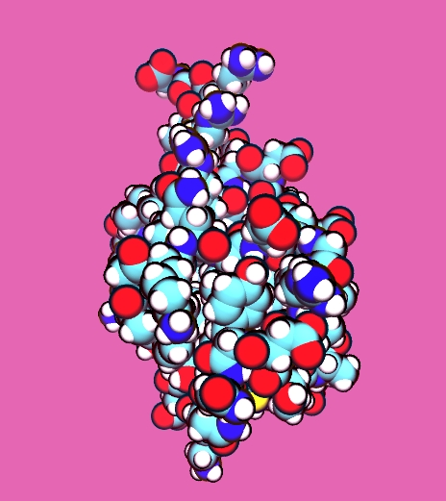
8. Now display only one structure using the “vdw” representation.
9. Colour by atom name.
10. Under “material” select “Goodsell”.
11. Render your image!!

