Slide 1
Social Cognition
experimental task ----> real world scenario
single agent ----> multi-agent

Slide 2
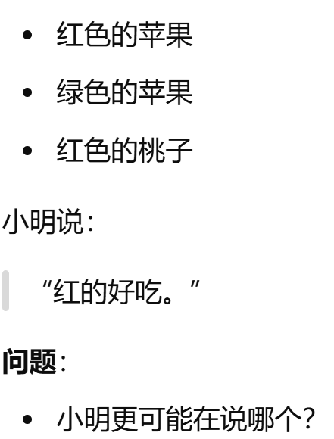
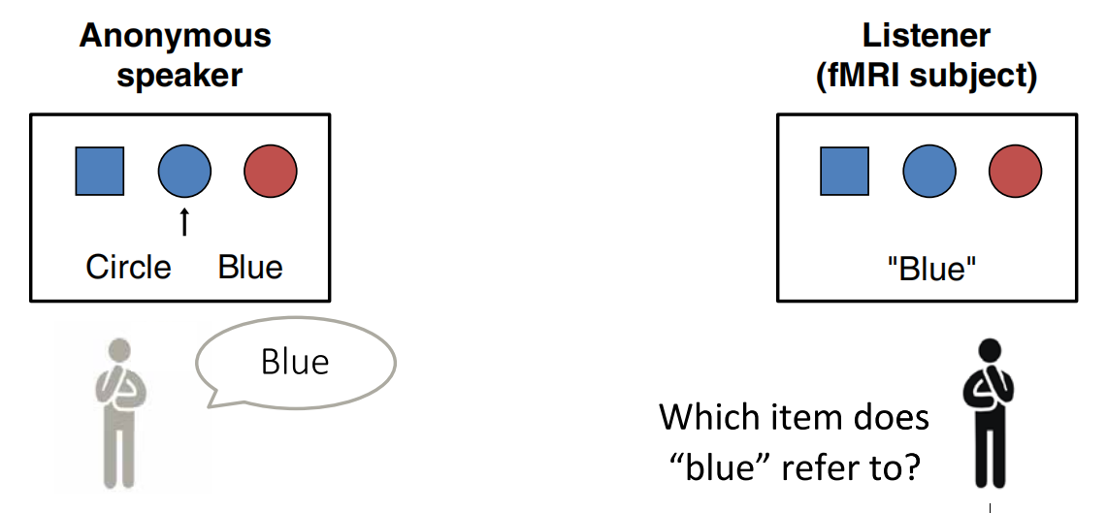

Ref: Reading between the lines: Listener’s vmPFC simulates speaker cooperative choices in communication games
1. Referential Communication
Core question
Can the model infer a speaker’s intended referent when the literal expression is ambiguous, underspecified, or partially misleading?
Subtasks
Minimal Referential Task
Director Task
Everyday Referential Scenario

Slide 3
2. Tacit Coordination & Common Ground
Core question
Can the model coordinate on socially salient, mutually expected choices without explicit communication, and can it adapt those choices to shared background, local conventions, and higher-order knowledge constraints?
Subtasks
Schelling Meeting Task
Schelling Category/Number Task
ref:
Thomas Schelling, The Strategy of Conflict (1960)
Mehta, Starmer, & Sugden (1994)

Slide 4
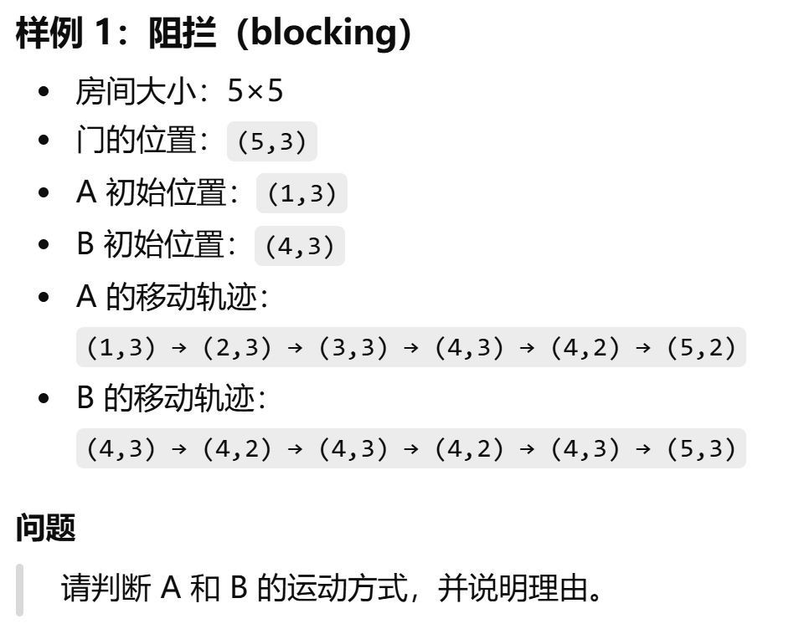
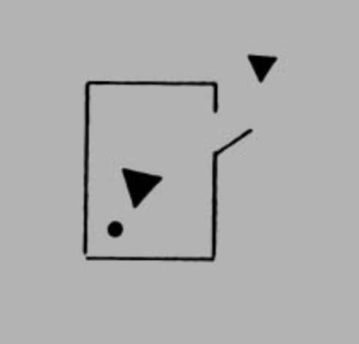
3. Frith-Happé Animations / Social Attribution Task
Core question
Can the model infer social meaning from abstract motion patterns, rather than relying on explicit verbal cues or human-like surface features?
Subtasks
Heider–Simmel Style Motion Description Task (Goal-directed / Physical)
Frith-Happé Animation Mental-State Attribution Task (Theory-of-Mind / Mentalizing)

Slide 5
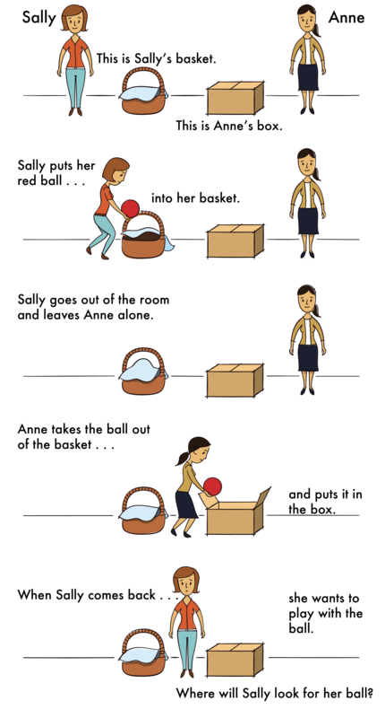
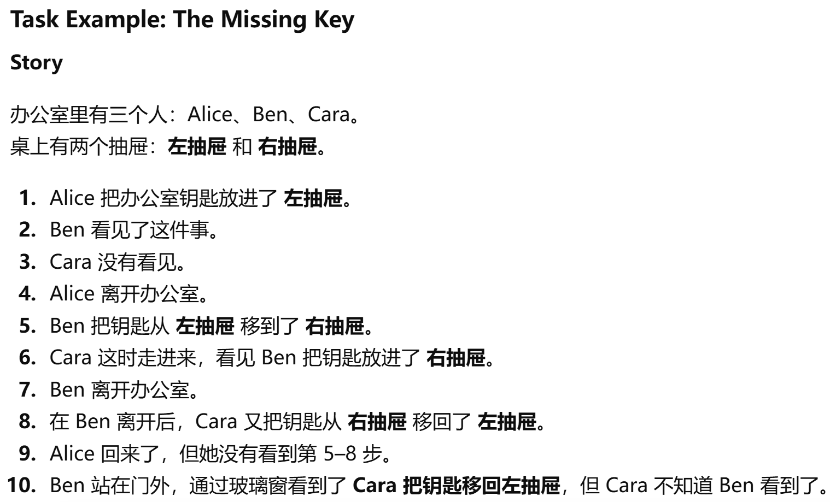
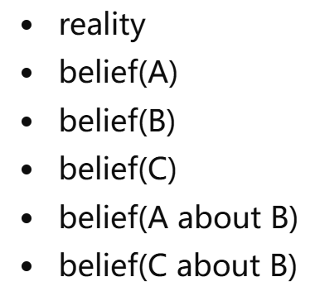
ref:
Wimmer, H., & Perner, J. (1983). Beliefs about beliefs: Representation and constraining function of wrong beliefs in young children’s understanding of deception.
Baron-Cohen, S., Leslie, A. M., & Frith, U. (1985). Does the autistic child have a “theory of mind”?
The Decrypto Benchmark for Multi-Agent Reasoning and Theory of Mind
. Multi-Agent False Belief

