Slide 1
Capstone Project
Finding the first 10 Indian cities with most Vegan Restaurants
&
Finding the most suitable place for investment on Opening a Vegan Restaurant

Slide 2
Introduction
Veganism is the practice of abstaining from animal products
Veganism can be traced to Indus Valley Civilization
Vaganism is still popular in India and as per estimates roughly 50 Million people still practice Veganism in India
Meat consumption is also treated as Taboo by certain people.
Such people prefer to visit restaurants offering STRICT VEGETARIAN menu.

Slide 3
Introduction..contd.
Despite of being so popular, finding a STRICT VEGAN Restaurant is difficult in present day Indian cities. In such a condition ,Vegans have to visit restaurants which also offer Non Vegetraian menu , for having Vegetarian cuisines, which they never prefer.
This project aims to
Find out first10 Indian Cities with most vegan restaurants
Find out the business opportunity of opening a Vegan Restaurant at the most suitable place.

Slide 4
Dataset
As dataset, name of the Indian Cities with their population, is a prerequisite.
It is fetched from Open Sources.
The said dataset is further used to fetch related data from Foursquare API.

Slide 5
Methodology
Firstly, the Geographical Coordinates are fetched from Foursquare API
Thereafter, Venues within 25 KMs of the centroids of all the Million_plus cities are fetched.
The dataset is visualized.

Slide 6
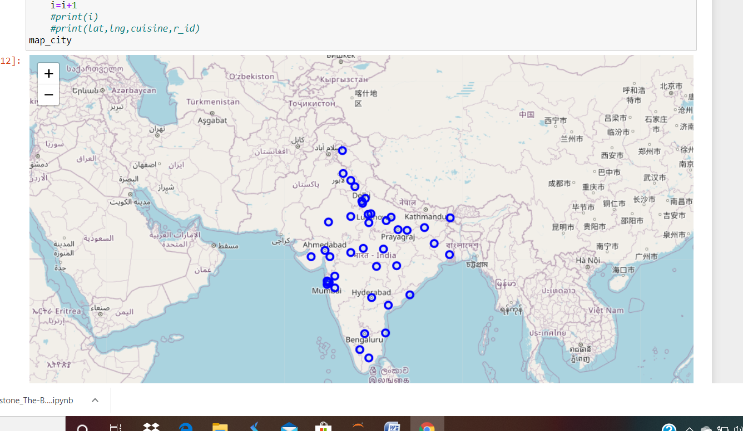
Million_plus Indian Cities

Slide 7
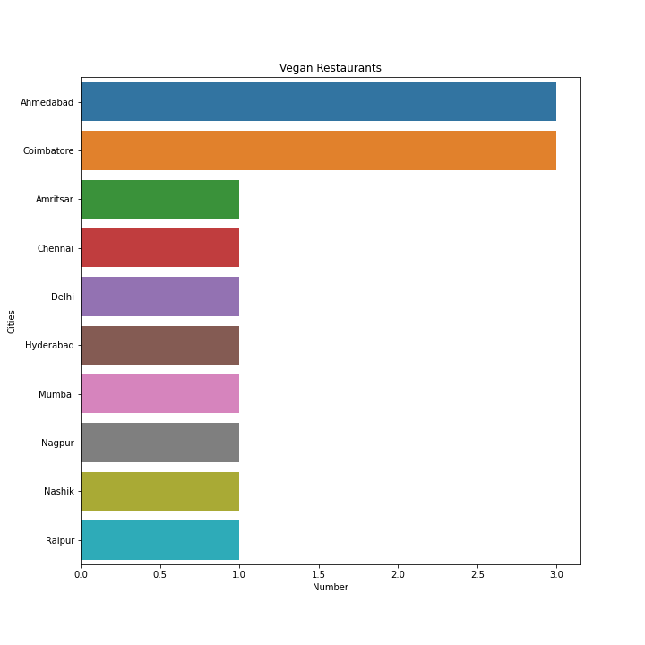
Most number of Vegan Restaurants

Slide 8
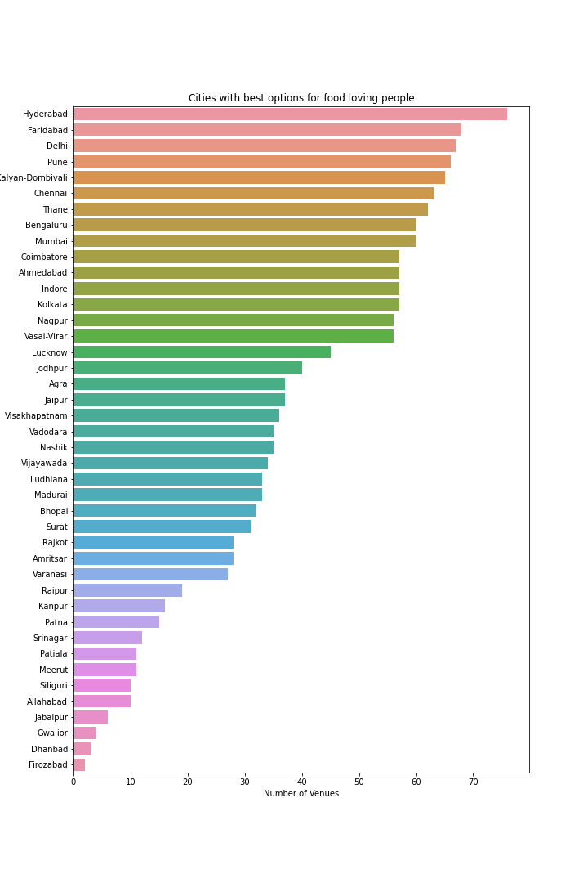
Most number of Food Venues- Hydearbad has the maximum number of venues

Slide 9
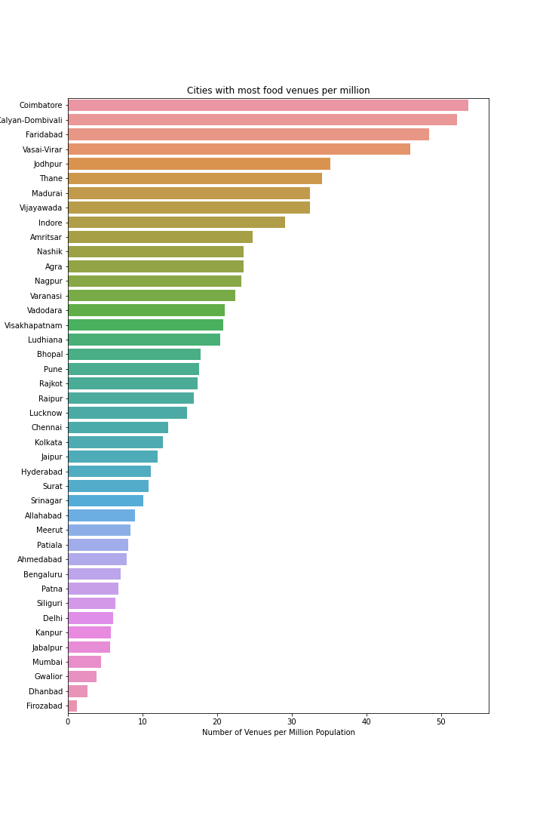
Most number of Food Venues per Million Population-Coimbatore has the most number of venues per Million population

Slide 10
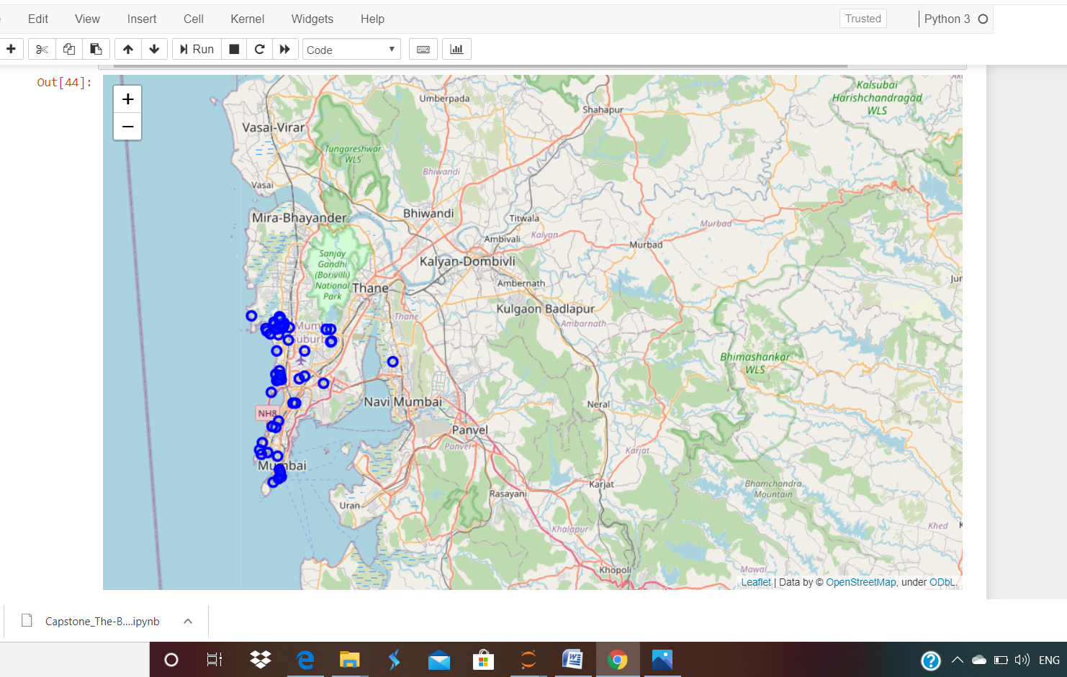
Food Venues in Mumbai

Slide 11
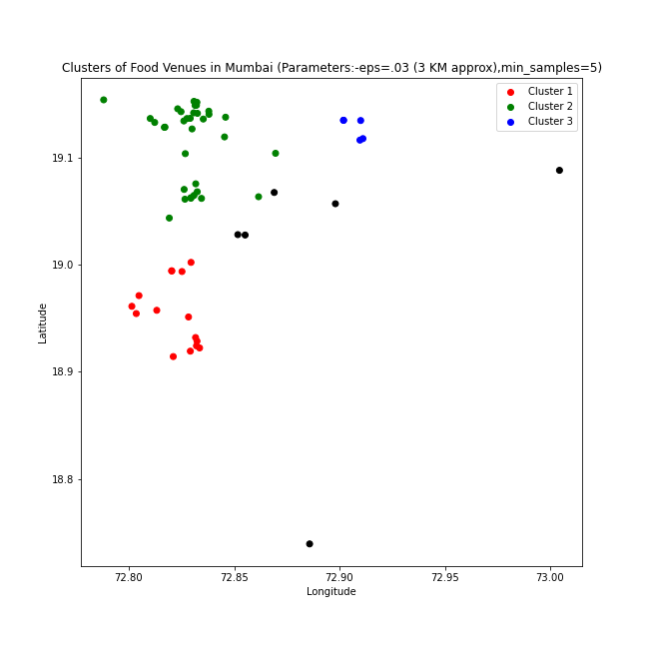
Food Clusters in Mumbai using DBSCAN Algorithm

Slide 12
Results
Three places are found out for , which are
Bandra area (Orange Cluster)
Lokhandwala_Oshiwara area(Green Cluster)
Powai area (Blue Cluster)
The above three locations are best suited for opening of a Vegan Restaurant
This is based on the assumption that
The identified clusters have the locational advantage due to proximity of Residential places, Tourist places and better accessibility.

Slide 13
Discussion
The database of Foursquare database may not be complete, giving rise to error in the analysis.
Before investment, physical survey of the site must be conducted.
For the project, every food venue has been treated at PAR , which is not the case.

Slide 14
Conclusion
Data analysis and visualization is a very powerful tool to solve very complicated problems.
The correctness of data plays a very important role in the overall process of decision making.

