Slide 1
Final Project
Group: BLACK CODE
Course: Object-Oriented Programing
WELCOME TO OUR PRESENTATION

Slide 2

Group Member
Phan Quoc Khoi
ITDSIU18028
Le Van
ITITIU19242
Pham Ngoc Tuan Anh
ITITIU19074

Slide 3

Our Project
- A simple game where we apply what we learnt in class to practice the concept of OOP.
- In this project, we use the Apache Net Bean IDE thanks to its beginner friendly GUI design.

Slide 4
To do list
Create the board game
Draw block on the board
Add block color
Make the block fall down
Spawn new block
Moving, rotating block on key press
Clear complete rows and add score

Slide 5
Requirements
Java
Java Swing

Slide 6
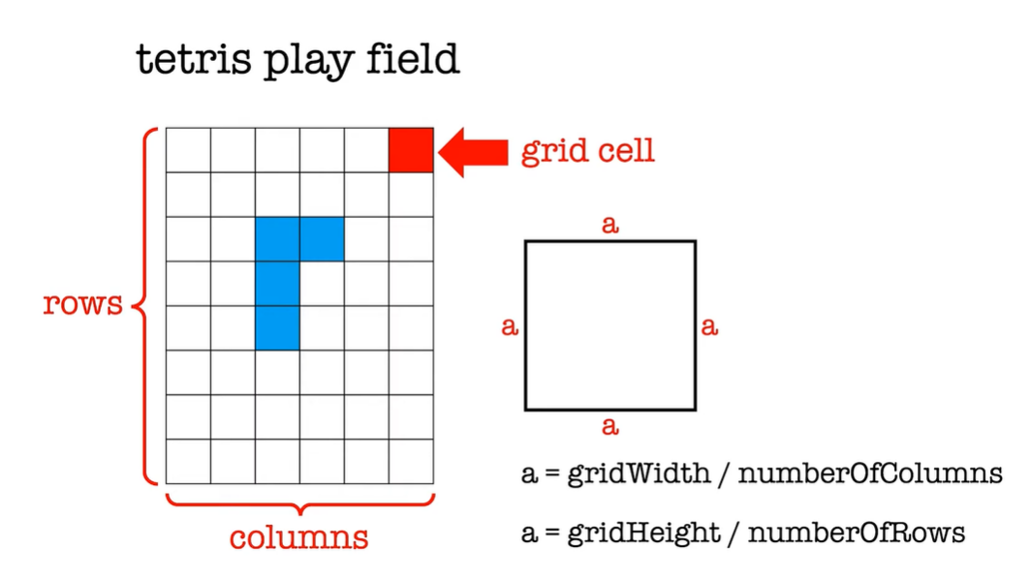
Board game
- First, we create the game board by using JPanel, then we divided it into smaller cells base on the formula below.

Slide 7
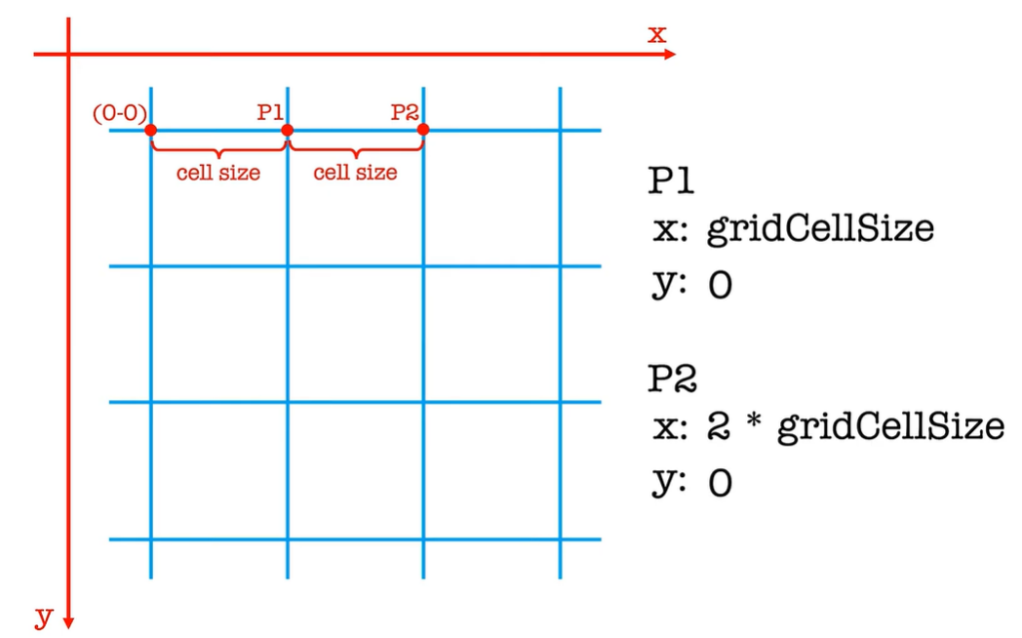
Drawing Block
- After creating the board, now we need to draw the shape (tetrominoes) inside it. There are 7 tetrominoes in total, each of them will have different shape and color to distinguish.

Slide 8
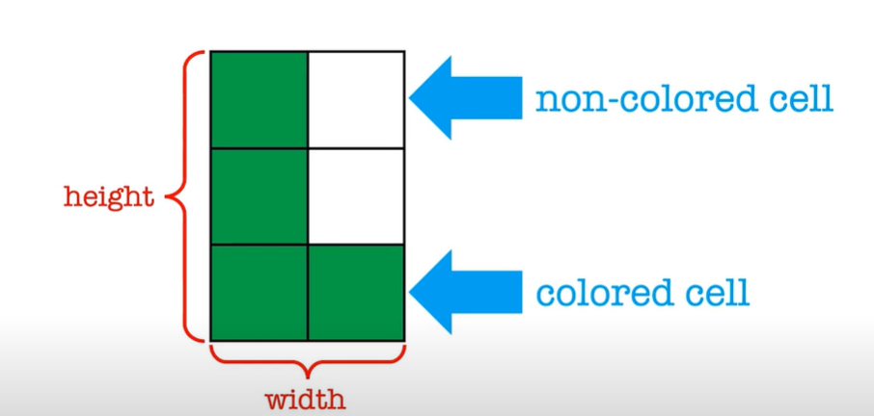
Drawing Block
- Each tetrominoes will be stored in a 2d array with values 0, 1 where 1 is colored cell and otherwise.

Slide 9
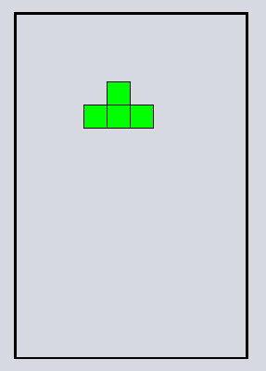
Drawing Block
- The output is something similar like this:

Slide 10
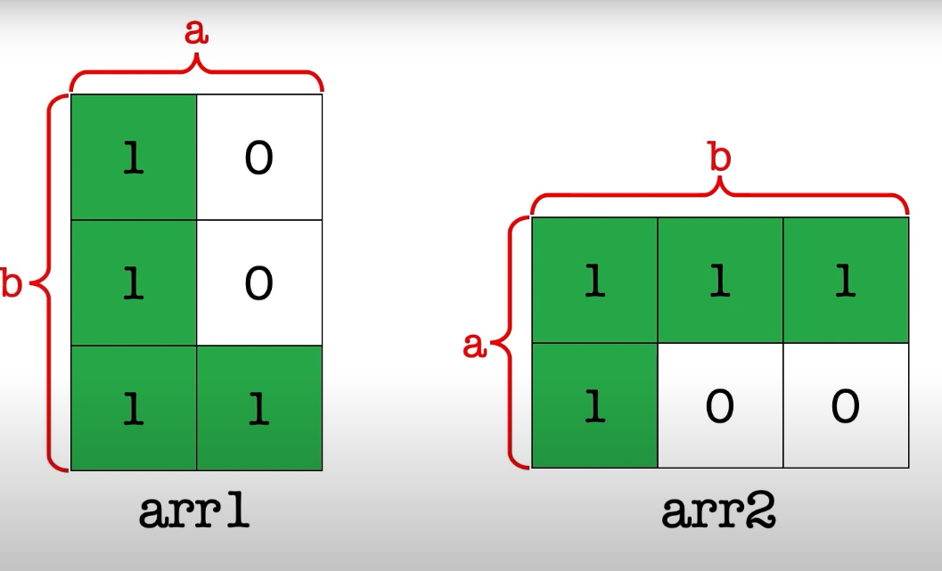
Rotate block
- The row of arr1 is equal to the column of arr2 and contrary.
- We’ll make a loop to executed 4 time for 4 rotation.

Slide 11
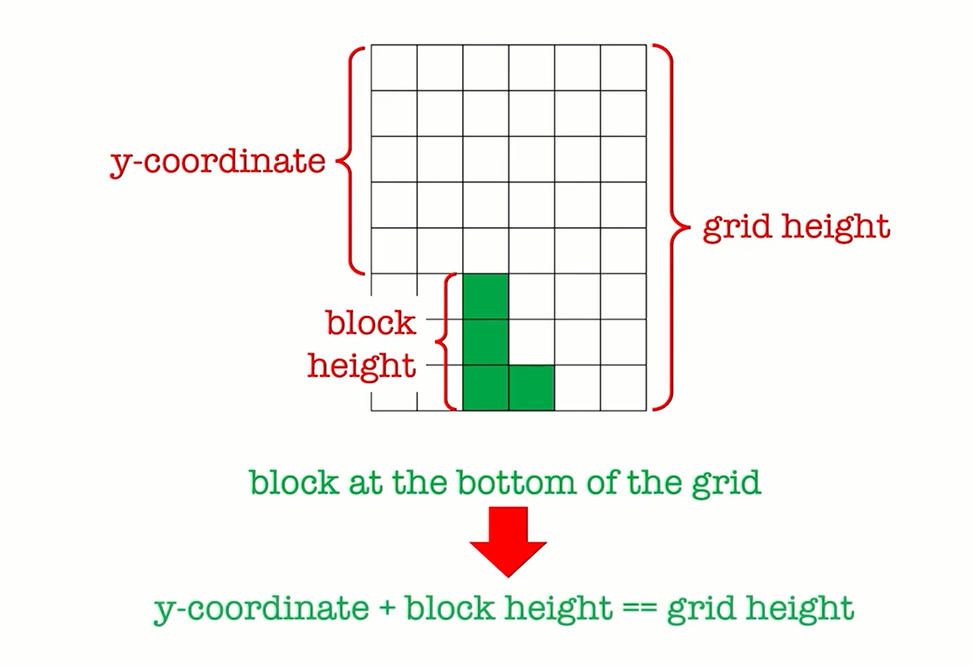
Make block fall down
- With the block spawning at the middle top of game board, now we need to make them fall down by printing its position after a fixed timestep and delete the previous one.
- So the process is: print-wait-delete-print

Slide 12
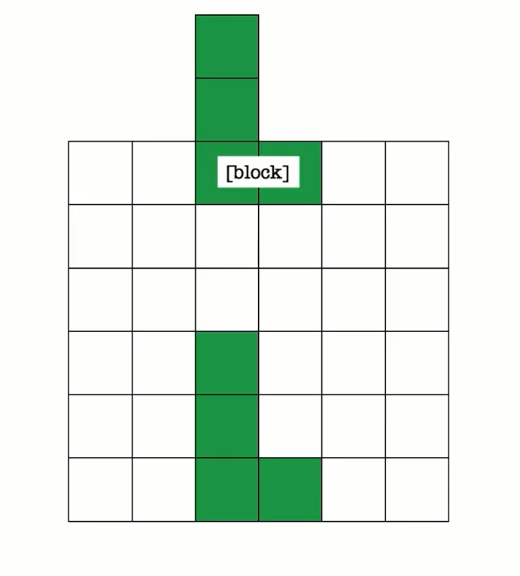
Spawning New Block
- When the current block hit the bottom edge of the game area, the game thread creates and spawns a new block and the reference to the new block object is stored in the variable block

Slide 13
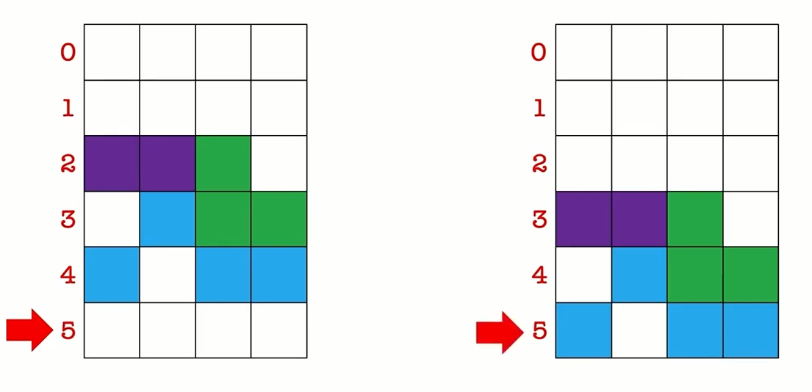
Line removal
- First we need to find the completed line
- Remove it
- Shift down the lines above

Slide 14
Demo
- The game will run for demo:

Slide 15
Reference
http://www.geom.uiuc.edu/java/tetris/explanation.html
https://www.iodraw.com/en/blog/211243890

Slide 16
Thank you for listening !

