Slide 1

DP-100 Final Project
ER Triage Patient Classification
Using Azure Machine Learning
LEARNER
COURSE
WORKSPACE
DATE
Nghiep Pham
[QS - K7] - Azure Data Scientist Associate
mlw-dp100-nghieppham
May 2026
4
92.8%
97.25%
500
Milestones
Completed
Best Model
Accuracy
Peak
Recall
Patient
Records

Slide 2


Project Objective & Problem Statement
Project Objective
Problem Statement
Build an end-to-end ML pipeline on Azure ML
Emergency rooms face constant pressure to optimally allocate patients. A misclassification routing a severe patient to Fast-Track can be life-threatening.
Auto-classify ER patients: Fast-Track (0) or Regular (1)
⚠ False Negative = Severe patient routed to Fast-Track = Clinically catastrophic
Demonstrate the full Azure ML lifecycle
Compare AutoML vs. manual training approaches
Manual triage is slow and variable
Optimize for healthcare-critical metrics (Recall)
High Recall is the primary optimization target
Azure ML provides auditable, scalable platform
DP-100 Project | Nghiep Pham | May 2026

Slide 3



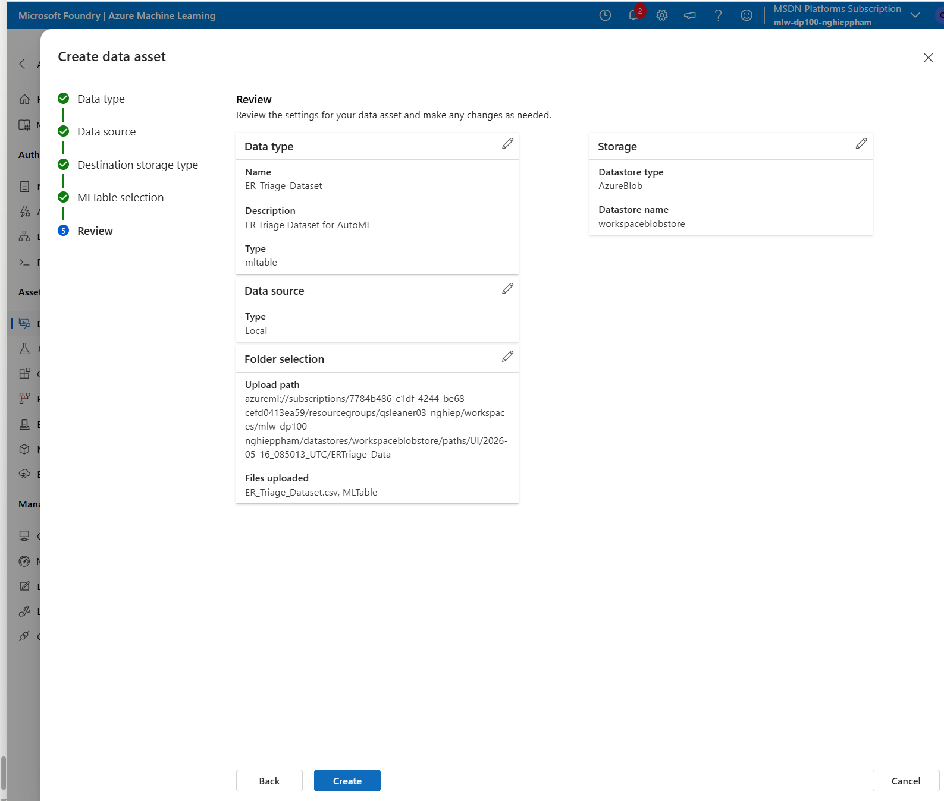
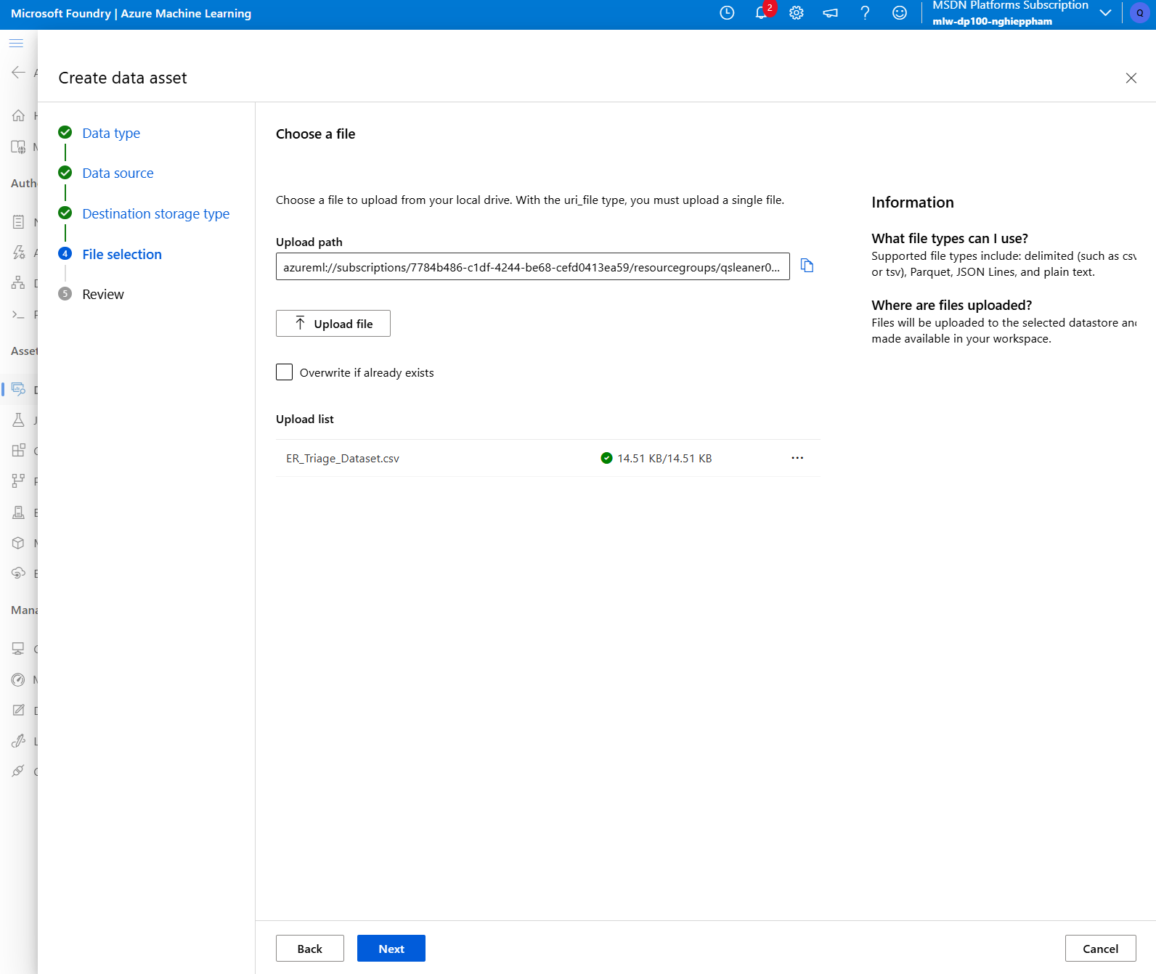
Environment Setup & Dataset
Workspace
Compute Instance
Compute Cluster
mlw-dp100-nghieppham
qslearner03-aml-compute
qslearner03-aml-cluster
East US 2 | MSDN Subscription
Standard_D11 | Development
Standard_D11 | min=0, max=2 nodes
Dataset Details
📷 Data Asset Registration
Dataset
ER_Triage_Dataset.csv (14.51 KB)
Records
500 patients
Features
5 clinical input features
Target
Routing_Class: 0=Fast-Track, 1=Regular
MLTable (v1)
For AutoML (M1)
uri_file (v1)
For Command & Sweep Jobs (M2–M4)
DP-100 Project | Nghiep Pham | May 2026

Slide 4

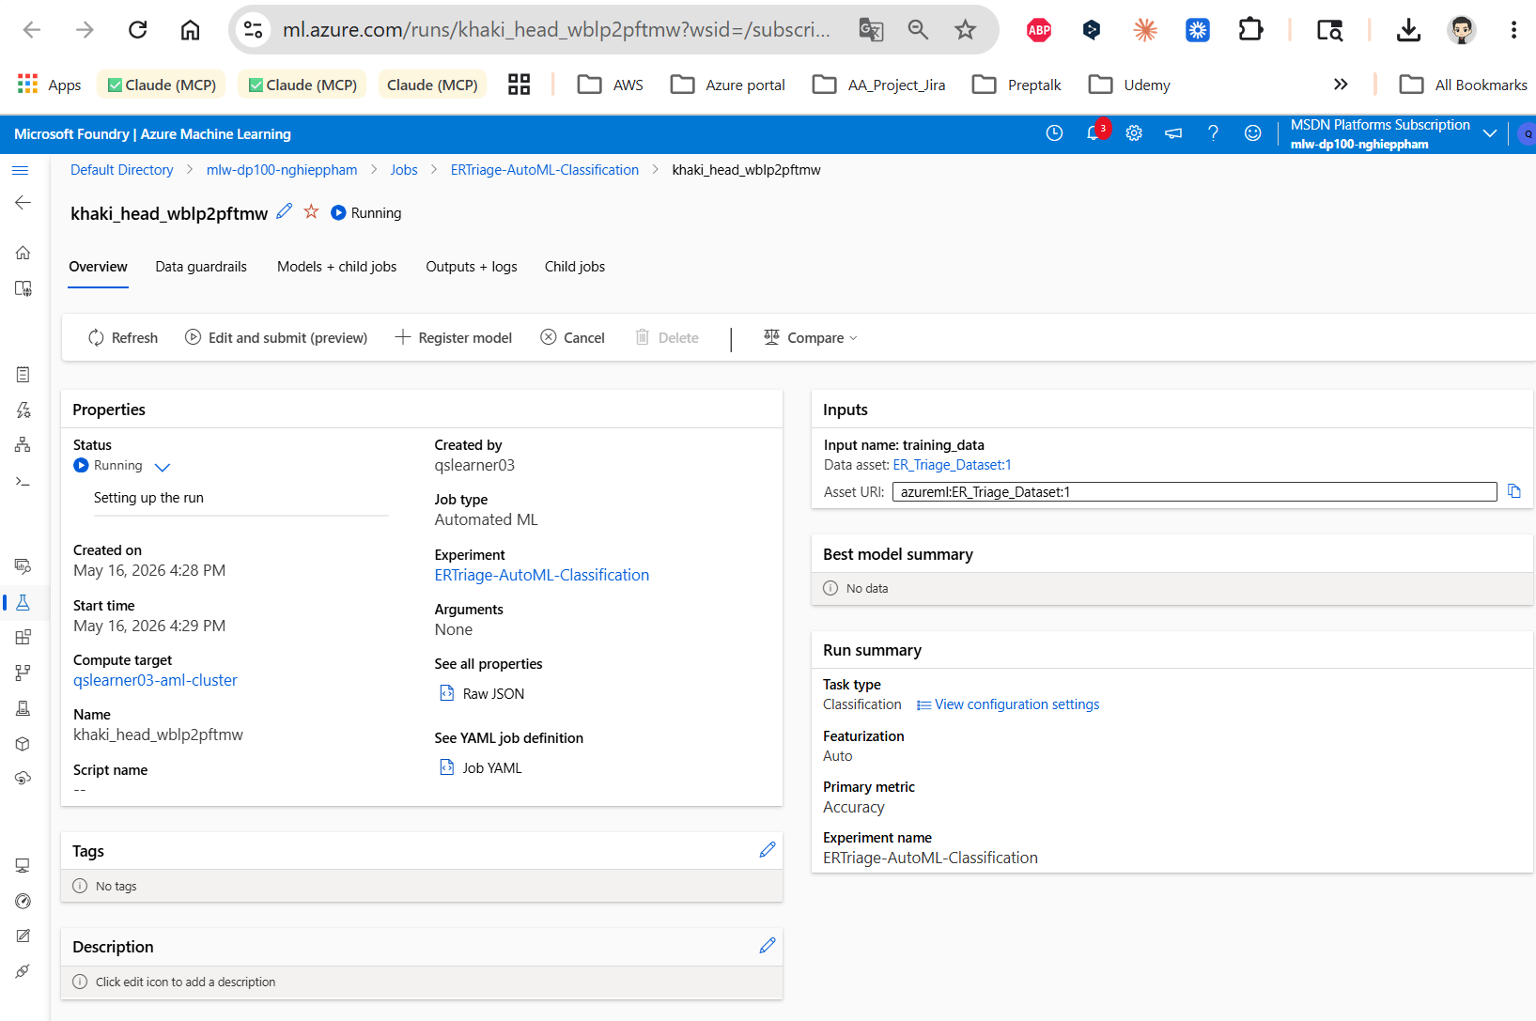
Milestone 1 — AutoML Classification
M1
Experiment:
ERTriage-AutoML-Classification
Job:
khaki_head_wblp2pftmw ✅ Completed
Duration:
23m 56.54s
Primary Metric:
Accuracy | Compute: qslearner03-aml-cluster
#
Algorithm
Accuracy
Duration
1
MaxAbsScaler + LightGBM ⭐ Best Model
0.9280
44s
2
VotingEnsemble
0.9260
3m 27s
3
StackEnsemble
0.9200
52s
4
MaxAbsScaler + XGBoostClassifier
0.9180
36s
5
MaxAbsScaler + ExtremeRandomTrees
0.8940
33s
DP-100 Project | Nghiep Pham | May 2026

Slide 5
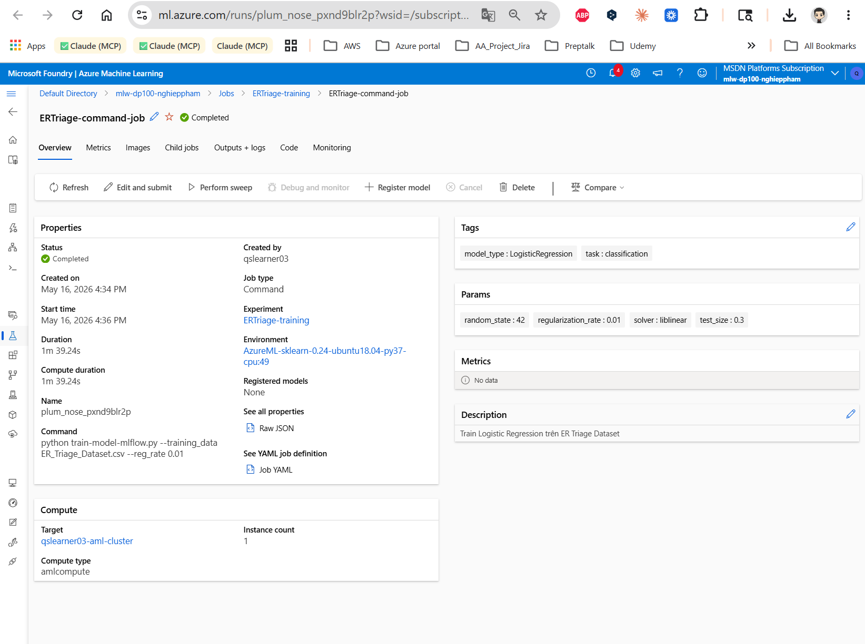
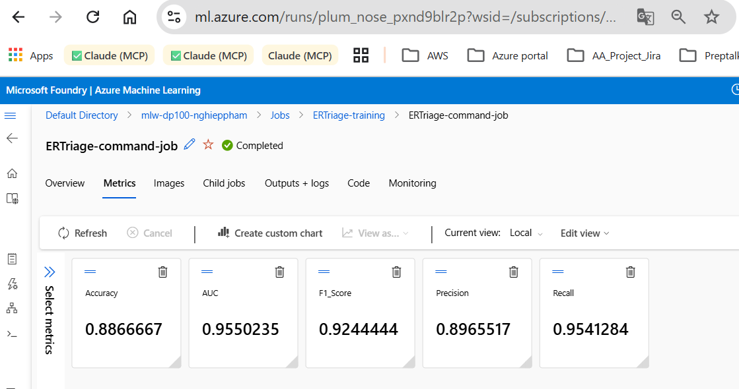
Milestone 2 & 3 — Command Job + MLflow Tracking
M2+M3
Experiment:
ERTriage-training
Job Name:
plum_nose_pxnd9blr2p ✅ Completed | 1m 39s
Model:
Logistic Regression | reg_rate = 0.01
Command:
python train-model-mlflow.py --training_data ER_Triage_Dataset.csv --reg_rate 0.01
0.8867
0.9550
0.9244
0.8966
0.9541
Accuracy
AUC-ROC
F1-Score
Precision
Recall
MLflow automatically logged all metrics to Azure ML Experiments, enabling visual comparison of ROC curves, confusion matrices, and per-run parameters in Studio.
DP-100 Project | Nghiep Pham | May 2026

Slide 6
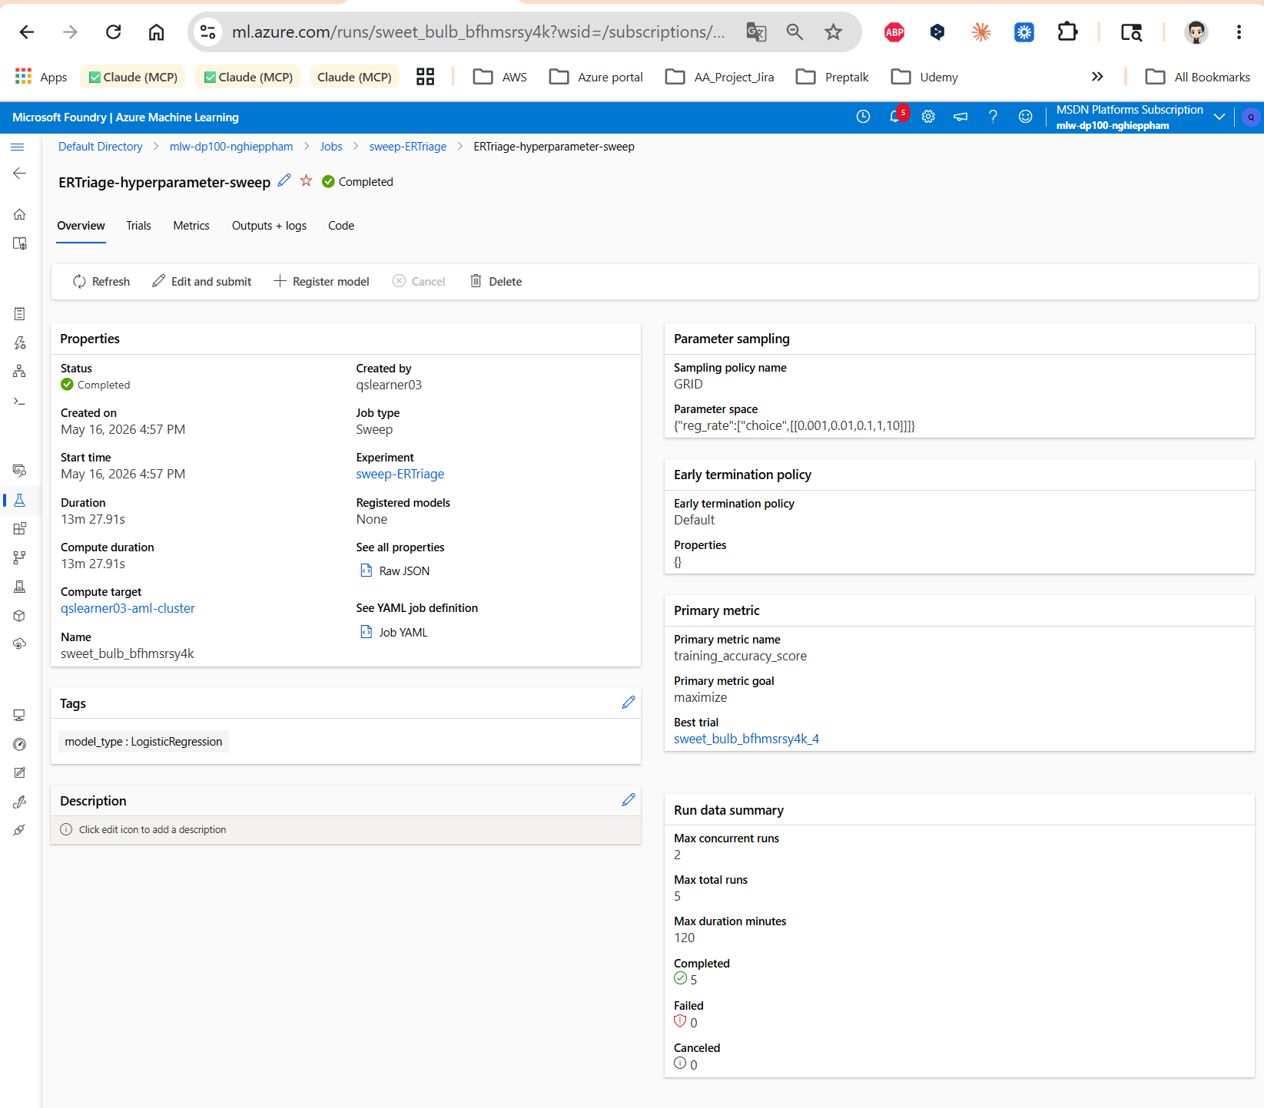
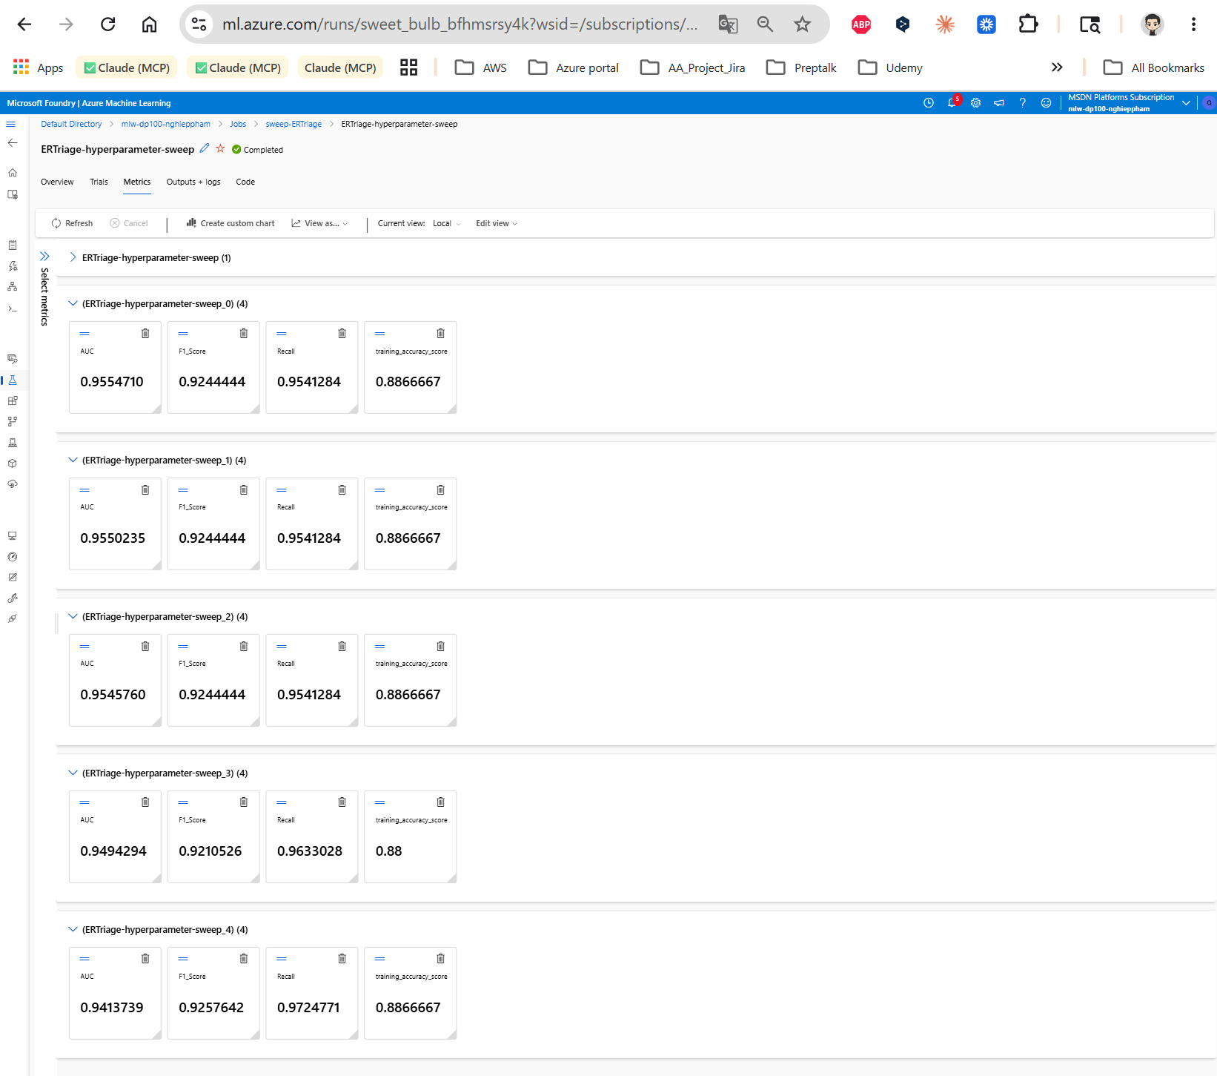
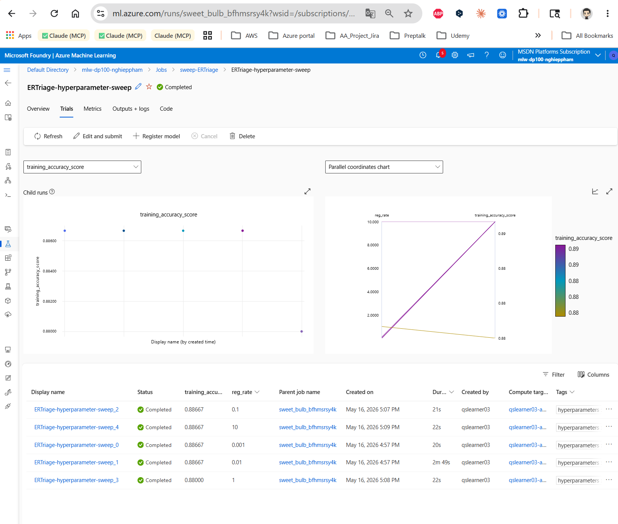

Milestone 4 — Hyperparameter Sweep (Grid Search)
M4
Job:
sweet_bulb_bfhmsrsy4k ✅ Completed | 13m 27.91s
Strategy:
Grid Search | reg_rate ∈ {0.001, 0.01, 0.1, 1, 10} | 5 trials, concurrent=2
Metric:
training_accuracy_score (maximize) | Best Trial: sweep_4 (reg_rate=10)
Trial
reg_rate
Accuracy
AUC
Recall
sweep_0
0.001
0.8867
0.9555
0.9541
sweep_1
0.01
0.8867
0.9550
0.9541
sweep_2
0.1
0.8867
0.9546
0.9541
sweep_3
1
0.8800
0.9494
0.9633
sweep_4 ⭐
10
0.8867
0.9414
0.9725
Clinical insight: reg_rate=10 (sweep_4) achieves highest Recall (97.25%) — critical in ER to prevent severe patient misrouting.
DP-100 Project | Nghiep Pham | May 2026

Slide 7

Results & Conclusion
All 4 Milestones completed successfully
AutoML (LightGBM) = 92.8% accuracy — best overall
Sweep M4 achieves 97.25% Recall — optimal for ER safety
MLflow provides full experiment traceability
Recommendation: Deploy AutoML LightGBM with tuned decision threshold to maximize Recall in production.
DP-100 Project | Nghiep Pham | May 2026

Slide 8

Challenges, Learnings & Future Work
⚠ Challenges Faced
✓ Key Learnings
▸ MLTable required both .csv + MLTable definition file
▸ AutoML rapidly explores many algorithms in one run
▸ Cluster cold start (2-3 min) on first job submission
▸ MLflow + Azure ML = seamless zero-infra tracking
▸ MLflow context errors when evaluate_model() called outside run
▸ Sweep Jobs enable parallel hyperparameter search
▸ Grid sweep ran all 5 trials even when early stopping helpful
▸ Healthcare ML: Recall > Accuracy for model selection
▸ Data versioning ensures experiment reproducibility
Future Improvements
Deploy LightGBM as Real-Time Endpoint in Azure ML
Use Bayesian optimization for more efficient hyperparameter search
Add data drift monitoring with Azure ML Model Monitor
Expand to multi-class: Fast-Track / Regular / Critical
DP-100 Project | Nghiep Pham | May 2026

Slide 9
Thank You
ER Triage Patient Classification — Azure ML
4 Milestones Complete
92.8% Best Accuracy
97.25% Peak Recall
Full MLflow Tracking
Nghiep Pham | qslearner03 | DP-100 Designing a Data Science Solution on Azure
Workspace: mlw-dp100-nghieppham | Subscription: MSDN Platforms | May 2026

