Slide 1
Arm Cortex-M33 Investigate
March 2026
RENESAS CONFIDENTIAL

Slide 2
Agenda
Introduction to Cortex-M33 Architecture
Scope of Core Self-Test
Arm Generic vs. Renesas Implementation
Register-Level Operations & Programming

Slide 3
1. Introduction to Cortex-M33 Architecture

Slide 4
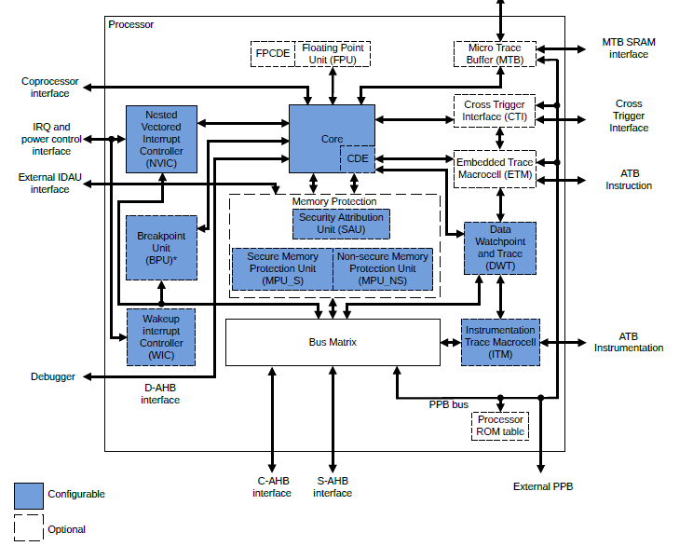
Introduce
The Cortex-M33 is an Armv8-M Mainline CPU designed for embedded systems (MCU/SoC) with a focus on: performance/power efficiency, deterministic interrupts, and security (TrustZone for Armv8-M).
Common Building Blocks:
Core: (pipeline, register file, ALU, optional DSP, optional FPU, debug)
Bus Interface: (I-Code, D-Code, System bus) + memory map (Code, SRAM, Peripheral, PPB)
Exception Model + NVIC: (interrupt/exception controller)
MPU (Memory Protection Unit) & (SoC dependent) SAU/IDAU: for TrustZone partitioning
System Control Block (SCB) + SysTick + debug/trace

Slide 5
Armv8-M Mainline – Architectural features affecting CST
The architectural features directly related to CST include:
Privileged vs Unprivileged execution (nPRIV bit in CONTROL register) → impacts peripheral/MPU access.
Stack pointer selection: MSP/PSP (SPSEL in CONTROL register) → related to exception entry/RTOS.
Exception masking: PRIMASK, BASEPRI, FAULTMASK → affects NVIC/exception preemption.
Exception model (vector table, priority, tail-chaining, late arrival) → NVIC behavior.
MPU (region-based access control + attribute) → memory protection, module isolation.
Security extension/TrustZone (if SoC enabled) → Secure/Non-secure state, SAU/IDAU, NSC veneer.

Slide 6
Cortex-M33 programmer model
Execution / privilege / security
Thread mode vs Handler mode (exceptions run in Handler mode).
Privilege levels: Privileged vs Unprivileged (CONTROL.nPRIV).
Two security states (if TrustZone enabled): Secure vs Non-secure.
Stack pointers: MSP and PSP, plus Secure/Non-secure banked SPs when Security is enabled.
Exception entry/return is mostly hardware-stacked (reduced latency).
Core control registers you configure
CONTROL: selects SP (MSP/PSP) and privilege (nPRIV).
PRIMASK / BASEPRI / FAULTMASK: interrupt masking and priority thresholding.
VTOR: vector table base relocation.
AIRCR: priority grouping, system reset request, endianness control (system-level).
SHCSR / CFSR / HFSR / MMFAR / BFAR: fault enable + fault status + fault address.

