Slide 1




Exploratory Network Modelling of Complex Human Systems in Time-Use Research: Results from Wave 1 of the Singapore NCSS-NAK 360 Panel Study
Ho Han Sheng, Emily Ortega, Bryan Chan Yu Xiu, Azriel Tay Xunkai, Sabrina Tang Seng Ooi
School of Humanities and Behavioural Sciences
Singapore University of Social Sciences
20th Conference on Complex Systems, Exeter, England
2nd – 6th September 2024

Slide 2
Motivation
Biological
Psychological
Socio-environmental
Psychological/ human phenomena are known to be complex processes
Notes:
The drilling of the biopsychosocial framework in undergraduate psychology modules reflects the field’s acknowledgement that psychological or human behaviour is an inherently complex process. Ironically, complex systems methods have yet to be fully exploited in the study of such constructs in spite of recent advancements in the modelling of psychopathology. Today we present an application of network analytic procedures for high-dimensional exploratory data analysis of everyday human behaviour.

Slide 3
Background
To investigate interactions between time-use patterns, Quality of Life (QoL), and socio-demographic factors
First of 3 waves
Stratified random sampling by ethnicity and housing type
Household listing acquired from Department of Statistics, Singapore
1 hour, in-person, verbal interview
Conducted across 2021 - 2022
Final sample - 3013 participants across 1399 households surveyed
47% response rate
Notes:
First, some background. As the first national time-use study in Singapore, we aim to investigate and benchmark the interactions between Singaporeans’ time-use patterns, well-being, and demographic factors. Data presented today is from the first of 3 waves and was collected during the height of the COVID pandemic between 2021-2022.

Slide 4

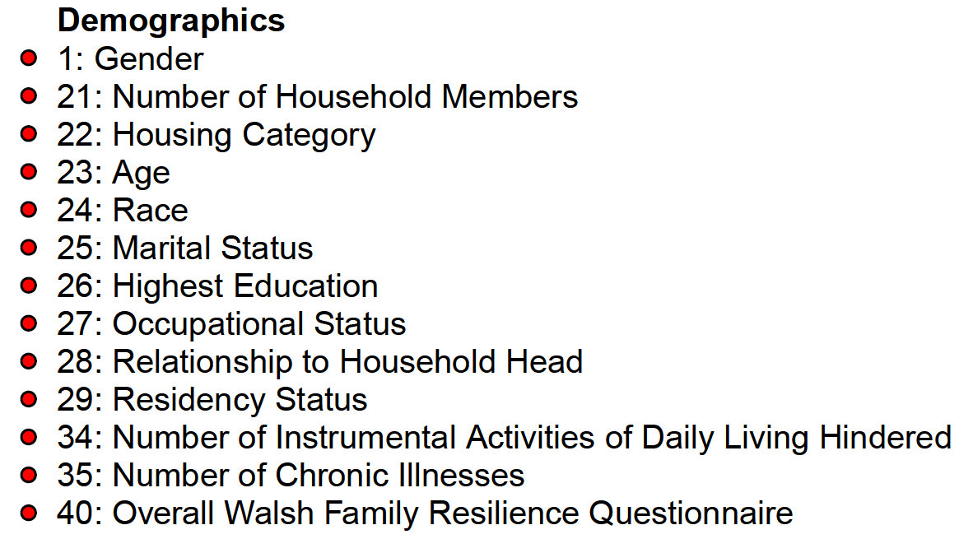
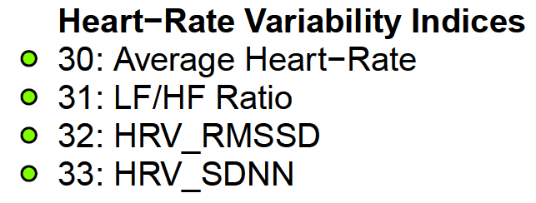
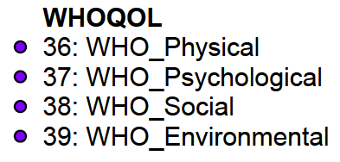
Background
Notes:
It becomes readily apparent that, with the wealth of data collected, traditional

Slide 5
Background
Notes:
It becomes readily apparent that, with the wealth of data collected, traditional

Slide 6
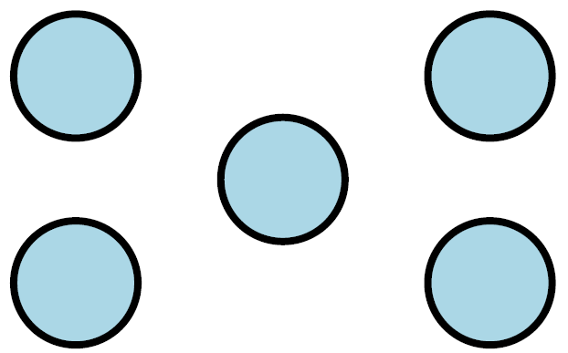
Network Approach
Variables as nodes/ circles

Slide 7
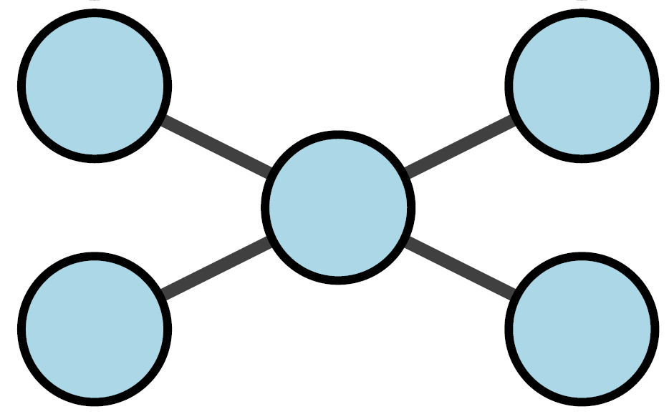
Network Approach
Statistical relations as edges/ lines

Slide 8
Network Approach
?
Edges/ lines need to be estimated in psychological data

Slide 9
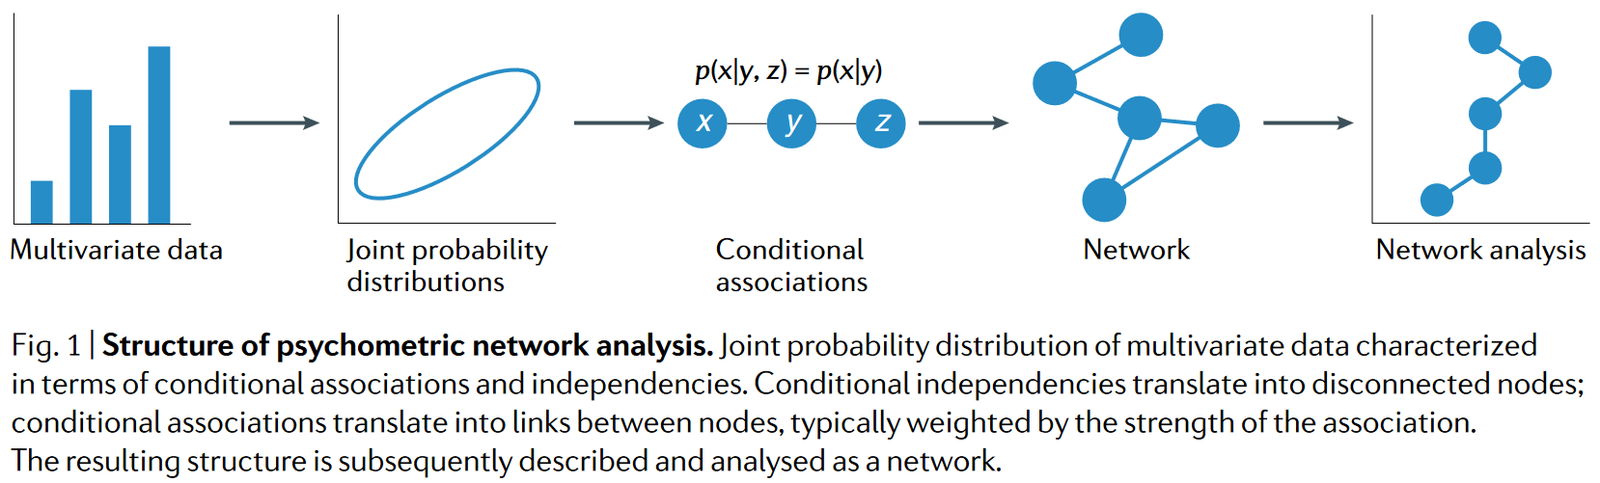
Network Approach
Markov Random Field
Borsboom, D., Deserno, M. K., Rhemtulla, M., Epskamp, S., Fried, E. I., McNally, R. J., Robinaugh, D. J., Perugini, M., Dalege, J., Costantini, G., Isvoranu, A.-M., Wysocki, A. C., Van Borkulo, C. D., Van Bork, R., & Waldorp, L. J. (2021). Network analysis of multivariate data in psychological science. Nature Reviews Methods Primers, 1(1), 58. https://doi.org/10.1038/s43586-021-00055-w

Slide 10
Network Approach
Notes:
It becomes readily apparent that, with the wealth of data collected, traditional

Slide 11
Mixed Graphical Model
Graph/ Network
Vertices/ Nodes/ Variables
Edges/ Statistical relations
Yang, E., Baker, Y., Ravikumar, P., Allen, G. & Liu, Z.. (2014). Mixed graphical models via exponential families. Proceedings of the 17th International Conference on Artificial Intelligence and Statistics, 33, 1042-1050.
https://proceedings.mlr.press/v33/yang14a.html

Slide 12

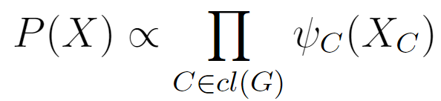
Mixed Graphical Model
Global Markov property: Any two disjoint subsets A and B are conditionally independent given a separating subset where every path between nodes in A and B pass through S.
Markov Factorisation property: The distribution of X factorizes according to G if it can be represented as a product of clique functions
Yang, E., Baker, Y., Ravikumar, P., Allen, G. & Liu, Z.. (2014). Mixed graphical models via exponential families. Proceedings of the 17th International Conference on Artificial Intelligence and Statistics, 33, 1042-1050.
https://proceedings.mlr.press/v33/yang14a.html

Slide 13
Mixed Graphical Model
Global Markov property: Any two disjoint subsets A and B are conditionally independent given a separating subset where every path between nodes in A and B pass through S.
If probability density is positive
Markov Factorisation property: The distribution of X factorizes according to G if it can be represented as a product of clique functions
Yang, E., Baker, Y., Ravikumar, P., Allen, G. & Liu, Z.. (2014). Mixed graphical models via exponential families. Proceedings of the 17th International Conference on Artificial Intelligence and Statistics, 33, 1042-1050.
https://proceedings.mlr.press/v33/yang14a.html

Slide 14
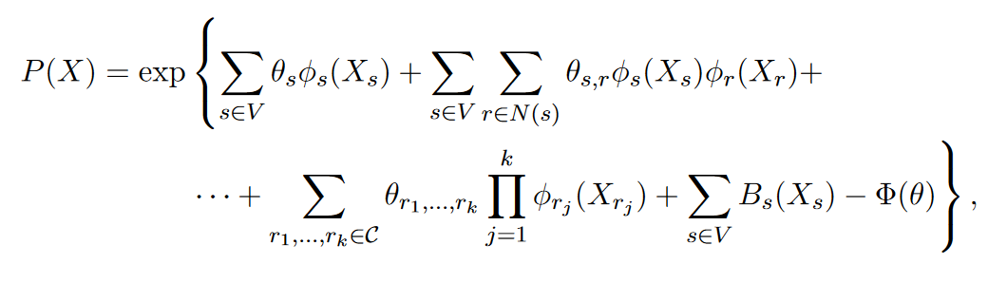
Mixed Graphical Model (MGM)
Neighbourhood of node s
Base measure
Sufficient statistic functions specified by exponential family
Order of interactions
Haslbeck, J. M. B., & Waldorp, L. J. (2020). mgm : Estimating time-varying mixed
graphical models in high-dimensional data. Journal of Statistical Software, 93(8).
https://doi.org/10.18637/jss.v093.i08

Slide 15

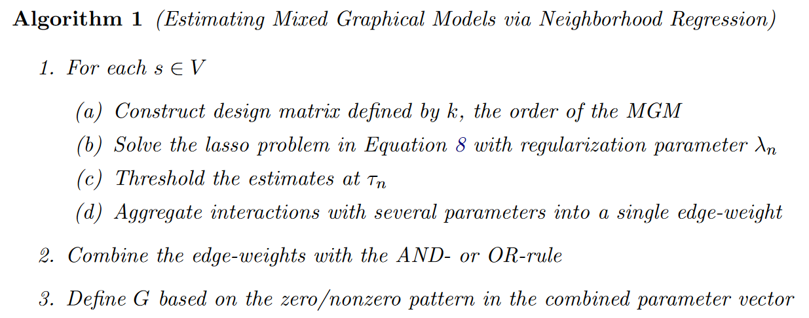
Mixed Graphical Model (MGM)
(beta-min condition)
Haslbeck, J. M. B., & Waldorp, L. J. (2020). mgm : Estimating time-varying mixed
graphical models in high-dimensional data. Journal of Statistical Software, 93(8).
https://doi.org/10.18637/jss.v093.i08

Slide 16
Network Estimation
library(mgm)
fit_mgm <- mgm(data = as.matrix(data),
type = var_type,
levels = var_level,
k = 2,
lambdaSel = "CV",
lambdaFolds = 10,
ruleReg = "AND”)
pairwise
cross-validation
10-fold
AND-rule
Haslbeck, J. M. B., & Waldorp, L. J. (2020). mgm : Estimating time-varying mixed
graphical models in high-dimensional data. Journal of Statistical Software, 93(8).
https://doi.org/10.18637/jss.v093.i08

Slide 17
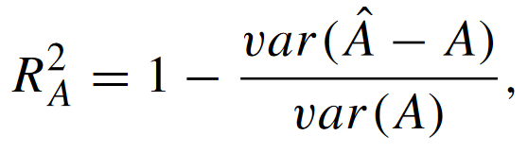
Node Predictability
For continuous variables:
Proportion of variance explained
Haslbeck, J. M. B., & Waldorp, L. J. How well do network models predict observations? On the importance of predictability in network models. Behavior Research Methods, 50, 853–861 (2018). https://doi.org/10.3758/s13428-017-0910-x

Slide 18
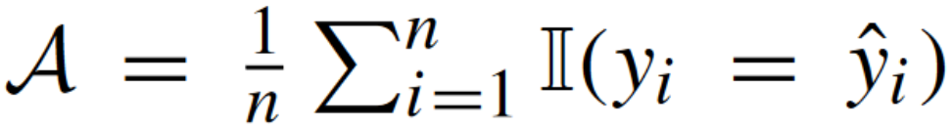
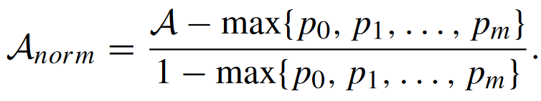
Node Predictability
For categorical variables:
Accuracy
Proportion of correct predictions by marginal distributions
Normalised accuracy
Proportion of correct predictions beyond what is predicted by marginal distributions
Haslbeck, J. M. B., & Waldorp, L. J. How well do network models predict observations? On the importance of predictability in network models. Behavior Research Methods, 50, 853–861 (2018). https://doi.org/10.3758/s13428-017-0910-x

Slide 19
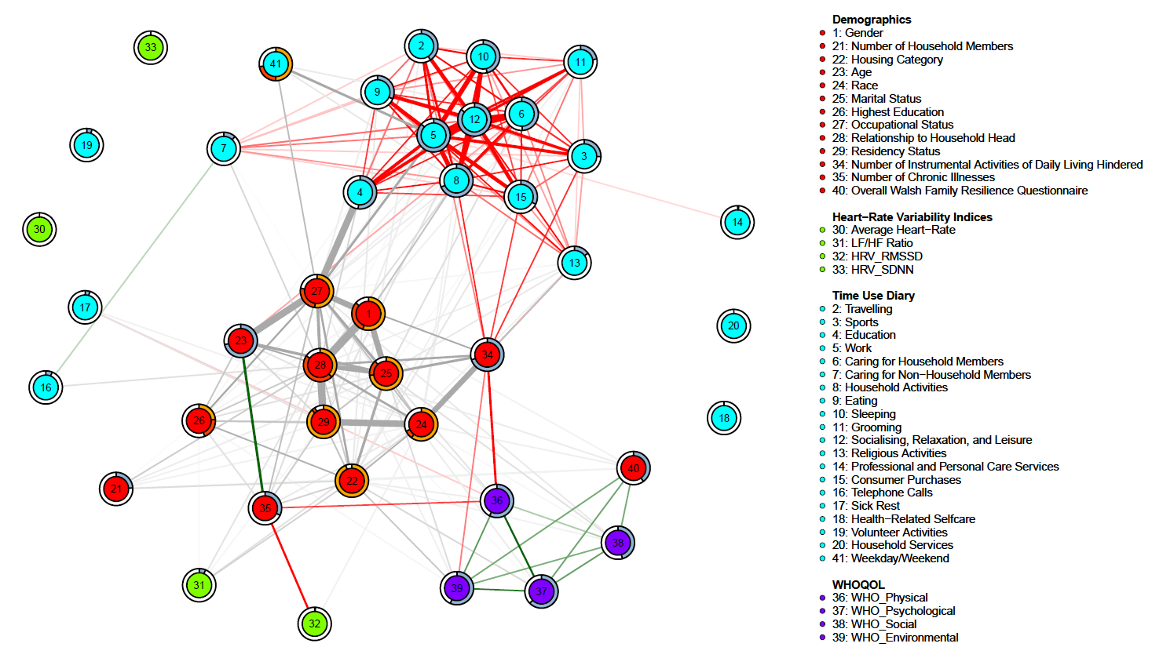
Adults

Slide 20
Adults
Categorical
Negative Correlation
Positive Correlation

Slide 21
Adults
R² Proportion of variance explained
A_{norm}:
Normalised Accuracy
A:
Accuracy

Slide 22
Adults

Slide 23
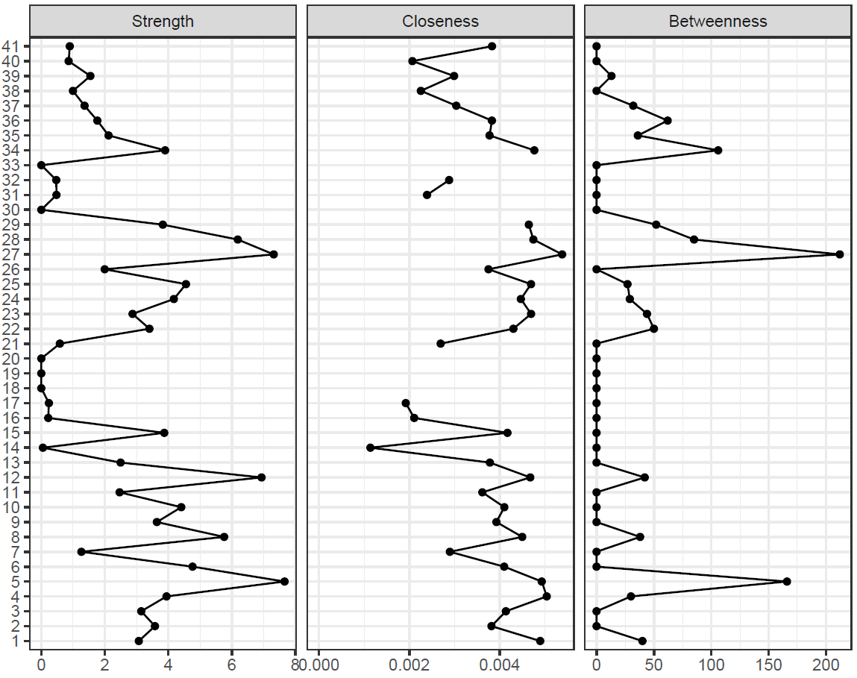
Adults
sums the absolute edge weights
how far a node is from all other nodes
how many times the node lies on the shortest path
connecting any other pair of nodes

Slide 24
Adults
Time Use Diary

Slide 25
Adults
Socialising, Relaxation, Leisure
Household Activities
Work
Caring for household members

Slide 26
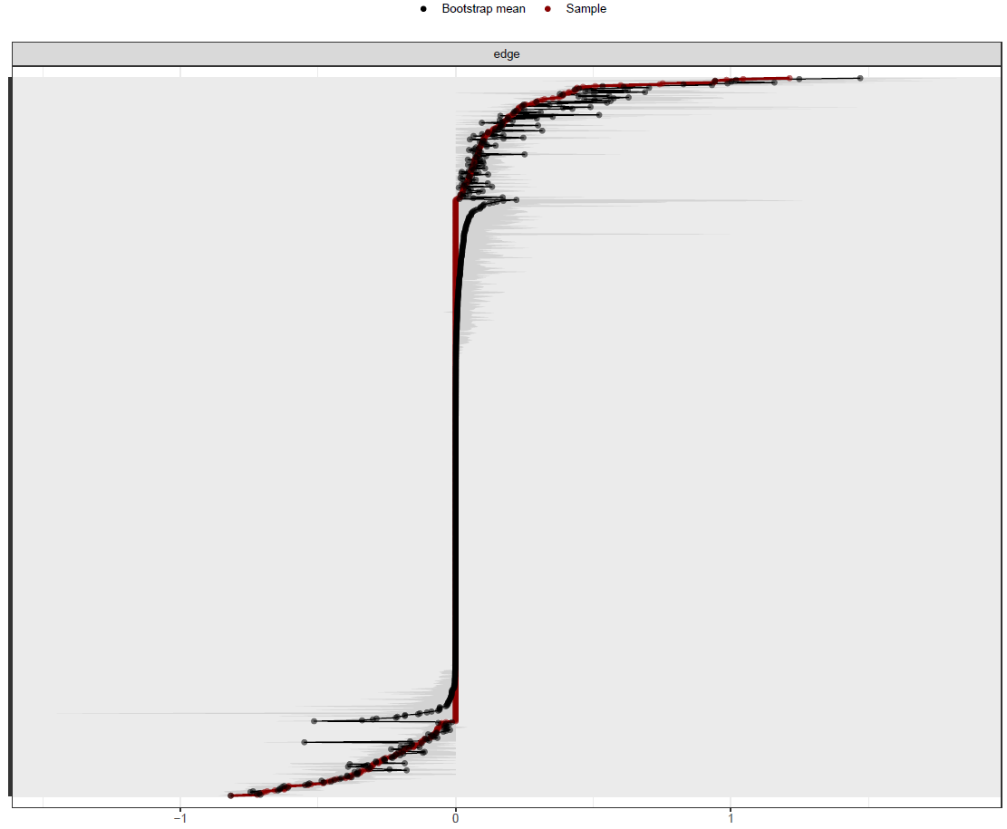
results <- bootnet(boot_data,
nBoots = 500,
nCores = 12)

Slide 27
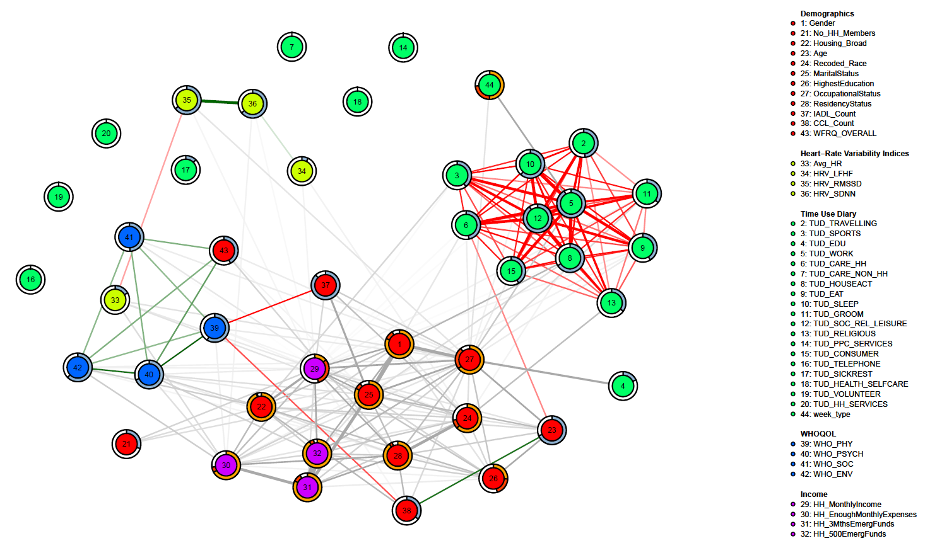
Heads of Household
(80% male)

Slide 28
Heads of Household
(80% male)

Slide 29
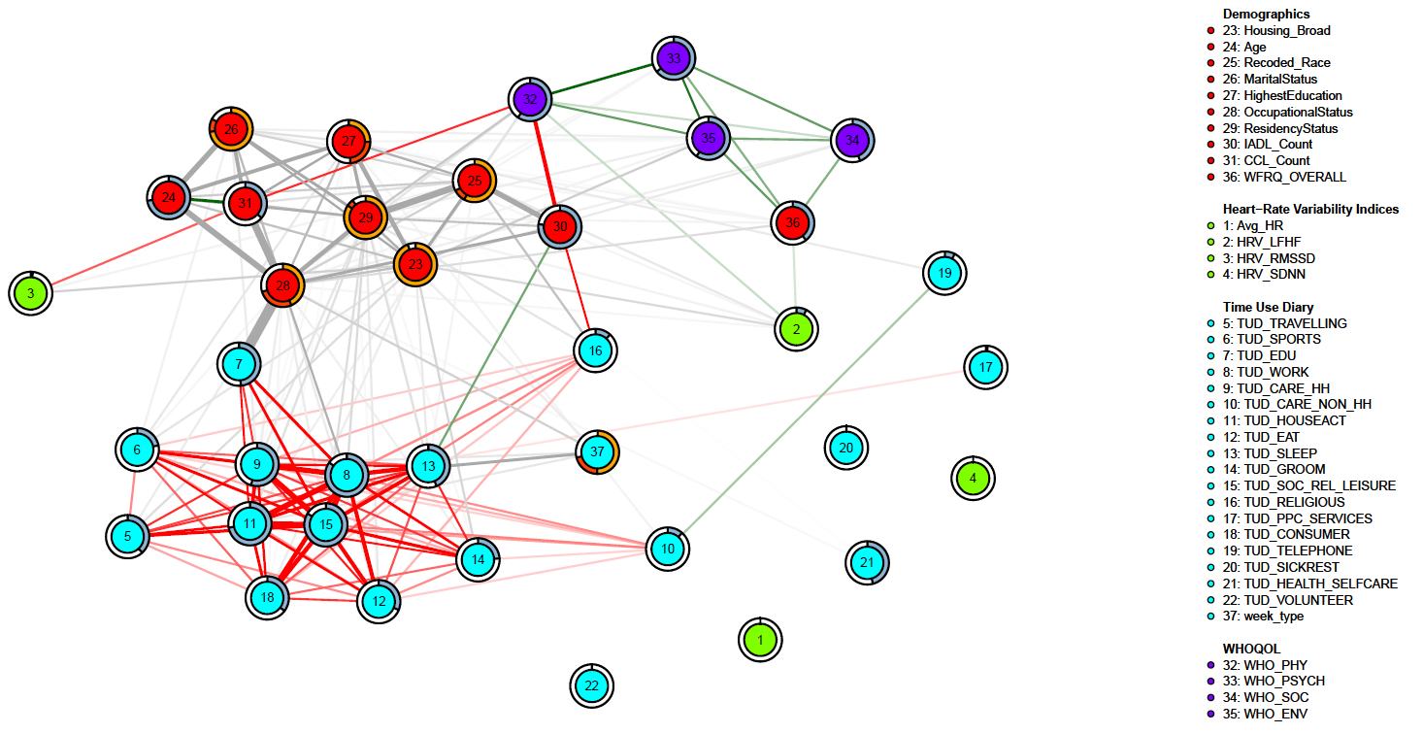
Male

Slide 30
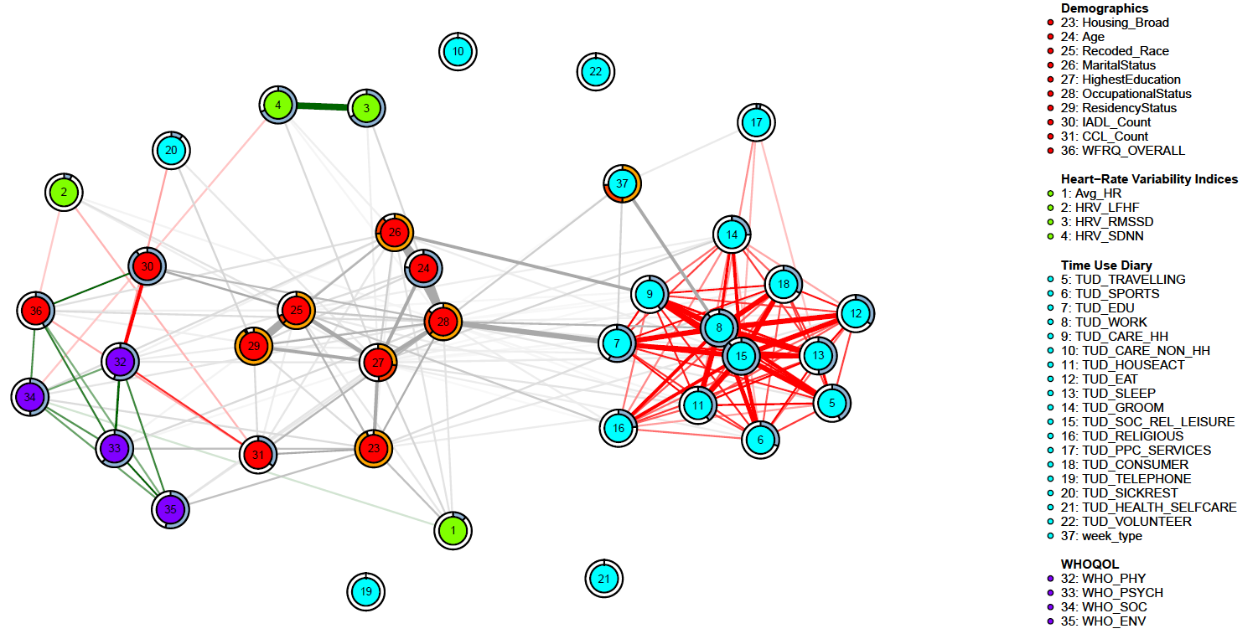
Female

Slide 31
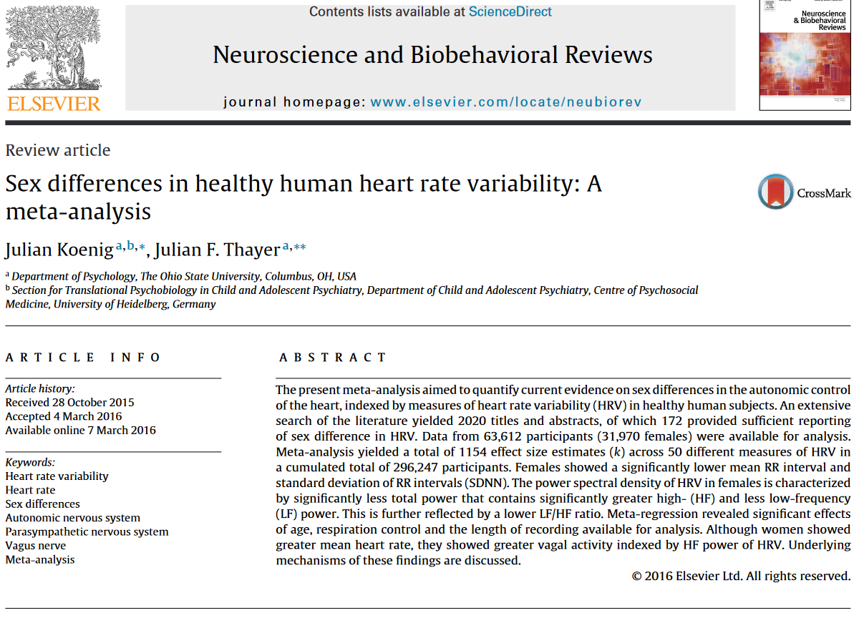
Gender moderates relationship b/w RMSSD & SDNN

Slide 32
Heads of Household
(80% male)
?

Slide 33
Limitations
Stability analysis is subjective
Computationally demanding
~ 21 hours

Slide 34
Limitations
Does not always factorise into a well-defined (normalisable) joint distribution
Chen, S., Witten, D. M., & Shojaie, A. (2015). Selection and estimation for mixed graphical models. Biometrika, 102(1), 47–64. https://doi.org/10.1093/biomet/asu051

Slide 35
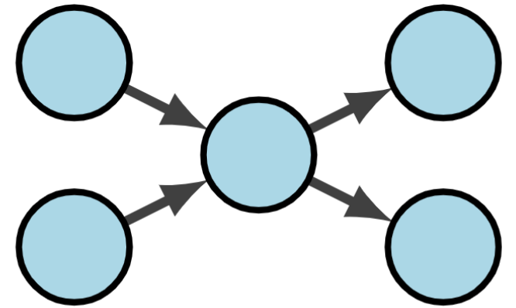
Limitations
Edges are undirected

Slide 36
Limitations
Loss of temporal information
Non-i.i.d. observations → consider multilayer networks for hierarchical data
Only considered pairwise interactions → higher-order interactions? 3-way, moderating variables?

Slide 37
Conclusion
Networks are convenient for visualizing multivariate data and their statistical relations
Enables high-dimensional exploratory data analysis with little assumptions
Integrates multi-modal data into a coherent entity

Slide 38




Thank you
Ho Han Sheng
Research Assistant & Psychology Undergraduate
Singapore University of Social Sciences
@hsho.bsky.social
@_hsho_
linkedin.com/in/hsho
ho-han-sheng.github.io
pqrst-lab.github.io

Slide 39
Acknowledgements
This study was funded by the National Council of Social Services, Singapore, and Ngee Ann Kongsi, Singapore, and is part of the NCSS-NAK 360 Panel Study. NCSS does not endorse any analysis, conclusions, methods, or results created wholly by the institution in any way, and that any such analysis, conclusion, methods, or results, are strictly the Institution's own.

