Slide 1
Git Basic Tutorial

Slide 2
Git uses checksums
Git generates a unique SHA-1 hash – 40 character string
of hex digits, for every commit. Refer to commits by this ID rather
than a version number. Often we only see the first 7 characters:
1677b2d Edited first line of readme
258efa7 Added line to readme
0e52da7 Initial commit
Git has the ability to tag specific points in history as being important
$ git tag
v.0.1
v.1.3

Slide 3

A Local Git project has three areas
Unmodified/modified
Files
Staged
Files
Committed
Files
Note: working directory sometimes called the “working tree”, staging area sometimes called the “index”.

Slide 4
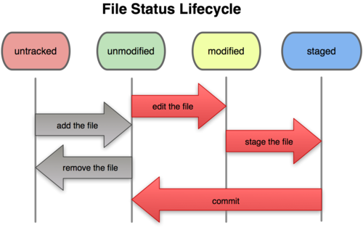
Git file lifecycle

Slide 5
Basic Workflow
Basic Git workflow:
Modify files in your working directory.
Stage files, adding snapshots of them to your staging area.
Do a commit, which takes the files as they are in the staging area and stores that snapshot permanently to your Git directory.
Notes:
  If a particular version of a file is in the git directory, it’s considered committed.
  If it’s modified but has been added to the staging area, it is staged.
  If it was changed since it was checked out but has not been staged, it is modified.

Slide 6
Github
GitHub.com is a site for online storage of Git repositories.
Many open source projects use it, such as the Linux kernel.
You can get free space for open source projects or you can pay for private projects.

Slide 7
Get ready to use Git!
Set the name and email for Git to use when you commit:
$ git config --global user.name “Bugs Bunny”
$ git config --global user.email bugs@gmail.com
You can call git config –list to verify these are set.
These will be set globally for all Git projects you work with.
You can also set variables on a project-only basis by not using the
--global flag.
You can also set the editor that is used for writing commit messages:
$ git config --global core.editor emacs (it is vim by default)

Slide 8
Create a local copy of a repo
Two common scenarios: (only do one of these)
  To clone an already existing repo to your current directory:
$ git clone <url> [local dir name]
This will create a directory named local dir name, containing a working copy of the files from the repo, and a .git directory (used to hold the staging area and your actual repo)
  To create a Git repo in your current directory:
$ git init
This will create a .git directory in your current directory.
Then you can commit files in that directory into the repo:
$ git add file1.java
$ git commit –m “initial project version”

Slide 9
Git commands
command | description
git clone url [dir] | copy a git repository so you can add to it
git add files | adds file contents to the staging area
git commit | records a snapshot of the staging area
git status | view the status of your files in the working directory and staging area
git diff | shows diff of what is staged and what is modified but unstaged
git help [command] | get help info about a particular command
git pull | fetch from a remote repo and try to merge into the current branch
git push | push your new branches and data to a remote repository
others: init, reset, branch, checkout, merge, log, tag

Slide 10
Committing files
The first time we ask a file to be tracked, and every time before we commit a file we must add it to the staging area:
$ git add README.txt hello.java
This takes a snapshot of these files at this point in time and adds it to the staging area.
To move staged changes into the repo we commit:
$ git commit –m “Fixing bug #22”
Note: To unstage a change on a file before you have committed it:
$ git reset HEAD -- filename
Note: To unmodify a modified file:
$ git checkout -- filename
Note: These commands are just acting on your local version of repo.

Slide 11
Status and Diff
To view the status of your files in the working directory and staging area:
$ git status or
$ git status –s
(-s shows a short one line version similar to svn)
To see what is modified but unstaged:
$ git diff
To see staged changes:
$ git diff --cached

Slide 12
Viewing logs
To see a log of all changes in your local repo:
$ git log or
$ git log --oneline (to show a shorter version)
1677b2d Edited first line of readme
258efa7 Added line to readme
0e52da7 Initial commit
$ git log -5 (to show only the 5 most recent updates, etc.)
$ git log –-graph “or” gitk
Note: changes will be listed by commitID #, (SHA-1 hash)
Note: changes made to the remote repo before the last time you cloned/pulled from it will also be included here

Slide 13
Pulling and Pushing
Good practice:
Add and Commit your changes to your local repo
Pull from remote repo to get most recent changes (fix conflicts if necessary, add and commit them to your local repo)
Push your changes to the remote repo
To fetch the most recent updates from the remote repo into your local repo, and put them into your working directory:
$ git pull origin master
To push your changes from your local repo to the remote repo:
$ git push origin master
Notes: origin = an alias for the URL you cloned from
master = the remote branch you are pulling from/pushing to,
(the local branch you are pulling to/pushing from is your current branch)
Notes:
$ git remote -v
origin https://github.com/rea2000/santalist.git (fetch)
origin https://github.com/rea2000/santalist.git (push)

Slide 14
Branching
To create a branch called experimental:
$ git branch experimental
To list all branches: (* shows which one you are currently on)
$ git branch
To switch to the experimental branch:
$ git checkout experimental
Later on, changes between the two branches differ, to merge changes from experimental into the master:
$ git checkout master
$ git merge experimental
Note: These branches are in your local repo!

Slide 15
Undoing Changes
Generate a new commit that undoes all of the changes introduced in <commit>, then apply it to the current branch:
$ git revert <commit>
The staged snapshot is updated to match the specified commit, but the working directory is not affected:
$ git reset <commit>
The staged snapshot and the working directory are both updated to match the specified commit:
$ git reset --hard <commit>
The staged snapshot and working directory are not altered in any way
$ git reset --soft <commit>
Remove untracked files from the current directory:
$ git clean -f

Slide 16
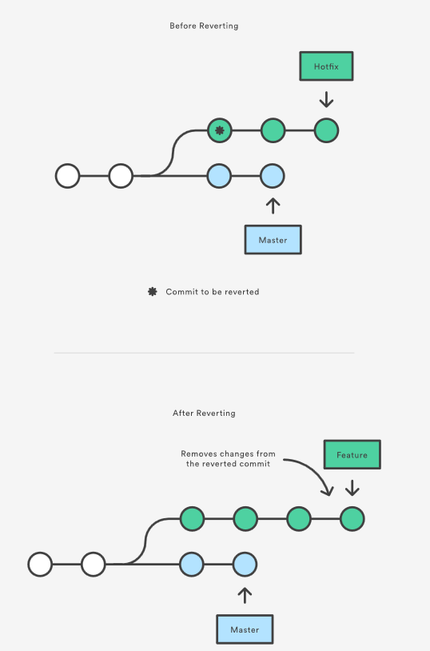
Reverting

Slide 17
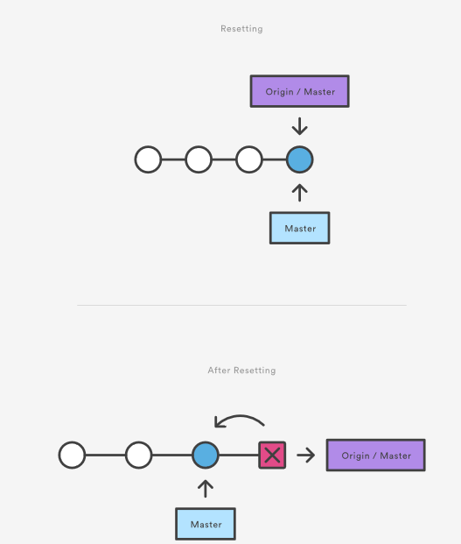
Reseting

Slide 18
Rewriting History
Combine staged changes with the previous commit or simply edit the previous commit message:
$ git commit --amend
Rebase the current branch onto <base>, move all the changes onto the top of <base>
$ git rebase <base>
Rebase the current branch onto <base>, but use an interactive rebasing session:
$ git rebase -i <base>
The reflog contains information about the old states of branches and allows you to go back to that state if necessary (even though they are not referenced by any branch or tag)
$ git reflog

Slide 19
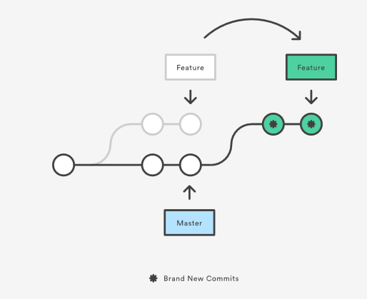
Rebasing

Slide 20
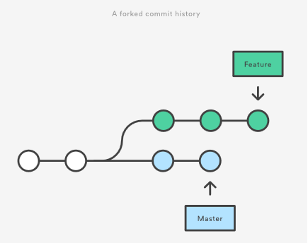
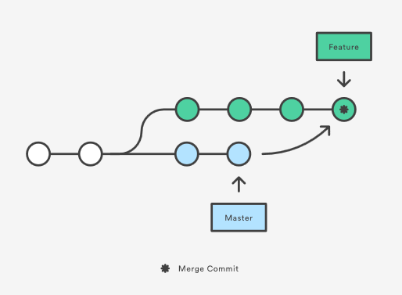
Merging

Slide 21
Customer work-flow suggestion
Make a new_branch
Commit frequently
At a good point, run “$ git log” to find the hash ID of the last good commit before the work is started (SHA)
(new_branch)$ git reset —soft SHA
(new_branch)$ git commit (only 1 commit for all the changes)
(new_branch)$ git push -f origin new_branch
(new_branch)$ git rebase upstream-master
(new_branch)$ git checkout upstream-master
(upstream_master)$ git merge —ff-only new-branch
If ok then: (upstream_master) $git push upstream_master
Otherwise: Back to new_branch to merge/rebase again.

