Slide 1












1.1. Initial App Launch Flow to Home Screen
Prebuilt Social Login Screen
First time login?
Y
Welcome to Limeorange
N
START
1
2
Input format correct?
Y
Account verified?
Y
7
LIMEORANGE
S E O U L
NEW BEST EVENT SALE
N
N
3
email
Format rule violation
Auth Failure
password
OK
OK
4
Forgot password
5
SIGN UP
6
Proceed without login
email
Reset email sent.
P
Enter Your Email
Input format correct?
N
Format rule violation
1
Initial launch screen
Signin process is performed here
With no stored account info, go to
If 1st login, welcome email will be sent
OK
2
Y
Y
2
Signin/Signup Screen – Social Media login
FB, G+ are must-be login options
New options like Zalo can be added
RESET PWD
Back to Login
Sign up with email
3
Signin/Signup Screen – Email login
No login button to encourage
Once successful, login info is stored within the app so that it can stay logged in after on.
Welcome to Limeorange
2
email
Input format correct?
Y
Terms of Service checked?
Y
Signin/Signup Screen – forgot password
Provide password reset by email
Password
4
Terms of Service
NEXT
N
N
Go to Home
5
Signin/Signup Screen – Sign Up
Signup for the service without FB, G+ connect
Every first login comes with welcome email
Format rule violation
Format rule violation
6
Signin/Signup Screen – Proceed without lognin
User can to Home screen without signin
To use wishlist, cart, coupon, point, etc., signin must be done
OK
OK

Slide 2

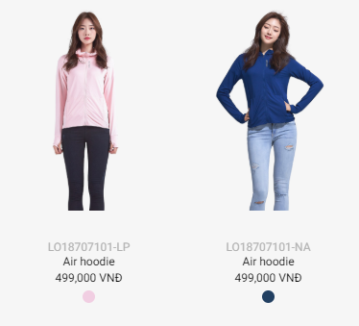
2.1. Home Screen & Key Menus
Slide Menu Button
Typical slide menu button
All menus are found here
1
LIMEORANGE
S E O U L
2
Search Button
- Tag search showing results by product(brand, category), contents(articles, videos)
NEW BEST EVENT SALE
Most Popular Menus
Each menu leads to individual sub home screen
Each sub home screen shares the same contents type as Home Main screen
3
1
2
SUMMER SALE!
4
Main Contents Section
Timeline style list
Display order managed by server side
Horizontal scroll and page control
no fixed height
Products, events, articles, videos
Predefined custom cells(more to come)
3
Summer sale up to 50%. Don’t miss the chance to get the..
1
Only image with horizontal scroll support and page control
NEW ARRIVAL!
2
Title/Image/Caption with fixed lines
LO
R3
AW
BW
3
Custom cell with buttons and linked collection view with image & text
Bottom Tab Bar
Tab to expand
Frequently used functions are placed here
On click, popup screen shows up from bottom to top
Membership barcode + point
Coupons
Wishlist
Cart
Barcode scanner
History
5
1400P

Slide 3

2.1. Home Screen & Key Menus
Slide Menu Button
Typical slide menu button
All menus are found here
1
LIMEORANGE
S E O U L
2
Search Button
- Tag search showing results by product(brand, category), contents(articles, videos)
NEW BEST EVENT SALE
Most Popular Menus
Each menu leads to individual sub home screen
Each sub home screen shares the same contents type as Home Main screen
3
1
2
SUMMER SALE!
4
Main Contents Section
Timeline style list
Display order managed by server side
Horizontal scroll and page control
no fixed height
Products, events, articles, videos
Predefined custom cells(more to come)
5
3
Summer sale up to 50%. Don’t miss the chance to get the..
LUCKY DAY!
1
Only image with horizontal scroll support and page control
NEW ARRIVAL!
LO
R3
AW
BW
4
T-SHIRT
2
Title/Image/Caption with fixed lines
3
Custom cell with buttons and linked collection view with image & text
Bottom Tab Bar
Tab to expand
Frequently used functions are placed here
On click, popup screen shows up from bottom to top
Membership barcode + point
Coupons
Wishlist
Cart
Barcode scanner
History
4
Custom cell without brand button
11 DAYS 12:35:45
5
Custom cell for shocking deal promotion. Comes with time ticker, sold amount, average discount rate.
SOLD
AVG DISCOUNT
230
40% OFF
5
1400P

Slide 4
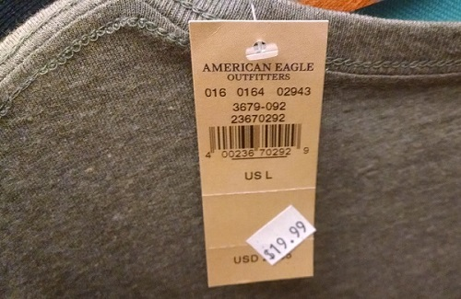
2.2. Sub Screens linked to Home Main Screen
1
LIMEORANGE
S E O U L
LIMEORANGE
S E O U L
NEW BEST EVENT SALE
X
MENU
2
NEW BEST EVENT SALE
LO
R3
AW
BW
LIMEORANGE
S E O U L
LIMEORANGE
S E O U L
LIMEORANGE
S E O U L
LIMEORANGE
S E O U L
NEW BEST EVENT SALE
NEW BEST EVENT SALE
NEW BEST EVENT SALE
NEW BEST EVENT SALE
LO
R3
AW
BW
SUMMER SALE!
P
P
Summer sale up to 50%. Don’t miss the chance to get the..
3
P
P
P
P
LIMEORANGE
S E O U L
NEW BEST EVENT SALE
5
AFTERWORK
1
Slide Menu Bar: This slide menu bar contains all menus.
2
Top menu: Each menu navigates to the corresponding sub screen. Can navigate back to the previous screen
3
Each cell in the home main screen leads to the screen linked by web admins. Can navigate back to the previous screen
4
Bottom Popup Menu: Modal popup screen with no navigation. It pops up over the home main screen.
P
5
Search Popup: Search box opens as a popup
4
X
X
X
X
X
X
MY PROFILE
MY COUPONS
WISH LIST
MY CART
HISTORY
SCAN BARCODE
POINT
1000P
VISIT
1000P
PURCHASE
1000P
SOCIAL SHARE
1000P
EXTRA
1000P

Slide 5
3.1. Sub Screens linked to Home Main Screen
LIMEORANGE
S E O U L
NEW BEST EVENT SALE
P

