Slide 1
SAT Solver
Goncharov Mark
Scherbakov Alexey
Kuznetsova Margarita

Slide 2
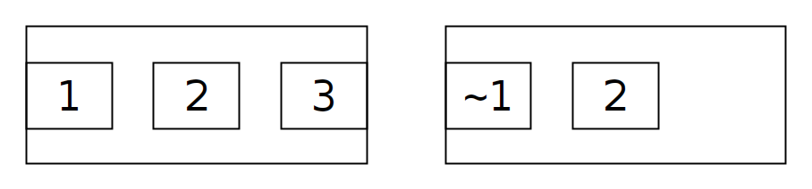
SAT Example

Slide 3
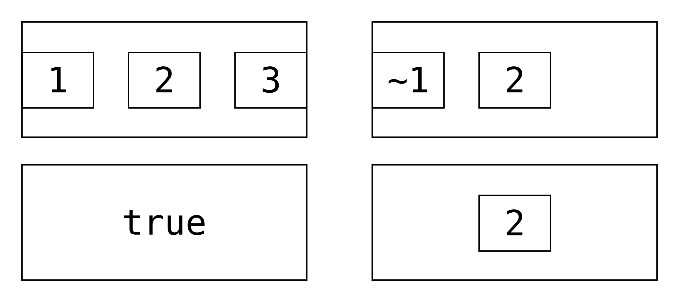
Set 1

Slide 4
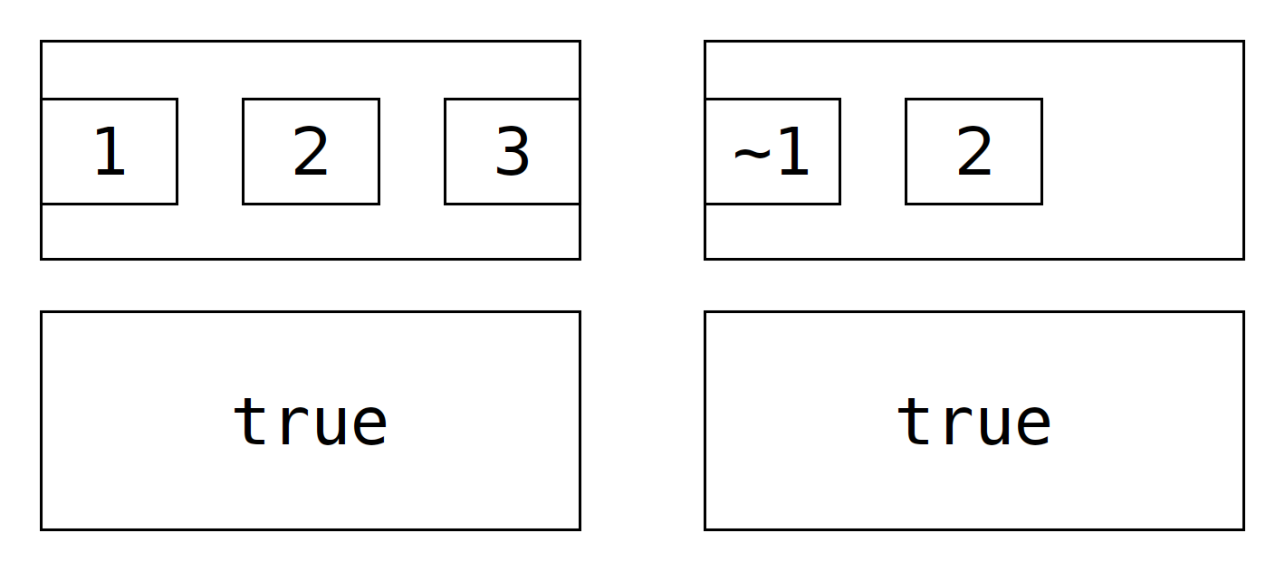
Set 2

Slide 5
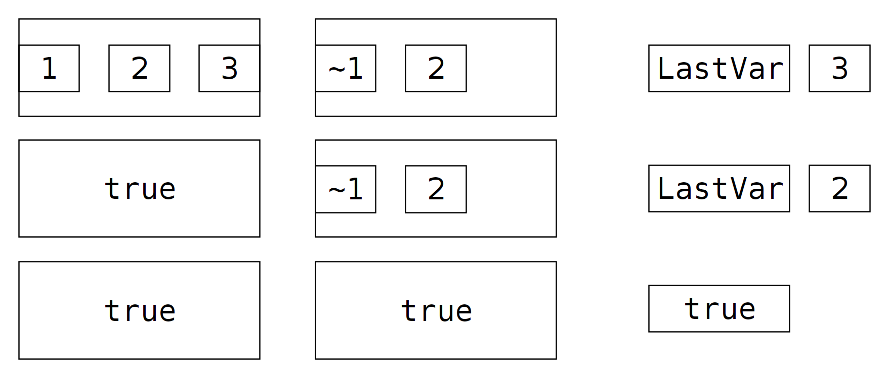
SAT 1th generation

Slide 6
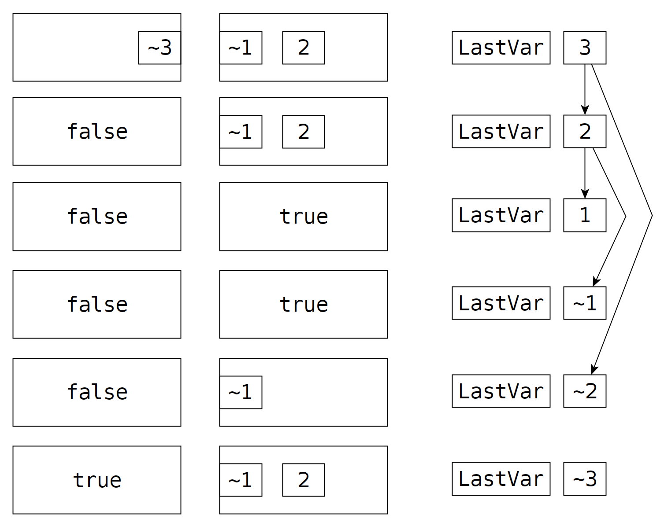
SAT-1

Slide 7
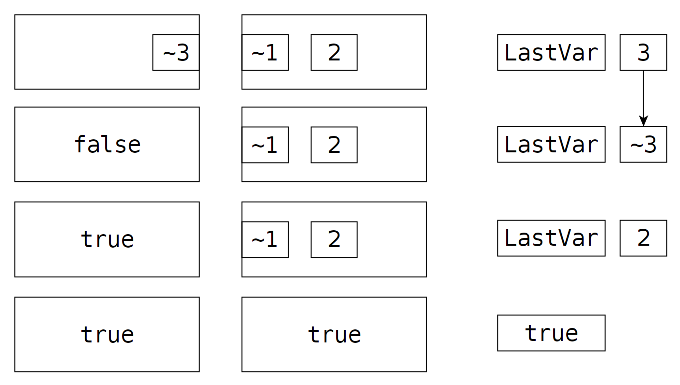
SAT-2

Slide 8
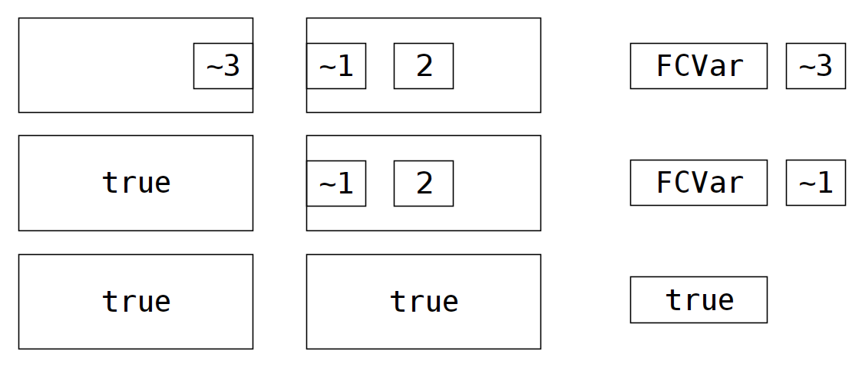
SAT-3
FCVar: first clause var

Slide 9
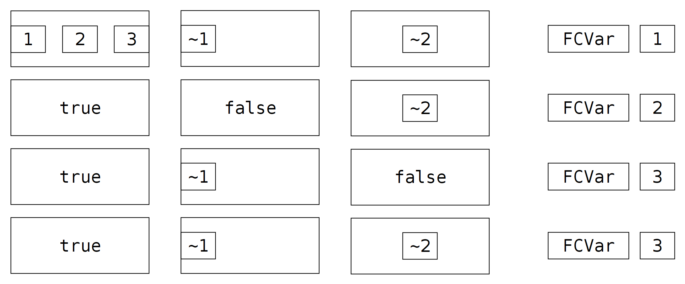
SAT-3 problem

Slide 10
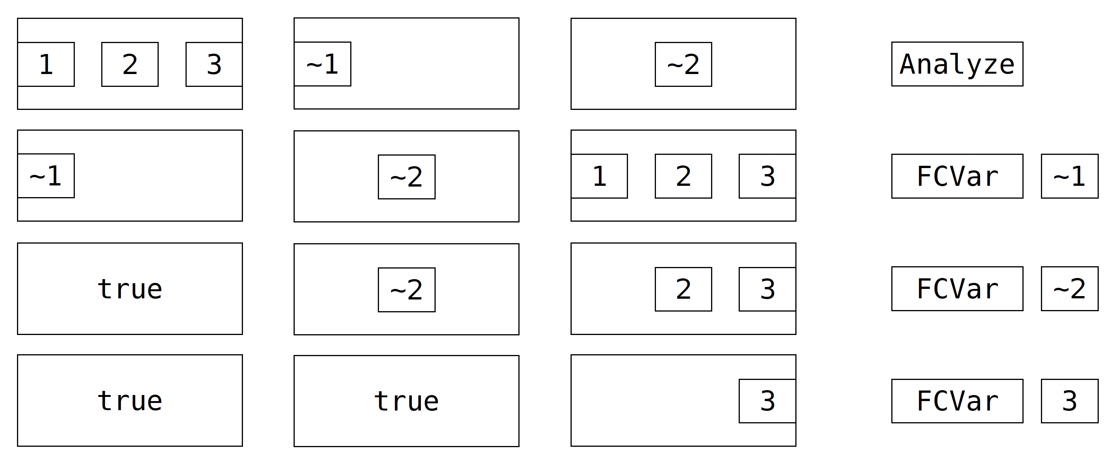
SAT-4

Slide 11
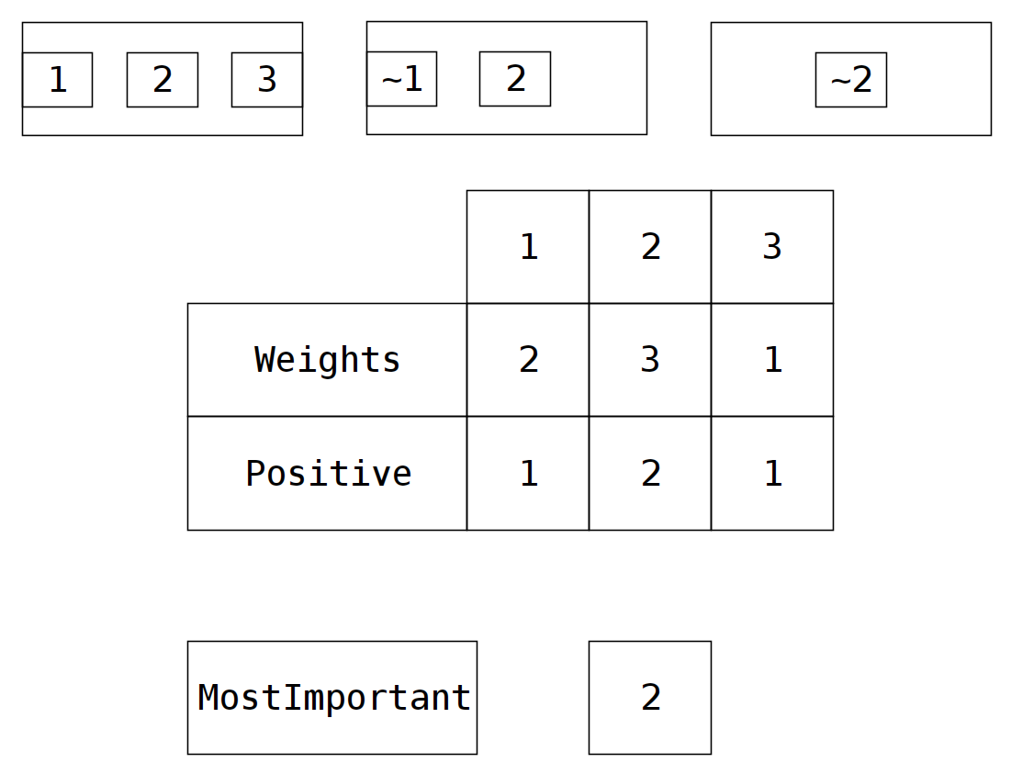
SAT-5

Slide 12
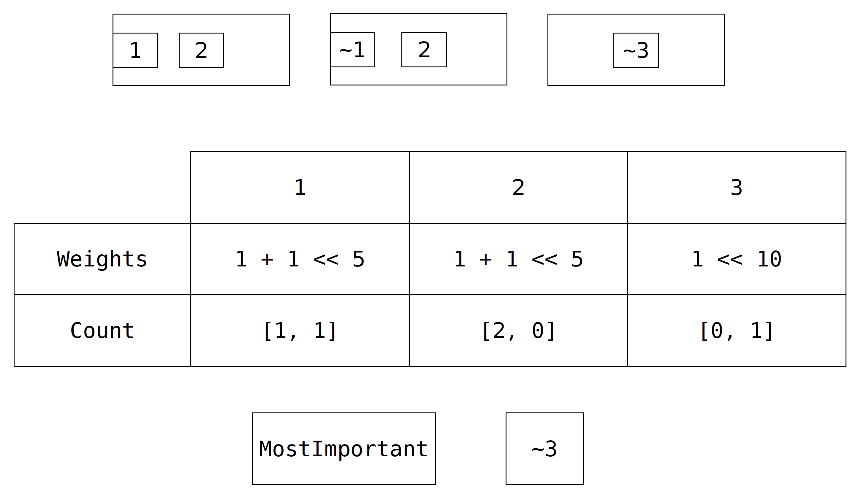
SAT-6 = SAT-4 + SAT-5

