Slide 1
AppSnitch
Empowering non-technical users to instantly audit mobile threat exposure on-device.
PS-01 · Mobile Security · On-Device Risk Auditor

Slide 2
01 / PROBLEM STATEMENT & ACCEPTANCE TEST
Translating Cryptic Android Permissions into Clarity
QUESTION 01
Which of my apps can do the most harm?
THE USER CHALLENGE
Technical Jargon Blocks Safety
QUESTION 02
Android permissions are opaque constants. Average users cannot gauge security threats or know which background components endanger their data.
Why is each one flagged? (Plain language)
QUESTION 03
What can I do about it right now?

Slide 3
02 / SCORING ARCHITECTURE & BANDS
Four-Stage Risk Computation Engine
Risk Score Bands (0–100)
Base Weights & Modifiers
Special access (25 pts), SMS (15), Contacts/Camera (10), Location (8). Declared-only at 25% weight.
LOW
0–24
MEDIUM
25–49
Diminishing Returns
Second and subsequent permissions in any single category count at 50% weight.
HIGH
50–74
CRITICAL
75–100

Slide 4
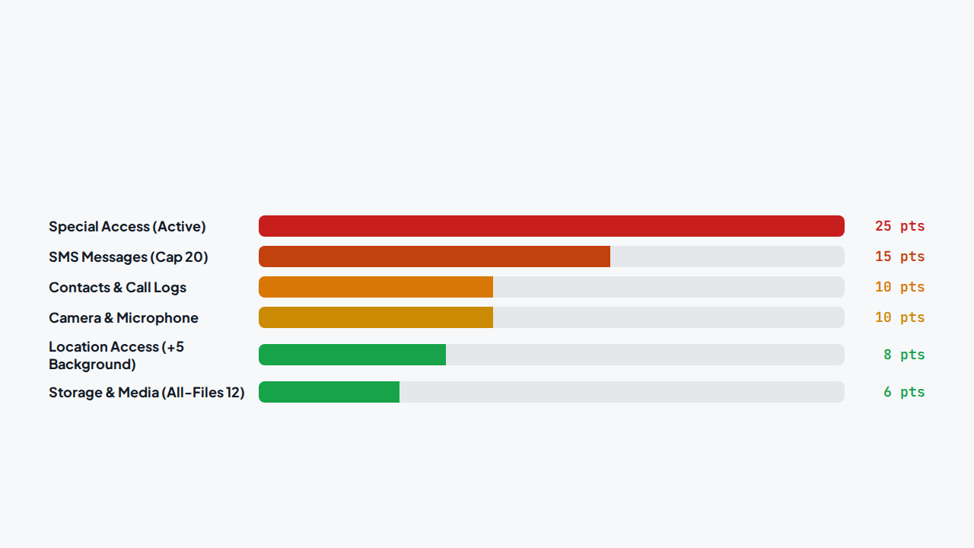
03 / SCORING RUBRIC · BASE WEIGHTS
Category Weights & Caps

Slide 5
04 / COMBINATION RULES & ATTACK CHAINS
Detecting Known Malware Tactics
+25
+20
+15
Accessibility + Overlay
OTP Exfiltration Chain
Privilege Abuse
Classic banking-trojan pair: read screen data and draw fake login prompts over real apps.
SMS read + Internet + Boot persistence + Sideloaded package source.
Device Admin on non-security app, Notification Listener + Internet, or Accessibility + SMS.

Slide 6
05 / CONTEXT MISMATCH DETECTION
Purpose vs. Permission Mismatch
THE CLASSIC TORCH TRAP
Utility + Sensitive Data
Flashlights Asking for SMS
Simple tools rarely need message access. Mismatch signals a rogue app.
Torch, scanner, calculator, wallpaper, clock, notepad or game apps holding SMS, contacts, mic, or special access trigger an immediate +20 penalty and force a minimum High band. System apps are exempt.
Enforced Band Floor
Guarantees misaligned apps surface immediately at the top of the risk list.

Slide 7




06 / TRUST MODIFIERS & REDUCERS
Origin Source & System App Dampening
Sideloaded Source (+10)
Legacy SDK < 23 (+10)
Installed outside official stores with no upstream safety check.
Predates runtime permissions; receives all permissions at install.
Trusted Store (−10)
System App (−15)
Google Play store provenance reduces risk score.
Pre-installed system apps reduced and floored at 0.

Slide 8
07 / HARD CONSTRAINTS & PRIVACY
Zero-Network Privacy Architecture
On-Device Execution
Visibility & Safety
No Root / No ADB: Works entirely through standard public APIs.
QUERY_ALL_PACKAGES: Declared for complete inventory visibility.
Zero Data Leaves Device: No analytics, crash SDKs, or cloud uploads.
No Live Malware: Safe demonstration on over-permissioned benign apps.
Offline First: Full scanning and score explanation in airplane mode.
Optional Hash Lookups: Strictly opt-in with explicit user consent.

Slide 9
08 / HACKATHON EXECUTION
Six-Hour Build & Demo Schedule
HR 0.0–1.5
HR 1.5–2.5
HR 2.5–3.5
HR 3.5–4.5
HR 4.5–5.0
Inventory & Base
HR 5.0–6.0
Special Access
Scoring Engine
AppSnitch UI
Ship APK
Rehearsal
Data classes and PackageManager extraction.
Accessibility, Admin, and AppOps states.
Weights, combos, and reasons engine.
Scan, risk breakdown, and settings tabs.
Installed on judging device (hard deadline).
3-minute timed demo on test kit.

Slide 10
AppSnitch: Ready for Live Demo
Answering what matters: Which app is dangerous, why, and how to fix it in 60 seconds.

