Slide 1
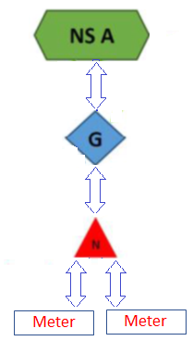
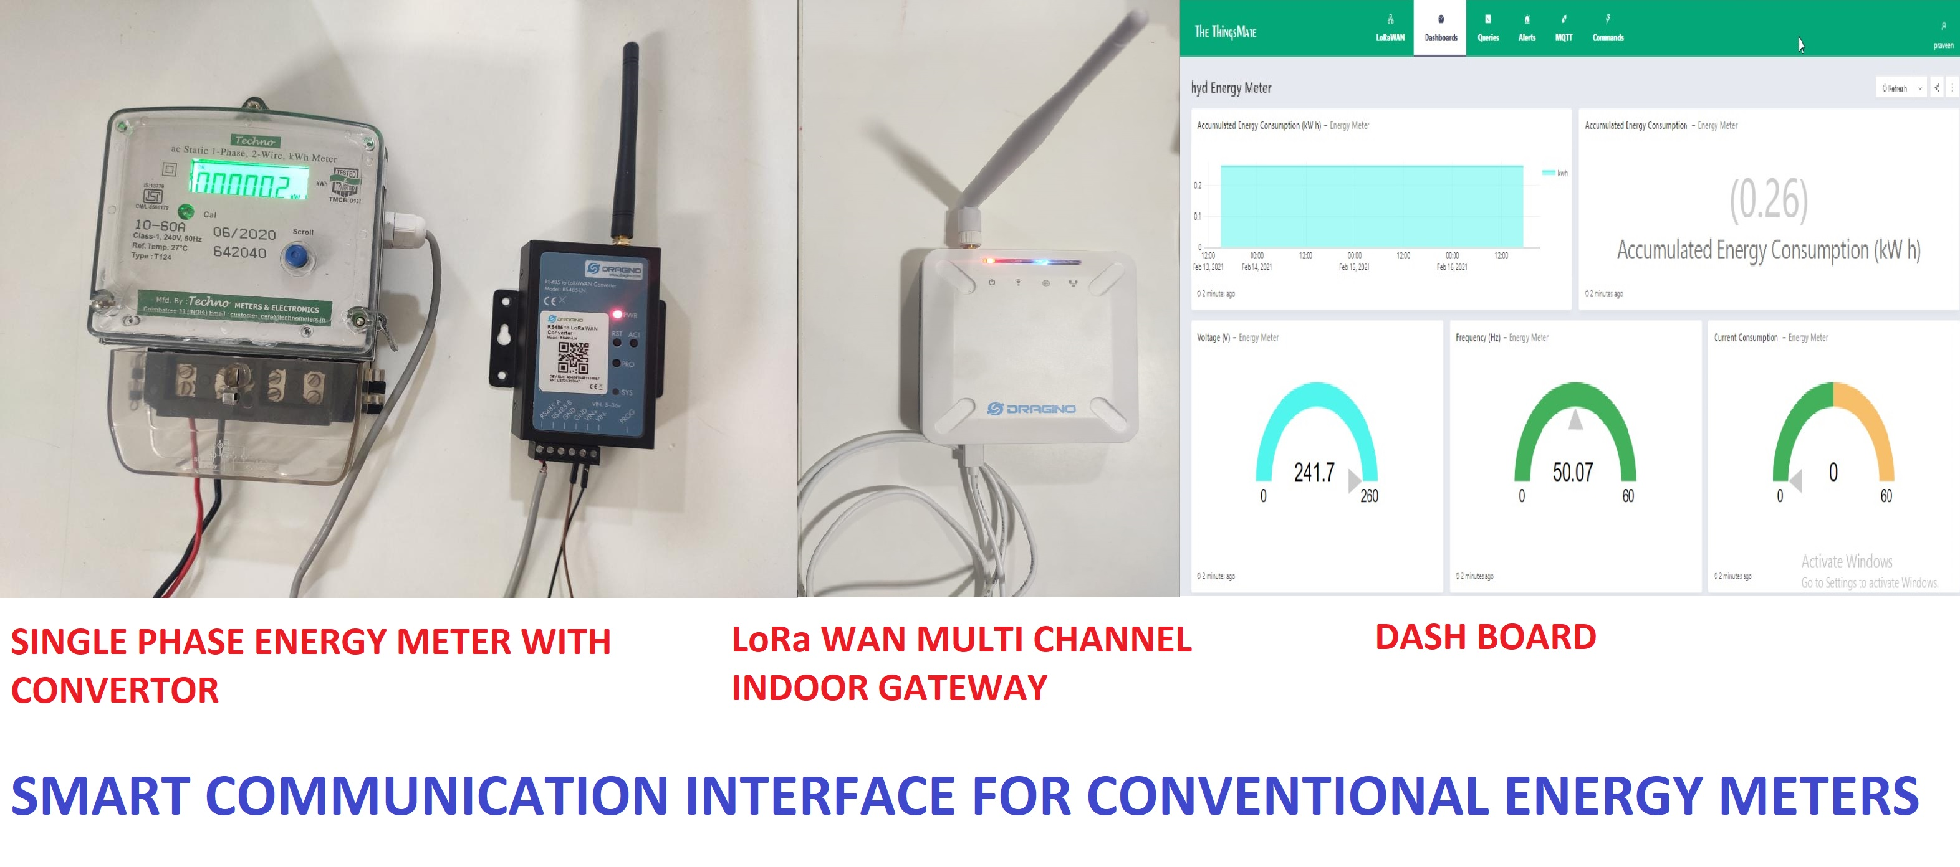
SMART INTERFACE FOR CONVENTIONAL ENERGY METER
Dept. ECE | Mentor : Dr.S.Praveen Chakkravarthy, , Assoc. Prof.
Student Team :G.Sohan Reddy, Gaddam Srilekha, Sruthi Chittopalli, B.Tech, IV sem
Objectives
To create a smart communication infrastructure for conventional energy meters using LPWAN (LoRa WAN) Technologies
Target is to develop a communication platform for the meter and subsequently perform indoor testing (includes communication to and from the user to the power gateway). This prototype will demonstrate the complete functioning of the smart meter.
Deliverable will be a real time working model with full quality testing for single user access.
Lighting Arrangement
Control Units
Sensing of Human
entering/ leaving
Activity | Status
one node (Energy meter) connected to the LoRa WAN Gateway has been successfully tested and the parameters are obtained in the dashboard | Completed
The manual trial has been successful for single node | Completed
To derive the dashboard parameters. | Completion by 15th Aril, 2021.
Adding another node to the indoor gateway and test. | Completion by 25th Aril, 2021.
Amount proposed | Amount Sanctioned | Amount Spent | Balance Amount
200,000 | 200,000 | 181000 | 19000

Slide 2
FLEET MANAGEMENT SYSTEM
Dept. ECE | Mentor : Dr. Gaurav Sharma , Assoc. Prof.
Student Team :S.Abhinav, D. Yashwanth, Imtiyaz Mohammed B.Tech, III Year
Objectives
To create a smart fleet management system to track live location of the busses using smart IoT devices.
Developing a mobile application that can be provided to college stakeholders to track or view bus live location, and route.
Deliverable will be a real time working model and mobile application to get updated with live location tracking.
Lighting Arrangement
Control Units
Sensing of Human
entering/ leaving
Activity | Status
one node (Energy meter) connected to the LoRa WAN Gateway has been successfully tested and the parameters are obtained in the dashboard | Completed
The manual trial has been successful for single node | Completed
To derive the dashboard parameters. | Completion by 15th Aril, 2021.
Adding another node to the indoor gateway and test. | Completion by 25th Aril, 2021.
Amount proposed | Amount Sanctioned | Amount Spent | Balance Amount
200,000 | - | - | -

Slide 3
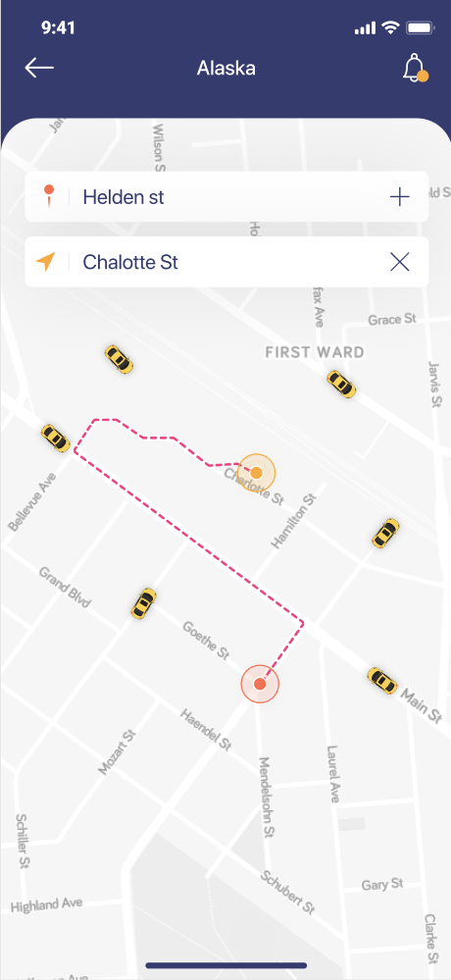
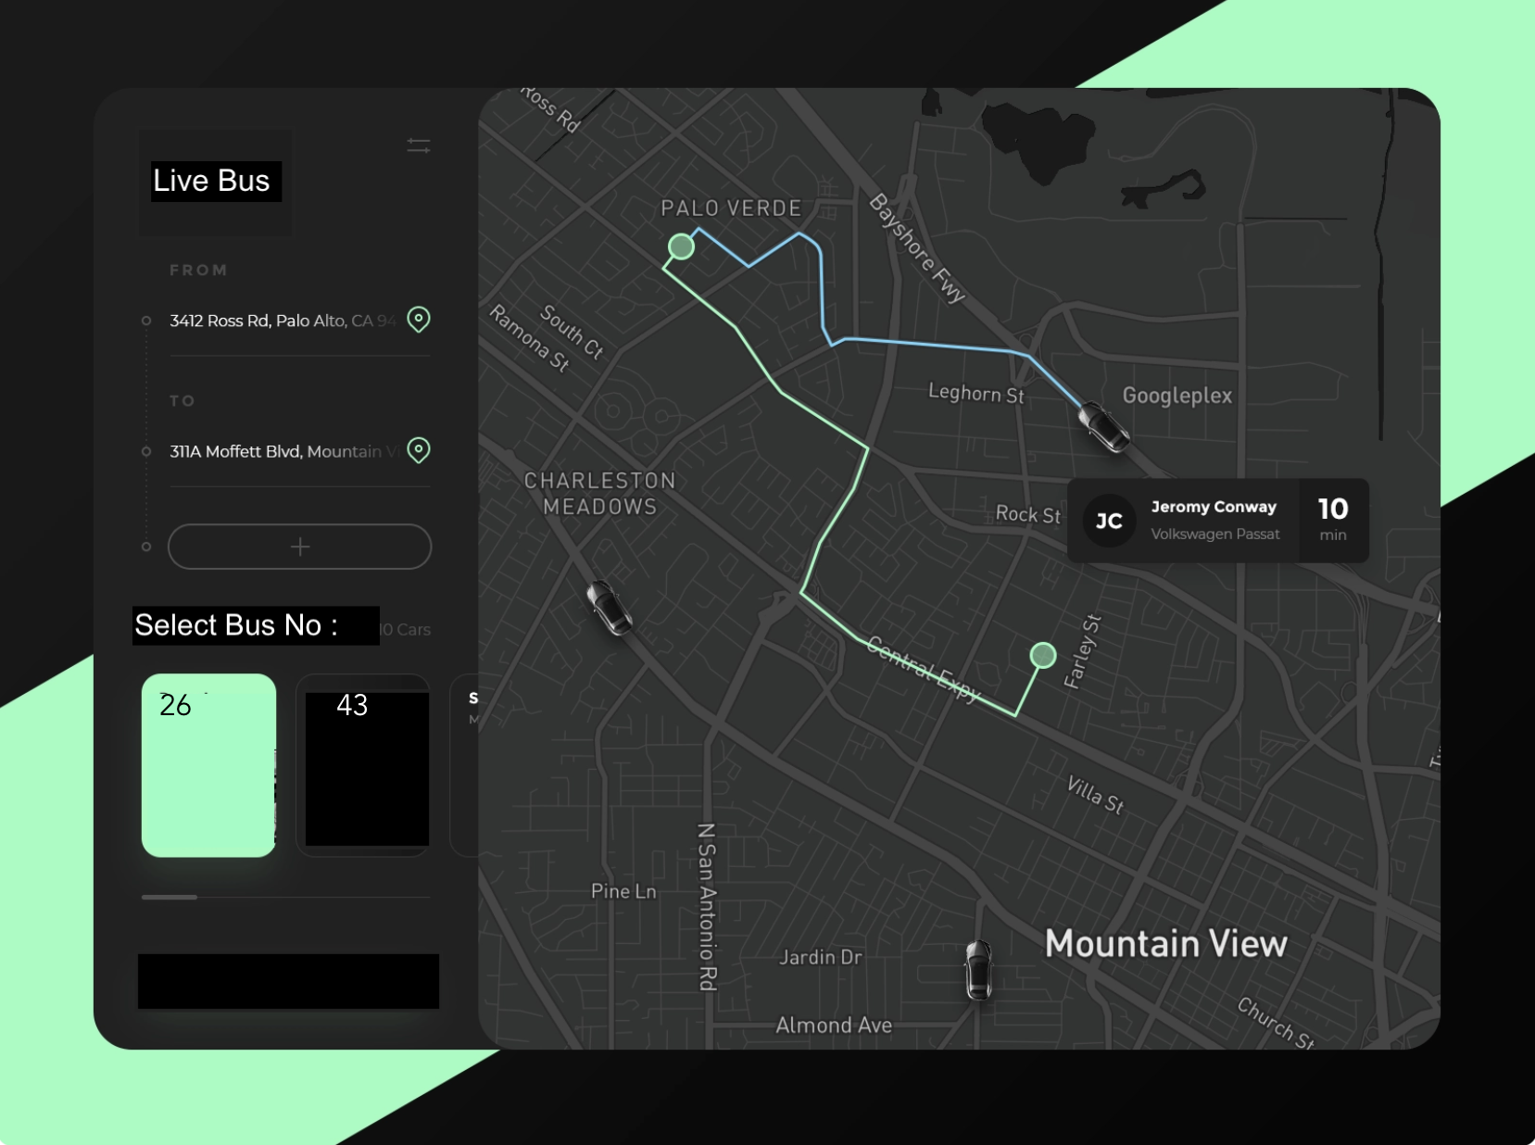
FLEET MANAGEMENT SYSTEM
Dept. ECE | Mentor : Dr. Gaurav Sharma , Assoc. Prof.
Student Team :S.Abhinav, D. Yashwanth, Imtiyaz Mohammed B.Tech, III Year
Objectives
To create a smart fleet management system to track live location of the busses using smart IoT devices.
Developing a mobile application that can be provided to college stakeholders to track or view bus live location, and route.
Deliverable will be a real time working model and mobile application to get updated with live location tracking.
Lighting Arrangement
Control Units
Sensing of Human
entering/ leaving
Amount proposed | Amount Sanctioned | Amount Spent | Balance Amount
200,000 | - | - | -
Fleet Manager’s App Dashboard
User App interface

