Slide 1
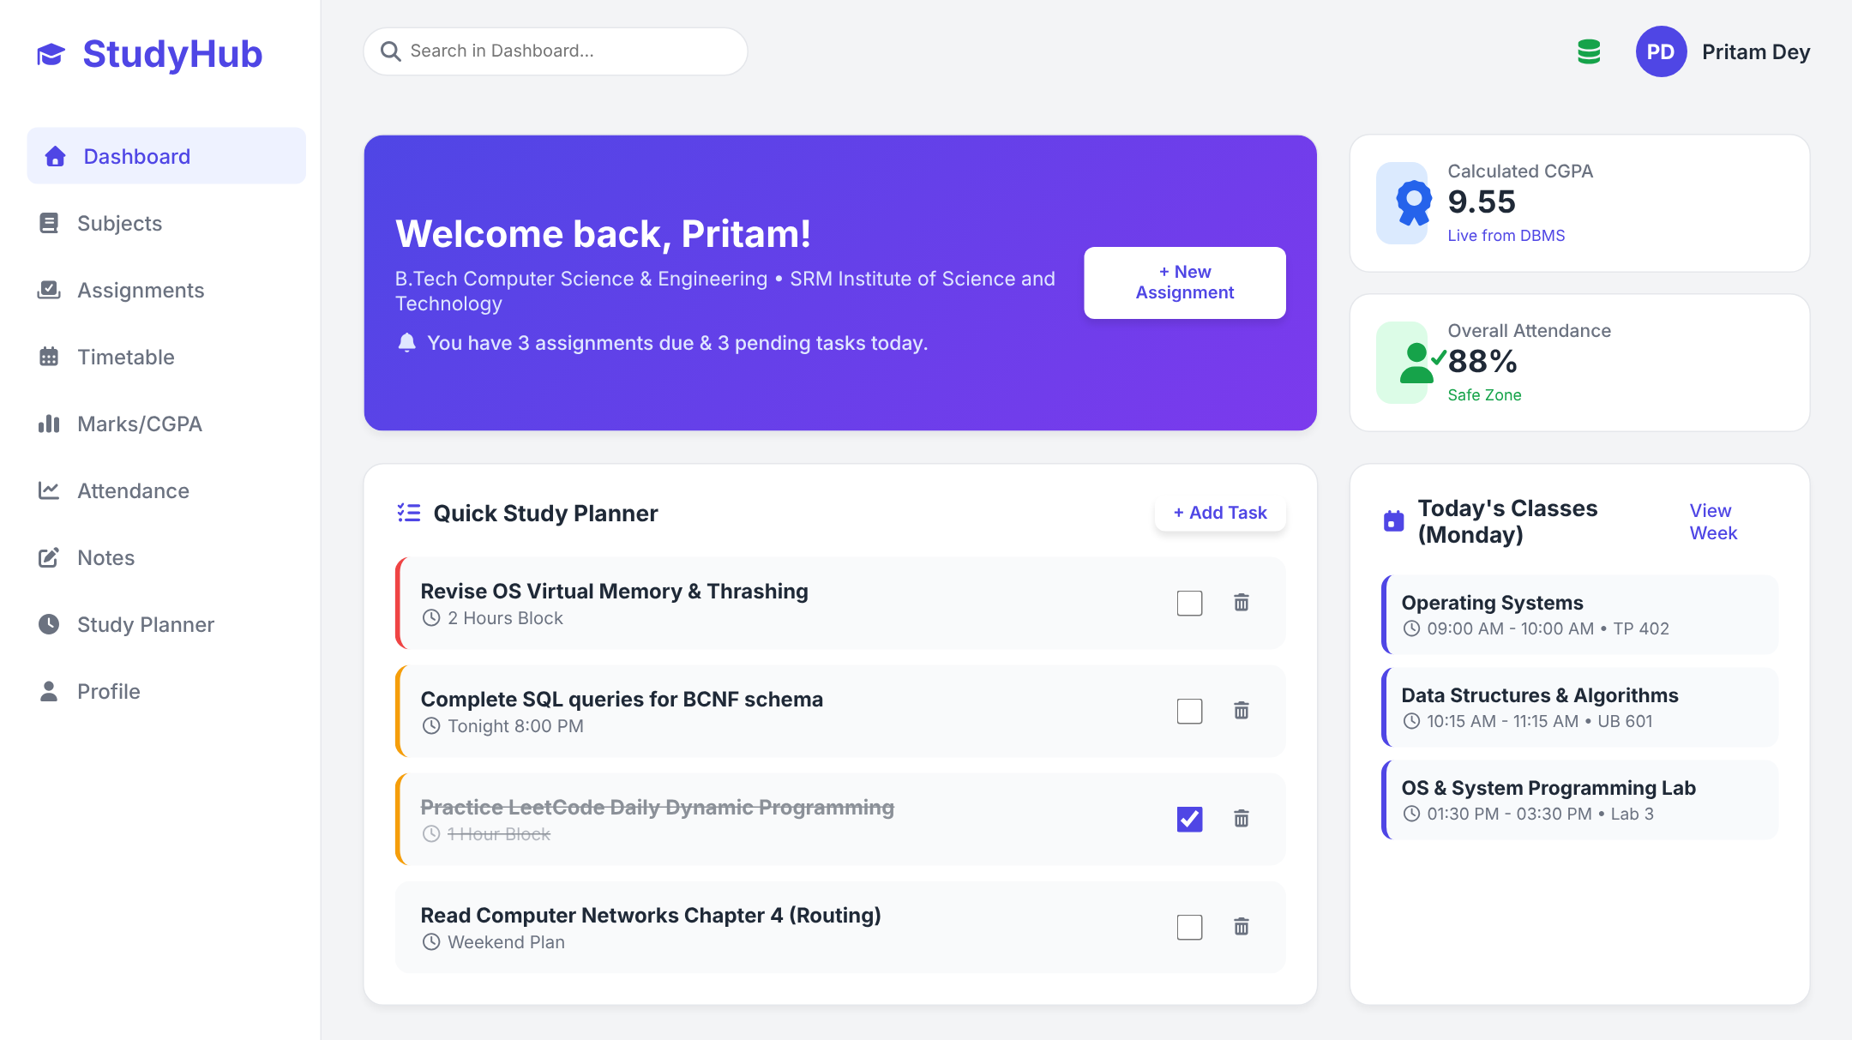
StudyHub
A full stack academic management and student productivity platform, built with React, Spring Boot and microservices
Pritam Dey
RA2411003012276
Notes:
Introduce StudyHub: one place for a student's subjects, timetable, assignments, marks, attendance, notes and study plan.

Slide 2


Why StudyHub
The problem
The solution
Timetables, deadlines, marks and notes are scattered across tools
Attendance shortage is noticed only after the list is out
CGPA is worked out by hand at semester end
No single view of where you stand academically
One web app with 9 modules and a live dashboard
Server computes grade, SGPA/CGPA automatically
Attendance tracker with the 75% rule and a “bunk advisor”
Study planner with a Pomodoro focus timer
One app that knows credits, grading scales and attendance rules, and turns raw entries into clear guidance.

Slide 3






Tech stack
React 18 (JSX)
Spring Boot 4 · Java 21
Spring Data JPA + H2
Single page client, hooks for state, modals and toasts
REST controllers, services, dependency injection
Hibernate ORM, one in-memory database per service
REST / JSON
Microservices
CSS + Font Awesome
fetch API, CORS enabled, standard HTTP status codes
Core 8080 · Course 8081 · User 8082
Custom responsive styles and icon set

Slide 4
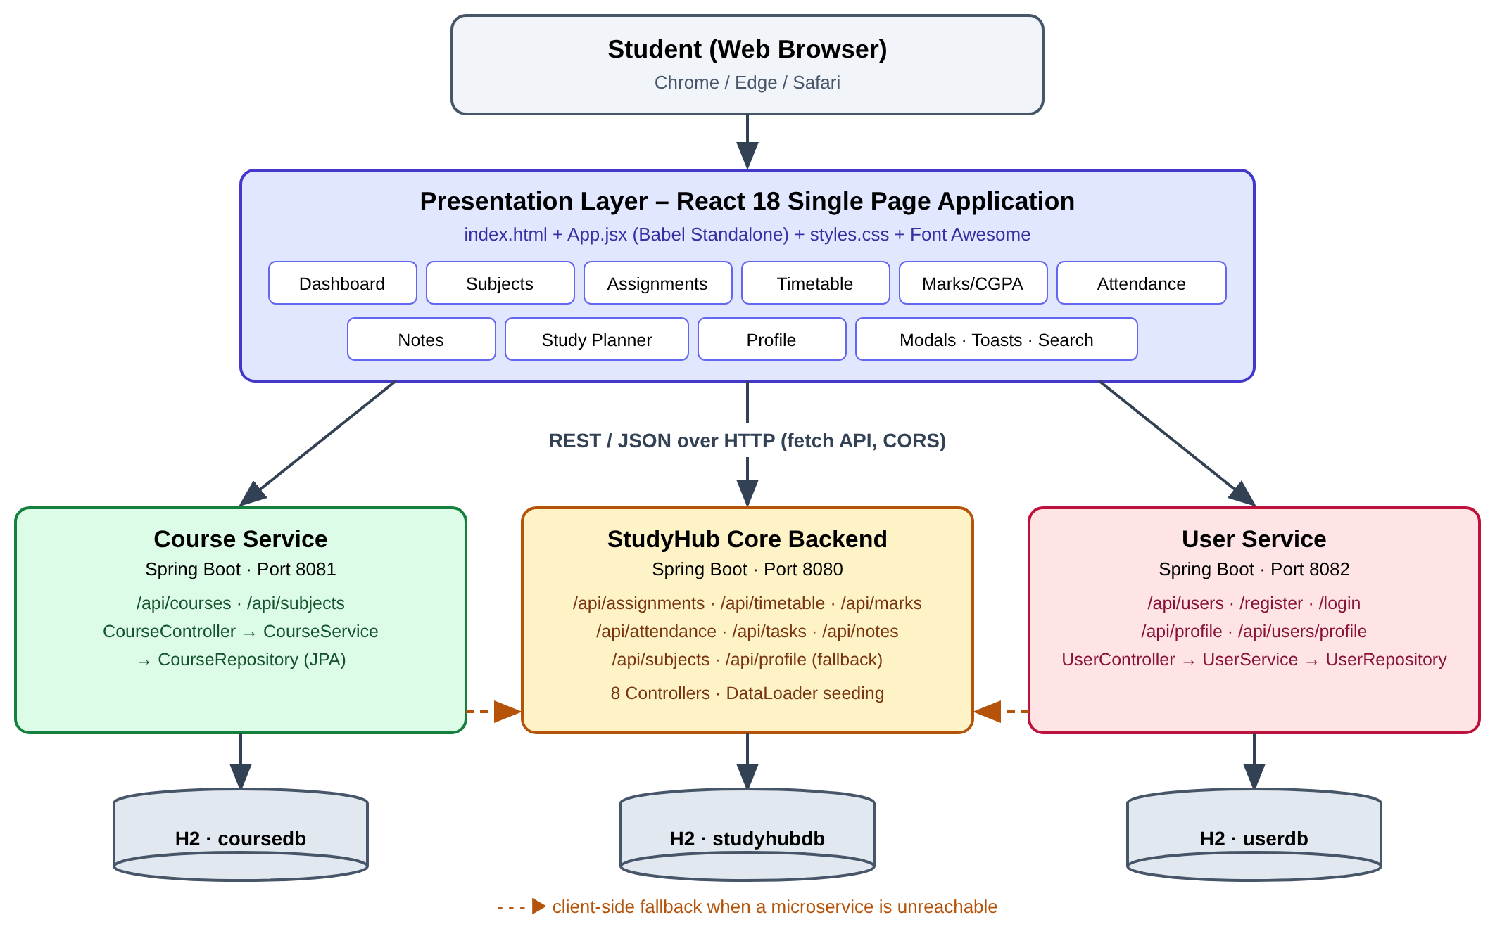
Architecture
React client
Calls each service over REST/JSON
3 Spring Boot services
Core, Course and User, each with its own H2 database
Layered code
Controller → Service → Repository → Entity
Fallback
If a microservice is down, the client retries on the core service

Slide 5









Components of the app
Dashboard
Subjects
Assignments
CGPA, attendance, today’s classes, quick tasks
Code, credits, faculty, room, syllabus
Priority, due date, pending / submitted / overdue
Timetable
Marks / CGPA
Attendance
Weekly slots with day filter
Auto grade and credit-weighted CGPA
75% rule, Safe / Warning / Critical, bunk advisor
Notes
Study Planner
Profile
Subject-wise revision notes vault
Tasks + Pomodoro (25 / 5 / 15 min)
Served by the User microservice

Slide 6
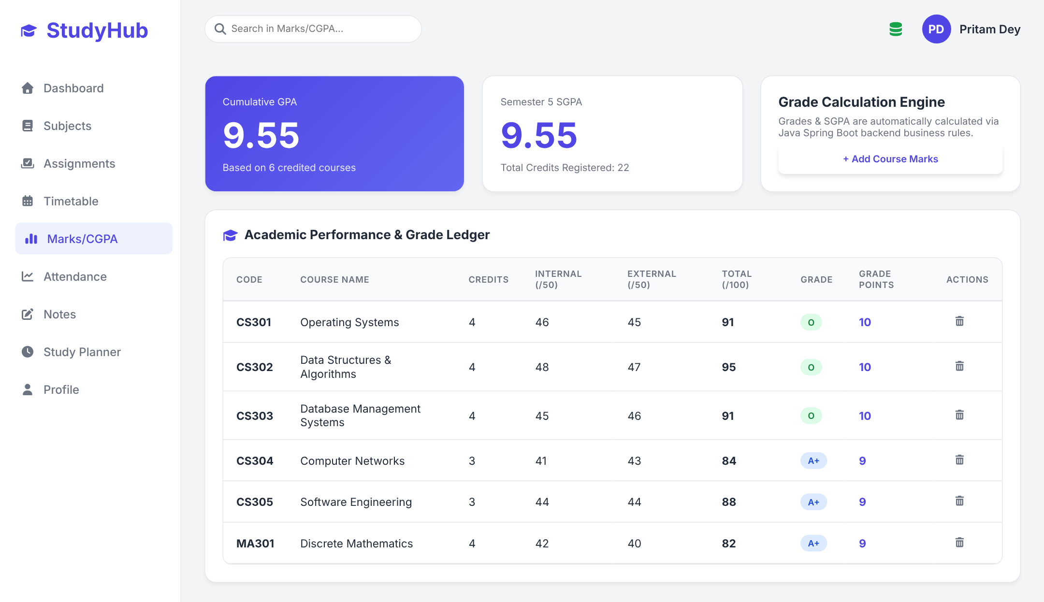
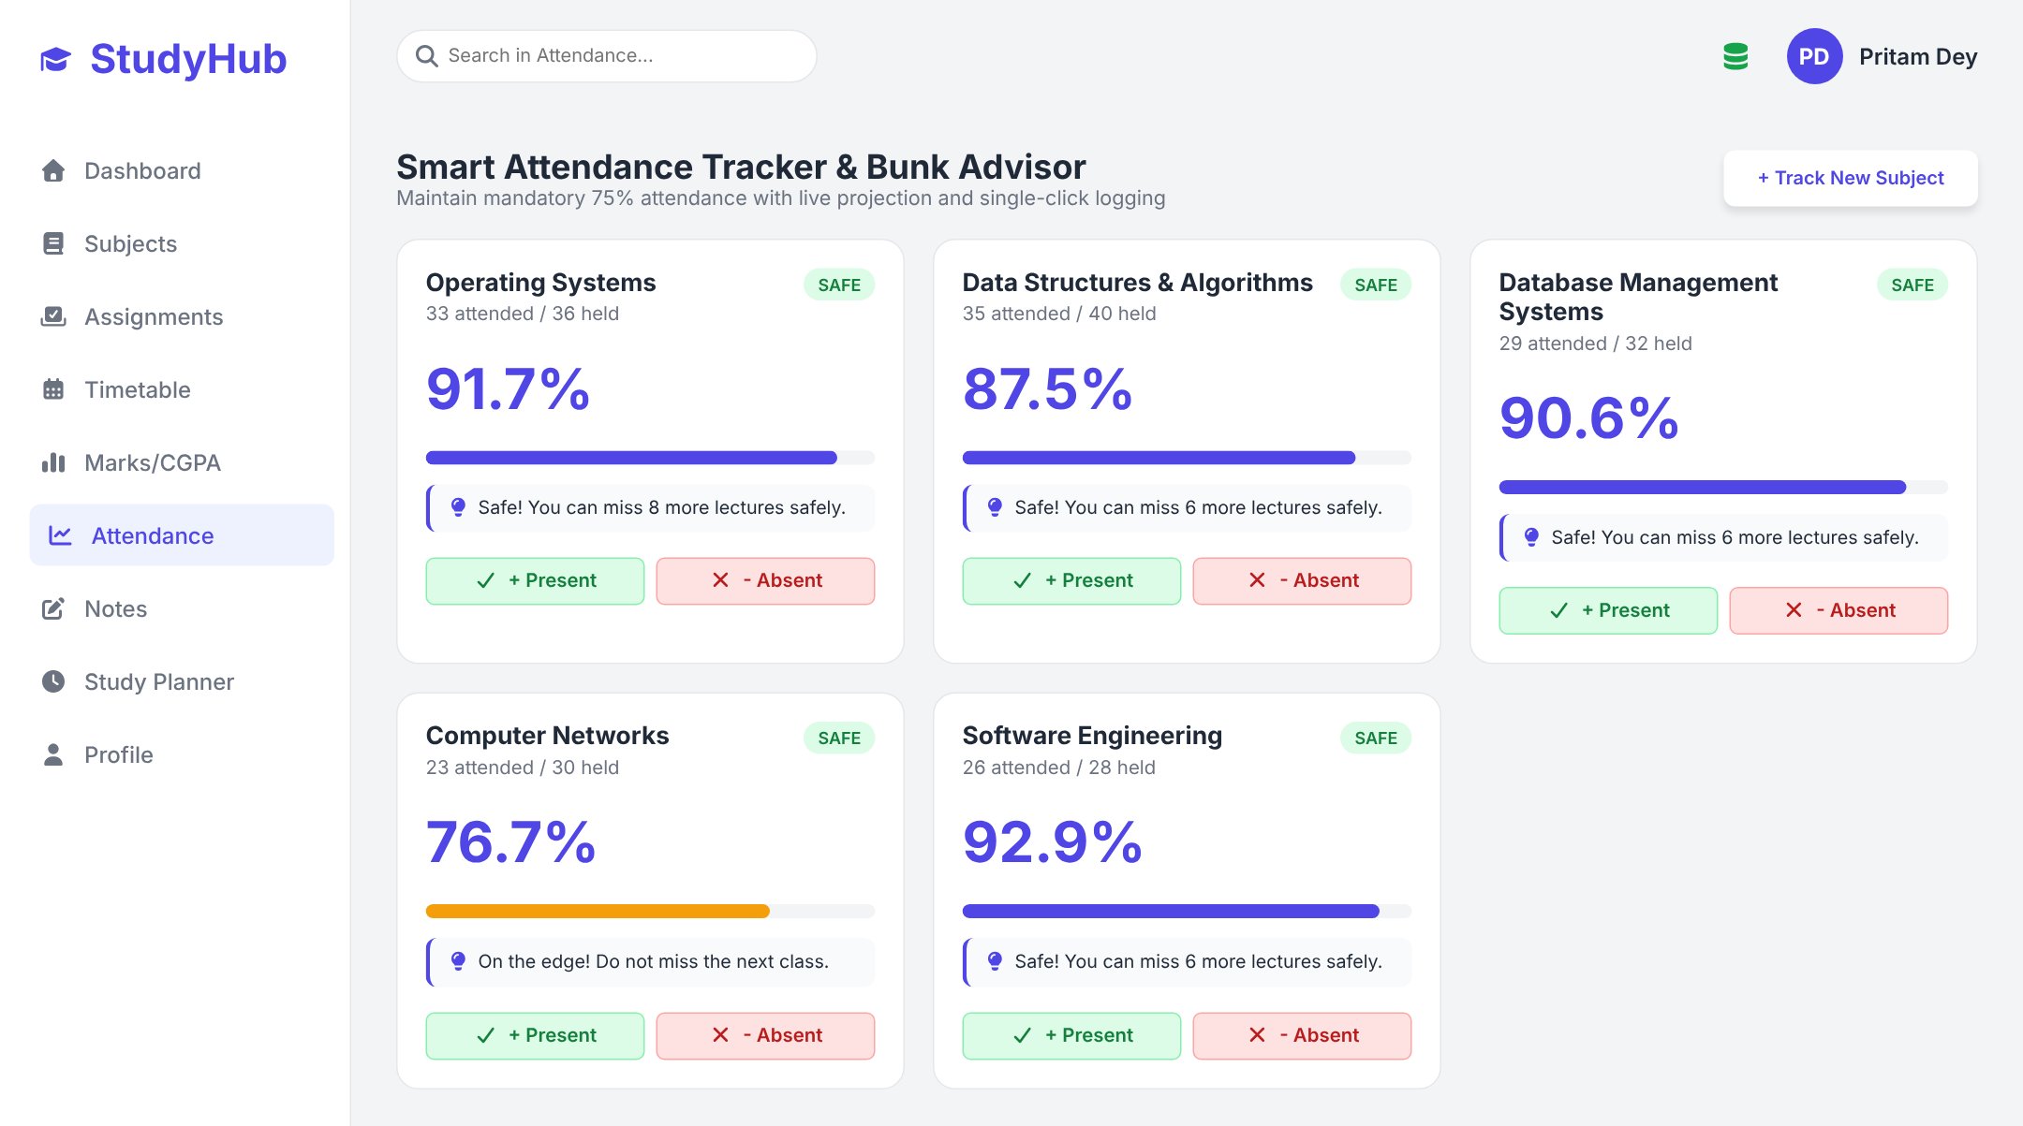
Screens: marks and attendance
Grade ledger: CGPA 9.55 computed on the server
Attendance cards with status and bunk advice
Every screen loads from the REST API on start and refreshes after each change, so the dashboard always shows current data.

Slide 7
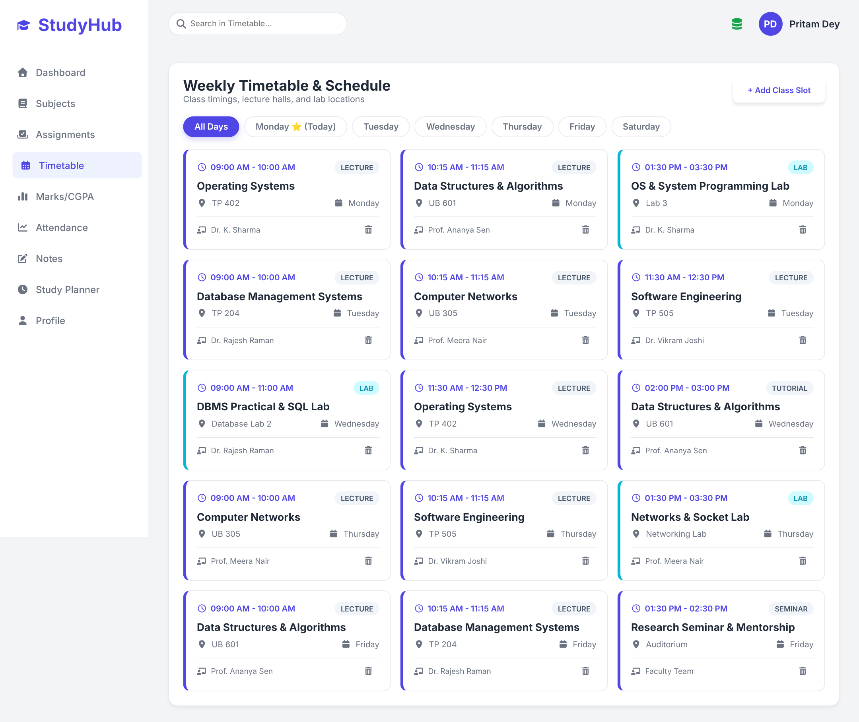
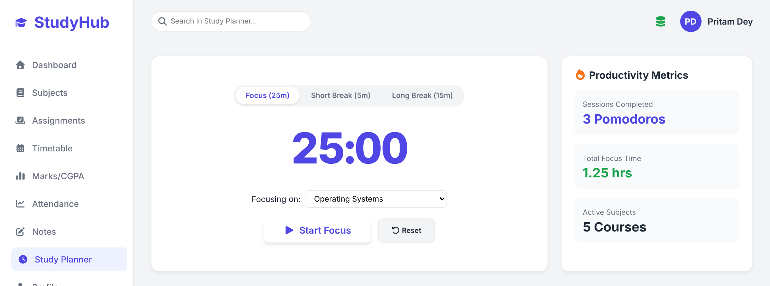
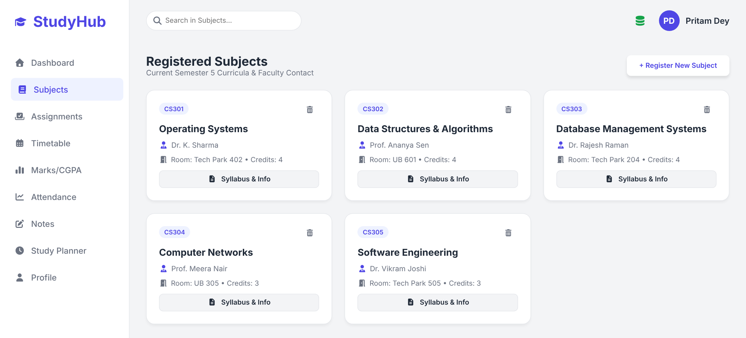
Screens: timetable and planner
Pomodoro timer with productivity metrics
Weekly timetable with day filter
Registered subjects (Course Service)

Slide 8
Core logic on the server
// AcademicRecord.java
public void calculateGrade() {
totalMarks = internalMarks + externalMarks;
if (totalMarks >= 90) { grade = "O"; gradePoints = 10; }
else if (totalMarks >= 80) { grade = "A+"; gradePoints = 9; }
else if (totalMarks >= 70) { grade = "A"; gradePoints = 8; }
...
}
// CGPA = Σ(credits × gradePoints) / Σ credits
Grades
Total out of 100 maps to O / A+ / A / B+ / B / C / F and grade points
CGPA
Credit-weighted average, rounded to 2 decimals
// AttendanceRecord.java
percentage = round(attended / total × 100, 1);
status = pct >= 75 ? "Safe"
: pct >= 65 ? "Warning" : "Critical";
// Bunk advisor (App.jsx)
canMiss = floor(attended / 0.75 − total);
mustAttend = ceil(3 × total − 4 × attended);
Attendance
Classifies each subject and tells you exactly how many classes you can miss or must attend

Slide 9
Microservices and fallback
// CourseController.java (port 8081)
@RestController @CrossOrigin(origins = "*")
public class CourseController {
@GetMapping({"/api/courses", "/api/subjects"})
public List<Course> getCourses() {
return courseService.getAllCourses();
}
}
8080
Core service
Assignments, timetable, marks, attendance, notes, tasks
8081
Course service
Subjects / courses CRUD
// App.jsx: microservice first, then core
fetch(`${API_COURSE}/subjects`) // 8081
.then(res => res.json())
.then(data => setSubjects(data))
.catch(() =>
fetch(`${API_BASE}/subjects`) // 8080
.then(res => res.json())
.then(data => setSubjects(data)));
8082
User service
Register, login, profile

Slide 10

Thank You
Questions?
StudyHub
Pritam Dey
RA2411003012276

