Slide 1
HEALTHCARE ANALYTICS
MENTORMIND
WWW.MENTORMIND.IN
MENTORMIND
P R E S E N T A T I O N

Slide 2

Project Presentation
2
Problem Statement and Scope
Analyse Health and Demographic Data to identify common traits leading to Heart Disease
1
Research report
4
Data visualization
2
Dataset Review
5
Insights
3
Data Analysis
6
Conclusion

Slide 3
3
Project Presentation
Let’s look at Stats and common trends
The global big data analytics market in healthcare was valued at approximately
$43.1 billion in 2023,
with projections suggesting it will grow at a CAGR of over 21.1% through 2030
source: Grand View Research

Slide 4
3
Project Presentation
Let’s look at Stats and common trends
About 60% of healthcare executives currently utilize data analytics within their organizations
with significant improvements reported in patient satisfaction (42%) and cost savings (39%) as a result

Slide 5
Project Presentation
4
Data Pre-processing and Validation
Cleaning the dataset includes:
Convert Categorical Variables: Convert categorical variables to the appropriate data types (e.g., integers or categories) in this case to categories.
Categorical Variables: These include HeartDiseaseorAttack, HighBP, HighChol, Smoker, Stroke, Diabetes, PhysActivity, Fruits, Veggies, HvyAlcoholConsump, AnyHealthcare, NoDocbcCost, GenHlth, Sex, Education.

Slide 6
Project Presentation
4
Data Pre-processing and Validation
Cleaning the dataset includes:
☑HeartDiseaseorAttack
☑HighBP
☑HighChol
☑CholCheck
☑BMI
☑Smoker
Check for any irrelevant columns
☑Stroke
☑Diabetes
☑PhysActivity
No obvious irrelevant columns are seen, keeping all for now
☑Fruits
☑Veggies
☑HvyAlcoholConsump
☑AnyHealthcare
☑NoDocbcCost
☑GenHlth
☑MentHlth
☑PhysHlth
☑DiffWalk
☑Sex
☑Age
☑Education

Slide 7
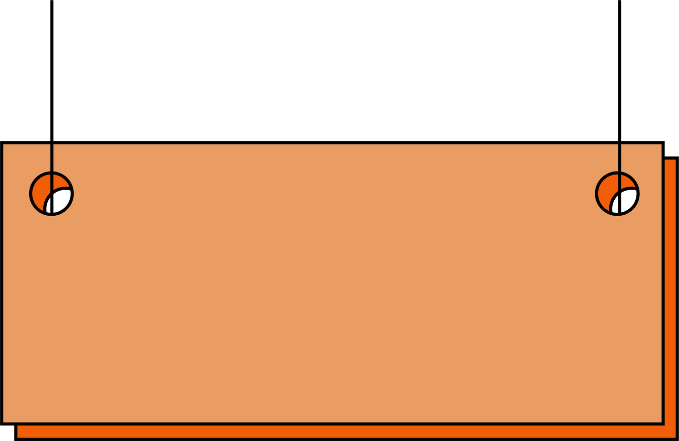
Project Presentation
4
Data Pre-processing and Validation
Cleaning the dataset includes:
Check for missing data
df.isnull().sum()
The dataset has no missing values, which allows us to proceed with the analysis smoothly

Slide 8
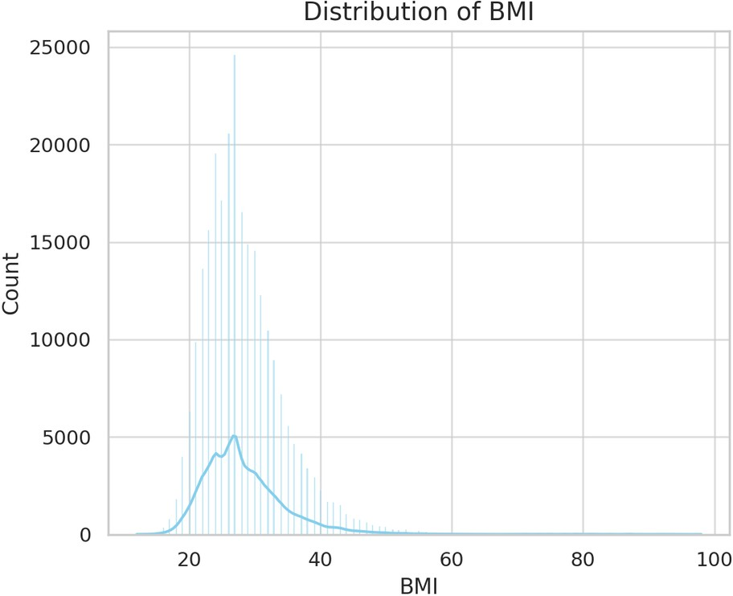
Project Presentation
5
Univariate Data Analysis
The distribution appears to be slightly right-skewed, with most individuals having a BMI between 20 and 40.

Slide 9
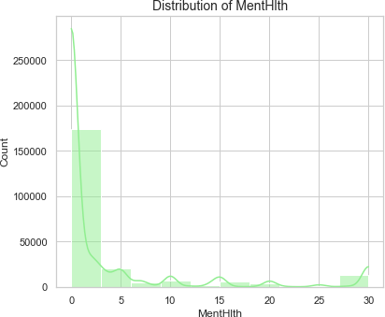
Project Presentation
5
Univariate Data Analysis
Mental health days range from 0 to 30, with a large proportion of individuals reporting no mental health issues.

Slide 10
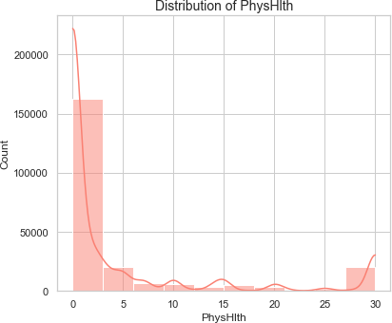
Project Presentation
5
Univariate Data Analysis
Physical health days also show a similar trend, with most individuals reporting few unhealthy physical days.

Slide 11
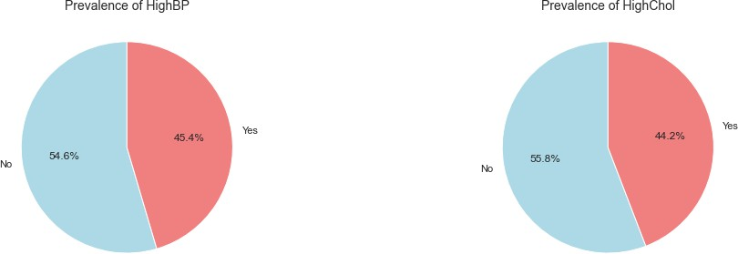
Project Presentation
5
Univariate Data Analysis
Prevalence of Health conditions

Slide 12
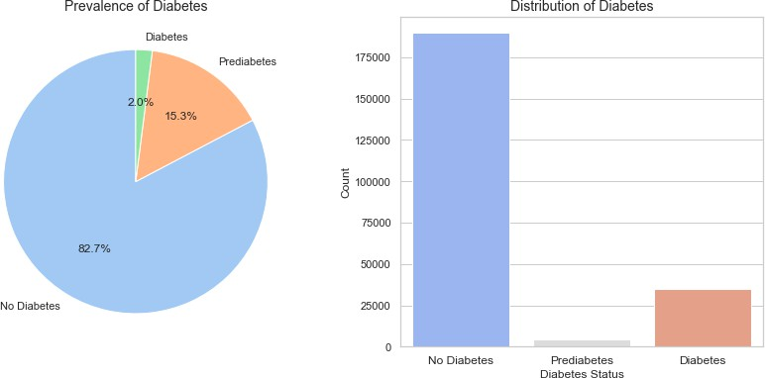
Project Presentation
5
Univariate Data Analysis
Prevalence of Health conditions

Slide 13
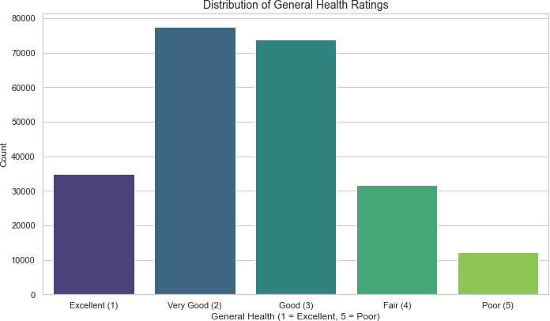
Project Presentation
5
Univariate Data Analysis
Prevalence of Health conditions

Slide 14
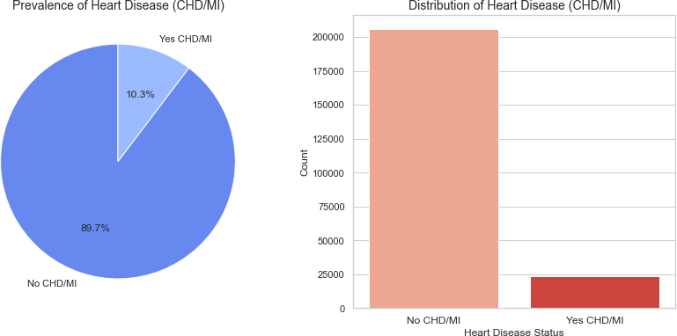
Project Presentation
5
Univariate Data Analysis
Analyze the Distribution of the target variable i.e, HeartDiseaseorAttack

Slide 15
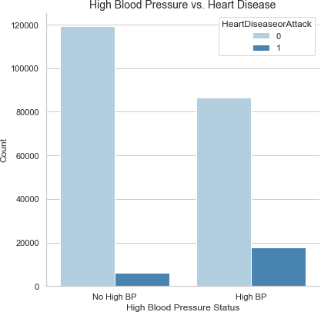
Bivariate Data Analysis
6
Project Presentation
High BP vs Target
A higher blood pressure shows clear signs of increase in chances of getting a heart disease which links to the fact that high BP can damage the heart and blood vessels, and increase the risk of a blockage in the coronary arteries

Slide 16
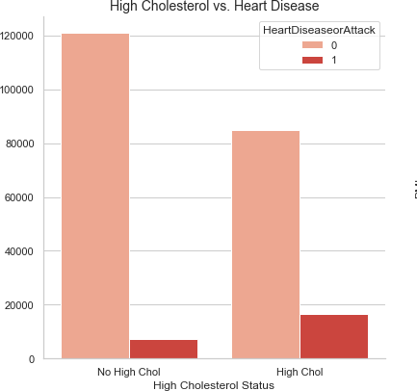
Bivariate Data Analysis
6
Project Presentation
High Cholesterol vs Target
People with high cholesterol reported more instances of heart disease than people with low cholesterol which supports the science that high cholesterol damages the heart and blood vessels, and increases the risk of a blockage in the coronary arteries

Slide 17
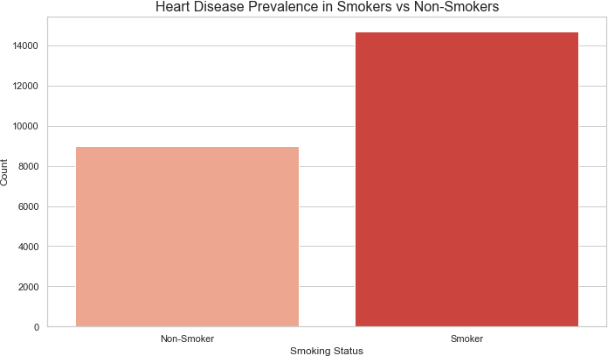
Project Presentation
6
Bivariate Data Analysis
Smokers have reported more instances of a heart attack than people who don’t smoke

Slide 18
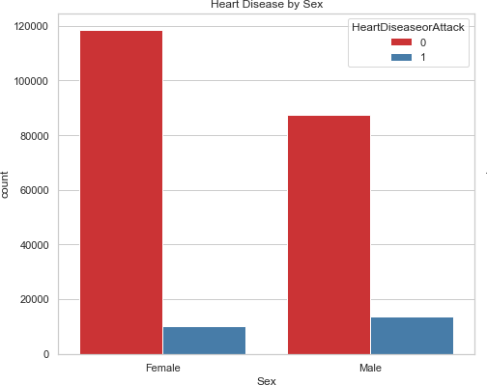
Bivariate Data Analysis
6
Project Presentation
(Sex)
Categorical vs Target
Males show a higher incidence of heart disease compared to females, highlighting potential differences in risk factors and lifestyle behaviors that may contribute to cardiovascular health

Slide 19
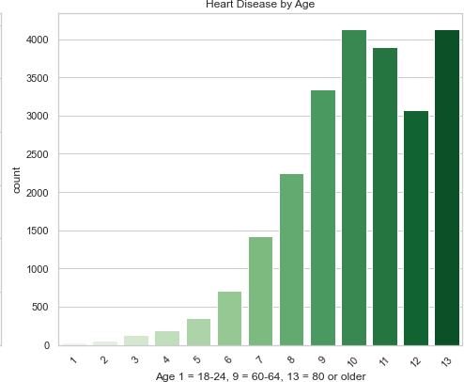
Bivariate Data Analysis
6
Project Presentation
(Age)
Categorical vs Target
The prevalence of heart disease increases significantly with age. Older age groups, particularly those aged 60 and above, exhibit a higher incidence of heart disease compared to younger individuals

Slide 20
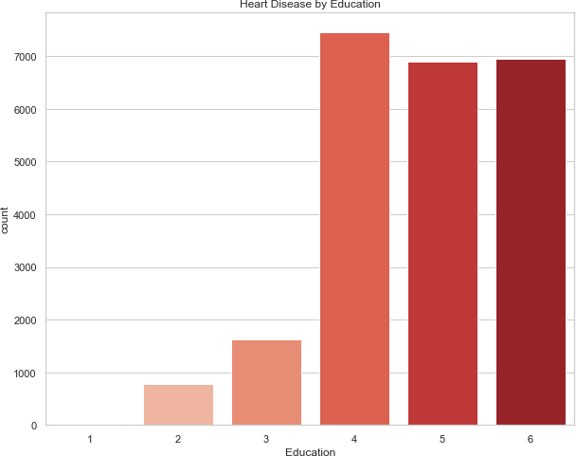
Bivariate Data Analysis
6
Project Presentation
(Education)
Categorical vs Target
Individuals with higher education levels, particularly those who completed high school graduate education, have a higher incidence of heart disease. In contrast, those with lower education, especially those with no formal education, tend to experience lower rates of heart disease, suggesting that work-related stress or added responsibilities may play a role in cardiovascular health.

Slide 21
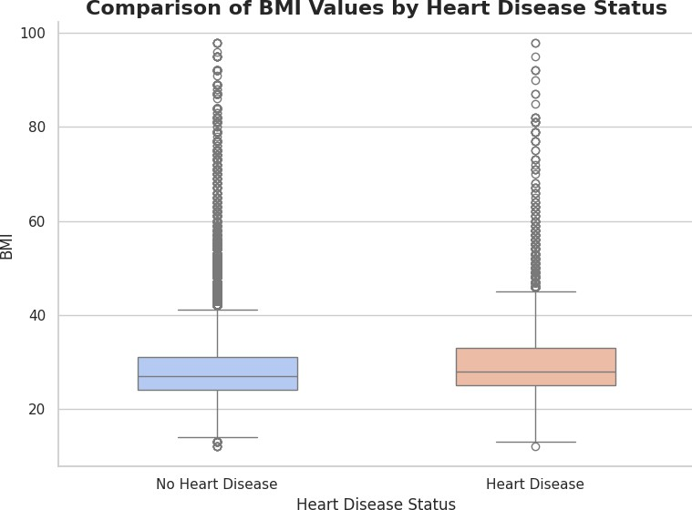
Bivariate Data Analysis
6
Project Presentation
(BMI)
Continuous vs Target
Individuals with heart disease generally have a higher median BMI compared to those without heart disease. Although there is some overlap in BMI distribution between the two groups, the presence of more extreme outliers in the heart disease group suggests that elevated BMI could be a contributing risk factor for cardiovascular conditions.

Slide 22
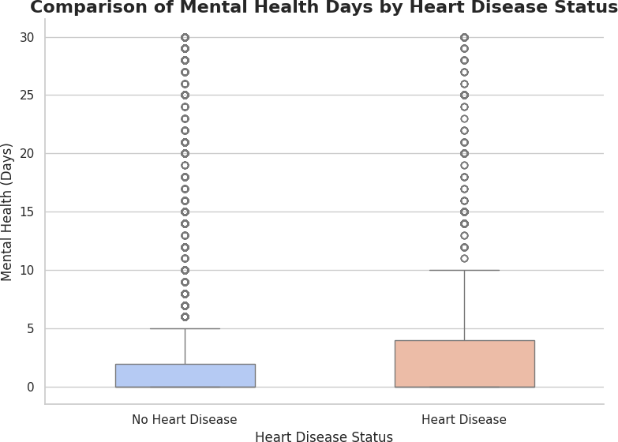
Bivariate Data Analysis
6
Project Presentation
(Mental Health days)
Continuous vs Target
The analysis of mental health days shows that individuals with heart disease report worse mental health, as indicated by a higher median number of days with poor mental health. This highlights the potential link between mental well-being and cardiovascular health.

Slide 23
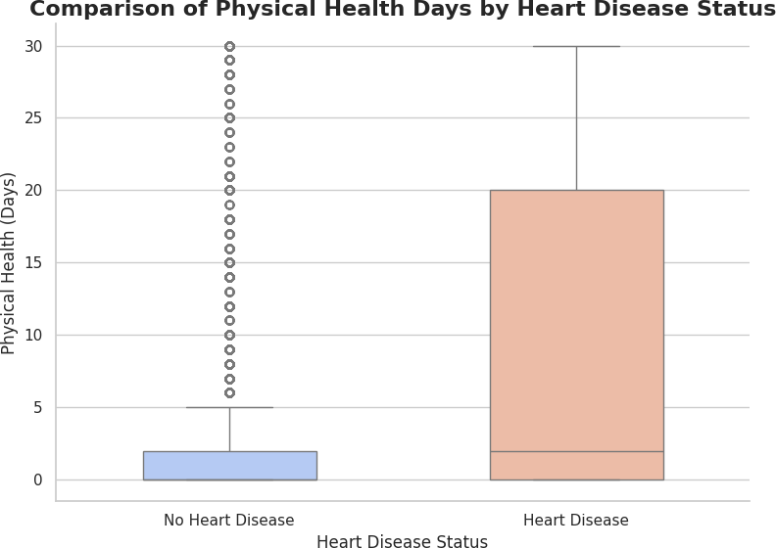
Bivariate Data Analysis
6
Project Presentation
(Physical Health days)
Continuous vs Target
The comparison of physical health days reveals that those with heart disease experience more days of poor physical health. The wider spread in this group suggests that chronic physical health conditions may correlate with a higher risk of heart disease.

Slide 24
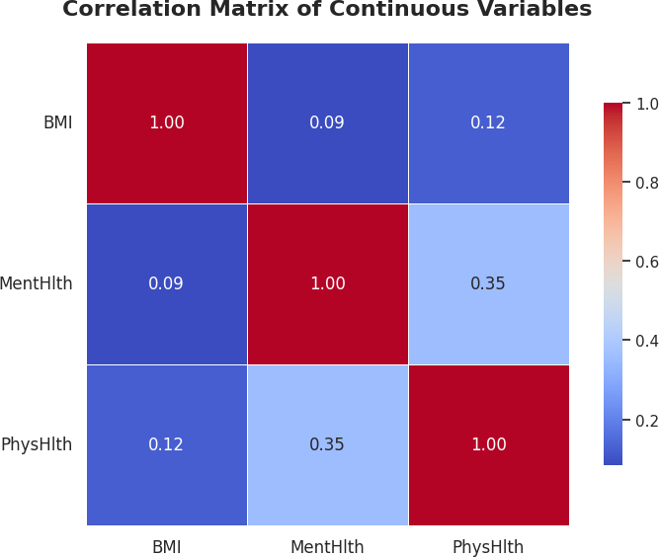
Bivariate Data Analysis
6
Project Presentation
'BMI', 'MentHlth', 'PhysHlth'
Correlation Matrix
The heatmap shows moderate positive correlations between BMI and physical health and between mental health and physical health, indicating some level of association. However, the correlation between BMI and mental health is weak, suggesting that these variables are not directly linked in this dataset.

Slide 25
Project Presentation
7
Data Visualization Techniques
A pie chart is a circular statistical graphic divided into slices to illustrate numerical proportions. Each slice represents a category's contribution to the total, with the size of each slice corresponding to its relative value. Pie charts are commonly used to visualize data in a clear and easy-to-understand format, making it easy to compare parts of a whole.

Slide 26
Project Presentation
7
Data Visualization Techniques
A bar chart is a graphical representation of data using rectangular bars, where the length or height of each bar is proportional to the value it represents. Bars can be displayed vertically or horizontally and are typically used to compare different categories or groups. Bar charts are effective for visualizing discrete data, showing trends over time, and highlighting differences between various items or categories.

Slide 27
Project Presentation
7
Data Visualization Techniques
Heatmaps are useful for identifying patterns, correlations, and trends in data, making them popular in fields such as data analysis, statistics, and machine learning. It uses color to represent the magnitude of values in a matrix or grid format. Each cell in the heatmap is colored based on its value, with a gradient or specific color scale indicating higher or lower values.

Slide 28
Project Presentation
7
Data Visualization Techniques
A histogram is a graphical representation of the distribution of numerical data, where data is grouped into continuous intervals, or "bins." Each bin is represented by a bar, and the height of the bar shows the frequency or count of data points within that interval. Histograms are useful for visualizing the shape, spread, and central tendency of a dataset, helping to identify patterns such as skewness, outliers, or normal distribution

Slide 29
Project Presentation
2
Key findings
Health Conditions
People with high blood pressure (HighBP) and high cholesterol (HighChol) are at a significantly higher risk for heart disease.
Individuals with diabetes (both prediabetes and diabetes) also show higher heart disease rates.
Lifestyle Factors
Smoking: Smokers are more likely to develop heart disease compared to non-smokers.
Physical Activity: Individuals engaging in regular physical activity show a lower prevalence of heart disease compared to those who do not.
General Health
People who rate their general health as "poor" or "fair" are much more likely to have heart disease compared to those who rate their health as "excellent" or "very good."

Slide 30
Project Presentation
2
Conclusion
The analysis of health and demographic data has revealed critical insights into the factors contributing to heart disease. Key risk factors include age, with older individuals facing a significantly higher risk, and sex, with males being more prone to heart disease.
Socioeconomic factors such as lower education and income levels are also linked to a higher prevalence of heart disease. Additionally, lifestyle choices, including smoking, lack of physical activity, and heavy alcohol consumption, further increase the risk. Health conditions like high blood pressure, high cholesterol, and diabetes serve as strong predictors of heart disease.
These findings emphasize the need for preventive measures and public health
interventions targeting at-risk groups, promoting healthier lifestyles, and improving access to healthcare and education to mitigate heart disease prevalence.

Slide 31
THANK YOU
MENTORMIND
FOR YOUR TIME
WWW.MENTORMIND.IN

