Slide 1
To Detect Fake Identities in Twitter using Machine Learning Models.
Under the guidance of Dr. S. Gowri
Panel: 6
Batch: CSE323
Presented by
Chetanroop ( 38110107 )
Ruthwik Preetham ( 38110471 )

Slide 2
Problem Statement
To detect an account in twitter is a bot or human through machine learning and deep learning algorithms.

Slide 3
Introduction
Bots in twitter are controlled via Twitter API.
Over 15% accounts in twitter are bots with 42% of traffic via tweeting
Example : bots retweeting if content of tweet has crypto related information

Slide 4
Objective
The main objective is to get classify the twitter accounts from humans vs bot/malicious using machine learning algorithms.
By classifying the accounts, the ease with which false accounts and actions can be obtained. For example, spreading of fake news about Hurricanes go viral and become main source of information for those affected by the storm.
The authenticity of people is constantly questioned if it is a fake or not, and to verify the account, this classifier authenticates and solves the problem.

Slide 5
Literature Survey
Title | Author- Year | Method Used | Pros | Cons
Twitter Turing test: Identifying social machines,” Information Sciences | A. Alarifi, M. Alsaleh, and A. Al-Salman - 2020 | Bayes Theorem | Easy to implement Good performance | Less performance in case of large features Learning time
“Detecting automation of twitter accounts: Are you a human, bot, or cyborg? | Z. Chu, S. Gianvecchio, H. Wang, and S. Jajodia - 2019 | Tree Based | Performance Accuracy Widely Used | Overfitting Problem
“Preprocessing framework for twitter bot detection | M. Kantepe and M. C. Ganiz - 2017 | Support Vector Machine (SVM) | Good accuracy based on kernel choice Solve regression problems Helped twitter to delete 4.5mil spam accounts | Training and testing time is affected by data size Sensitive to choice of kernel and parameters

Slide 6
Literature Survey
Title | Author- Year | Method Used | Pros | Cons
Random walk based fake account | J. Jia, B. Wang, and N. Z. Gong - 2017 | Trust Propagation Using Graphs | Good and easy to rank users based on spam activity Good to represent two trust classes | Depends on assumption and sensitive to selection
A sybilresilient system for user influence measurement on twitter, | J. Zhang, R. Zhang, J. Sun, Y. Zhang, and C. Zhang - 2017 | Centrality and properties using Graphs | Good to measure influence nodes Graph Visualization | Large network will be computationally cost Depends on assumptions Sensitive to neighborhood.
Classification of twitter accounts into automated agents and human users. | Z. Gilani, E. Kochmar, and J. Crowcrof - 2017 | Annotation task to build ground truth with crowdsourcing | Using human intelligence Good accuracy | Usually paid task Time consumption

Slide 7
Literature Survey
Title | Author- Year | Method Used | Pros | Cons
“Behavior enhanced deep bot detection in social media | C. Cai, L. Li, and D. Zeng - 2016 | Neural Network | Performance Accuracy | Training time is slow Need large sample to perform well
Debot: Twitter bot detection via warped correlation | N. Chavoshi, H. Hamooni, and A. Mueen - 2016 | Pairwise | Easy to implement in behavior change | Evasion of similarity metrics

Slide 8
Existing System
During the process of detecting the fake identities humans and bots have same behavior. These are applied to many supervised machine learning models. Many engineered features are existing but are not much successful in implementing to detect malicious accounts
Three major approaches:
Using Graphs
Crowdsourcing
Machine Learning Algorithms
Out of all the approaches , Machine learning algorithms are found to be more accurate than other approaches.
The model is dependent on features (name, location, profile image etc.)

Slide 9
Proposed System
To gather relational database with hashtags used, social media posts, feeds, comments, bio of the user, profile photo, location and other attributes.
Using a dataset preparation with preprocessing and cleaning. Splitting the dataset into training (80%), cross validation (10%) and test dataset (10%).
Applying supervised machine learning algorithms and deep learning for the training datasets and cross validating with cross validation dataset.
Finally evaluating and visualize the results with test dataset.
Further preprocessing if the accuracy of precision of obtained results are low, and iterating the previous steps to improve the accuracy of the models.

Slide 10
Proposed System
Preprocessing techniques:
Variables based on number of friends, followers etc. to ease the calculations.
Removing unwanted features that doesn't help for the accuracy of model through spearman correlation.
The tweets contains words which are often taken as bag of words model.
Features like screen name, name, description, status are converted into binary (0 or 1), using the bag of words adds more features.

Slide 11
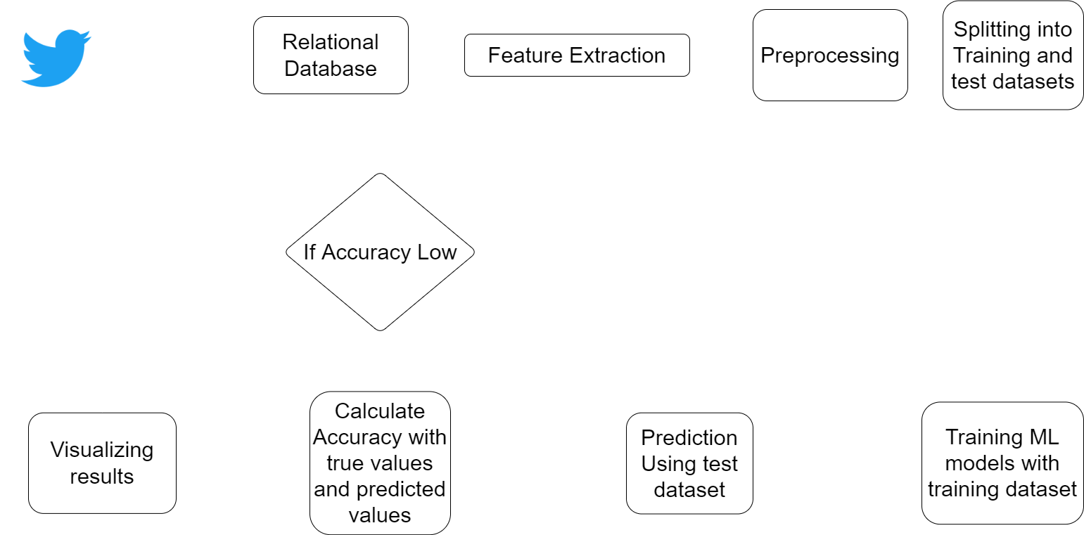
Architecture Diagram

Slide 12
System Requirements
Hardware Requirements
Windows 7 or higher operating system
CPU: intel i3 or higher or equivalent AMD core
At least 3gb of RAM for computations
Storage: Minimum 10MB to run the program
Software Requirements
VS code or Google Colab
Anaconda distribution of Python if using VS CODE

Slide 13
Dataset Description
The main challenges faced by us are unavailability of reliable dataset.
Though there are papers and articles about how to classify accounts into bots and humans, reliable dataset are not available.
Using Twitter API, extracted some features that are available for public use through third party website.
The main features include:
Id
Screen name
Location
Description
Url
Followers count
Friends count
Listed count
Created at ( data when account is created)
Verified
Status count
Default Profile
Has extended bio
Bot

Slide 14
Algorithms
Neural Networks:
Deep connected neural networks with 3 hidden layers and one output sigmoid layer.
Output layer gives the probability that the data provided is a bot
Threshold can be changed according to the preference
Decision Tree Classifier
With the pre-processed data trained with Decision Tree Classifier, the training accuracy is 88.02% and testing accuracy is 87.85%.
The ROC curve metric is 0.95 for training and 0.93 for testing.

Slide 15
Conclusion
Proposed two methods to classify accounts in social media platforms.
The results show the performance and effectiveness with high f1 scores.
Further studies can be done to classify accounts in other social media platforms, like Instagram.
With this classifier, and selective threshold, bots can be found in twitter accounts pretending to be humans and spread fake news or spam or scam users pretending to sell or buy

Slide 16
References
[1] M. Kantepe and M. C. Ganiz, "Preprocessing framework for Twitter bot detection," 2017 International Conference on Computer Science and Engineering (UBMK), 2018, pp. 630-634, doi: 10.1109/UBMK.2017.8093483.
[2] J. Jia, B. Wang and N. Z. Gong, "Random Walk Based Fake Account Detection in Online Social Networks," 2017 47th Annual IEEE/IFIP International Conference on Dependable Systems and Networks (DSN), 2019, pp. 273-284, doi: 10.1109/DSN.2017.55.
[3] V. S. Subrahmanian et al., "The DARPA Twitter Bot Challenge," in Computer, vol. 49, no. 6, pp. 38-46, June 2016, doi: 10.1109/MC.2016.183.
[4] Z. Gilani, E. Kochmar and J. Crowcroft, "Classification of Twitter Accounts into Automated Agents and Human Users," 2017 IEEE/ACM International Conference on Advances in Social Networks Analysis and Mining (ASONAM), 2020, pp. 489-496.
[5] C. Cai, L. Li and D. Zengi, "Behavior enhanced deep bot detection in social media," 2017 IEEE International Conference on Intelligence and Security Informatics (ISI), 2020, pp. 128-130, doi10.1109/ISI.2017.8004887.

Slide 17
References
[6] Z. Chu, S. Gianvecchio, H. Wang and S. Jajodia, "Detecting Automation of Twitter Accounts: Are You a Human, Bot, or Cyborg?," in IEEE Transactions on Dependable and Secure Computing, vol. 9, no. 6, pp. 811-824, Nov.-Dec. 2012, doi: 10.1109/TDSC.2012.75.

