Slide 1
Predicting Serious Delinquency
in Active Credit Accounts
A behavioural Early Warning System for proactive collections
1,514,045
56,539
0.7148
25.2%
account-month observations
distinct credit accounts
out-of-time AUC, XGBoost
of defaults in the top decile
Live application walkthrough · 11 screens · every figure computed from the real dataset
Notes:
Opening frame. The four numbers are live from the application, not typed in by hand. The whole talk is one continuous click-through of the app's Presentation section — 11 screens, ending on the recommendation.

Slide 2
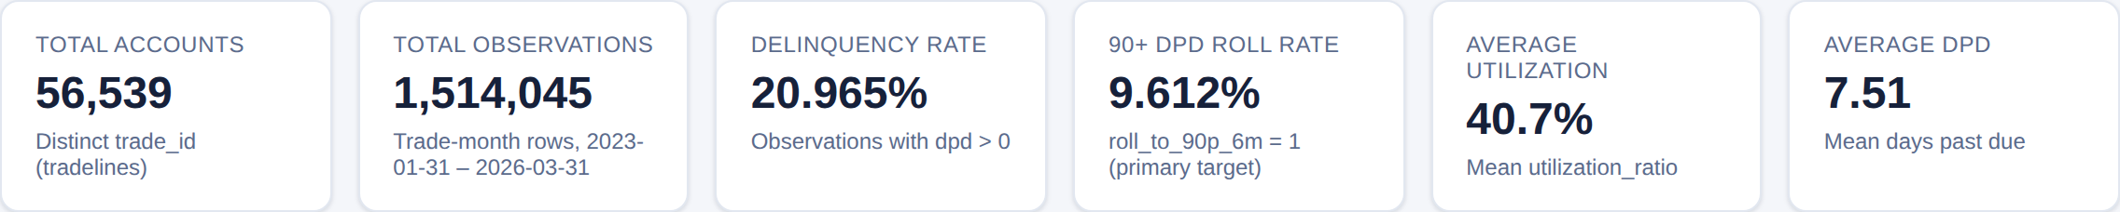
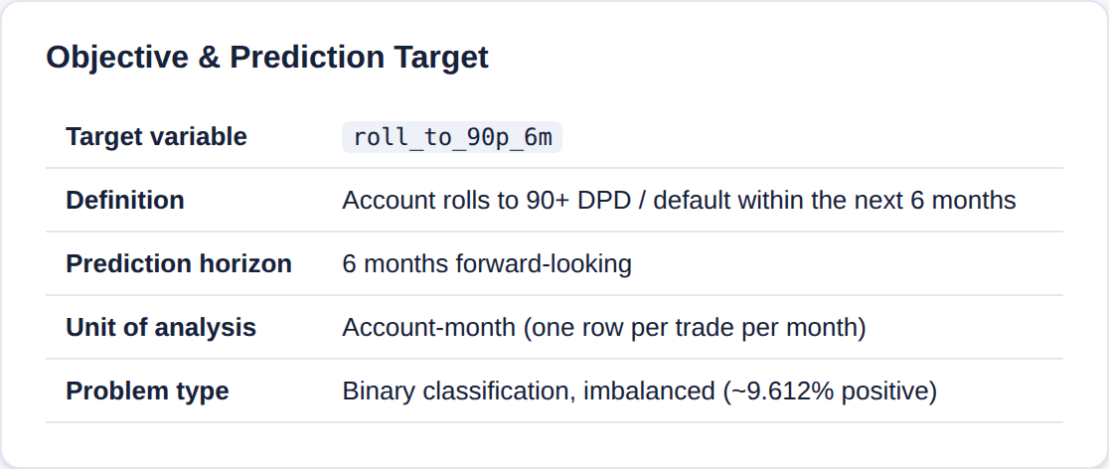
01
Executive Overview
One question, asked of every active account: will it roll to 90+ DPD within the next six months?
Portfolio KPIs, computed live from behavior_risk_mart
Why this matters
Standard reporting confirms an account has already gone bad. This flags it up to six months earlier.
9.6% of account-months end in a 90+ DPD roll — the base rate any model has to beat.
The output is a prioritised ranking for collections outreach, not an automated credit decision.
Objective & prediction target, as defined in the application
6 months
of warning before the account is formally delinquent
Behavioral Early Warning System · Executive Overview
2
Notes:
Frame the business problem. Emphasise 'active' accounts and the six-month forward window. The 9.6% base rate is the number to keep in mind for every metric that follows.

Slide 3
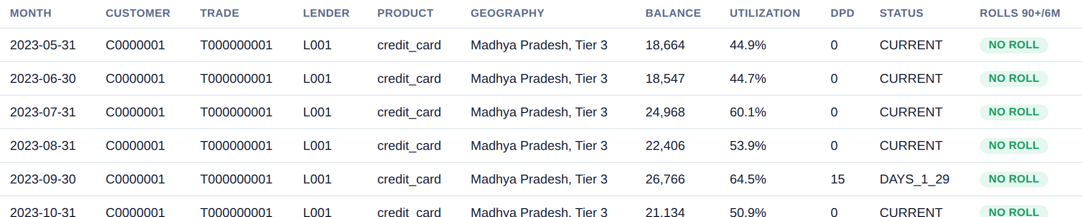
02
Data Overview
1.5 million account-months — the same accounts observed again and again. That repetition is what makes the signal behavioural.
Dataset shape and coverage
Data Explorer · one account followed month by month — the panel structure the model learns from
GRAIN
SPAN
DEPTH
One row per account per month
Jan 2023 – Mar 2026, 39 months
~27 monthly observations per account
Behavioral Early Warning System · Data Overview
3
Notes:
The key point is the panel structure — same trade_id repeating down the rows. That is why a random train/test split leaks, which is the next-but-one slide.

Slide 4
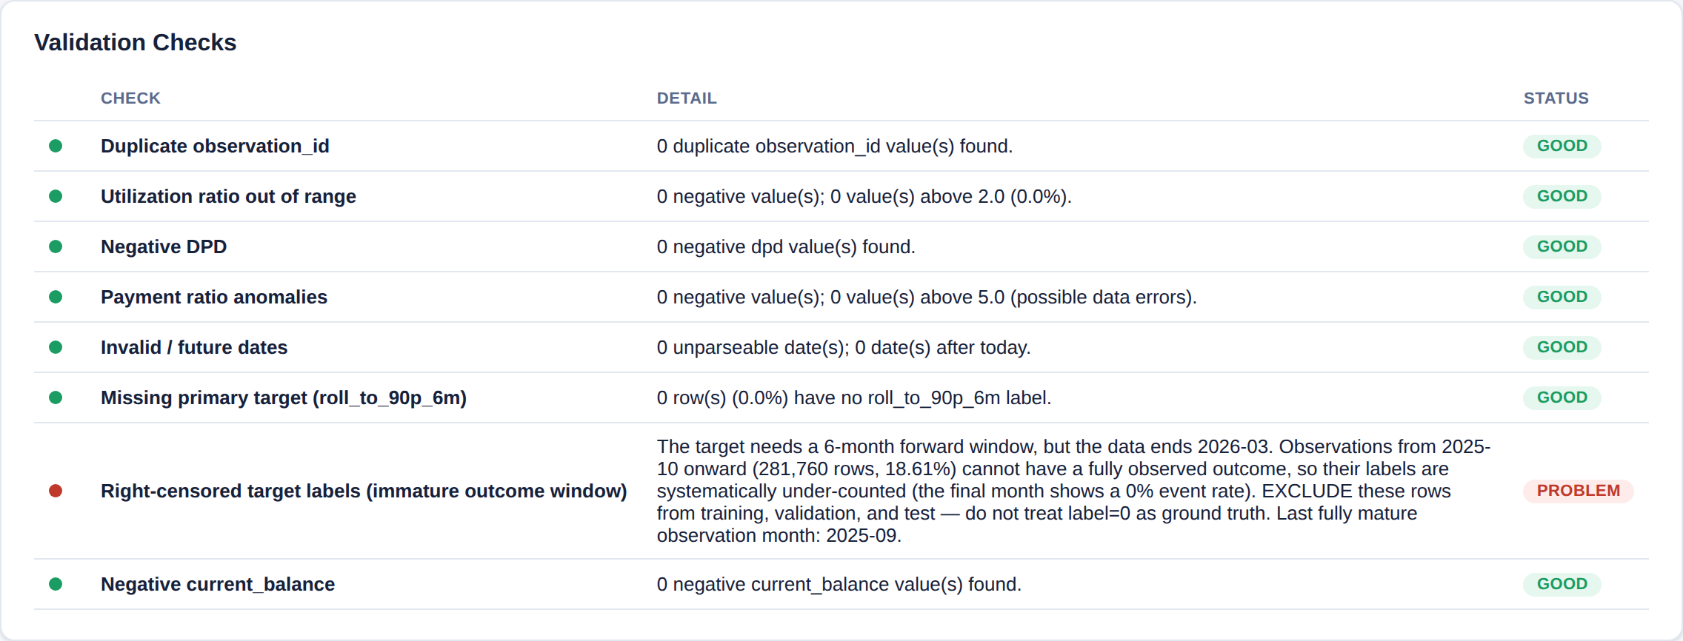
03
Data Quality
Every automated check the pipeline runs before a single model is trained — including one finding that changes how the data must be used.
The catch we found
The label looks six months forward, so the most recent months cannot have a valid outcome yet — an account seen in December has not had six months to roll.
That is right-censoring, not missing data. Left in, it looks like risk suddenly improved. It is excluded from every split instead.
Validation checks, run live against the full dataset
1,232,285
281,760
Sep 2025
mature rows kept for modelling
right-censored rows excluded (18.6%)
last month with a complete label
Behavioral Early Warning System · Data Quality
4
Notes:
This is the methodological catch worth leading with — it is a real finding, not textbook filler. If it were left in, the monthly roll rate collapses to zero at the end of the window and reads as risk improving.

Slide 5
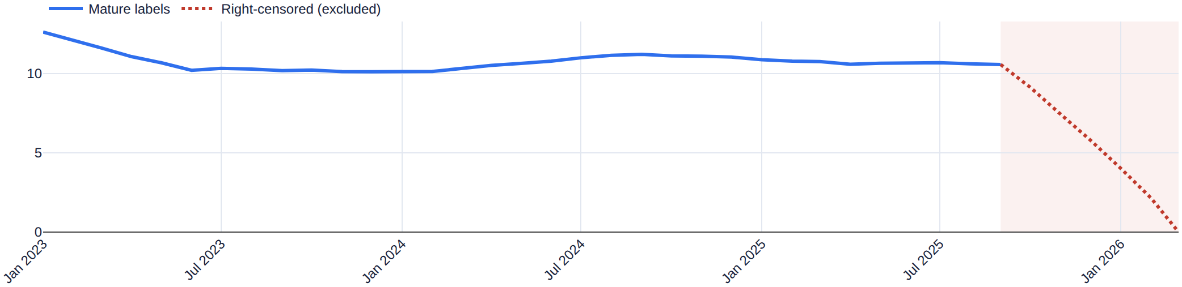
04
Out-of-Time Split
Train on the past, test on the future — the only split that does not leak on data like this.
Label maturity, computed from the data window
Why not a random split?
The label looks forward, so a random split can put an account's March row in training and its own April row in test.
Panel data: the same account appears ~27 times, so its months are correlated even without leaking the label directly.
Monthly event rate — the dotted red line is the censored tail, excluded from training
TRAIN
VALIDATE
TEST (OOT)
Jan 2023 – Nov 2024 · 802,557 rows
Dec 2024 – Apr 2025 · 207,824 rows
May 2025 – Sep 2025 · 221,904 rows
Behavioral Early Warning System · OOT Split
5
Notes:
Two independent reasons a random split fails here. The chart is the censoring finding from the previous slide, drawn: blue is usable, red dotted is the excluded tail.

Slide 6
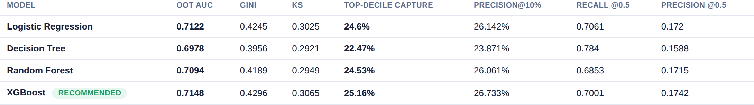
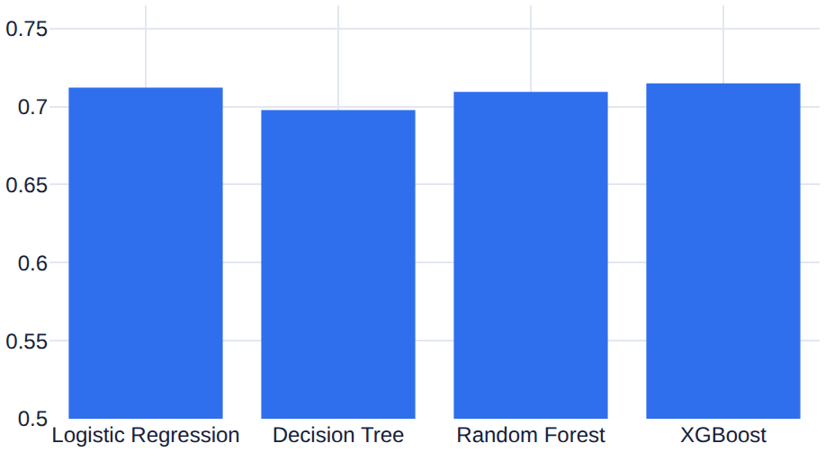
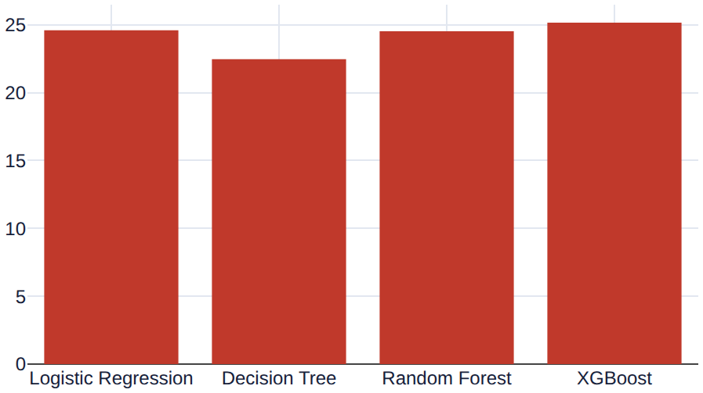
05
Model Screening
Four models, one out-of-time test set, identical imbalance handling. XGBoost wins — and not only on AUC.
Champion / challenger comparison on the out-of-time test set
Selected on the operational metrics
XGBoost leads on KS (0.3065) and top-decile capture (25.2%), not just AUC.
Those are the metrics that map to a fixed-capacity collections queue.
Logistic Regression stays as the interpretable baseline — it is only 0.0026 AUC behind.
OOT AUC by model
Top-decile capture by model
Behavioral Early Warning System · Model Screening
6
Notes:
The defensible selection criterion: chosen on the metrics that map to the actual decision, not the biggest number in one column. Flag the train/test gap honestly if asked — XGBoost trains at 0.740 vs 0.7148 on test.

Slide 7
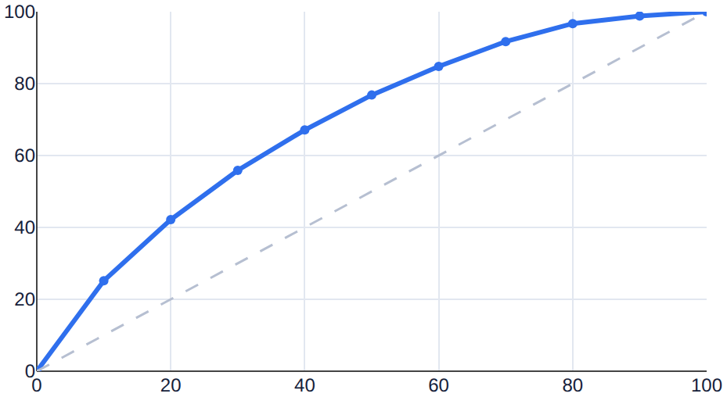
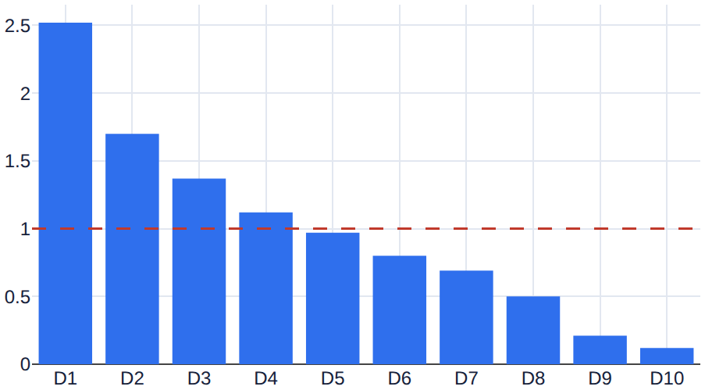
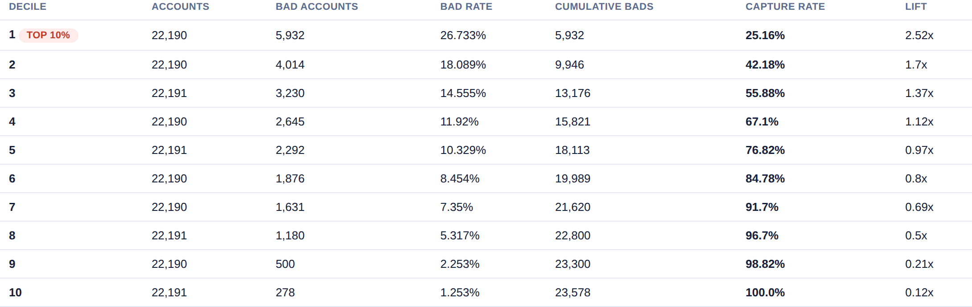
06
Lift & Gains
Rank every account by risk, and the riskiest 10% already contains a quarter of everyone who will default.
25.2%
of all defaults captured in the top decile
Reading the curves
The dashed diagonal is what undirected outreach would achieve.
The gap between the curves is the value the model adds.
Top decile runs at ~2.5x lift over random selection.
Cumulative gains — model vs. random
Lift by decile
Decile table, out-of-time test set
Behavioral Early Warning System · Lift & Gains
7
Notes:
This is the same result as the AUC number, restated in the language a collections manager uses. Point at the gap between the solid curve and the diagonal.

Slide 8
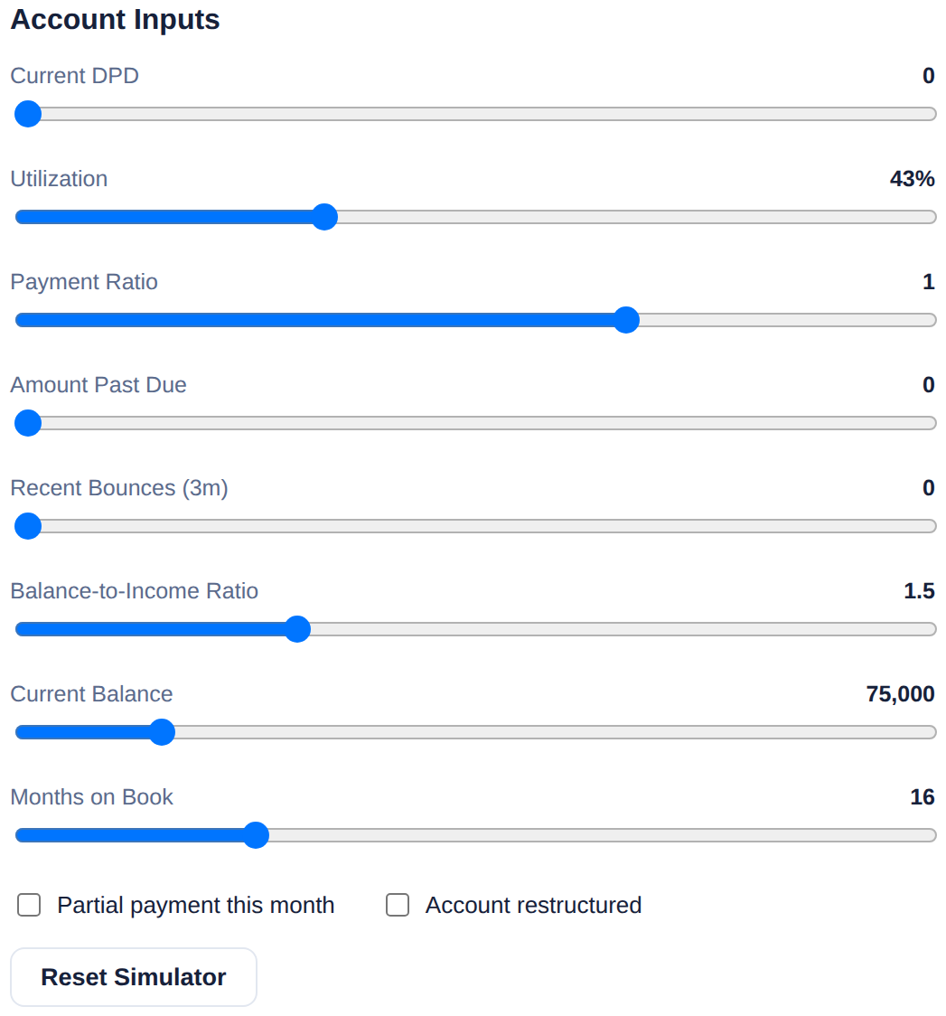
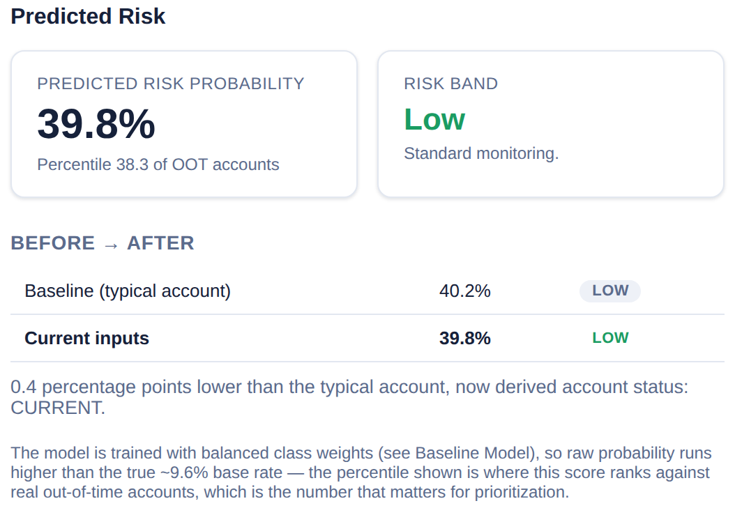
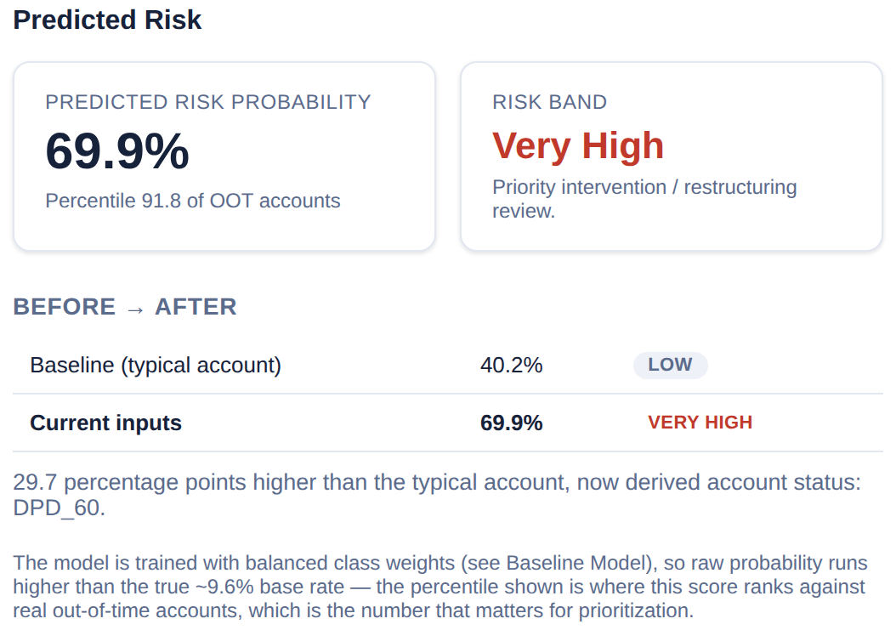
07
What-If Simulator
Every slider re-scores through the real trained pipeline — live, nothing precomputed.
Sliders at their default, typical-account settings
Same account with current DPD moved to 60
Account inputs · 8 sliders, 2 toggles
One input, 29.7 percentage points
The application's own before/after line: 40.2% (Low) → 69.9% (Very High), landing at the 92nd percentile of the out-of-time book. The percentile is the number that matters operationally — raw probabilities run high because the model is trained with balanced class weights.
Behavioral Early Warning System · What-If Simulator
8
Notes:
Do this one live: drag the DPD slider from 0 to 60 and pause on the number. It proves the model is really running, not a screenshot.

Slide 9
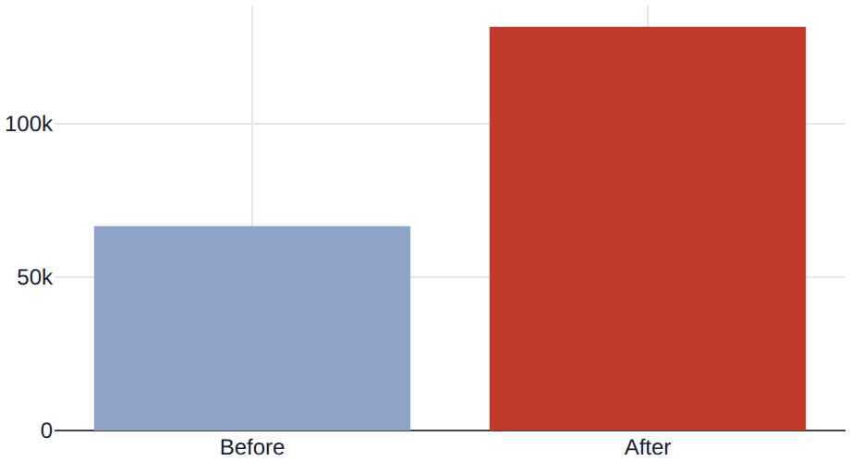
08
Portfolio Scenario Simulator
The same idea at book level: what happens to the whole portfolio if every account's DPD rises by 15 days?
Before → after, across all 221,904 out-of-time accounts
What the shock does
Mean predicted risk moves 43.3% → 53.9% across the book.
High-risk accounts roughly double: 66,571 → 131,533, with 65,032 newly flagged.
The shock is propagated into the 3-month rolling features the model actually weighs, not just the raw monthly snapshot — otherwise the effect would be negligible.
Expected-loss proxy rises by ₹9.5 billion, which sizes the stress event in money rather than counts.
High-risk account count under the DPD +15 shock
Behavioral Early Warning System · Portfolio Scenario Simulator
9
Notes:
Worth naming that the shock propagates into the rolling features — that was a real bug found and fixed during the build; the first version only shocked the raw snapshot and barely moved anything.

Slide 10
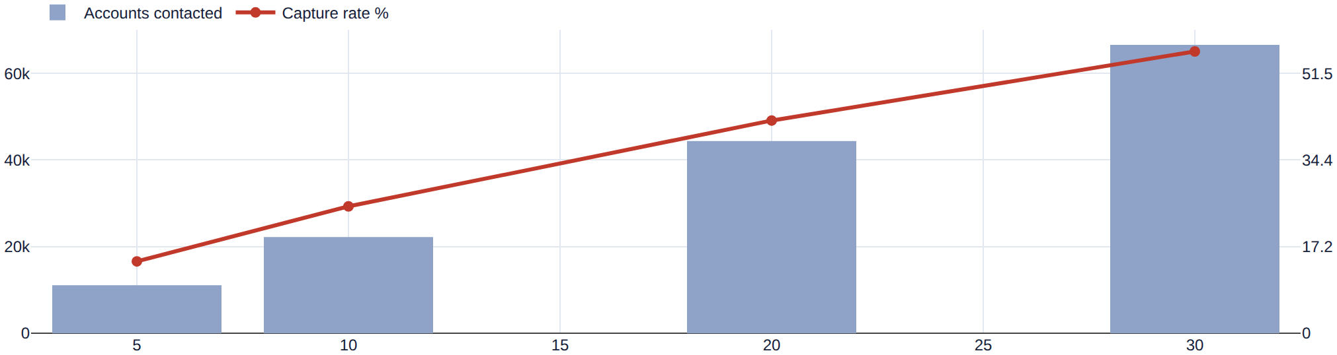
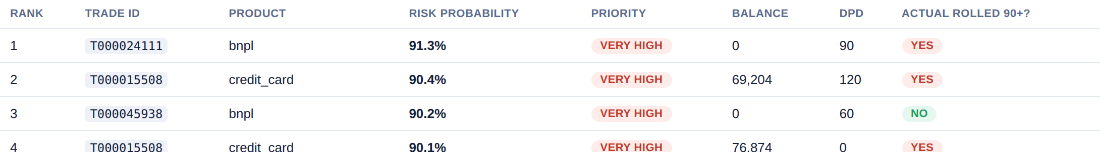
09
Collection Queue
Turning a score into a work list: given the capacity a team actually has, who gets contacted this cycle?
Queue at 10% collection capacity
The capacity trade-off
5% capacity → 14.2% of defaults caught
10% capacity → 25.2% caught
20% capacity → 42.2% caught
30% capacity → 55.9% caught
Capacity vs. capture rate — accounts contacted against defaults caught
The resulting work list — ranked, with the actual outcome shown for validation
Behavioral Early Warning System · Collection Queue
10
Notes:
This is the bridge from model metrics to an operational decision. The queue is ranked, so capacity is the only dial the team has to set.

Slide 11
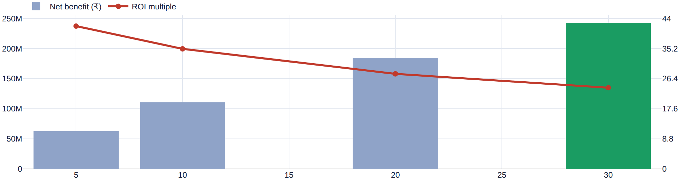
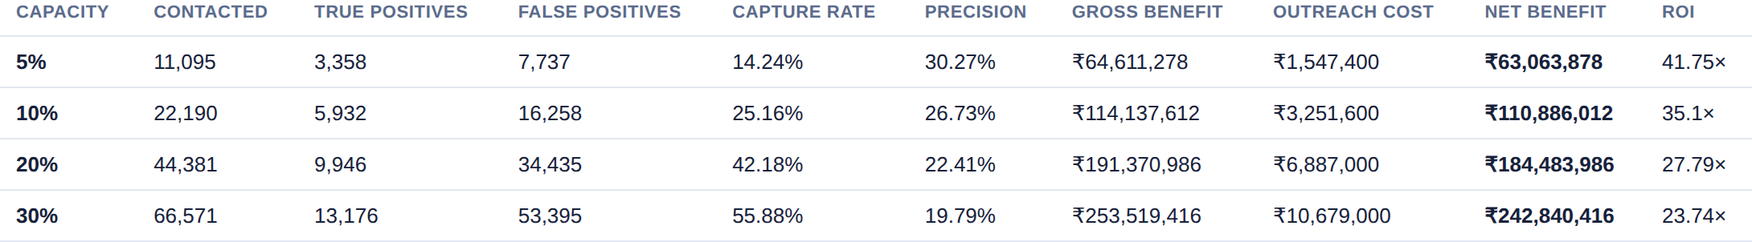
10
Cost-Benefit Analyzer
Two editable assumptions turn the queue into rupees — and the recommended capacity follows from the money, not the capture rate.
At the data-derived defaults: ₹200 per contact, ₹19,241 avoided per default caught
Where the numbers come from
Avoided loss per default caught is data-derived — the mean expected_loss_estimate among accounts that actually rolled.
Cost per contact has no source in the dataset. It is an assumption, editable live on the page.
Net benefit and ROI by collection capacity
Full breakdown by capacity level
Behavioral Early Warning System · Cost-Benefit Analyzer · capacity view
11
Notes:
If a panellist challenges the ₹200 contact cost, change it on stage — that is exactly what the page is for. Note that net benefit is still rising at 30%, so the real constraint here is operational capacity, not cost.

Slide 12
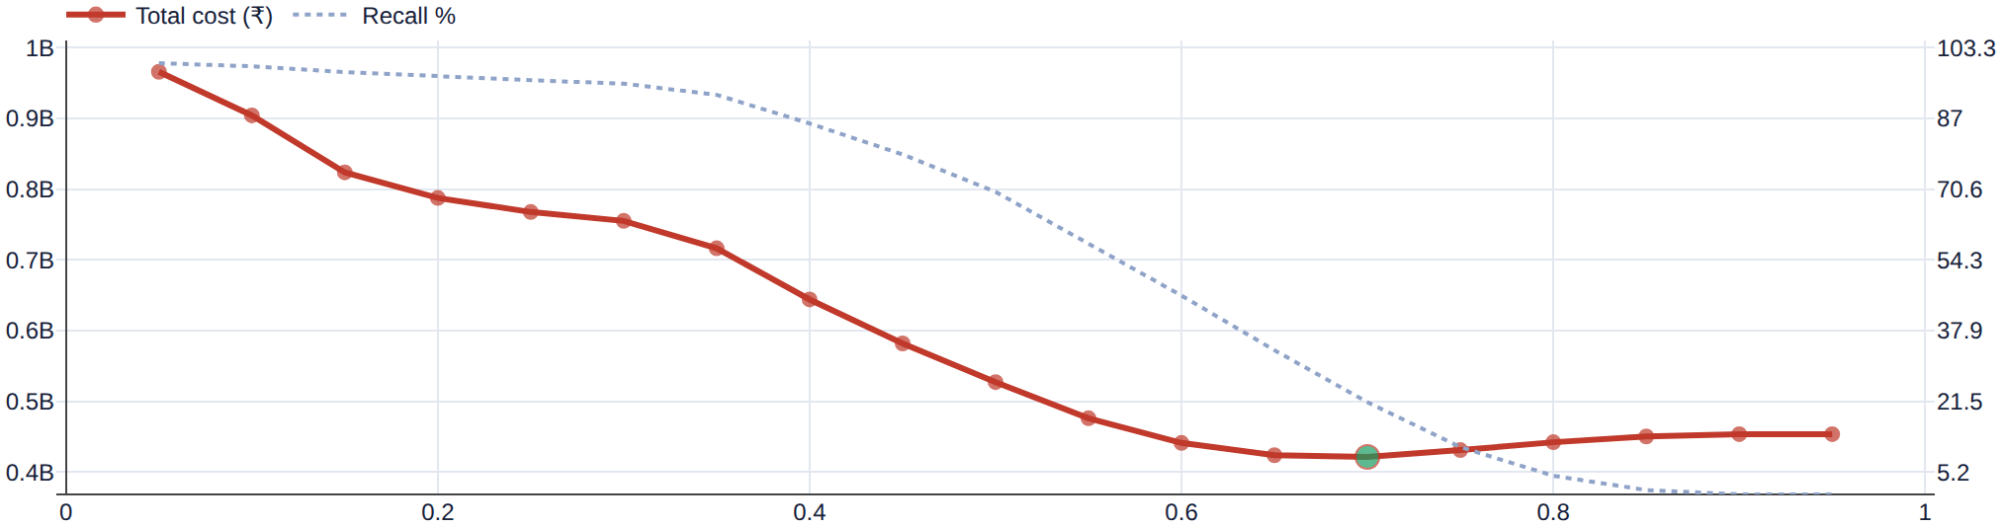
10
Threshold vs. Cost
The same two assumptions, swept across the model's own probability cutoff instead of a capacity bucket.
Cost-sensitive classification
Total cost = false positives × cost per contact + false negatives × loss per missed default.
The cost of a miss reuses the same avoided-loss figure, so this is one assumption framed two ways — not a second hidden one.
Total cost by threshold at ₹5,000 per contact — the green point is the cost-minimising cutoff
The optimum moves with the assumption
₹200 per contact
₹5,000 per contact
₹100,000 per contact
Cost falls to the floor of the range — flag almost everyone.
A genuine interior optimum appears at threshold 0.70.
Optimum at the ceiling — flag almost nobody, miss nearly every default.
Capacity-bound, not cost-bound
The instructive middle case
Minimising cost is not the objective
Behavioral Early Warning System · Cost-Benefit Analyzer · threshold view
12
Notes:
This is the classic cost-sensitive classification view. The point to make: the 0.5 default that ships with every classifier is almost never the right operating point once real costs are attached.

Slide 13
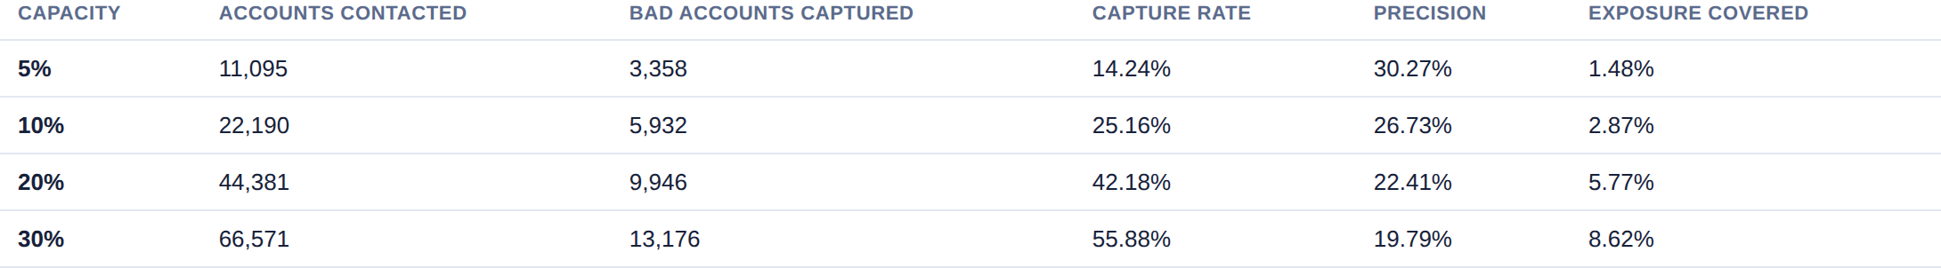
11
Final Recommendation
What to deploy, how well it performs, where to set the operating point — and what it must not be used for.
XGBoost, out-of-time performance
Recommended operating threshold, with the capacity trade-off in full
Recommendation
Scope limits
Deploy XGBoost as an early-warning prioritisation signal for proactive collections outreach — ranking active accounts by risk of rolling to 90+ DPD so limited capacity is spent where it matters most. Start at 20% capacity and scale with the team.
Decision support, not an autonomous credit decision.
Scores are ranking-optimised, not calibrated.
Synthetic case-study data; no fairness testing was possible.
Behavioral Early Warning System · Final Recommendation
13
Notes:
Close by stating the scope limits out loud before anyone has to ask for them. That is what makes the recommendation credible rather than oversold.

Slide 14
Early warning, six months ahead
A ranked, explainable, out-of-time-validated signal that puts collections capacity on the accounts most likely to need it — with every number in this deck computed live from the application.
Questions
Supporting detail — EDA, feature engineering, leakage governance, ROC/KS, explainability — is in the application's Appendix section.
Notes:
Closing frame. If asked about anything not covered, it is one click away in the app's Appendix — 15 further screens.

