Slide 1
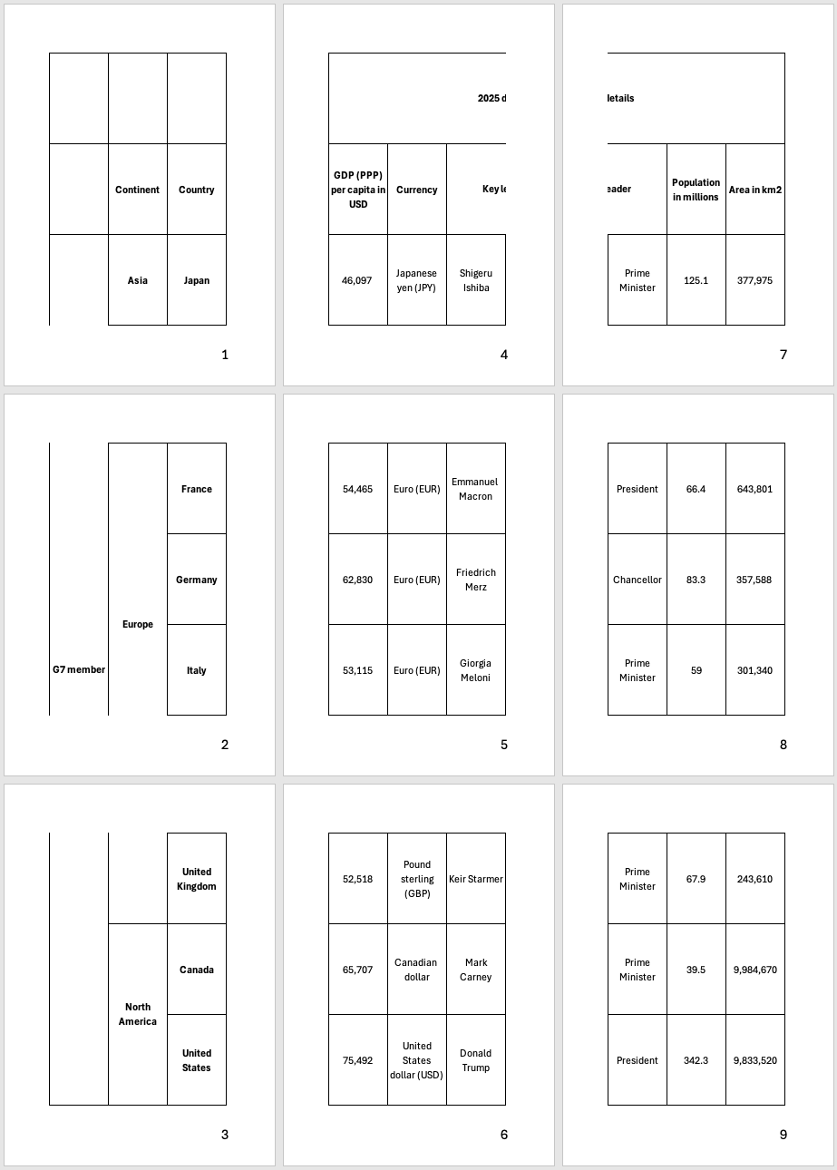
h_thread_1
h_thread_1
h_thread_1
h_thread_4
h_thread_4
thread_1
h_thread_5
h_thread_5
thread_2
h_thread_2
h_thread_2
h_thread_2
thread_1
thread_2
thread_3
h_thread_3
h_thread_3
h_thread_3
thread_3
thread_1
thread_2

