Slide 1
HACKATHON
IDENTIFY NEW BIKES
Cohort - QEA21QE021
Team 6 - Durgesh Pandhurkar - 918989
Gourav Thote - 918983
Riya Tandulkar - 918988
Pratik Bande - 918992
Pratik Chitode - 918999

Slide 2
PROBLEM STATEMENT
Display Upcoming bike details like bike name, price and expected launch date in India, for manufacturer ‘Honda' & Bike price should be less than 4Lac.
For Used cars in Chennai, extract all the popular models in a List, Display the same.
Try to login with google, give invalid account details & capture the error message.

Slide 3

TESTING
TOOLS/SOFTWARES USED -
JAVA – Programming Language
ECLIPSE - Integrated Development Environment
SELENIUM – Portable Framework for testing Web Applications
TestNG – Open source testing framework
MAVEN – Software and project management tool
Apache POI – JAVA Library for reading and writing in Microsoft Formats
Jenkins - to execute the test scripts periodically on Selenium Grid
Extent Report – Used to generate HTML report
GitHub - Source Code Management
WEBSITE USED -
www.zigwheels.com

Slide 4
TEST ENVIRONMENTS
DEVICE | LAPTOP | DEVICE | LAPTOP | DEVICE | LAPTOP
Browser | Google Chrome | Browser | Mozilla Firefox | Browser | Microsoft Edge
Browser Version | 94.0.4606.61 | Browser Version | 92.0.1 | Browser Version | 94.0.992.31
Platform | Windows | Platform | Windows | Platform | Windows
Platform Version | 20H2 (19042.1237) | Platform Version | 20H2 (19042.1237) | Platform Version | 20H2 (19042.1237)

Slide 5
TEST CASES
SR. NO. | TEST SCENARIOS | TEST CASES
TS-001 | ZigWheels Homepage | Assert homepage title(Smoke).
TS-002 | New Bikes (Upcoming) Functionality | Check the functionality of 'New Bikes' and 'Upcoming Bikes'(Smoke). Check the placeholder value of -‘ Select Manufacturer-' and click on 'Honda' (Regression).

Slide 6
TS-003 | 'Used Cars' Functionality | Check the functionality of 'Used Cars' and 'Chennai'(Regression and Smoke ).
TS-004 | Login Functionality | Check the functionality of 'Login/SignUp' button(Smoke). Check the functionality of 'Continue with Google' option(Smoke). Check the functionality of 'Email-id' input field(Regression and Smoke). Check the functionality of 'Sign-in' input field (Smoke).

Slide 7
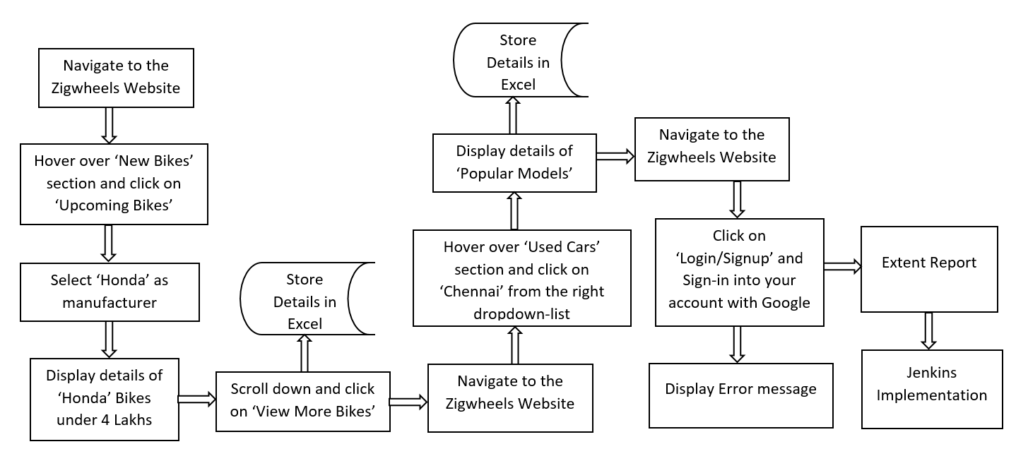
PROJECT WORKFLOW

Slide 8
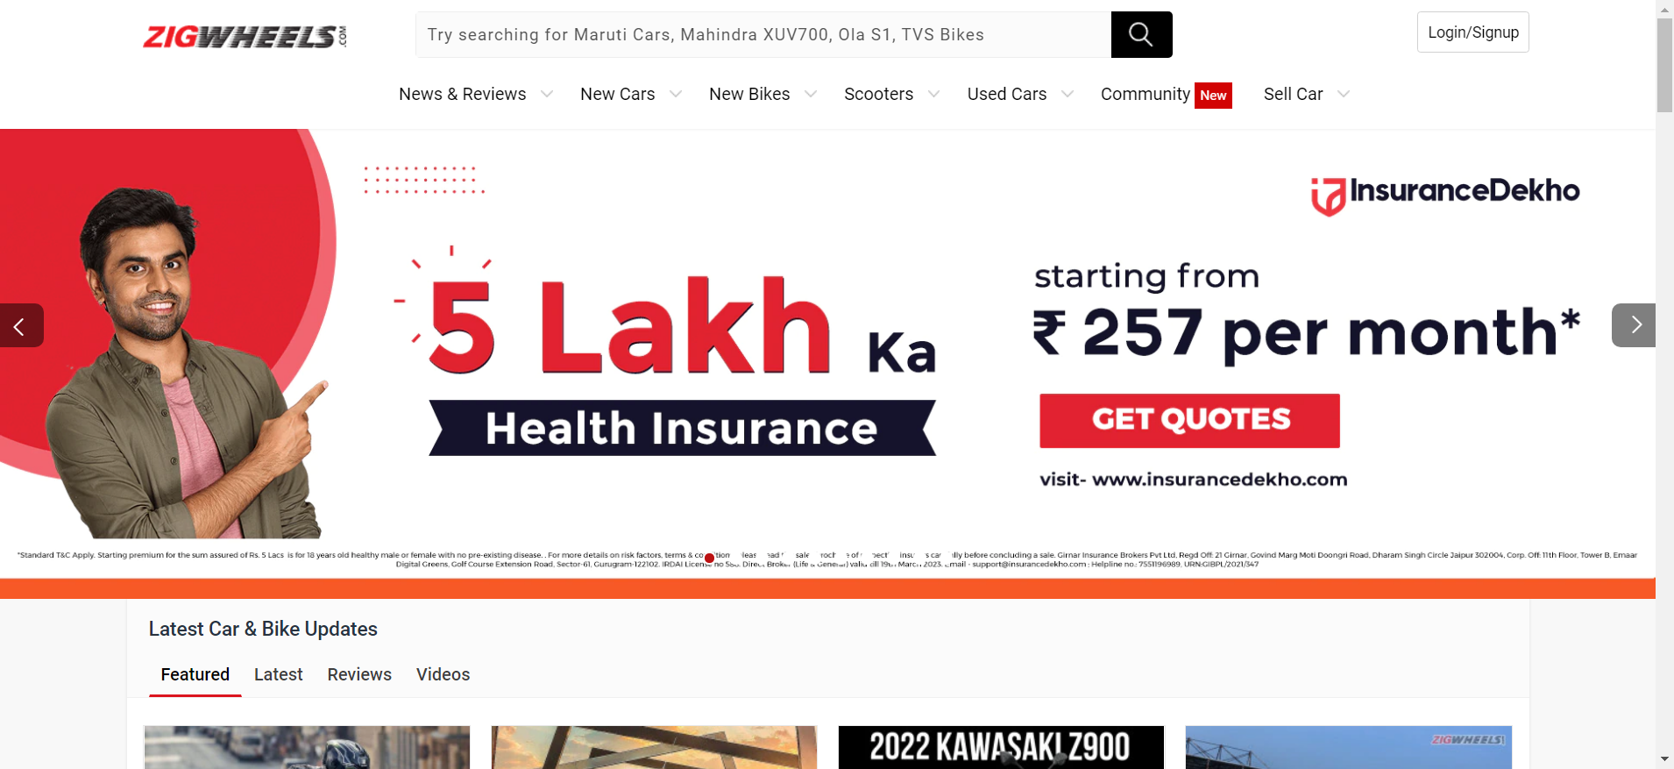
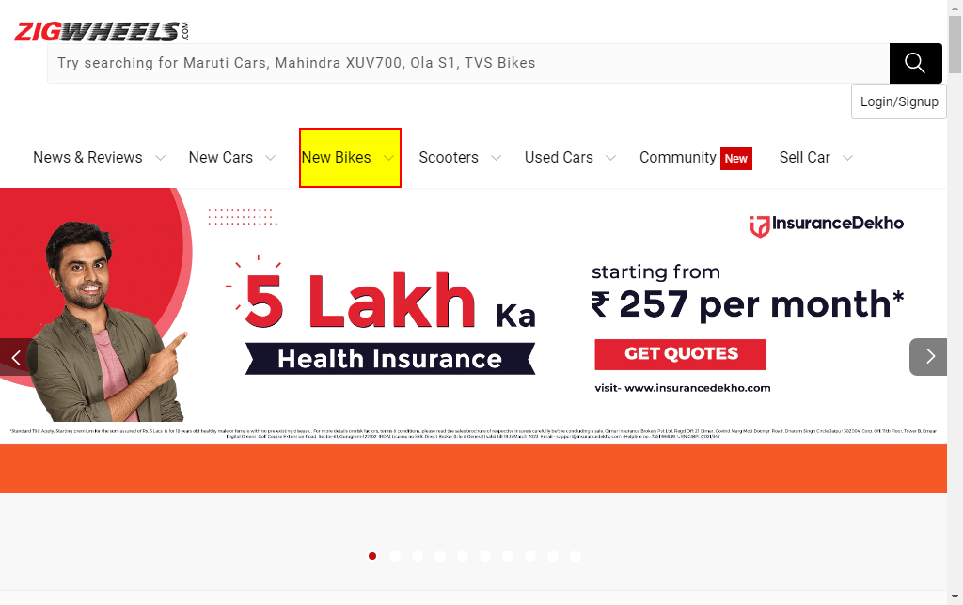
BASIC FRAMEWORK AND RESULTS

Slide 9
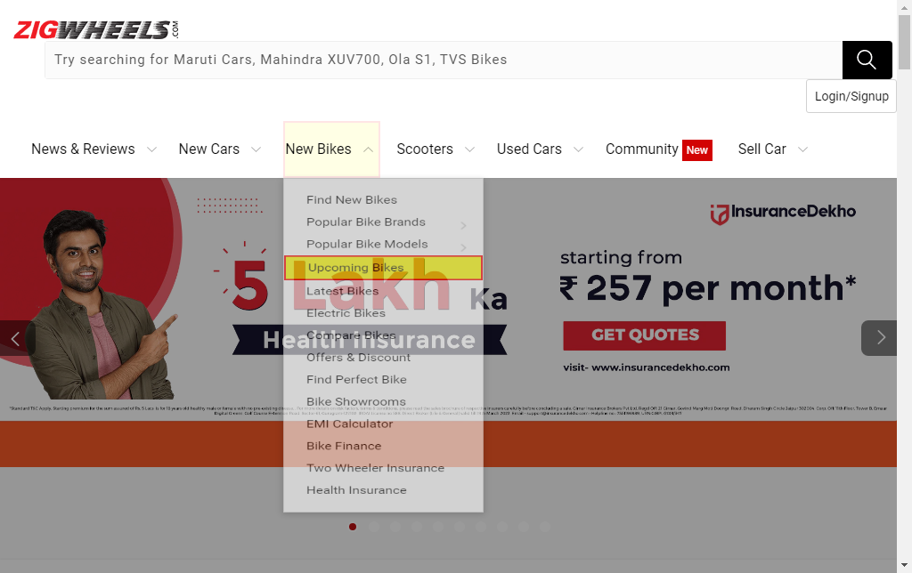
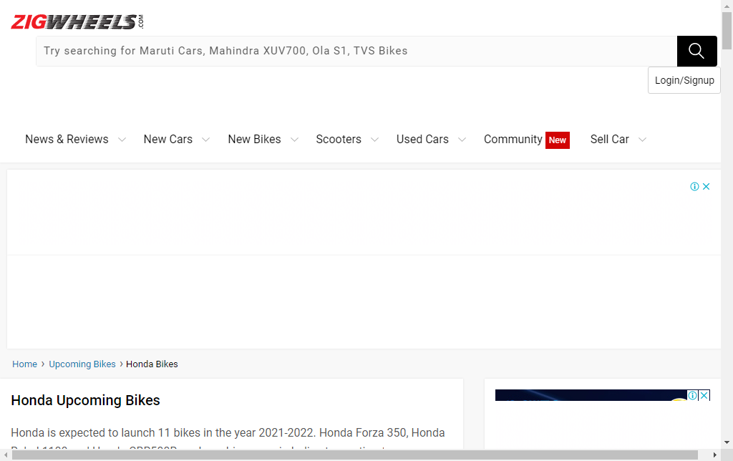
BASIC FRAMEWORK AND RESULTS

Slide 10
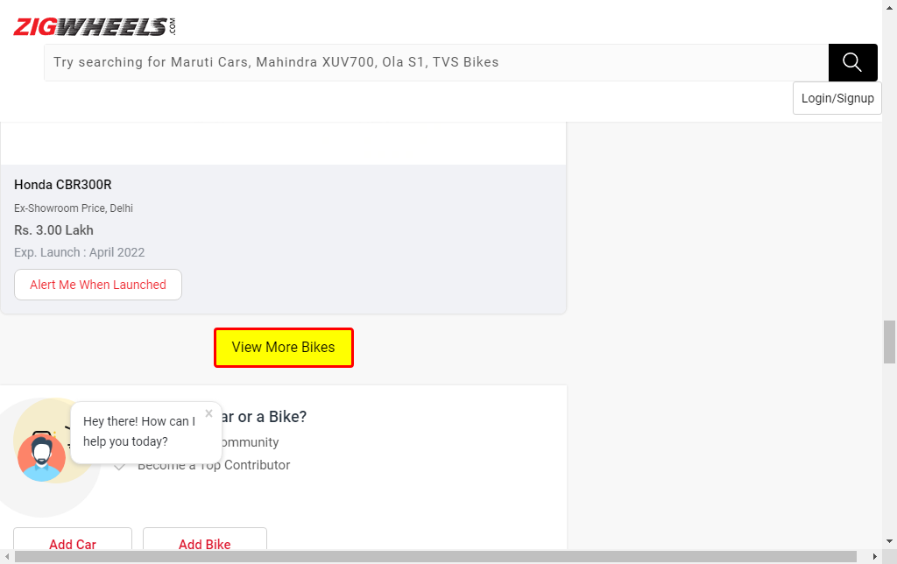
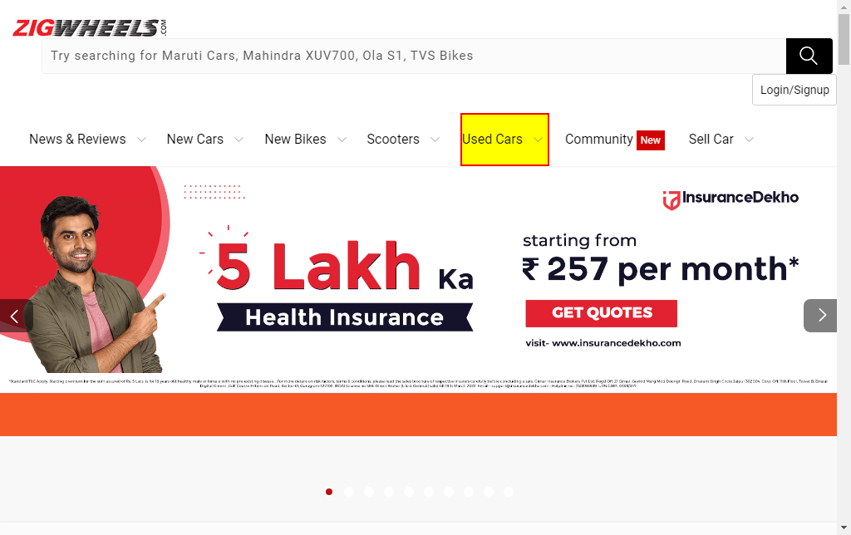
BASIC FRAMEWORK AND RESULTS

Slide 11
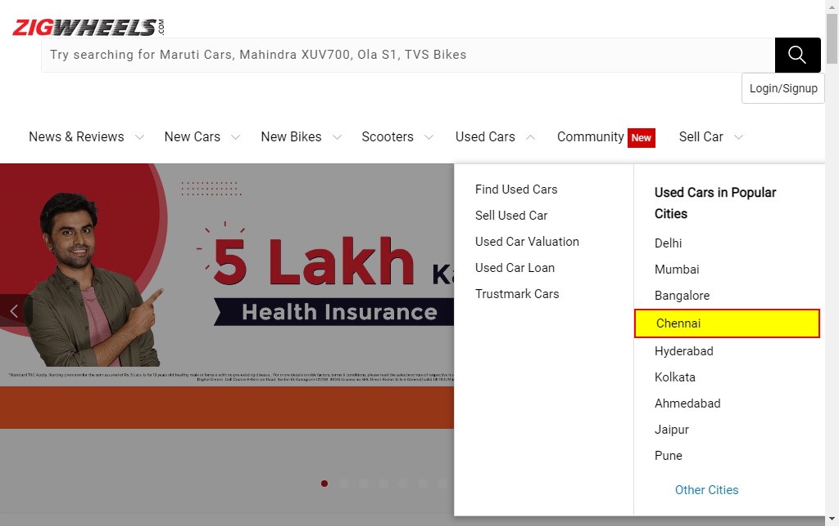
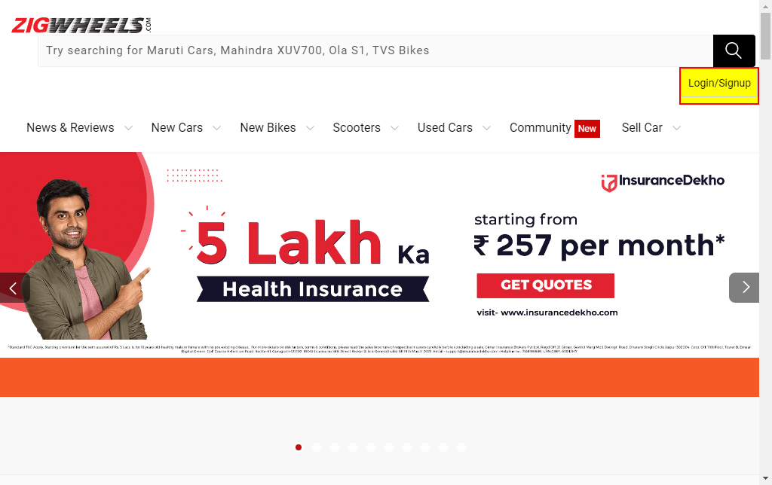

Slide 12
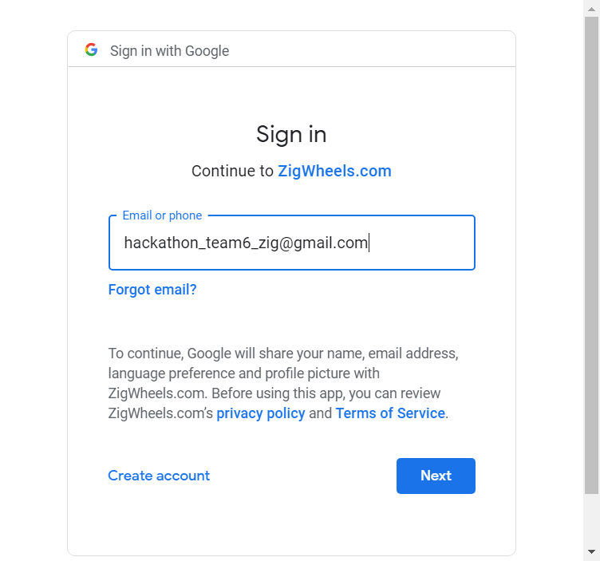
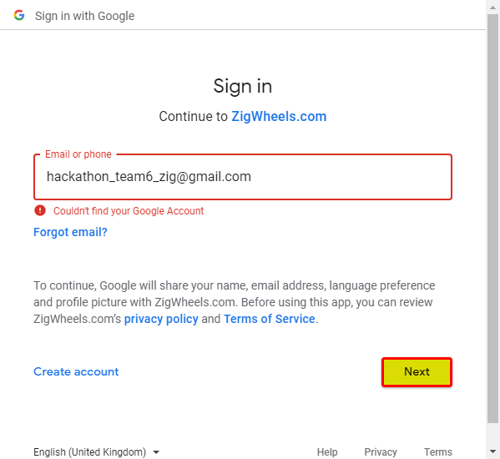

Slide 13
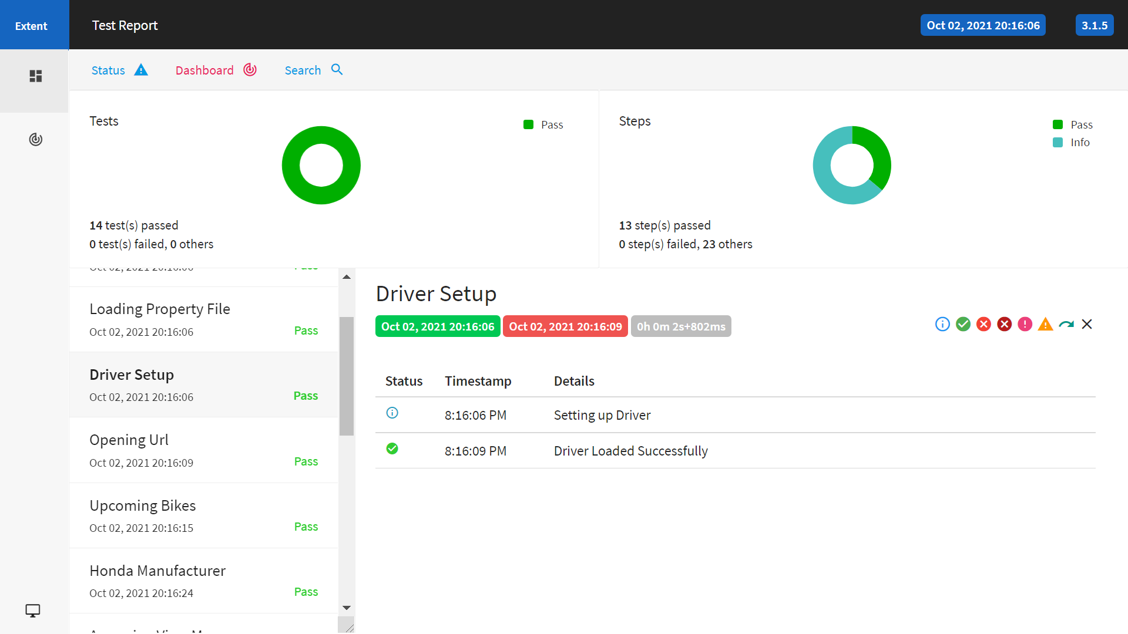
EXTENT REPORT

Slide 14
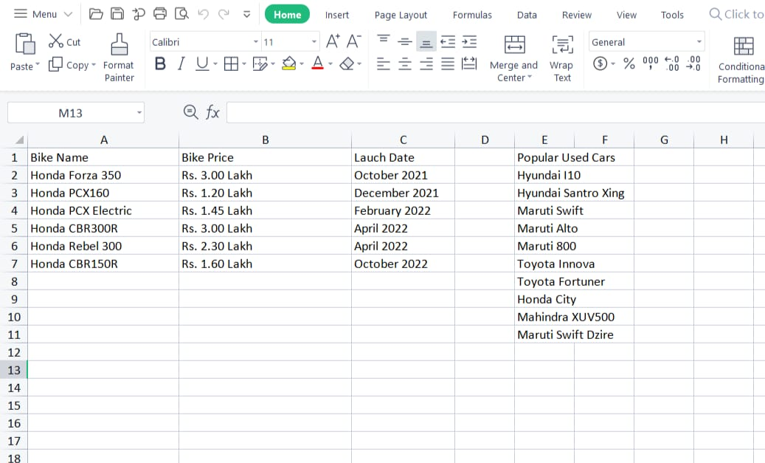
EXCEL OUTPUT

Slide 15
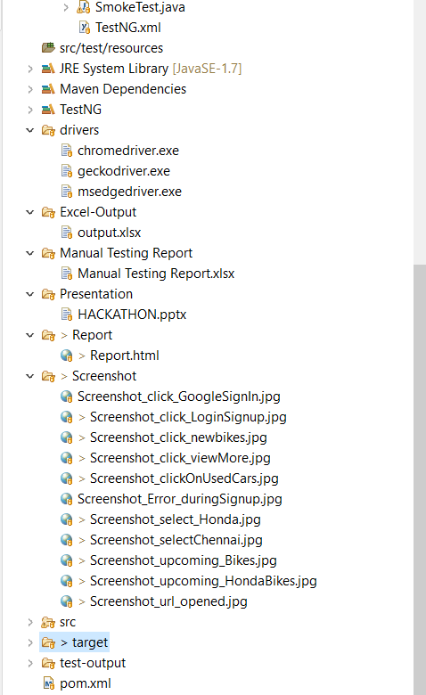
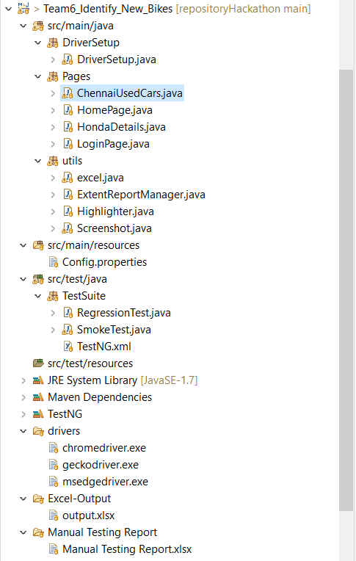
BASIC PROGRAM STRUCTURE

Slide 16
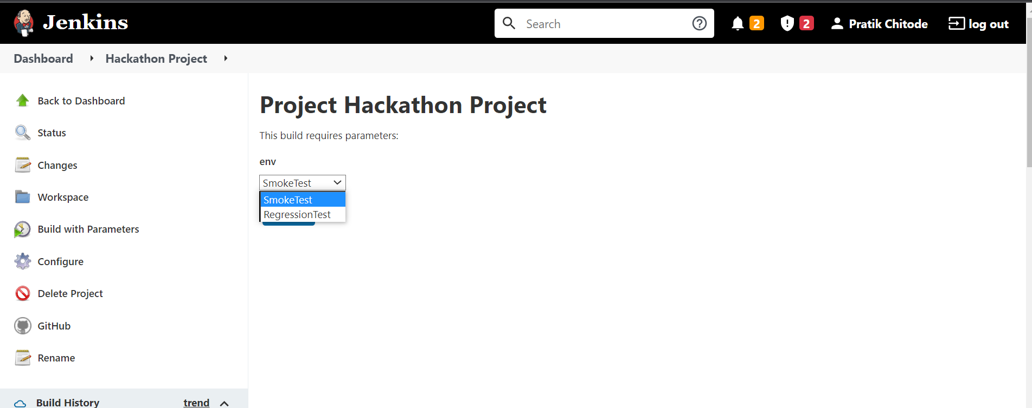

Slide 17
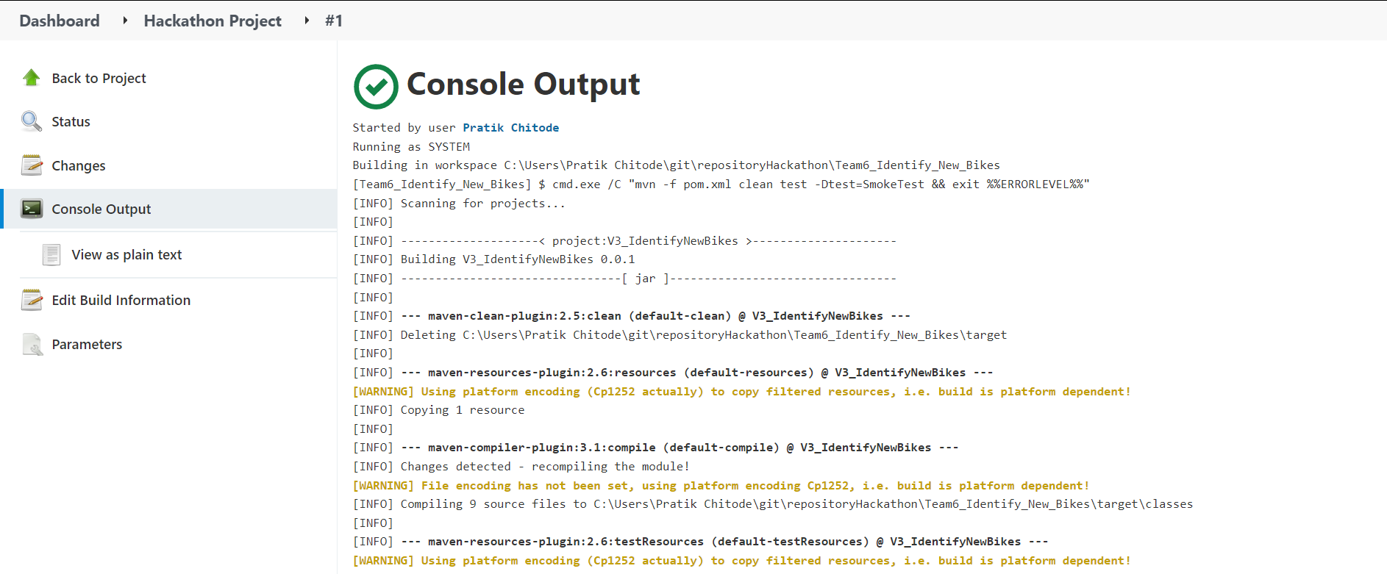
JENKINS RESULTS

Slide 18
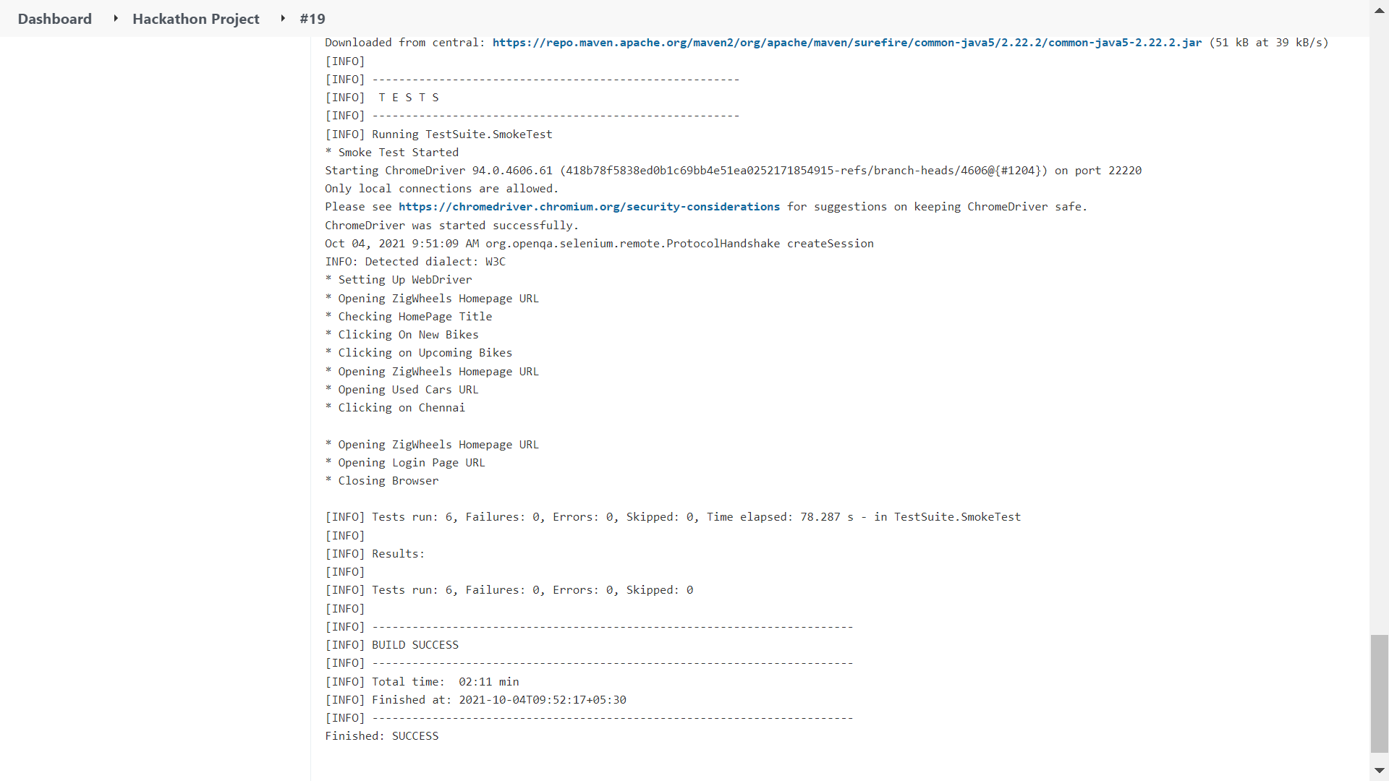

Slide 19
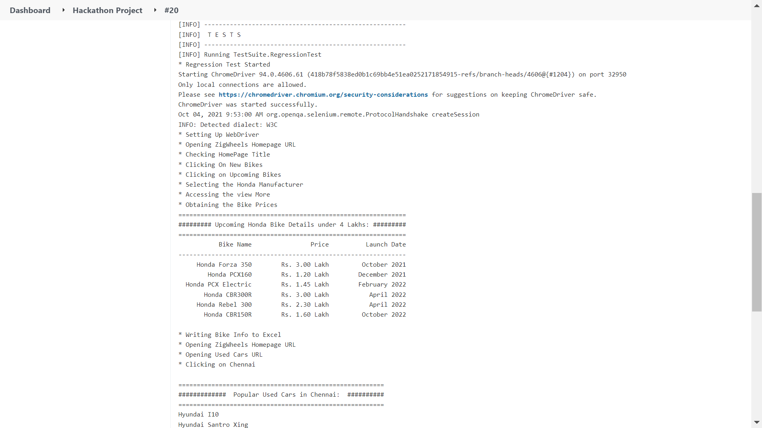

Slide 20
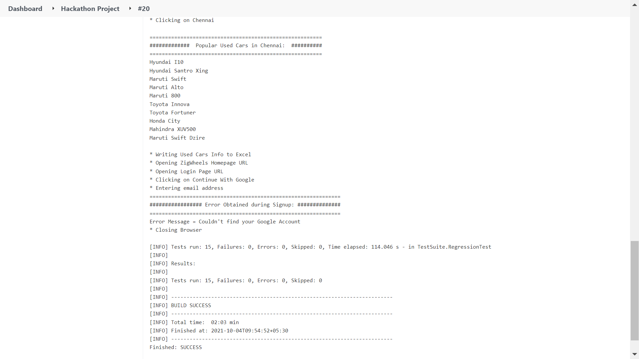

Slide 21
THANK YOU !

