Slide 1

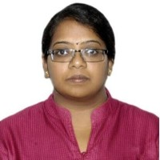

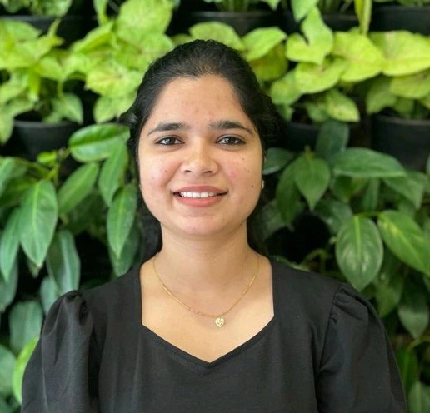

Platform Architecture and Adoption
Office of CTO, SAP
PVN PavanKumar
Uma Anbhazagan
Praveen Padegal
Swati Maste
Sr.Director & Head of APJ
Cloud Architect
Development Expert
Associate Developer
@_pvn_pavan
@UmaARamesh13
@praveen_padegal
@maste_swati
/pavankumarpvn/
/umaanbazhagan/
/praveenkumarpadegal/
/swati-maste/

