Slide 1
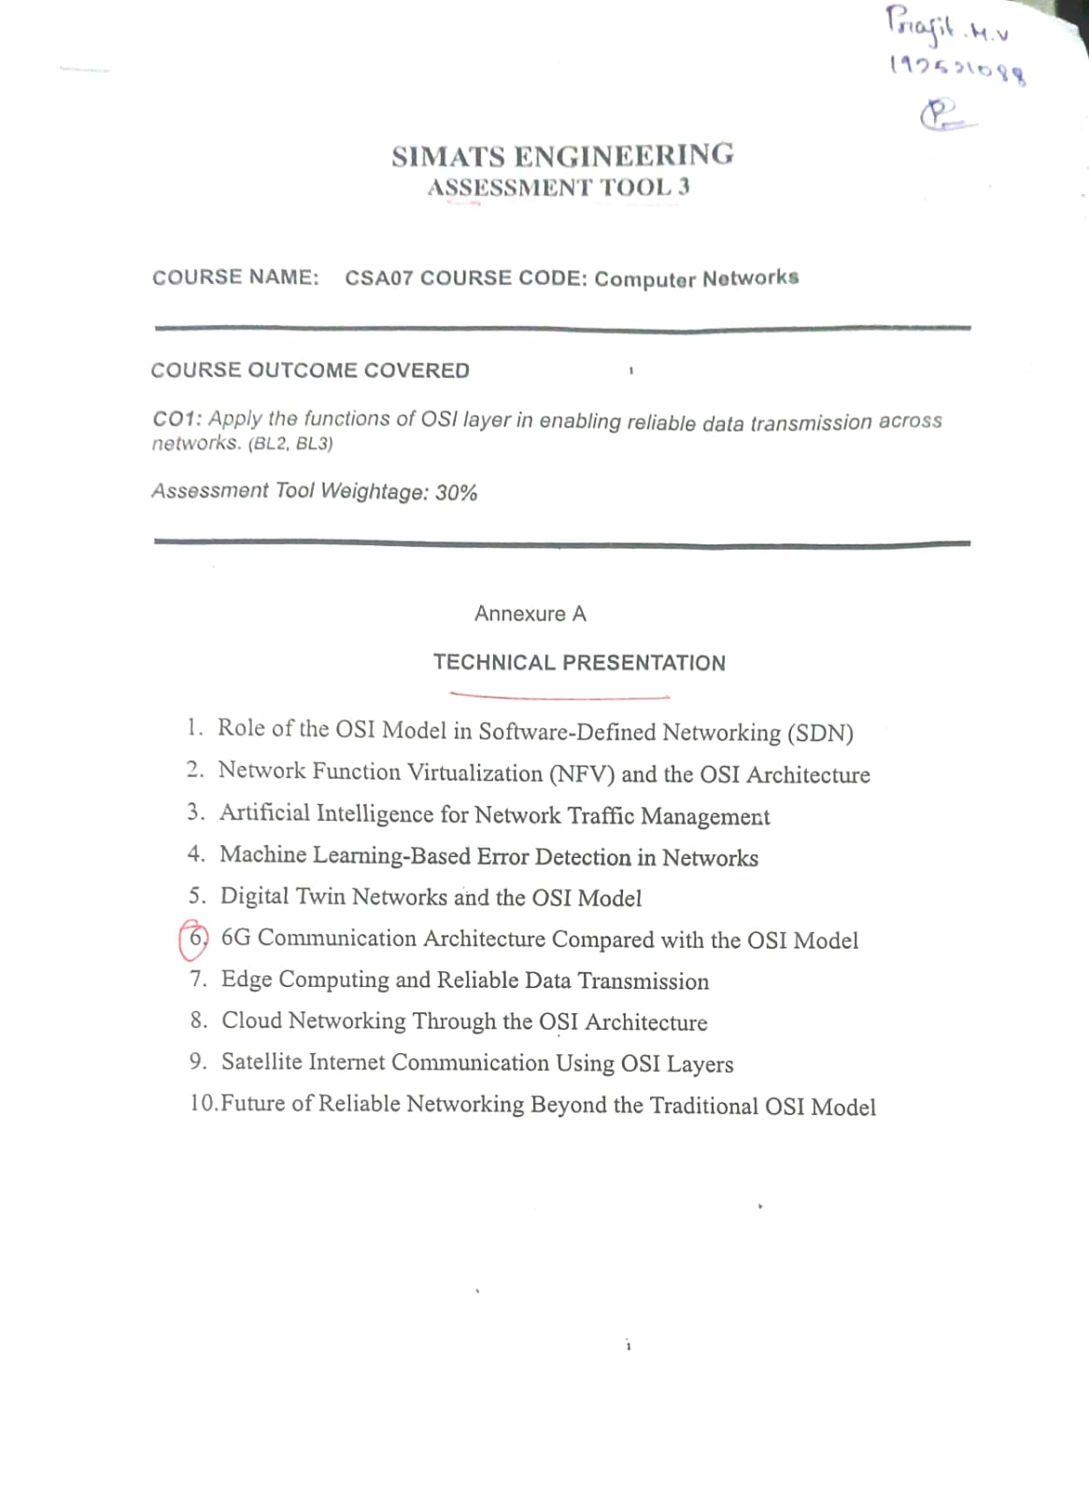

Slide 2

Satellite Internet Communication using the OSI Model CSA-0720
Guided By:
Agnes Shiffani.S
Presented by:
Prajit.M.V(192521088)
Guru Charan.M(192524434)

Slide 3


Introduction
Internet service provided through communication satellites.
Connects remote and rural areas.
Uses satellites orbiting the Earth.
Provides global internet connectivity. • Examples: Starlink, OneWeb, HughesNet

Slide 4
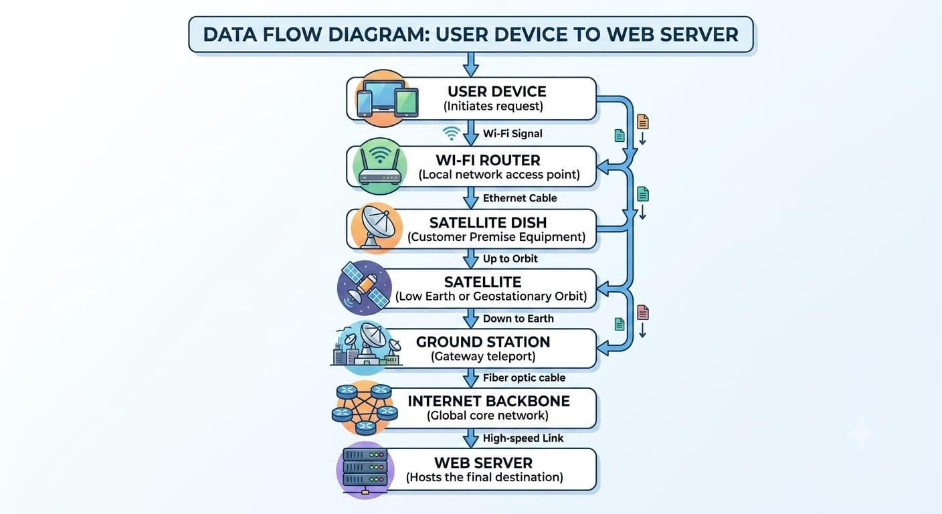
Basic Architecture

Slide 5
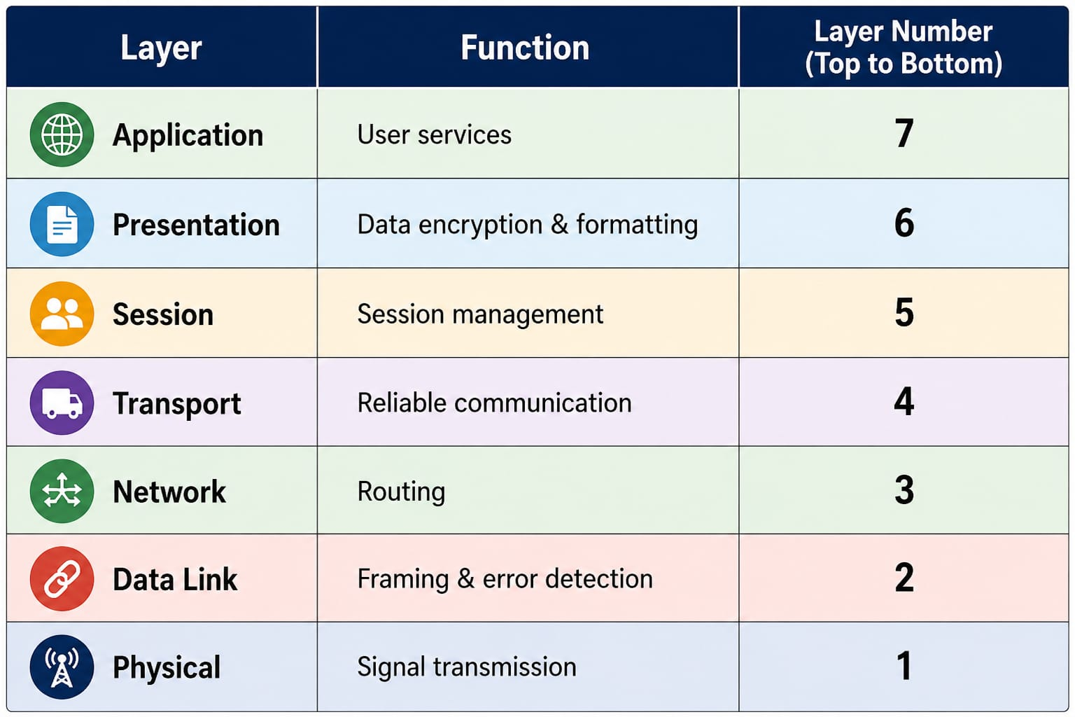
OSI Model Overview

Slide 6
Physical Layer
Role in Satellite Internet
Converts data into radio waves.
Transmits signals between Earth station and satellite.
Uses microwave frequencies (Ku, Ka, C Band).
Handles modulation and transmission.
Devices:
Satellite dish
Antenna
Modem

Slide 7
Data Link & Network
Data Link Layer:
Creates frames
Detects transmission errors
Performs MAC addressing
Controls access to the communication channel
Network Layer:
Assigns IP addresses
Determines routing path
Transfers packets through satellites
Handles fragmentation

Slide 8
Transport & Session
Transport Layer:
TCP/UDP communication
Error recovery
Flow control
Retransmission of lost packets
Session Layer:
Establishes communication session
Synchronization
Session recovery
Maintains active connections

Slide 9
Presentation & Application
Presentation Layer:
Data encryption
Compression
Data formatting
Application Layer:
Services used by users:
Web Browsing
Video Streaming
Email
Cloud Computing
Video Conferencing

Slide 10
Advantages & Challenges
Advantages:
Global coverage
Works in remote locations
High-speed internet
Disaster recovery communication
Challenges:
High latency (especially GEO satellites)
Weather interference
Expensive equipment

Slide 11
Conclusion
Satellite Internet enables worldwide connectivity.
Every OSI layer has a specific responsibility.
The OSI model ensures reliable, secure, and efficient communication.
Modern LEO satellites provide faster and lower-latency internet than traditional GEO satellites.

Slide 12
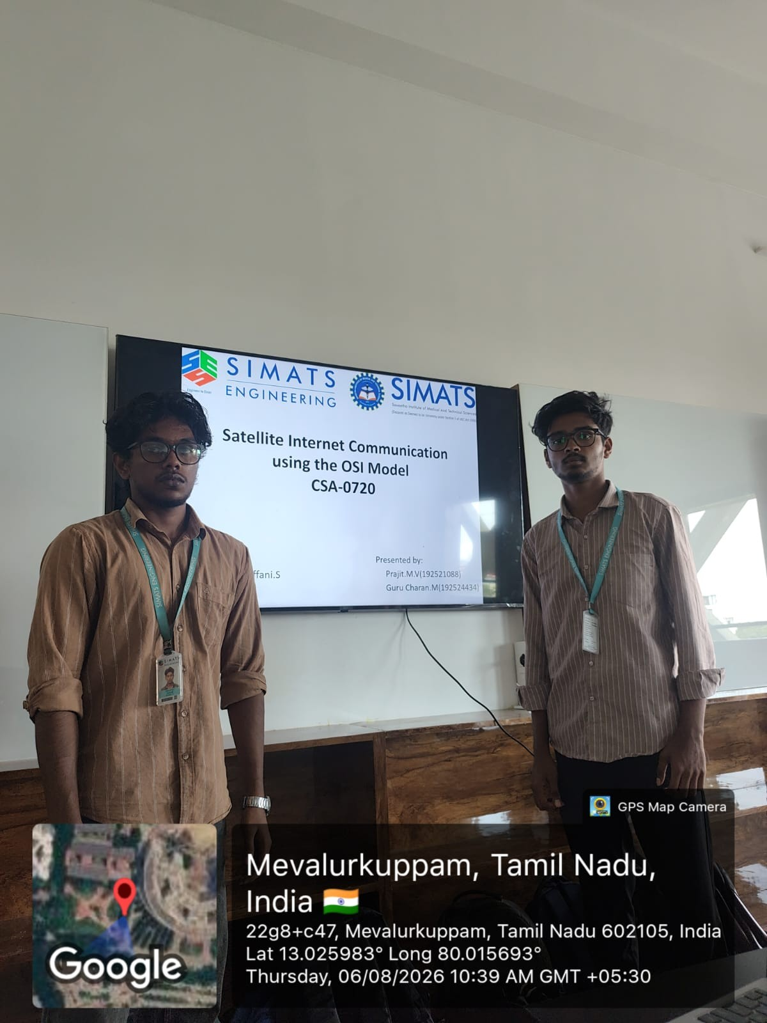

Slide 13
