Slide 1
🎓 Student Performance Prediction (Pass/Fail)
By Enter your name and teamates
Data Science & AI Project
2025

Slide 2
Objective
• Predict whether a student will pass or fail based on study hours, attendance, prior grades, and lifestyle factors.
• Early warning system to help educators and parents take timely action.

Slide 3
Dataset
• Synthetic dataset: student_performance_extended.csv (500+ records)
• Key features:
- gender, age, study hours, attendance, prior grade, assignments submitted
- family support, internet, extracurricular activities, health, sleep
- target variable: pass (1=Pass, 0=Fail)

Slide 4
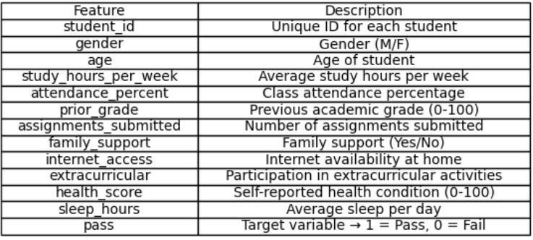
Dataset

Slide 5
Methodology
1. Data Preprocessing: Encode categorical variables (Yes/No, M/F)
2. Model Selection: Random Forest Classifier
3. Training & Testing: Train/test split, 100 estimators
4. Deployment: Streamlit dashboard for real-time predictions

Slide 6
Features Used
• gender, age, study_hours_per_week, attendance_percent
• prior_grade, assignments_submitted, family_support
• internet_access, extracurricular, health_score, sleep_hours

Slide 7
Model & Prediction
• Random Forest Classifier
• Handles numerical and categorical features effectively
• Example prediction: Given student details → PASS/FAIL with confidence score

Slide 8
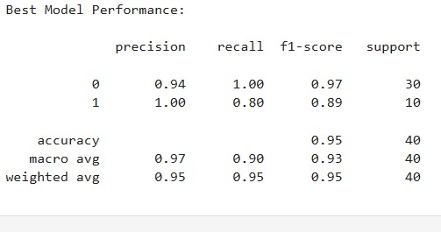
Model Performance

Slide 9
Dashboard
• Streamlit dashboard for interactive input
• Real-time prediction results
• Gauge chart for pass probability and feature bar chart

Slide 10
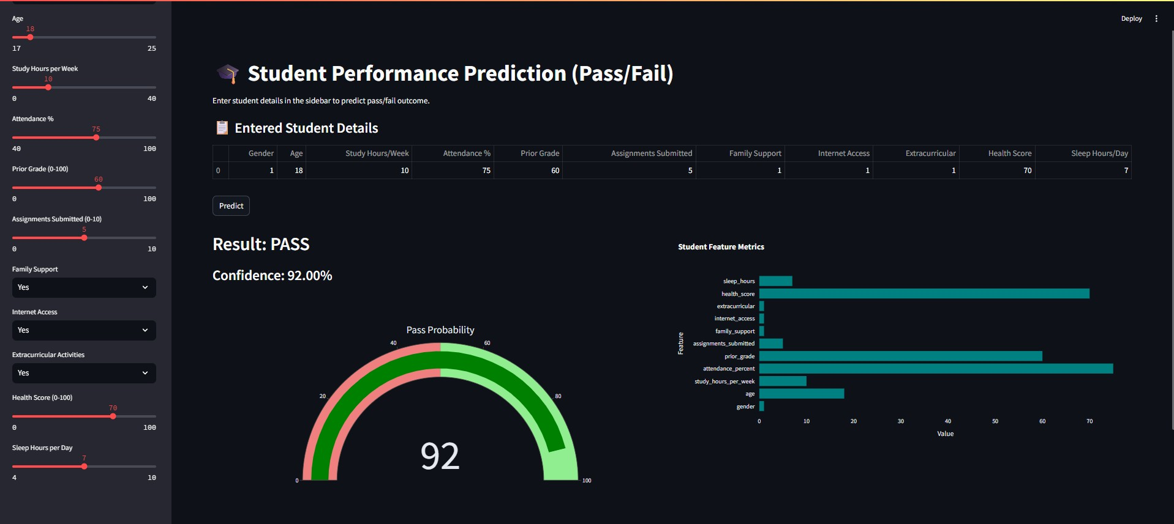
DashBoard

Slide 11
Results & Insights
• High prediction accuracy on test data
• Confidence score visualized
• Key insights: Study hours, attendance, prior grades highly impact performance

Slide 12
Conclusion & Future Work
• ML helps predict student performance effectively
• Future Improvements:
- Use real-world datasets
- Deploy online via Streamlit Cloud
- Add Explainable AI (SHAP values)
- Compare with other ML models (XGBoost, Neural Networks)

Slide 13
Thank You
Thank you!
Contact: Abhishek Khursange

