Slide 1
Android ?
An open-source operating system used for smart phones and tablet computers.
Developed by the Open Handset Alliance
led by Google

Slide 2
What can an Android phone do?
Highly customizable
Wallpapers
Themes
Face book
Twitter feeds
Manage your bank account
Order pizza and play games.

Slide 3
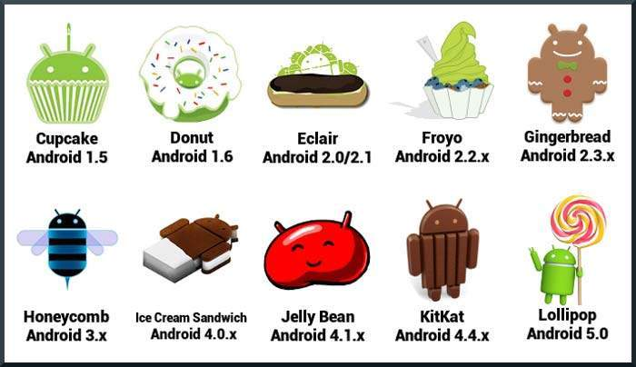
Android Version Name

Slide 4
API level?
Name | Version | Year
Froyo | 2.2 – 2.2.3 | 2010
Gingerbread | 2.3 – 2.3.7 | 2011
Ice Cream Sandwich | 4.0 – 4.0.4 | 2011
Jelly Bean | 4.1 – 4.1.2 , 4.2 – 4.2.2, 4.3 – 4.3.1 | 2012,2013
KitKat | 4.4 – 4.4.4 | 2013
Lollipop | 5.0 – 5.0.2 , 5.1 – 5.1.1 | 2014 , 2015
Marshmallow | 6.0 – 6.0.1 | 2015

Slide 5
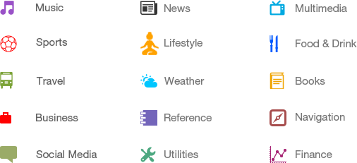
Categories of Android applications Android applications

Slide 6
Android Environmental Setup
Windows OS
Java JDK5 or later version
Android SDK
Java Runtime Environment (JRE) 6
Android Studio

Slide 7
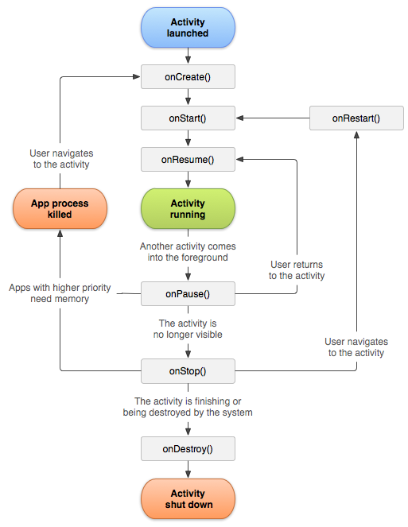
Android Life Cycle

Slide 8
onCreate() - Called when the activity is first created.
onRestart() - Called after your activity has been stopped, prior to it being started again. Always followed by onStart()
onStart() - Called when the activity is becoming visible to the user.
onResume() - Called when the activity will start interacting with the user.

Slide 9
onPause () - Called as part of the activity lifecycle when an activity is going into the background, but has not (yet) been killed.
onStop() - Called when you are no longer visible to the user.
onDestroy() - The final call you receive before your activity is destroyed.

Slide 10
Android Libraries
android.app − Provides access to the application model and is the cornerstone of all Android applications.
android.content − Facilitates content access, publishing and messaging between applications and application components.
android.database − Used to access data published by content providers and includes SQLite database management classes.
android.os − Provides applications with access to standard operating system services including messages, system services and inter-process communication.

Slide 11
android.text − Used to render and manipulate text on a device display.
android.view − The fundamental building blocks of application user interfaces.
android.widget − A rich collection of pre-built user interface components such as buttons, labels, list views, layout managers, radio buttons etc.
android.webkit − A set of classes intended to allow web-browsing capabilities to be built into applications.

Slide 12
Application Framework
Activity Manager − Controls all aspects of the application lifecycle and activity stack.
Content Providers − Allows applications to publish and share data with other applications.
Resource Manager − Provides access to non-code embedded resources such as strings, color settings and user interface layouts.
Notifications Manager − Allows applications to display alerts and notifications to the user.
View System − An extensible set of views used to create application user interfaces.

Slide 13
AndroidManifest.xml ?
It have configuration and permissions of an application
For example :
wifi
Bluetooth
Camera
Map Location
Data Usage…etc.,

Slide 14
Src :
This contains the .java source files for your project. By default, it includes an MainActivity.java source file having an activity class that runs when your app is launched using the app icon.
Gen :
This contains the .R file, a compiler-generated file that references all the resources found in your project. You should not modify this file.
Bin :
This folder contains the Android package files .apk built by the ADT during the build process and everything else needed to run an Android application.

Slide 15
res/drawable-hdpi :
This is a directory for drawable objects that are designed for high-density screens.
res/layout :
This is a directory for files that define your app's user interface.
res/values :
This is a directory for other various XML files that contain a collection of resources, such as strings and colours definitions.
AndroidManifest.xml :
This is the manifest file which describes the fundamental characteristics of the app and defines each of its components.

Slide 16
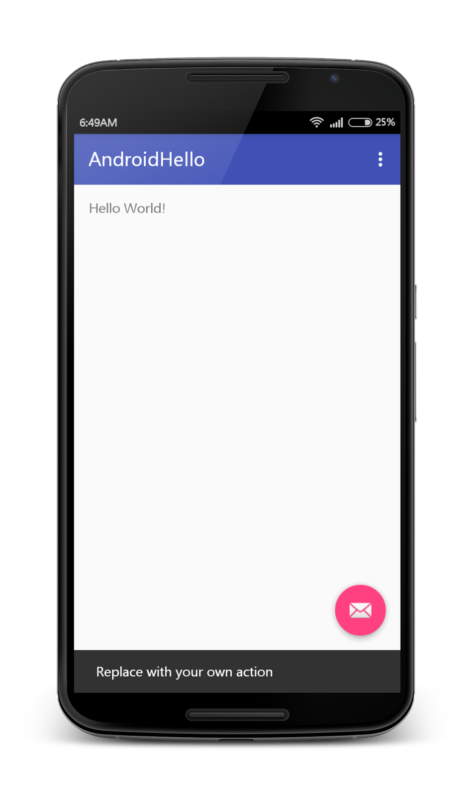
Activity ?:
An activity represents a single screen with a user interface just like window or frame of Java.
This Page is Called Activity Screen

Slide 17
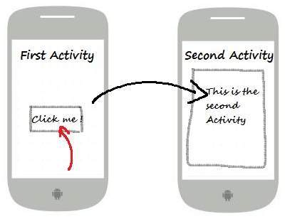
Intent ?:
Connect one activity to another activity, we can do
this quote by explicit intent, below image is
connecting first activity to second activity by
clicking button.
Examble Code :
Intent i = new Intent(FirstActivity.this, SecondActivity.class);
startActivity(i);

Slide 18
View class
All graphical UI objects collectively called UI
controls or Widgets
Button
TextView
EditText
CheckBox
RadioButton
ImageView
Spinner ,…etc,.

Slide 19
Layouts
Linear Layout
LinearLayout is a view group that aligns all children in a single direction, vertically or horizontally.
Relative Layout
RelativeLayout is a view group that displays child views in relative positions.
Table Layout
TableLayout is a view that groups views into rows and columns.
Absolute Layout
AbsoluteLayout enables you to specify the exact location of its children.

Slide 20
Frame Layout
The FrameLayout is a placeholder on screen that you can use to display a single view.
List View
ListView is a view group that displays a list of scrollable items.
Grid View
GridView is a ViewGroup that displays items in a two-dimensional, scrollable grid.

Slide 21
Layout Attributes
Attribute | Description
android:id | This is the ID which uniquely identifies the view.
android:layout_width | This is the width of the layout.
android:layout_height | This is the height of the layout
android:layout_marginTop | This is the extra space on the top side of the layout.
android:layout_marginBottom | This is the extra space on the bottom side of the layout.
android:layout_marginLeft | This is the extra space on the left side of the layout.

Slide 22
Attribute | Description
android:layout_marginRight | This is the extra space on the right side of the layout.
android:layout_gravity | This specifies how child Views are positioned.
android:layout_weight | This specifies how much of the extra space in the layout should be allocated to the View.
android:layout_x | This specifies the x-coordinate of the layout.
android:layout_y | This specifies the y-coordinate of the layout.
android:layout_width | This is the width of the layout.
android:layout_width | This is the width of the layout.

Slide 23
LET US GO FOR PRACTICLE CLASS

