Slide 1
HOTEL RESERVATION SYSTEM
A Java Console Application Demonstrating OOP, Collections, File Handling & Exception Handling
Project Presentation

Slide 2
Introduction
What the project is and why it was built
The Hotel Reservation System is a Java-based console application built using Object-Oriented Programming concepts. It automates hotel room booking, customer registration, room availability checking, bill generation, and reservation management.
Java Collections
File Handling
Exception Handling
Stores rooms and reservations dynamically using ArrayList
Persists reservation records to a text file
Prevents crashes from invalid user input

Slide 3
Project Objectives
What the system sets out to achieve
1
Automate hotel room booking
5
Save reservation details into a file
2
Store customer information
6
Demonstrate OOP concepts
3
Display available rooms
7
Demonstrate the Collections Framework
4
Generate customer bills
8
Demonstrate File & Exception Handling

Slide 4
Software & Hardware Requirements
Environment used to build and run the project
Hardware
Software
Processor: Intel i3 or above
RAM: 4 GB
Hard Disk: 100 MB free space
Java JDK 8 or above
Eclipse IDE
Windows / Linux

Slide 5
Project Modules
Five modules mapped to Java classes
Room Management
Add Room · Display Rooms · Search Room
Room.java
Customer Registration
Register Customer · Store Info
Customer.java
Reservation
Book Room · Cancel Reservation
Reservation.java
Hotel Management
Check-In · Check-Out · Billing · Save/Load
Hotel.java
User Interface
Menu · User Input · Method Calls
Main.java

Slide 6
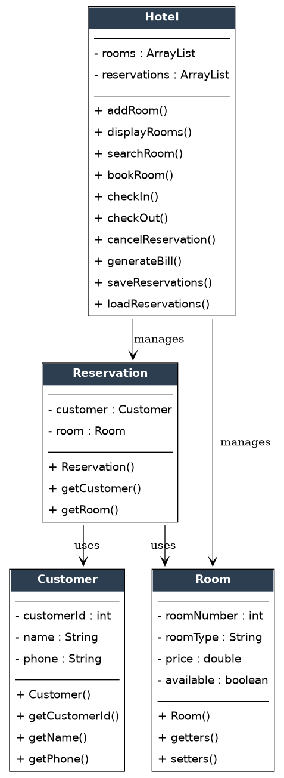
UML Class Diagram
Structural view of the system's core classes
Customer
Reservation
Room
Hotel
Reservation links a Customer to a Room. Hotel is the controller class, managing collections of Room and Reservation objects and exposing all booking operations.

Slide 7
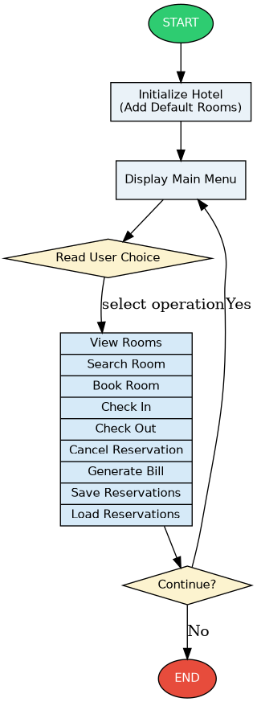
Process Flowchart
Runtime control flow of the console application
Initialize hotel & default rooms
Display main menu
Read & validate user choice
Execute selected operation
Loop until user exits

Slide 8
Core Java Concepts Applied
OOP, Collections, Exceptions, and File I/O
Encapsulation
Collections
private int roomNumber; — accessed via getters/setters
ArrayList<Room> rooms = new ArrayList<>();
Exception Handling
File Handling
catch (InputMismatchException e) { ... }
FileWriter writer = new FileWriter("reservations.txt");

Slide 9
Sample Output
Console walkthrough of a booking
HOTEL RESERVATION SYSTEM
1. View Rooms 2. Search Room 3. Book Room 4. Check In 5. Check Out
6. Cancel Reservation 7. Generate Bill 8. Save Reservations 9. Load 10. Exit
Customer ID : 1 Name : David Phone : 9876543210
Room Number : 102 -> Room Booked Successfully.
Room Number : 102 Days Stayed : 5 Total Bill = $400
Saved Successfully.

Slide 10
Advantages & Limitations
A balanced look at the current system
Advantages
Limitations
User-friendly
Easy to understand
Fast room booking
Prevents duplicate booking
Saves reservation records
Demonstrates core Java concepts
Console-based interface
No database connectivity
No login / authentication
Reservation data stored in a text file only

Slide 11
Future Enhancements
Where the project can go next
MySQL Database Integration
Java Swing / JavaFX GUI
Online Payment System
Customer Login
Admin Dashboard
Room Images
Date-Based Reservations
Email / SMS Notifications

Slide 12
Conclusion
The Hotel Reservation System successfully automates hotel booking operations using Java. It demonstrates Object-Oriented Programming, Collections, Exception Handling, and File Handling in a practical application — simple, reliable, easy to maintain, and well suited as a Java mini-project for academic purposes.
Thank You

