Slide 1

Secure P2P Using WebRTC
Noida Institute of Engineering & Technology
(An Autononomous Institute)
Guided By Ms. Barkha Bhardwaj
BY: Prateek kR. SINGH, Ritika singh, shadiya khan
Roll No: 2001331520083, 2001331520089, 2001331520098 B.tech CS-AI(B)
Year : 4th year

Slide 2
Contents
Introduction
Literature Review
Methodology
Result and Discussion
Conclusion
Future scope
References

Slide 3
Introduction
Due to the efficiency and direct data transmission capabilities, peer-to-peer (P2P) file transfer programs have grown in popularity.. However, ensuring the security and privacy of data in such decentralized systems remains a significant challenge. This research paper introduces the SecureLink protocol, a special approach that leverages Web Real-Time Communication (WebRTC) technology to enhance the security of P2P file transfers while maintaining the benefits of direct peer-to-peer communication. The SecureLink protocol is build upon the foundation of WebRTC, a standardized framework for real-time communication in web browsers, to establish secure connections between peer devices. This study provides a thorough overview of the design process. This paper further explores practical approach for the application of the SecureLink protocol, including secure data sharing, collaborative environments, and decentralized content delivery networks. This research contributes to the advancement of secure peer-to-peer communication, offering a promising avenue for secure data exchange while harnessing the power and convenience of direct connections in decentralized networks.

Slide 4
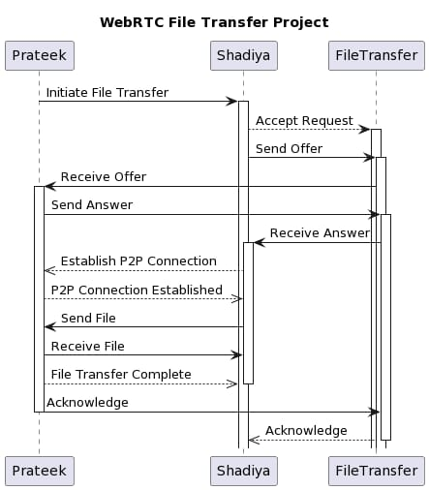
Steps in WebRTC File Transfer

Slide 5
Literature Review
Sr. No. | Author(s) | Focus of the Paper | Key Points in Coverage | Technique(s) Used | Parameter Analyzed | Research Gaps
1 | Arto Heikkinen et al (2015)[1] | Performance Evaluationof Distributed Data DeliveryUsing WebRTC | Delay,.Web Browser, Peer-to-Peer | PeerJS.JavaScript library and PeerServer signaling server | performance of WebRTC on mobile devices is examined. | Real-world application settings and LTE networks were not taken into account.
2 | Gao Ying et al (2011)[2][21] | P2P File Transfer in a Computational Grid | Condor Grid, P2P File System, WheelFS | CONDOR, WheelFS | Condor now.has a new file transmission technique. How do I get wheelfs to function with Condor? | The work processing pace was substantially slower.
3 | Lei You et al (2011)[3][24] | RealPeer-based P2P File Search System | P2P; RealPeer; file search system; .LDAP | CL-PKC security authentication mechanism and LDAP | addressing the security issue of the P2P network file search system and establishing a secure and stable solution | RealPeer is built on a single thread scheduler, whereas most P2P networks are multi-threaded.
4 | Rajesh Dukiya et al (2017)[4] | Web RTC File Sharing in a Distributed Operating System | WebTorrent, peer-to-peer.file sharing, distributed operating systems, and network burden sharing are examples of technologies. | System for Distributed Computing | Identifying bottlenecks in speed, the breadth of Web.Torrent file sharing, and free-riding | Between RTC and P2P, there is still a.communication gap.
5 | Shyan Hwang et al (2020)[5][22] | Locality-Aware P2P File Sharing Using BitTorrent | BitTorrent, P2P, TWDM-PON, Colorless ONU, Traffic Localization | BitTorrent (BT), Passive optical network (PON) | Enhances QoS by reducing mean packet latency, system performance, and traffic drop percentage. | Can be used with multi-PON and a variety of applications.
6 | Tyler Wilson et al (2018)[6] | Routing Protocol Evaluation Using FTP and P2P | File Transfer Protocol (FTP), EIGRP, OSFPRIP, DES Peer to Peer(P2P) | RIP, OSPF, or EIGRP routing protocols are supported by Riverbed Academic Modeler 17.5. | To discover the most effective routing protocol for given network configuration. | Throughput may be boosted 1.5x while queue waits are reduced somewhat.

Slide 6
7 | Ahmed Abada et al (2007)[7][23] | A New Path Selection and Recovery Mechanism for P2P File Sharing Applications in MANETs | Peer to peer computing , Protocols , Mobile ad hoc networks , Unicast , Network topology. | Mobile Ad Hoc Networks (MANETS) file sharing protocols | a novel approach for path selection and recovery (Reactive with Unicast Probing Messages) | The problem of threshold calculation in the completely random environment of MANETs must be solved.
8 | Yingjie Xia et al (2008)[8] | A Role and Reputation-Based Peer-to-Peer Transfer System | Peer to peer computing, Access control, Authentication, Web server, Internet, Network servers, Digital signatures, File servers, Computer architecture | R2P System | To address the issues of resource piracy, user privacy, and network congestion | To reduce I/O, network, and other system overloads, application performance should be improved.
9 | Cong Shi et al (2011)[9][25] | Data Transfer with Low Delay for P2P File Sharing Systems | Delay , Bandwidth , Peer to peer computing , Internet , Network topology , Topology , Computer architecture | iDTT is now supported by eMule and BitTorrent. | It minimizes network traffic during peak hours while just marginally increasing download times for certain apps. | the architecture of the iDTT node (the iServer), the positioning of the iServers within the Internet and routing of data in the overlay.
10 | Mohamed Amine RIAHLA et al (2012)[10] | An Anonymous and Confidential File Sharing Protocol Adapted to P2P Networks | Components include anonymity, encryption, mobile multi-agent systems, and peer-to-peer networks. | ANONYMEP2P PROTOCOL, e Diffie-Helman protocol | It explains the development and testing of AnonymP2P, a unique anonymous and secure peer-to-peer system. | A Man-In-The-Middle attack is successful if at least one node on each channel connecting any two nodes in the network is compromised.
11 | Arto Heikkinen et al (2015)[11] | Assessing Performance of Distributed Data Delivery via WebRTC | Investigation into WebRTC performance within web browsers and P2P scenarios, particularly concerning latency | It makes use of the PeerJS JavaScript library and the PeerServer signaling server. | WebRTC performance on mobile devices is being evaluated. | One of the drawbacks mentioned is the absence of real-world application scenarios and LTE networks.
12 | Gao Ying et al (2011)[12] | Innovations in File Transfer within Computational Grids using P2P Techniques | Introduction of a novel file transfer approach in the CONDOR environment, specifically addressing WheelFS integration | Employed CONDOR and WheelFS | Observed significantly reduced job processing speeds with the new method | Highlighted challenges in optimizing job processing with WheelFS in the context of CONDOR

Slide 7
13 | Lei You et al (2011)[13] | Creating a Secure Peer-to-Peer File Search System Using RealPeer | Establishment of a secure P2P file search system based on RealPeer, LDAP, and CL-PKC security | CL-PKC security authentication and LDAP implementation | Aimed to enhance security in P2P file searches and establish system stability | Acknowledged RealPeer's limitation of using a single-thread scheduler compared to multi-threaded P2P networks
14 | Rajesh Dukiya et al (2017)[14] | Exploring File Sharing in Distributed Operating Systems through WebRTC | Examination of file sharing in distributed operating systems, incorporating WebTorrent, P2P sharing, and network workload distribution | Utilized WebTorrent and P2P file sharing within a distributed OS | Investigation into performance bottlenecks and the presence of free-riding | Noted the existence of a communication gap between RTC and P2P technologies
15 | Shyan Hwang et al (2020)[15] | Improving QoS with BitTorrent-Based P2P Locality-Aware File Sharing | Through BitTorrent and PON technologies, Quality of Service (QoS) measures like as packet latency, system throughput, and traffic drop % may be improved. | Leveraged BitTorrent and Passive Optical Network (PON) | Demonstrated QoS enhancements and suggested applicability in multi-PON setups and diverse applications | No specific research gaps mentioned
16 | Tyler Wilson et al (2018)[16] | Evaluation of Routing Protocol Efficiency in Network Setup with FTP and P2P | Assessment of routing protocol efficiency in a network setup | Utilized Riverbed Academic Modeler 17.5 and routing protocols (RIP, OSPF, EIGRP) | Indicated the potential for a 1.5x throughput increase and marginal reductions in queuing delays | Research gaps were not explicitly stated
17 | Ahmed Abada et al (2007)[17] | P2P File Sharing in MANETs: A Novel Path Selection and Recovery Mechanism | A route selection and recovery technique for file sharing on Mobile Ad Hoc Networks (MANETs) is being developed. | A route selection and recovery technique for file sharing on Mobile Ad Hoc Networks (MANETs) is being developed. | Addressed file sharing protocols in MANETs | A new path selection and recovery approach utilizing Reactive with Unicast Probing Messages was presented.
18 | Cong Shi et al (2011)[18] | Adaptation of eMule and BitTorrent for efficient data transfer in P2P file sharing | Adapted eMule and BitTorrent to use iDTT | Reduced network congestion during peak times with minimal impact on download times | Emphasized design aspects of iDTT nodes and their strategic placement within the Internet | Highlighted the challenge of threshold calculation in the random MANET environment
19 | Yingjie Xia et al (2008)[19] | Introducing a Role and Reputation-Based Peer-to-Peer Transfer System (R2P System) | Taking care of concerns such as resource piracy, user privacy, and network congestion | Introduced the R2P System | Dedicated to improving application performance in order to reduce I/O, network, and system overloads. | Specific research gaps were not mentioned
20 | Mohamed Amine RIAHLA et al (2012)[20] [26] | Designing an Anonymous and Confidential P2P File Sharing Protocol for Enhanced Security | Development of the ANONYMEP2P PROTOCOL with the Diffie-Hellman protocol | Created AnonymP2P and highlighted the potential for Man-In-The-Middle attacks | Noted the requirement of at least one compromised node on each path for a successful attack | The study concentrated on the security and anonymity elements of P2P file sharing systems.

Slide 8
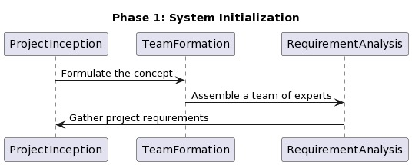
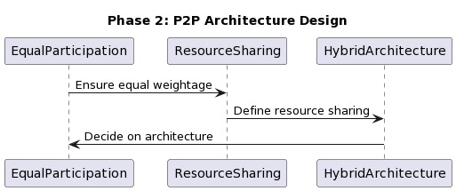
Flow chart of Methodology Adopted

Slide 9
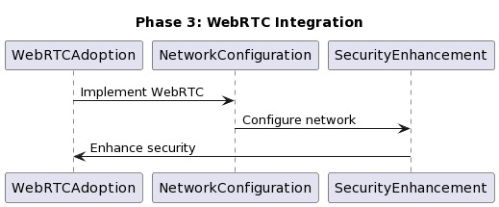
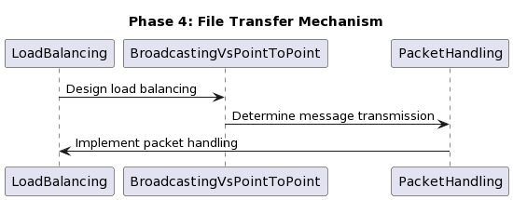
Flow chart of Methodology Adopted (Contd.)

Slide 10
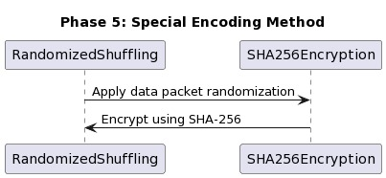
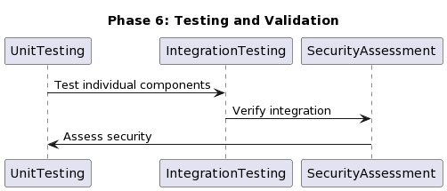

Slide 11
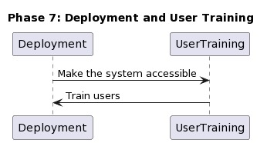
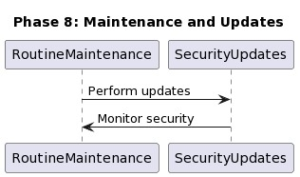

Slide 12
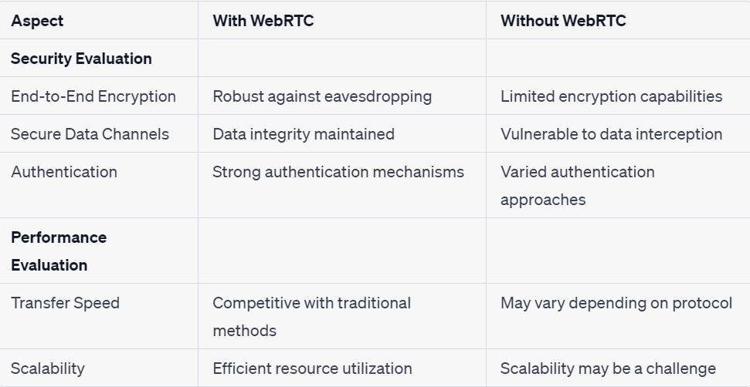
Experimental Results & Discussion

Slide 13
Experimental Results & Discussion (Contd.)
Security Enhancement:
The security evaluation results confirm that WebRTC provides a secure foundation for P2P file transfers. However, additional measures, such as key management and forward secrecy, could be implemented to
further enhance security.
User Experience:
WebRTC's ease of use and compatibility with web browsers make it a user-friendly choice for secure file transfers. The seamless integration with web applications ensures a smooth user experience.
Network Reliability:
WebRTC's ability to traverse NATs and firewalls contributed to the reliability of our P2P file transfer system. Users can initiate transfers even in challenging network environments.

Slide 14
Conclusion
In conclusion, our project represents a pioneering effort in the domain of distributed file sharing through Web-based P2P mechanisms. It serves as a testament to the transformative potential of WebRTC and P2P integration, not only in the realm of file sharing but also in shaping the future of Internet of Things (IoT), smartphones, cloud computing, and even space science. While communication gaps between real-time communication (RTC) and P2P may persist, we remain confident that innovative solutions, such as NPM libraries, can bridge these divides. Our project stands as a testament to the boundless possibilities that emerge when cutting-edge technologies converge, opening doors to new horizons in distributed operating systems and beyond.

Slide 15
Future Scope
The future outcome is mostly focused on increasing the security of the file transfering process and making the files transferred to be non-corrupt or be error free the development team's expertise, and user feedback. Regular testing and user feedback can help refine and improve the app over time to meet user expectations and address any issues that may arise during usage. Using WebRtc for transferring file may have privacy concern. To increase its privacy our scope is to itegrate blockchain with this project.

Slide 16
References
[1]A. Heikkinen, T. Koskela and M. Ylianttila, "Performance evaluation of distributed data delivery on mobile devices using WebRTC," 2015 International Wireless Communications and Mobile Computing Conference (IWCMC), Dubrovnik, Croatia, 2015, pp. 1036-1042.
[2]G. Ying, L. GuanYao and H. JianCong, "A New Method of File Transfer in Computational Grid Using P2P Technique," 2011 International Conference on Network Computing and Information Security, Guilin, China, 2011, pp. 332-336.
[3]Lei You, Zhongwen Li, Fang Fang, Jian Liu and Jun Hu, "P2P file search system based on RealPeer," 2011 IEEE International Conference on Anti-Counterfeiting, Security and Identification, Xiamen, 2011, pp. 5-8.
[4]R. Dukiya, S. Sharma, S. Koppu and M. Rao, "Reliable file sharing in distributed operating system using web RTC," 2017 International conference on Microelectronic Devices, Circuits and Systems (ICMDCS), Vellore, 2017
[5]S. Hwang, A. Rianto and R. Kharga, "BitTorrent-Based P2P Locality-Awareness File Sharing over Software-defined NG-PON2," 2020 International Computer Symposium (ICS), Tainan, Taiwan, 2020, pp. 131-134,
[6]T. Wilson, E. Abdelfattah and S. Hamada, "Evaluation of routing protocols with FTP and P2P," 2018 IEEE Long Island Systems, Applications and Technology Conference (LISAT), Farmingdale, NY, USA, 2018, pp. 1
[7]A. Abada, L. Cui, C. Huang and H. -H. Chen, "A Novel Path Selection and Recovery Mechanism for MANETs P2P File Sharing Applications," 2007 IEEE Wireless Communications and Networking Conference, Hong Kong, China, 2007Y. Xia, G. Song, Y. Zheng and M. Zhu, "R2P: A Peer-to-Peer Transfer System Based on Role and Reputation," First International Workshop on Knowledge Discovery and Data Mining (WKDD 2008), Adelaide, SA, Australia, 2008, pp. 136-141.
[8]Y. Xia, G. Song, Y. Zheng and M. Zhu, "R2P: A Peer-to-Peer Transfer System Based on Role and Reputation," First International Workshop on Knowledge Discovery and Data Mining (WKDD 2008), Adelaide, SA, Australia, 2008.
[9]C. Shi, M. H. Ammar and E. W. Zegura, "iDTT: Delay Tolerant Data Transfer for P2P File Sharing Systems," 2011 IEEE Global Telecommunications Conference - GLOBECOM 2011, Houston, TX, USA, 2011, pp. 1-5.
[10] M. A. Riahla, K. Tamine and P. Gaborit, "A protocol for file sharing, anonymous and confidential, adapted to P2P networks," 2012 6th International Conference on Sciences of Electronics, Technologies of Information and Telecommunications (SETIT), Sousse, Tunisia, 2012, pp. 549-557

Slide 17
[11]Gupta, K. K., Vijay, R., Pahadiya, P., Saxena, S., & Gupta, M. (2023). Novel Feature Selection Using Machine Learning Algorithm for Breast Cancer Screening of Thermography Images. Wireless Personal Communications, 1-28.
[12]Pahadiya, P., Vijay, R., Gupta, K. K., Saxena, S., & Shahapurkar, T. (2023). Digital Image Based Segmentation and Classification of Tongue Cancer Using CNN. Wireless Personal Communications, 1-19.
[13]Gupta, K. K., Vijay, R., Pahadiya, P., & Saxena, S. (2022). Use of novel thermography features of extraction and different artificial neural network algorithms in breast cancer screening. Wireless Personal Communications, 1-30.
[14]Gupta, K. K., Rituvijay, Pahadiya, P., & Saxena, S. (2022). Detection of cancer in breast thermograms using mathematical threshold based segmentation and morphology technique. International Journal of System Assurance Engineering and Management, 1-8.
[15]Gupta, K. K., Vijay, R., & Pahadiya, P. (2022). Detection of abnormality in breast thermograms using Canny edge detection algorithm for thermography images. International Journal of Medical Engineering and Informatics, 14(1), 31-42.
[16] R. Rojas-Cessa and C-B. Lin, "Captured-Frame Eligibility and Roundrobin Matching for Input-
queue Packet Switches," IEEE Commun. Letters, vol.8, issue 9, pp. 585-587, Sep. 2004.
[17] R. Rojas-Cessa and C-B. Lin, "Captured-frame matching schemes for scalable input-queued packet switches," Computer Communications, 13pages, May 2007.
[18] H. Kim, J. Son, K. Kim, "A packet-based scheduling algorithm for highspeed switches," Proc. IEEE TENCON, Vol. 1, pp. 117-121, August,2001.
[19] C. Hu, X. Chen, W. Li, and B. Liu, "Fixed-length switching vs. variable length switching in input-queued IP switches," Proc. IEEE Workshop on IP Operations and Management, pp. 117-122, October 2004.
[20] Y. Ganjali, A. Keshavarzian, D. Shah, "Cell Switching Versus Packet Switching in Input-Queued Switches," IEEE/ACM Trans. on Network.,Vol. 13, Issue 4, pp. 782-789, August 2005.
[21] Aggarwal, V., Feldmann, A., & Scheideler, C. (2007).” Can ISPs and P2P users cooperate for improved performance?.” ACM SIGCOMM Computer Communication Review, 37(3), 29-40.

Slide 18
[22] Yang, B. B., & Garcia-Molina, H. (2003, March). “Designing a superpeer network. In Data Engineering,” 2003. Proceedings. 19th International Conference on (pp. 49-60). IEEE.
[23] Saroiu, S., Gummadi, P. K., & Gribble, S. D. (2001, December). “Measurement study of peer-to-peer file sharing systems. In Electronic Imaging” 2002 (pp. 156-170). International Society for Optics and Photonics.
[24] Ripeanu, M. (2001, August). “Peer-to-peer architecture case study:Gnutella network. In Peer-to-Peer Computing,” 2001. Proceedings. First International Conference on (pp. 99-100). IEEE.
[25] Jiang, H., Li, J., Li, Z., & Bai, X. (2009). “Efficient large-scale content distribution with combination of CDN and P2P networks.” International Journal of Hybrid Information Technology, 2(2), 4.
[26] Lamport, L. (1978). “Time, clocks, and the ordering of events in a distributed system.” Communications of the ACM, 21(7), 558-565.

Slide 19
Thank You

