Slide 1

Flight Delay Risk Assessment and Cascade
Diagnosis using Bayesian Networks
Estimating flight delay risk and diagnosing how delays propagate between connected flights, using a Bayesian Network
Probabilistic Reasoning — Review 1 · Course 22AIE301
Name:
Mamidala Som Praneeth Babu CB.SC.U4AIE24029
Charith Dasari CB.SC.U4AIE24014
Group 16

Slide 2
Introduction
Airlines and passengers can usually check if a specific flight is running late. What is harder to see is how that delay moves through the system — the same aircraft flies several times a day, so a delay on one flight can push into the next flight, and the one after that.
What we're building — a system that estimates delay risk from real flight conditions, and traces how that risk carries over to the next flight on the same aircraft
Why Bayesian Networks — the problem is naturally about reasoning under uncertainty — we don't know for certain if a flight will be delayed, only how likely it is given what we observe
What makes it more than prediction — the same trained model can be asked in reverse — given a flight was delayed, was it caused fresh, or inherited from an earlier flight
Core idea: a flight's delay risk is not just about its own conditions — it also depends on what already happened earlier that day, on that same aircraft.
Flight Delay Risk — PR Review 1
3

Slide 3
Literature Review
Source
Main Idea
Limitation
Flight Delay and Delay Propagation Analysis Based on Bayesian Network (ResearchGate)
Predicts delay distributions using a BN on the same DOT-style flight data
Reports error metrics only — no live, queryable tool
Characterization of Delay Propagation in Air Traffic Networks (ScienceDirect, 2021)
Separates delay into 'primary' (caused fresh) vs 'propagated' (inherited)
Framed as offline network analysis, not per-flight diagnosis
Wu & Law (2019), Transportation Research Part E
Models delay propagation through shared aircraft/crew connections
Focused on airline-level patterns, not a single flight's risk
A Review of Research on Flight Delay Propagation (Wiley, 2025)
Surveys BN-based propagation work; confirms it's an active research area
A survey — doesn't build or test a model itself
Flight Delay Risk — PR Review 1
4

Slide 4
Objectives
1.
Predict delay risk from real flight conditions — airline, season, time of day, origin airport.
2.
Model cascade propagation — how one flight's delay affects the delay probability of the next flight flown by the same aircraft.
3.
Diagnose delay backward — given an observed delay, infer whether it was inherited from an earlier flight or newly caused.
4.
Flight Delay Risk — PR Review 1
6

Slide 5
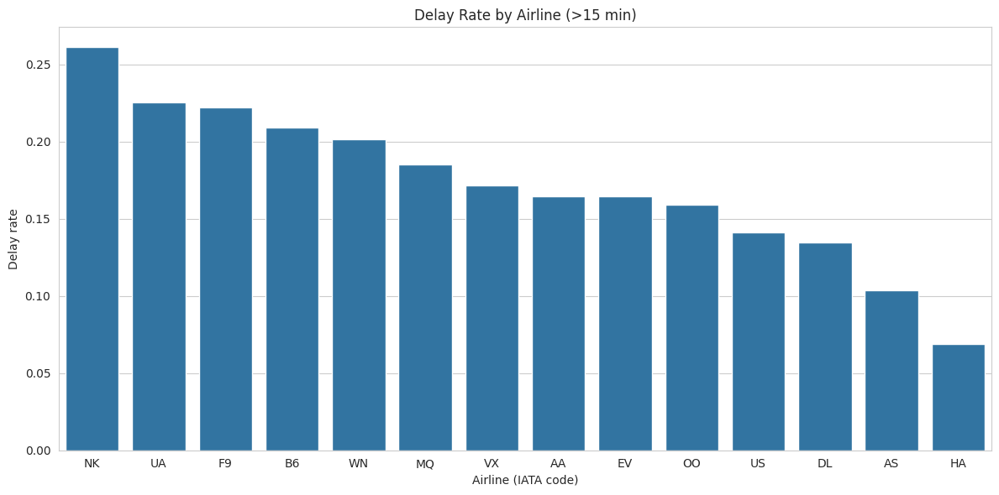
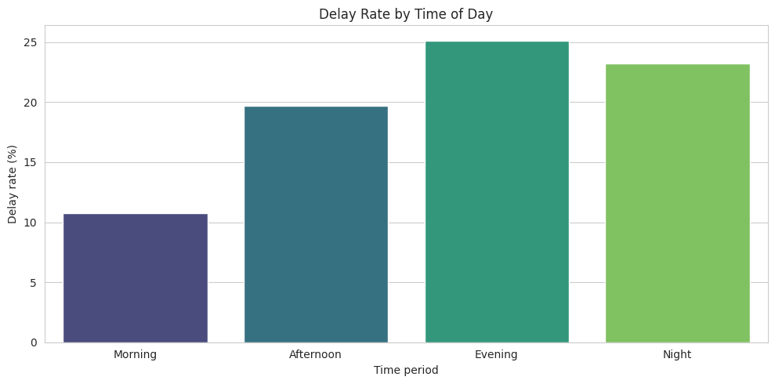
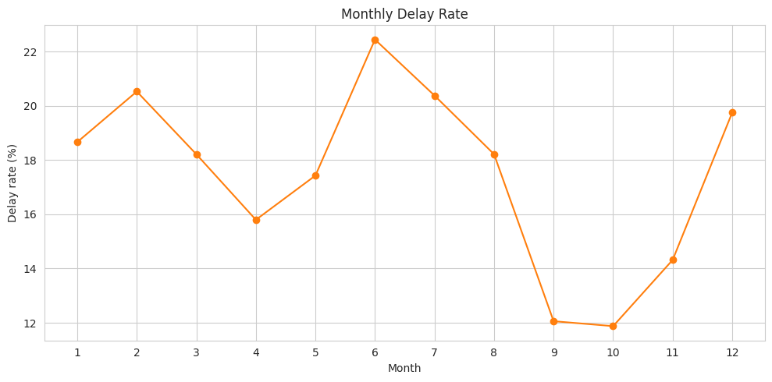
Data Analysis
Real delay-rate breakdowns from the 5.8M-flight dataset — checked before choosing which variables go into the network.
Spread ranking here (Airline 19.2pp > Time of Day 14.4pp > Month 10.6pp > Day Type 2.9pp) matches the Value of Information ranking on the Decision / What-If slide (Time of Day highest, Day Type lowest) — two independent checks agree.
Flight Delay Risk — PR Review 1
7

Slide 6
Methodology — Overall
Probabilistic reasoning module used: a Discrete Bayesian Network (pgmpy), built over categorical flight-condition variables.
Real flight
data (US DOT)
Clean +
categorize
Base Bayesian
Network
Cascading
Bayesian Network
Inference
(forward & backward)
5.8M flights, verified for real signal before use
Airline, season, time of day, origin, delay category
Airline / Season / Time / Origin → Delay risk
Same-aircraft consecutive flights linked by tail number
Variable Elimination — exact inference, both directions
Base Bayesian Network — edges labeled with real delay-rate spread from EDA
Airline
Time of Day
DELAY
BINARY
Month / Season
Origin Airport
Day Type
Flight Delay Risk — PR Review 1
8

Slide 7
Cascading Bayesian Network — Concept
The base network (previous slide) scores one flight at one point in time, using 5 condition nodes.
The Cascading Bayesian Network is a second, separate model ( just 2 nodes ) that links a flight's delay outcome to the delay outcome of the next flight flown by the same aircraft.
Trained network structure: 2 nodes (CURRENT_DELAY, NEXT_DELAY), each with 2 states (Delayed / OnTime), 1 directed edge.
CURRENT
DELAY
NEXT
DELAY
1
2
3
4
Flight 1
Flight 2
Flight 3
Flight 4
States: {Delayed, OnTime}
Same edge, applied repeatedly across one aircraft's day
Because it is one trained joint probability model, it can be queried forward (what's the risk?) or backward (what caused it?) without retraining.
Flight Delay Risk — PR Review 1
9

Slide 8
Cascading Bayesian Network — On Our Dataset
US Department of Transportation — 2015 Flight Delays and Cancellations Dataset (Kaggle: usdot/flight-delays).
5,724,299 real chained flight pairs — no synthetic rows.
1.
Dataset is grouped as 5.8M flights by tail number — 4,897 real aircraft
2.
Sort each aircraft's flights by date and scheduled departure
3.
CPT (from data)
Pair each flight with the next one flown by that aircraft
CURRENT_DELAY
NEXT: Delayed
NEXT: OnTime
4.
Label both legs On Time / Delayed, keep only complete pairs
On Time
11.2%
88.8%
Delayed
48.2%
51.8%
A delayed flight is about 4.3× more likely to be followed by another delay.
Worked example — reading a query off the trained network
Forward query — Aircraft N407AS departs delayed on its first leg.
P(NEXT_DELAY | CURRENT_DELAY = Delayed) → looks up the CPT row above → 48.2% Delayed, 51.8% OnTime for its next leg.
Backward query — A later flight on some aircraft is observed Delayed.
P(CURRENT_DELAY | NEXT_DELAY = Delayed) → same table, read in reverse → 81.2% the earlier flight was also delayed, 18.8% it was fresh.
Flight Delay Risk — PR Review 1
10

Slide 9
Methodology — PR Inference
Method used — Variable Elimination, from pgmpy
Category — exact inference;
probabilities are computed directly from the learned joint distribution
How it's used here — the same trained network answers forward queries (given conditions, what's the risk?) and backward queries (given a delay, what caused it?)
Conditions
Delay Risk
Forward: P(flight is delayed∣known conditions)
Conditions
Delay Risk
Backward P(likely cause∣delay already observed)
Flight Delay Risk — PR Review 1
11

Slide 10
Methodology — PR Learning
Structure
the DAG is expert-specified from domain knowledge (airline, season, time, origin all point to delay; current delay points to next-flight delay) not learned from data
Parameters
Conditional Probability Tables(CPT) are learned using a Discrete Bayesian Estimator with a BDeu prior
Bayesian estimation, not plain counting, so rare condition combinations don't produce extreme probabilities
Data discipline — every dataset was checked for real signal before training, and classes were balanced by real undersampling, not synthetic oversampling
Flight Delay Risk — PR Review 1
12

Slide 11
Methodology — Decision / What-If (Value of Information)
Using entropy over the base network, we rank how much each unknown factor would reduce uncertainty about a flight's delay risk — i.e. what's most worth knowing first.
Time of day is nearly 3.5× more informative than the next-best factor — the single most useful thing to ask about an unknown flight.
Factor
Information gain (bits)
Time of Day
0.0209
Airline
0.0061
Information Gain=H(Delay)−H(Delay∣Factor)
Season
0.0055
Origin Airport
0.0011
Day Type
0.0003
Flight Delay Risk — PR Review 1
13

Slide 12
Methodology — Combining with AI
Our project does not combine the Bayesian Network with any machine learning or deep learning models,
every probability traces back to a conditional probability table that can be inspected directly.
Future scope
A learned signal for better weather or airport-congestion data could feed in as an additional node, without changing the interpretability of the reasoning layer itself.
Flight Delay Risk — PR Review 1
14

Slide 13
Progress in terms of Project Objectives
Objective
Progress
Predict delay risk (base BN)
Trained and evaluated — 68% accuracy vs 33% random baseline to check if BN is working or not…
Model cascade propagation
Trained on 5.7M real chained flight pairs — 48.2% vs 11.2%
Diagnose backward
Reverse query on cascade model — 81.2% inherited delays
Web interface
Not Started
Final write-up + deployment
Not started
Flight Delay Risk — PR Review 1
15

Slide 14
Weekly Timeline for Project Completion
Week
Planned work
Done so far
Data verification, base BN, cascade BN, backward reasoning, value of information, working Streamlit interface
Deploy the interface, add error handling, test with more scenarios
Write the final report and prepare for final review
Flight Delay Risk — PR Review 1
16

Slide 15
Thank You
Sowmya Mam — Probablistic Reasoning (222AIE301)
FitStack — DBMS Zeroth Review
17

