Slide 1
DEEP LEARNING — PROJECT REVIEW
Knee Osteoarthritis Severity Grading from X-rays Using a From-Scratch ResNet Ensemble
R1
R2
Y
R3
Kellgren–Lawrence grade classification (G0–G4) with label cleaning, self-supervised pre-training and a four-seed ensemble
R4
Mamidala Som Praneeth Babu (CB.SC.U4AIE24029)
Course 22AIE304 · Deep Learning
Amrita Vishwa Vidyapeetham, Coimbatore
Four ResNet seeds (R1–R4) → ensemble → KL grade Y

Slide 2
Project Implementation Workflow
Five stages from the raw X-ray to the final KL grade
01
Preprocessing & Augmentation
Grayscale 224×224 replicated to 3 channels and scaled to [−1, 1]; GPU augmentation (rotation, shift, zoom, flip, noise, erasing).
Output: 4,911 train / 867 validation / 4,008 test images
02
Label Cleaning with CleanLab
5-fold out-of-fold predictions flag suspect labels; flagged samples are down-weighted to 0.3× and never removed.
Output: 988 of 4,911 training labels down-weighted
03
Self-Supervised Pre-training
Rotation prediction (0° / 90° / 180° / 270°) for 15 epochs on the training images only; no labels, no outside data.
Output: Initial weights for every ResNet
04
Fine-tuning Four ResNet Seeds
80 epochs with class-weighted focal loss and ordinal soft labels; AdamW, cosine schedule, weight EMA of 0.998.
Output: Four models, validation κ 0.815 – 0.823
05
Ensemble & Decoding
κ-weighted average with horizontal-flip test-time augmentation; per-class bias tuned on the validation set only.
Output: 65.7 % accuracy, quadratic κ 0.813
Knee Osteoarthritis KL-Grade Classification Using ResNet · Deep Learning · 22AIE304
2 / 16

Slide 3
ResNet Architecture
A 5.31 M-parameter residual network trained from random initialisation
1
DATA FLOW
Input
RGB image
Entry
Conv + Pool
Stage 1
2× ResBlock
Stage 2
↓2 + 2× Res
Stage 3
↓2 + 2× Res
Stage 4
↓2 + 1× Res
GAP
Avg pool
Head
MLP
224×224×3
112×112×64
112×112×64
56×56×128
28×28×256
14×14×256
256-d
5 logits
2
DESIGN CHOICES
3
PARAMETERS BY COMPONENT
From scratch: random initialisation, no pretrained weights
Four stages: 64 → 128 → 256 → 256 channels
Overall stride 16: 224×224 input reduced to a 14×14 map
Downsampling: stride-2 convolutions instead of pooling
Compact: about 25 minutes per model on a Kaggle T4
Component | Output | Parameters | Share
Entry | 112×112×64 | 1,856 | < 0.1 %
Stage 1 | 112×112×64 | 147,968 | 2.8 %
Stage 2 | 56×56×128 | 664,832 | 12.5 %
Stage 3 | 28×28×256 | 2,656,768 | 50.0 %
Stage 4 | 14×14×256 | 1,771,008 | 33.4 %
Head | 5 logits | 67,333 | 1.3 %
Total |  | 5,309,765 | 100 %
Knee Osteoarthritis KL-Grade Classification Using ResNet · Deep Learning · 22AIE304
3 / 16

Slide 4
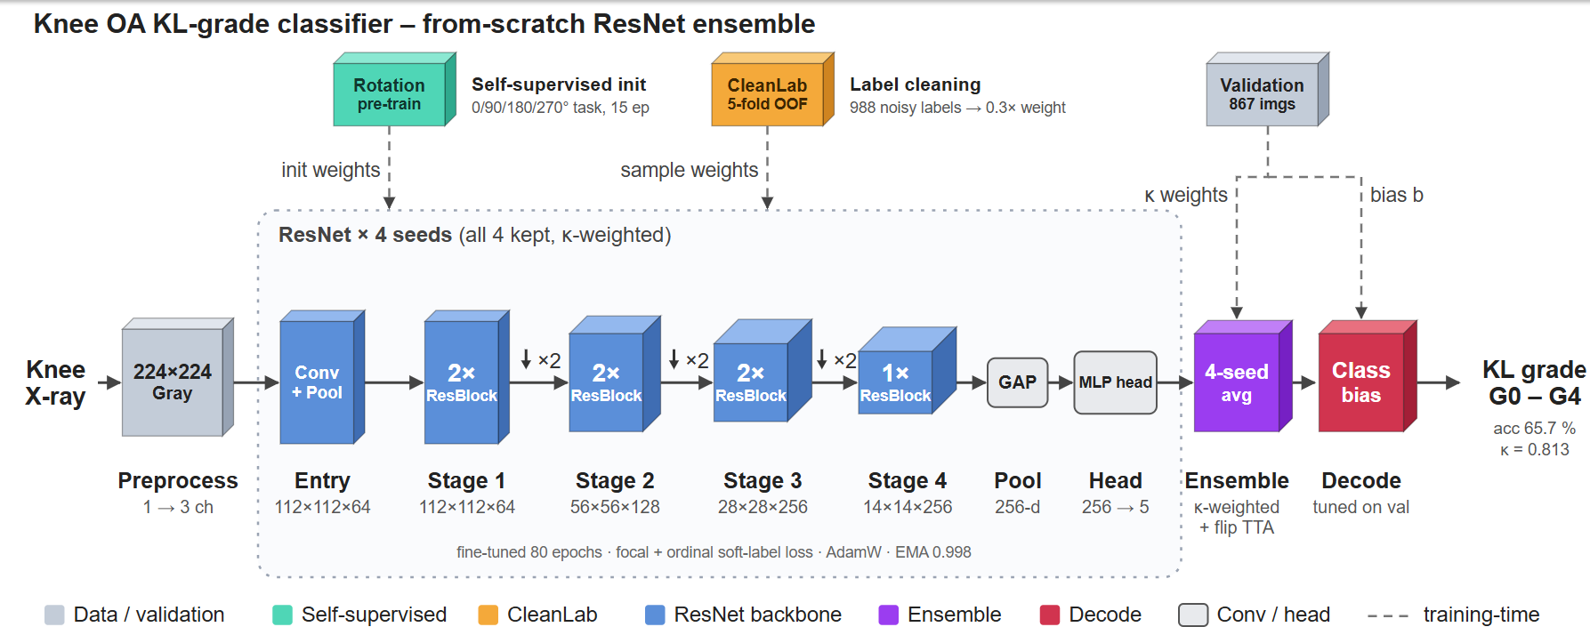
Model Architecture Overview
End-to-end pipeline: self-supervised init, label cleaning, four ResNet seeds, ensemble and decoding
Knee Osteoarthritis KL-Grade Classification Using ResNet · Deep Learning · 22AIE304
4 / 16

Slide 5
Components: Residual Block & Downsampling
The two building blocks that make up Stages 1 to 4
Input x
1
RESIDUAL BLOCK
Two 3×3 convolutions with batch normalisation. The input is added back before the final ReLU: add, then activate.
Conv 3×3
y = ReLU( BN(Conv(ReLU(BN(Conv(x))))) + x )
BatchNorm + ReLU
identity
skip
Conv 3×3
2
WHY IT HELPS
The identity path gives gradients a direct route to early layers, which makes a four-stage network trainable from scratch.
BatchNorm
3
DOWNSAMPLING BETWEEN STAGES
+
A stride-2 3×3 Conv-BN-ReLU halves the resolution and widens the channels (64 → 128 → 256), replacing pooling.
ReLU
74 K
parameters in a ResBlock at 64 channels
1.18 M
parameters in a ResBlock at 256 channels
Output y
Knee Osteoarthritis KL-Grade Classification Using ResNet · Deep Learning · 22AIE304
5 / 16

Slide 6
Components: Entry, Pooling & Classification Head
How the image is lifted into features and turned into a grade
1
ENTRY BLOCK
2
GLOBAL AVERAGE POOLING
3
CLASSIFICATION HEAD
Conv 3×3, 3 → 64
14×14×256 feature map
Linear 256 → 256
BatchNorm + ReLU
Adaptive average pool
BatchNorm + ReLU
MaxPool 2×2
256-d vector
Dropout 0.4
Linear 256 → 5
Lifts the 3-channel input to 64 feature maps and halves the resolution from 224 to 112.
Averages each channel over space into a fixed-length descriptor that tolerates small shifts of the joint.
Maps the descriptor to five KL-grade logits; dropout limits over-fitting on the small training set.
1,856
parameters
0
parameters
67,333
parameters
4
WHERE THE 5.31 M PARAMETERS SIT
Entry < 0.1 % Stage 1 2.8 % Stage 2 12.5 % Stage 3 50.0 % Stage 4 33.4 % Head 1.3 % (left to right)
Knee Osteoarthritis KL-Grade Classification Using ResNet · Deep Learning · 22AIE304
6 / 16

Slide 7
Training Strategy
Loss, optimisation and inference choices, all tuned on the validation set
1
LOSS FUNCTION
3
AUGMENTATION (ON THE GPU)
Focal loss (γ = 2) with class weights for the rare G4
Ordinal soft labels: 15 % of the label mass goes to neighbouring grades
Ordinal MSE term ramped up over 15 epochs (weight 0.05)
CleanLab weights: suspect labels count 0.3×
Rotation ±15°, translation, zoom, horizontal flip
Gamma, brightness and contrast jitter
Gaussian noise and random erasing
4
INFERENCE
2
OPTIMISATION
Flip test-time augmentation on every model
κ-weighted average of the four seeds
Per-class bias tuned on validation macro-F1
AdamW: lr 1e-3, weight decay 2e-2 (not on BatchNorm or bias)
Schedule: 3-epoch warm-up, then per-step cosine to 0
Weight EMA 0.998; checkpoint chosen by validation κ
Mixed precision (fp16) on a Kaggle T4
Nothing is selected or tuned on the test images.
Knee Osteoarthritis KL-Grade Classification Using ResNet · Deep Learning · 22AIE304
7 / 16

Slide 8
Comparison of the Three Architectures
Same data, same training recipe, four seeds each; scored on all 4,008 test images
Architecture | Parameters | Design | Val κ | Test accuracy | Test κ
MixedKernelNet | 1.24 M | 4 conv blocks alternating 3×3 and 5×5 kernels | 0.688 | 54.7 % | 0.655
DenseNet | 0.23 M | 3 dense blocks (growth 16) with 1×1 transitions | 0.776 | 62.0 % | 0.752
ResNet (selected) | 5.31 M | 4 stages of residual blocks, 64 → 256 channels | 0.811 | 65.5 % | 0.817
Ensemble of all 12 models | – | κ-weighted, flip TTA, bias tuned on validation | – | 64.72 % | 0.796
Ensemble of 4 ResNets (final) | – | κ-weighted, flip TTA, bias tuned on validation | – | 65.67 % | 0.813
Note: single-model rows are means over seeds 1 to 4 (validation κ is the selection metric); test numbers are for reporting only. The 4-ResNet ensemble comes from a separate ResNet-only run of the same recipe; before bias tuning the two ensembles score 64.67 % / κ 0.787 (12 models) and 65.82 % / κ 0.819 (4 ResNets).
Knee Osteoarthritis KL-Grade Classification Using ResNet · Deep Learning · 22AIE304
8 / 16

Slide 9
Per-Seed Accuracy by Architecture
Each of the 12 models scored on all 4,008 test images; the ranking holds for every seed
1
TEST ACCURACY (%) OF EACH MODEL
10.8 pts
higher mean accuracy for ResNet than for MixedKernelNet (65.5 % vs 54.7 %)
DenseNet sits in between at 62.0 % with only 0.23 M parameters.
64.67 %
raw accuracy of the 12-model ensemble, below the best single ResNet (65.99 %)
The final ensemble therefore keeps the four ResNets only.
Knee Osteoarthritis KL-Grade Classification Using ResNet · Deep Learning · 22AIE304
9 / 16

Slide 10
Results
Four-seed ResNet ensemble, trained from scratch
65.67 %
0.813
0.665
65.94 %
Accuracy
Quadratic κ
Macro-F1
Accuracy
all 4,008 test images
all 4,008 test images
all 4,008 test images
official 1,656 test images
1
FULL EVALUATION (SCORED ONCE ON TEST)
Evaluation set | Images | Accuracy | Balanced acc. | Macro-F1 | Quad. κ
All test – final (bias-tuned) | 4,008 | 65.67 % | 0.661 | 0.665 | 0.813
All test – raw | 4,008 | 65.82 % | 0.684 | 0.672 | 0.819
Official test – final (bias-tuned) | 1,656 | 65.94 % | 0.657 | 0.661 | 0.825
Official test – raw | 1,656 | 66.61 % | 0.689 | 0.677 | 0.833
Final applies the per-class bias tuned on validation; raw is the plain κ-weighted ensemble. Bias tuning trades about 0.2 points of accuracy for better balance between grades; both are reported.
Knee Osteoarthritis KL-Grade Classification Using ResNet · Deep Learning · 22AIE304
10 / 16

Slide 11
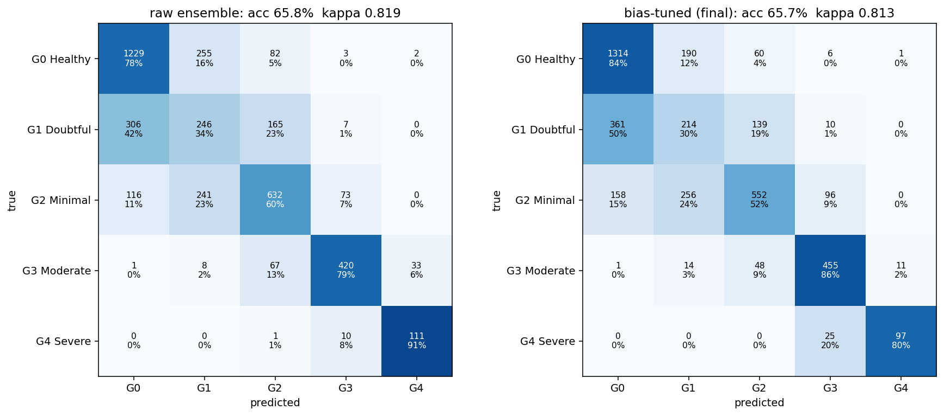
Confusion Matrices
Raw ensemble (left) and final bias-tuned ensemble (right) on all 4,008 test images; rows = true grade, columns = predicted
Knee Osteoarthritis KL-Grade Classification Using ResNet · Deep Learning · 22AIE304
11 / 16

Slide 12
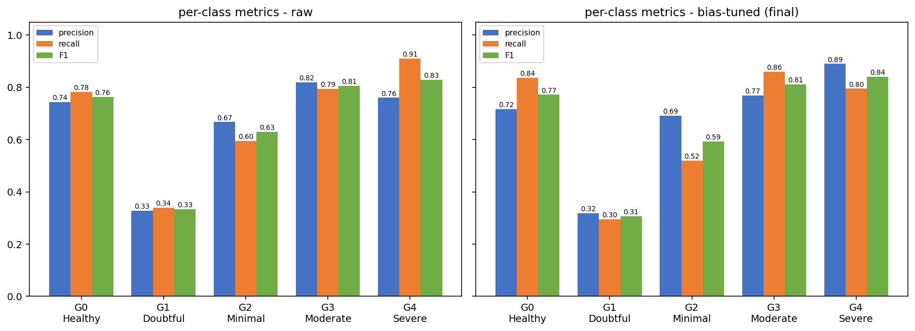
Per-Class F1
Final ensemble on all 4,008 test images; G1 (Doubtful) is the weakest grade, G3 and G4 the strongest
1
PER-CLASS F1 (FINAL ENSEMBLE)
93.8 %
of predictions are within one grade of the truth
G1 (Doubtful) is the hardest grade; it is most often read as G0 or G2.
Knee Osteoarthritis KL-Grade Classification Using ResNet · Deep Learning · 22AIE304
12 / 16

Slide 13
Comparison with Published Work
Studies on the same knee-OA dataset (Chen / Kaggle), numbers as reported by the authors
Work | Model | Pretrained? | Accuracy | Other reported
Chen et al., 2019 | VGG-19 + ordinal loss | Yes (fine-tuned) | 69.7 % | MAE 0.344
Yong et al., 2022 | DenseNet-161 + ordinal regression | Not checked | 70.2 % | –
Jain et al., 2024 | OsteoHRNet (multi-scale attention) | Not checked | 71.7 % | –
Jeong & Lee, 2025 | CLIP-KOA (CLIP ViT-B/16) | Yes (CLIP) | 71.9 % | F1 0.709
Pi et al., 2023 | Ensemble of 6 CNNs | Yes (ImageNet) | 76.9 % * | F1 0.767
Momenpour & Abu Mallouh, 2025 | EfficientNetB5 baseline | Yes (ImageNet) | 66.4 % | macro-F1 0.602
afzall003 (GitHub) | Custom CNN, 1.18 M params | No (from scratch) | not reported | bal. acc. 0.644, κ 0.753
This work | ResNet × 4 ensemble, 5.31 M params | No (from scratch) | 65.9 % | bal. acc. 0.657, macro-F1 0.661, κ 0.825
Test set: all rows use the 1,656-image official test split as reported, except * Pi et al., who use five-fold cross-validation on the remaining images and do not state clearly which split the headline number uses. Protocols, label cleaning and metrics differ between studies.
Knee Osteoarthritis KL-Grade Classification Using ResNet · Deep Learning · 22AIE304
13 / 16
Notes:
Sources: Chen et al. 2019, Comput Med Imaging Graph 75:84-92 (69.7 %, MAE 0.344; abstract as quoted by secondary sources). Yong et al. 2022 (Multimed Tools Appl 81:41497) and Jain et al. 2024 (OsteoHRNet, arXiv 2106.14292): accuracies taken from the comparison table of Jeong & Lee 2025, arXiv 2504.19443 (CLIP-KOA, 71.86 %, F1 0.709, test 1,656). Pi et al. 2023, Sci Rep 13:22887 (76.93 %, F1 0.7665). Momenpour & Abu Mallouh 2025, Diagnostics 15(11):1332 (EfficientNetB5, 66.36 %, macro-F1 60.23 % on original labels, official test). afzall003/knee-oa-classification README (from scratch, 1,175,845 params, balanced acc 0.644, QWK 0.753, no accuracy reported). Pretrained status of Yong 2022 and Jain 2024 was not verified.

Slide 14
Our Work vs Existing Work
Approach and results side by side; existing numbers as reported by the authors
Aspect | Existing work | This work
Starting weights | 4 of 7 listed works start from ImageNet or CLIP weights; 1 trains from scratch, 2 not checked | Random initialisation; only rotation-prediction pre-training on our own training images
Architecture | VGG-19, DenseNet-161, OsteoHRNet, CLIP ViT-B/16, EfficientNetB5; a 1.18 M-parameter CNN from scratch | Compact 4-stage ResNet with 5.31 M parameters
Key techniques | Ordinal loss or regression, multi-scale attention, CLIP backbone, one CNN ensemble | CleanLab label cleaning, rotation self-supervision, focal loss with ordinal soft labels, four-seed ensemble
Evaluation | Official 1,656-image test split as reported; Pi et al. use five-fold cross-validation | Official 1,656 images and all 4,008; nothing selected or tuned on test
Accuracy | 66.4 – 76.9 % across the six works that report it | 65.94 % on the official split, 65.67 % on all 4,008
Balanced acc. / κ | From-scratch CNN: 0.644 / 0.753; EfficientNetB5 macro-F1 0.602 | 0.657 / 0.825; macro-F1 0.661
Takeaway: with no pretrained weights, this work is within 0.5 point of an ImageNet EfficientNetB5 baseline and ahead of the other from-scratch CNN on balanced accuracy and κ. It stays 4 to 11 points below the best pretrained models. Protocols and metrics differ between studies.
Knee Osteoarthritis KL-Grade Classification Using ResNet · Deep Learning · 22AIE304
14 / 16

Slide 15
Where This Work Stands
Accuracy on the same dataset; every other model starts from pretrained weights or was not checked
1
REPORTED ACCURACY (%)
2
WHAT THE COMPARISON SHOWS
Gap to pretrained models
4 to 11 points lower accuracy than the 69.7 – 76.9 % reported with pretrained backbones, and within 0.5 point of an ImageNet EfficientNetB5 baseline (66.4 %), whose macro-F1 is 0.602 against our 0.661.
Ahead among from-scratch models
Balanced accuracy 0.657 and κ 0.825, against 0.644 and 0.753 for the other from-scratch CNN we found on the same official test set.
A fair reading
Pretraining is a key difference: the stronger works start from ImageNet or CLIP weights, ours from random weights plus rotation pre-training.
* Pi et al.: five-fold cross-validation, split of the headline number unclear. Results on relabelled test labels or small subsets are excluded.
Knee Osteoarthritis KL-Grade Classification Using ResNet · Deep Learning · 22AIE304
15 / 16
Notes:
Chart values: Pi 2023 76.93; CLIP-KOA 71.86; OsteoHRNet 71.74; Yong ORM DenseNet-161 70.23; Chen 2019 69.7; EfficientNetB5 baseline 66.36; this work 65.94 (official 1,656 test, bias-tuned; raw 66.61). The 82.07 % CleanLab result (Momenpour & Abu Mallouh 2025) is scored on relabelled test labels (McNemar p = 0.076 on the original labels) and is excluded. Mohammed et al. 2023 (ResNet-101, 69 %) uses a random 7:2:1 split of all 9,786 images, not the official test split, so it is also excluded from the chart.

Slide 16
Conclusion & Future Work
What the project shows and where it stops
1
KEY OUTCOMES
2
LIMITATIONS
Accuracy: 65.67 % on 4,008 test images, quadratic κ 0.813
Official test: 65.94 %, κ 0.825, from scratch
Ensemble: four ResNet seeds, validation κ 0.815 – 0.823 each
Label noise: CleanLab down-weighted 988 suspect labels without discarding data
Efficiency: the whole pipeline ran in 2.7 hours on one Kaggle T4
G1 (Doubtful) has F1 of only 0.31; it is hard to separate from G0 and G2
Bias tuning trades a little accuracy for better balance between grades
One dataset only; no external validation
Below the best pretrained ensembles reported in the literature
A research prototype, not a medical device
Takeaway. A compact ResNet, cleaned labels and a four-seed ensemble reach κ 0.81 without any pretrained weights.
Future work: larger and external data, pretrained backbones as a comparison, and calibrated uncertainty for borderline grades.
Knee Osteoarthritis KL-Grade Classification Using ResNet · Deep Learning · 22AIE304
16 / 16

