Slide 1
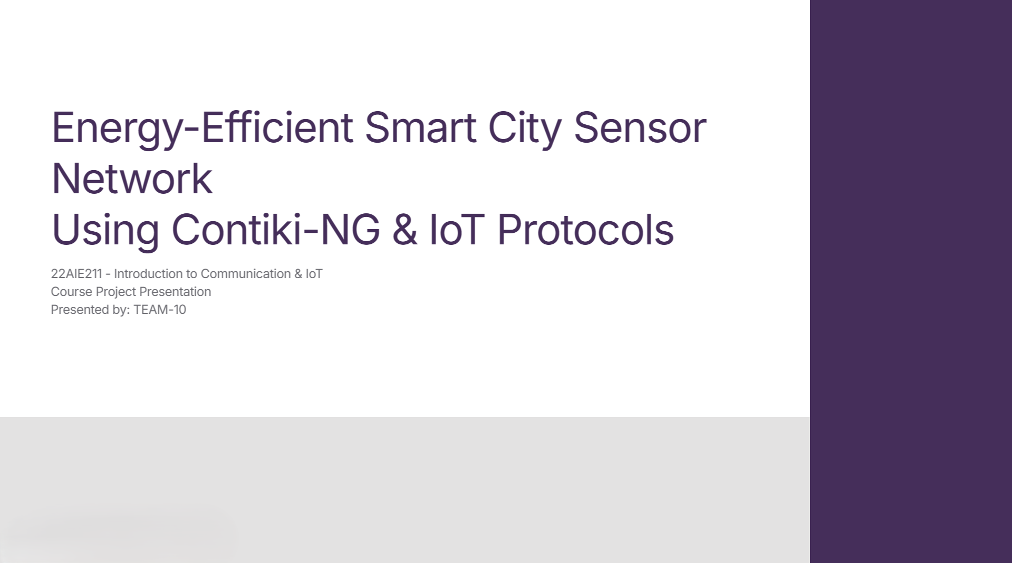

Slide 2
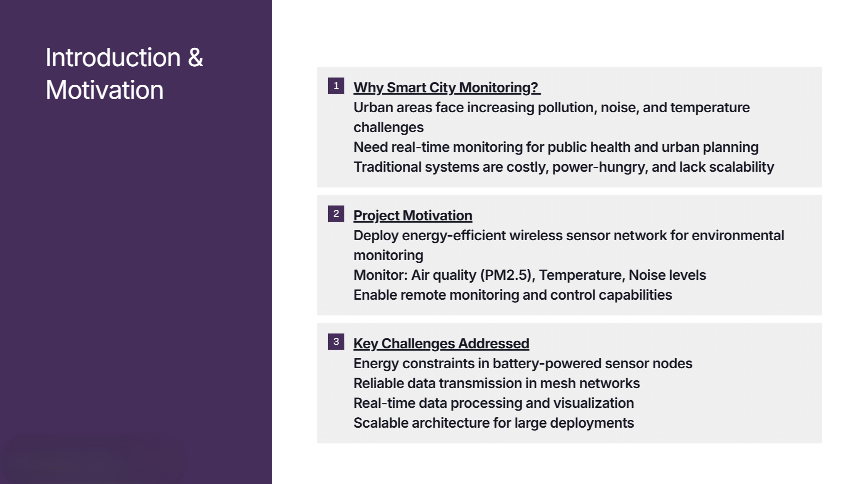

Slide 3
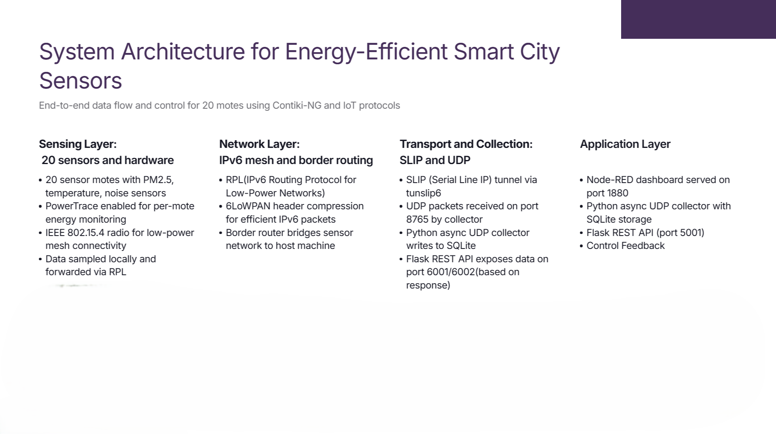

Slide 4
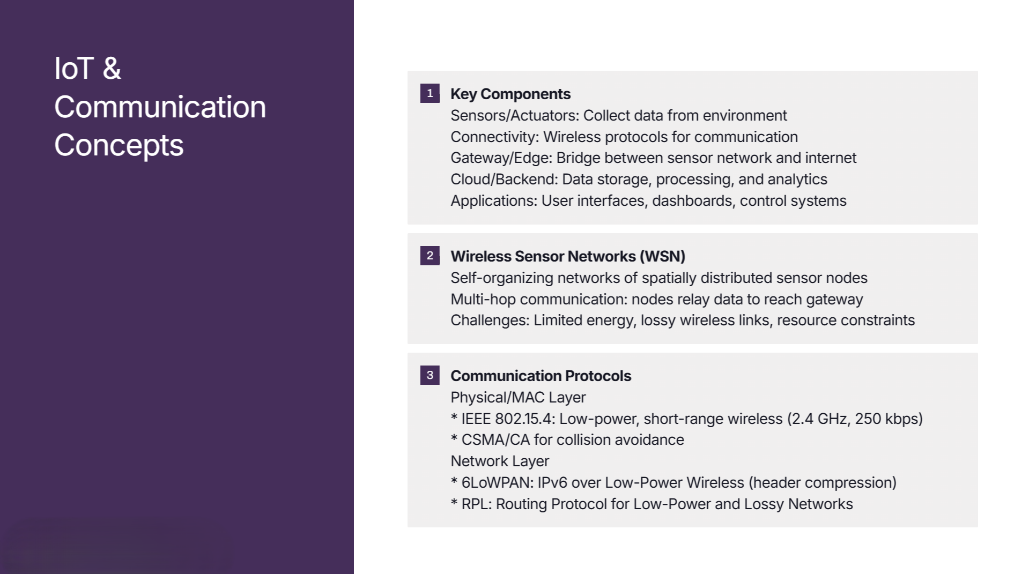
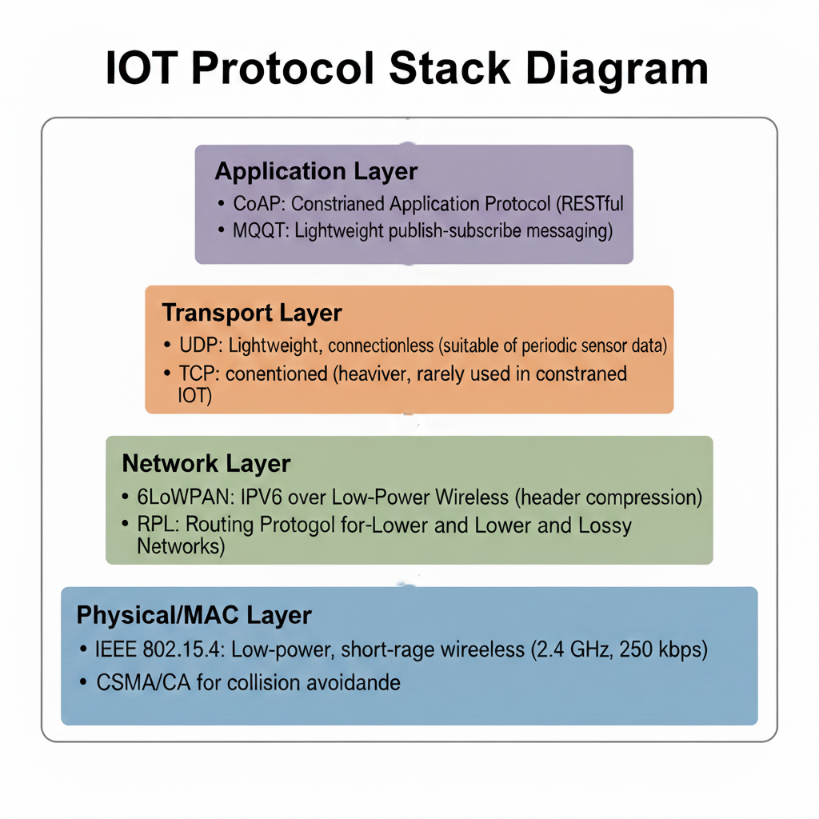

Slide 5
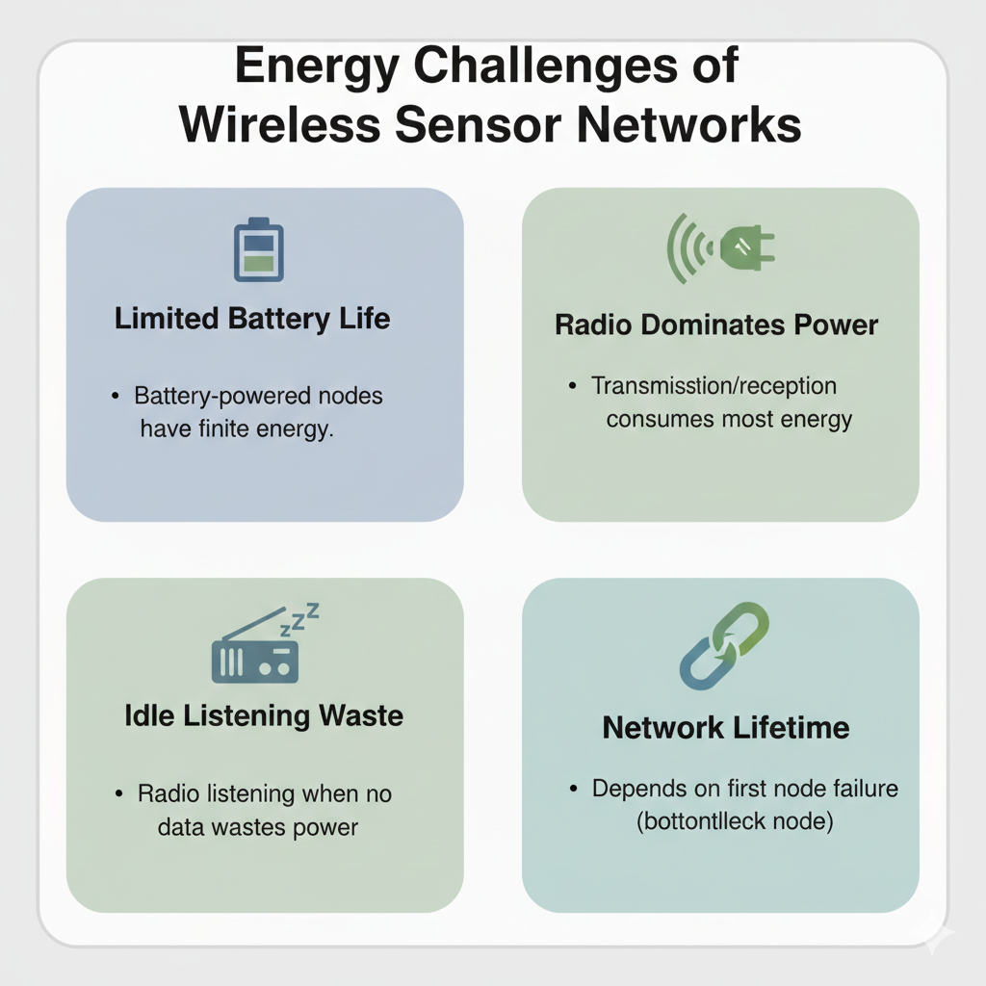

Slide 6
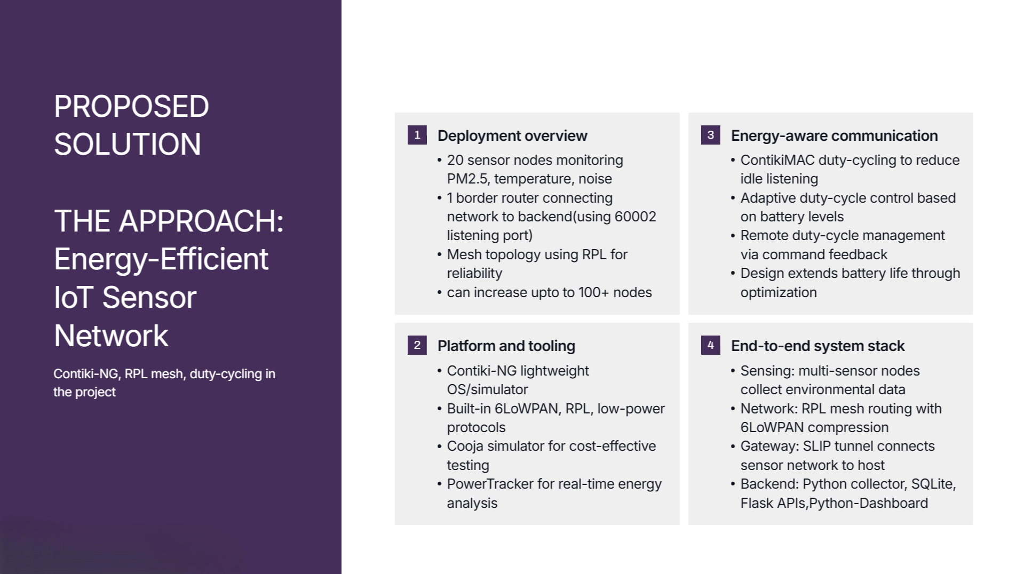

Slide 7
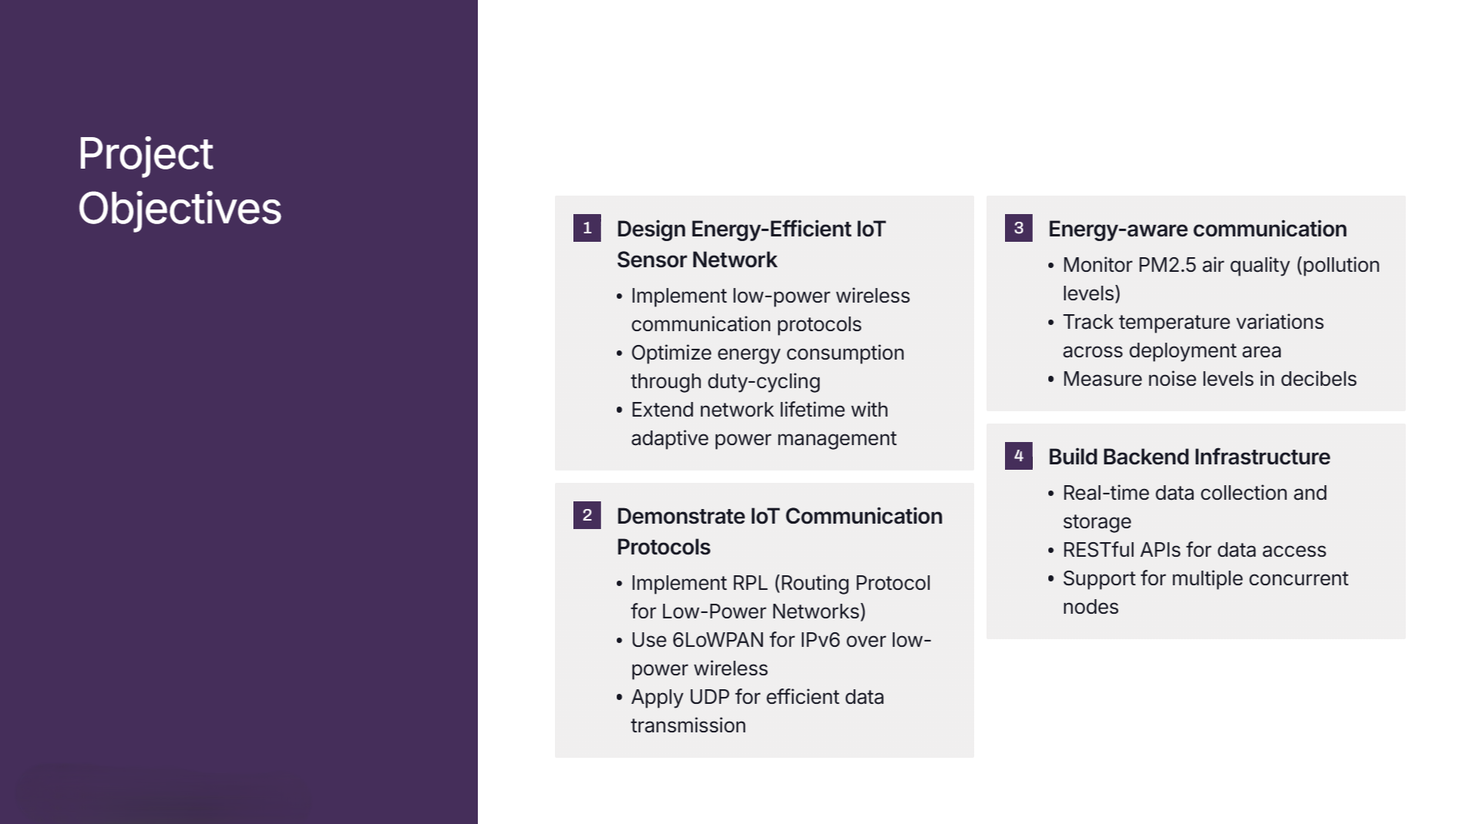

Slide 8
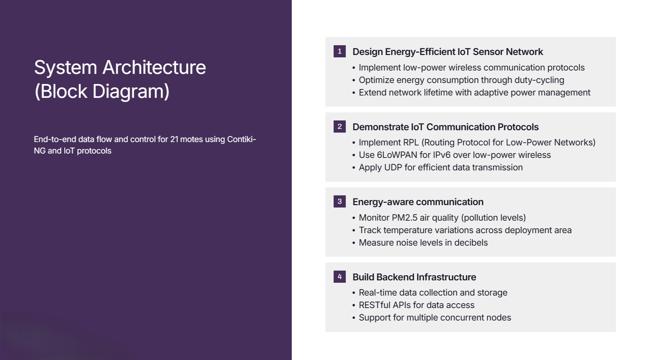
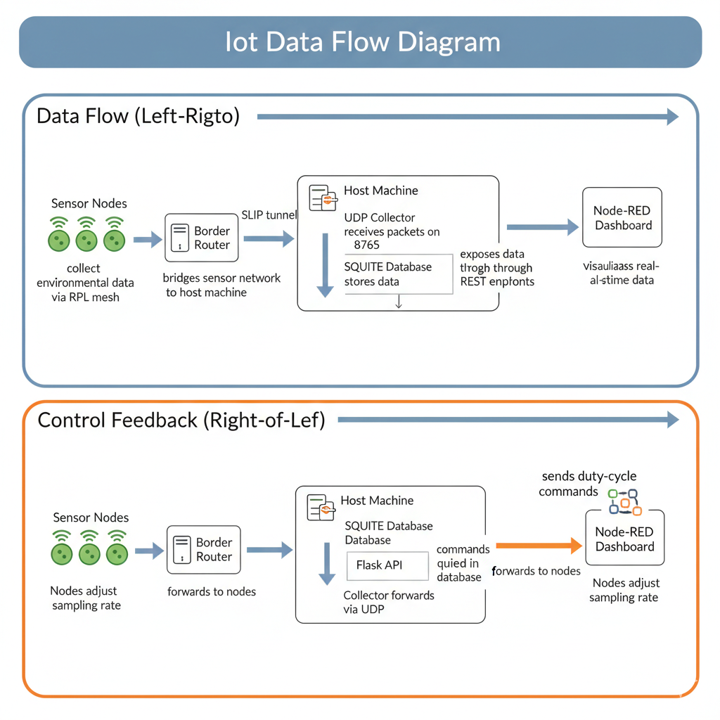

Slide 9
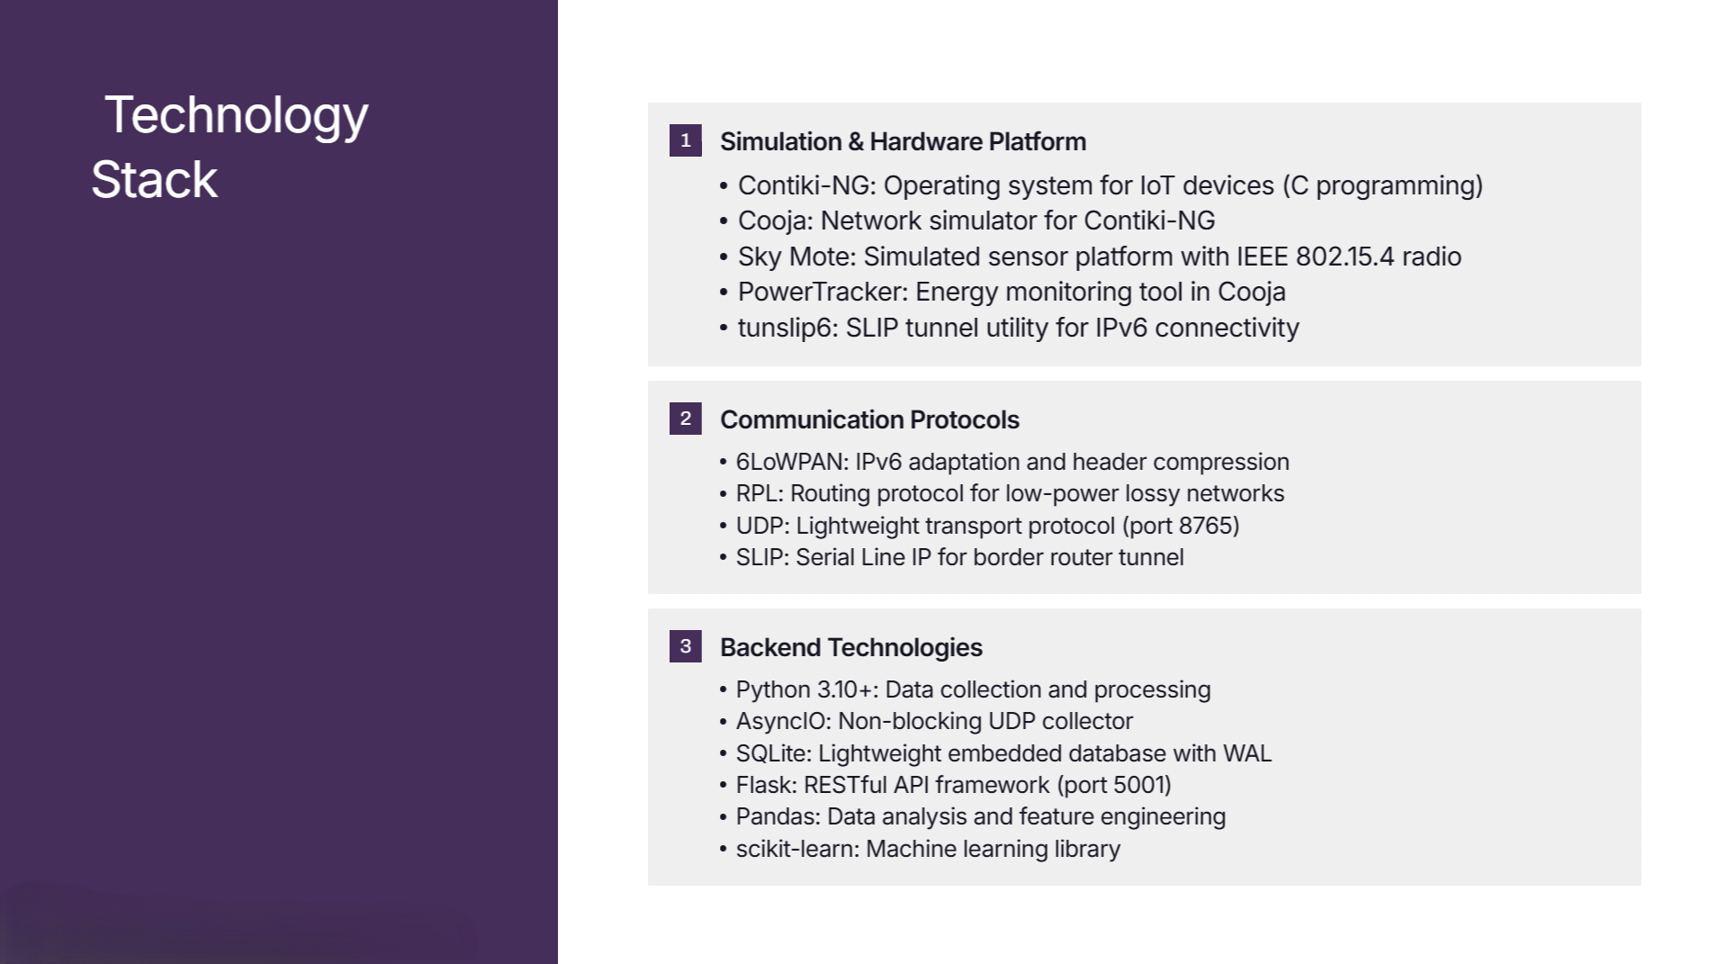

Slide 10
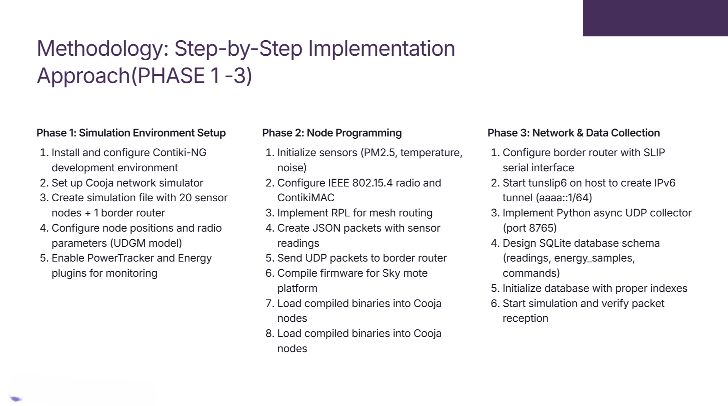

Slide 11
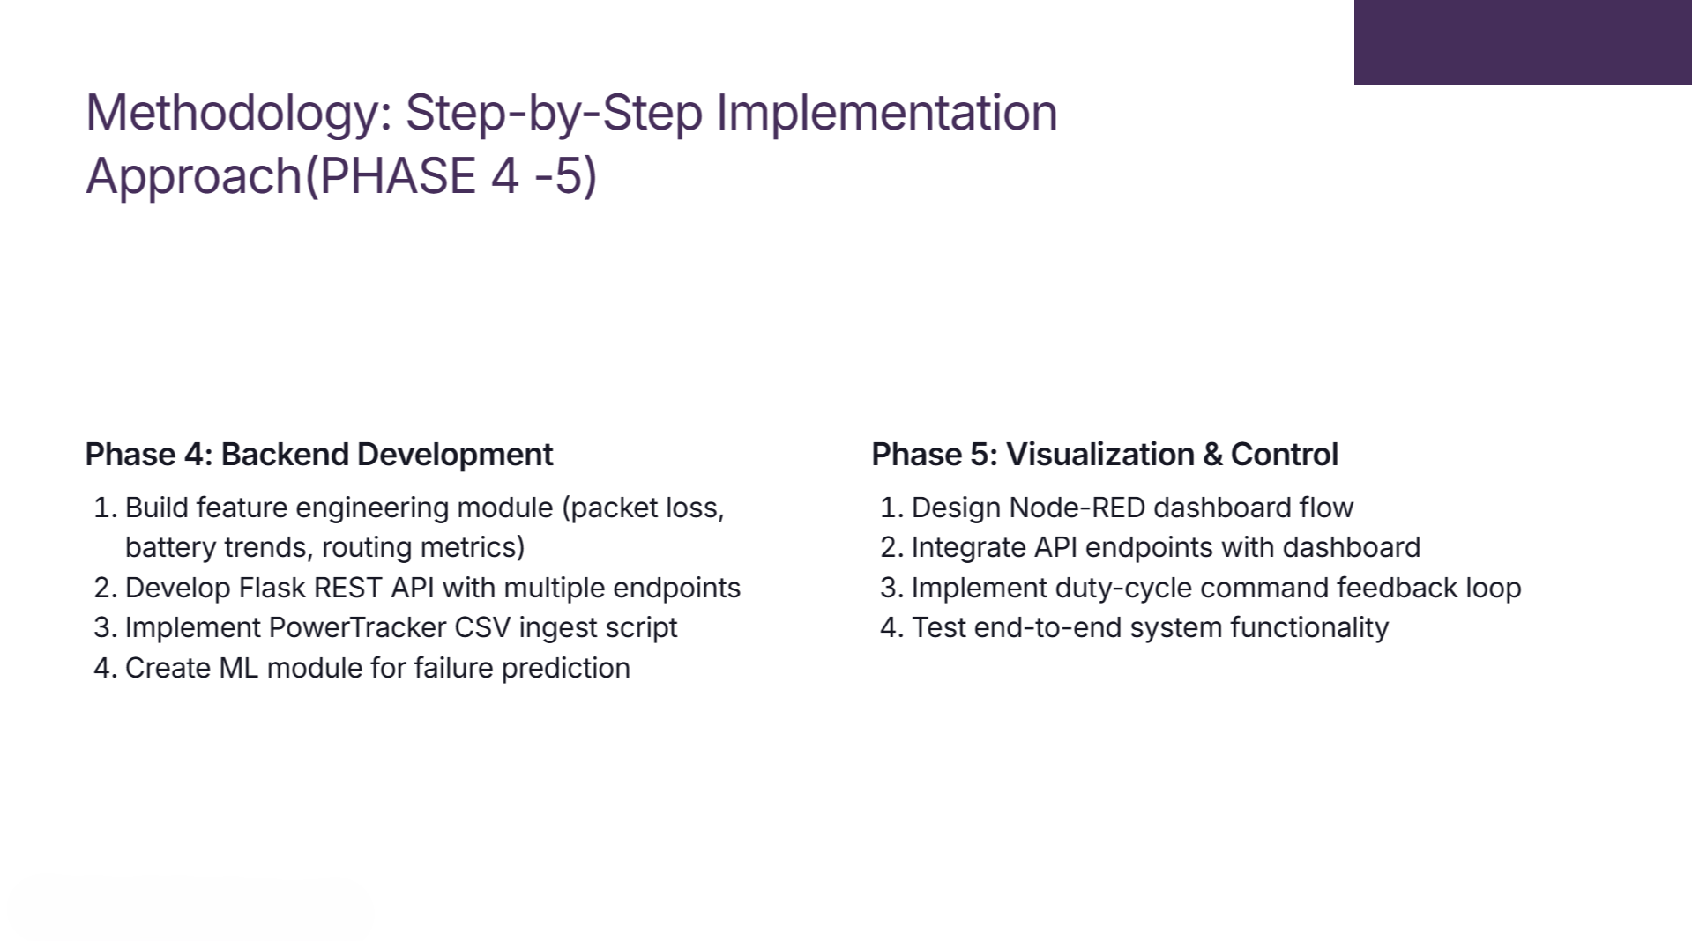

Slide 12
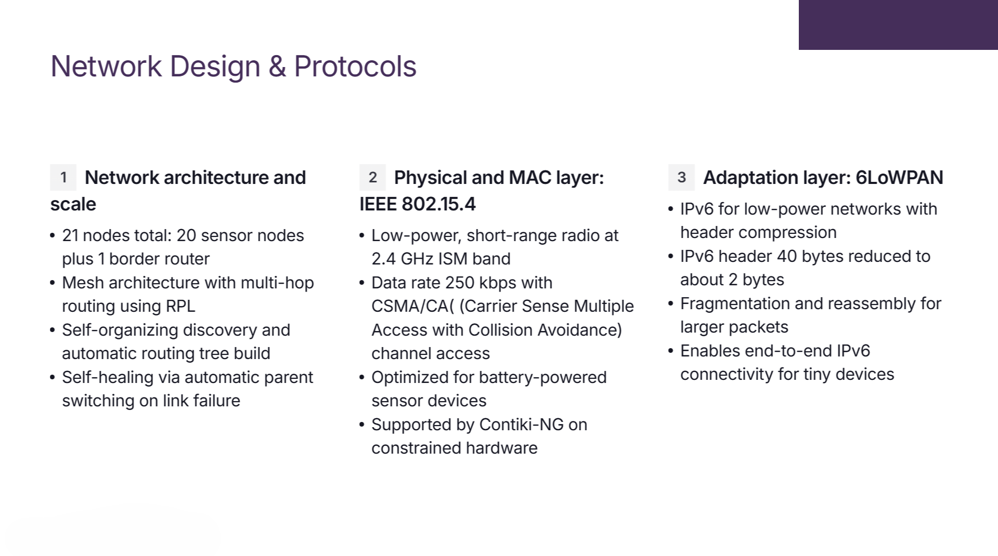

Slide 13
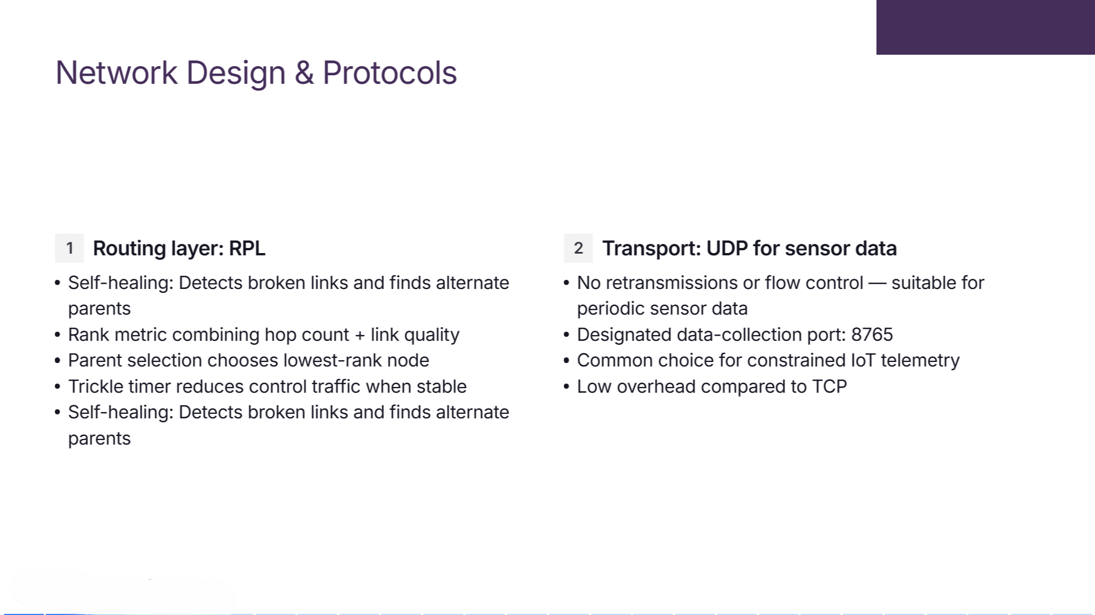
4
5

Slide 14
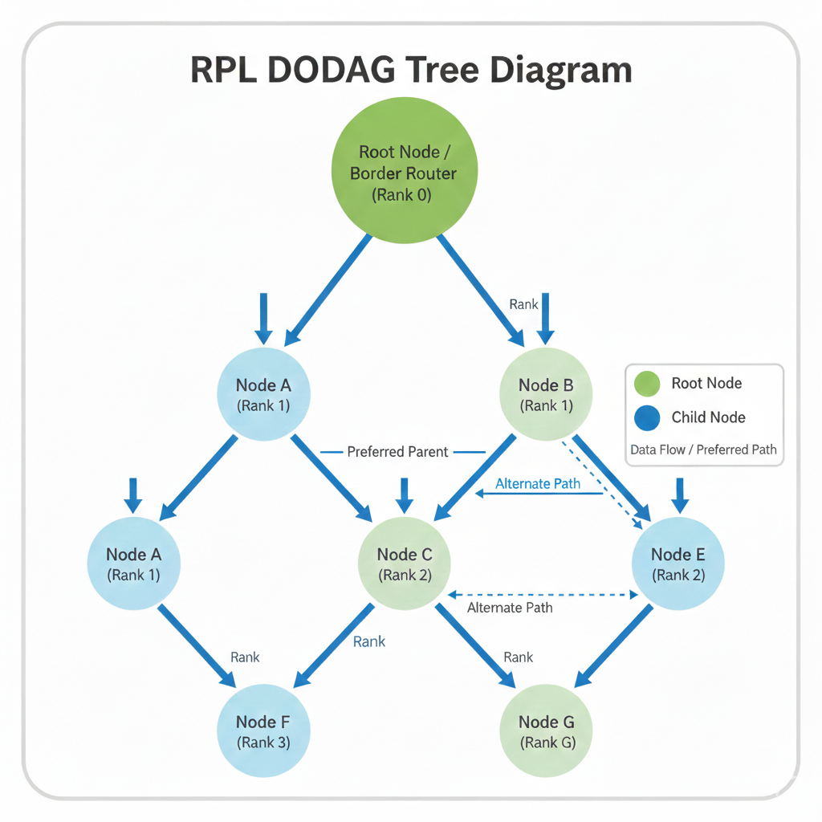
NODE Z
(RANK 2)

Slide 15
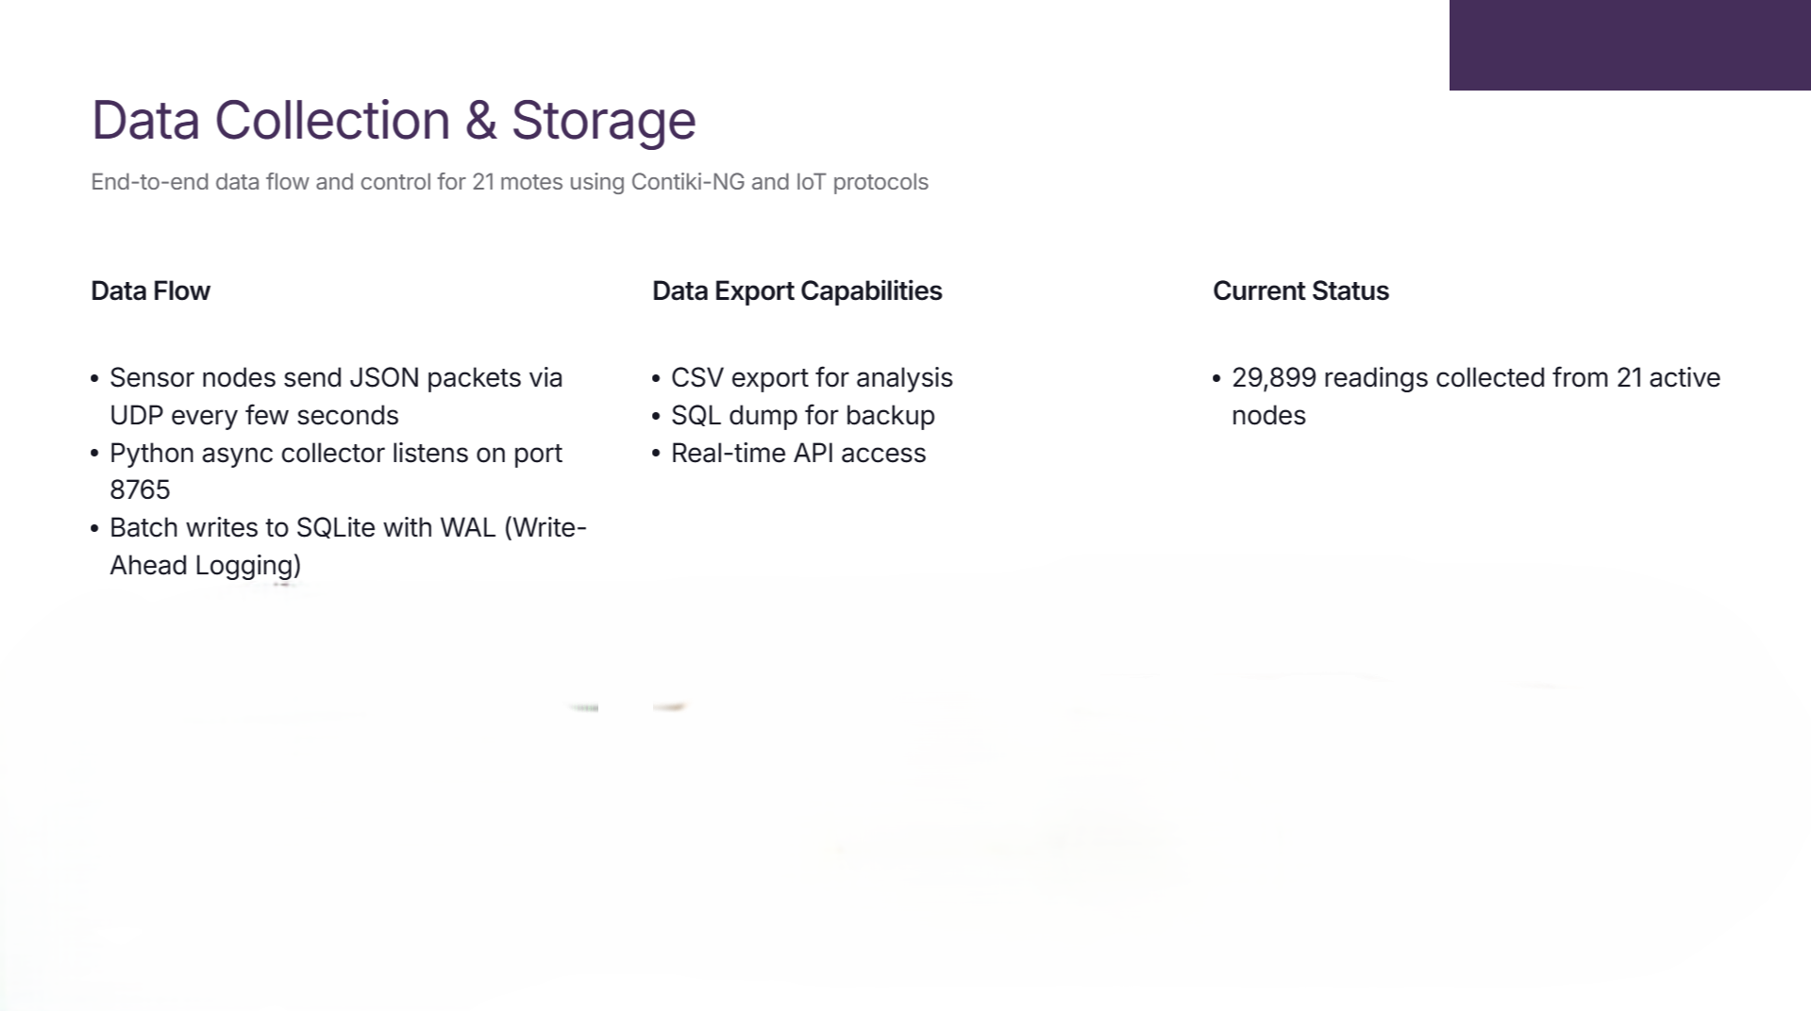

Slide 16
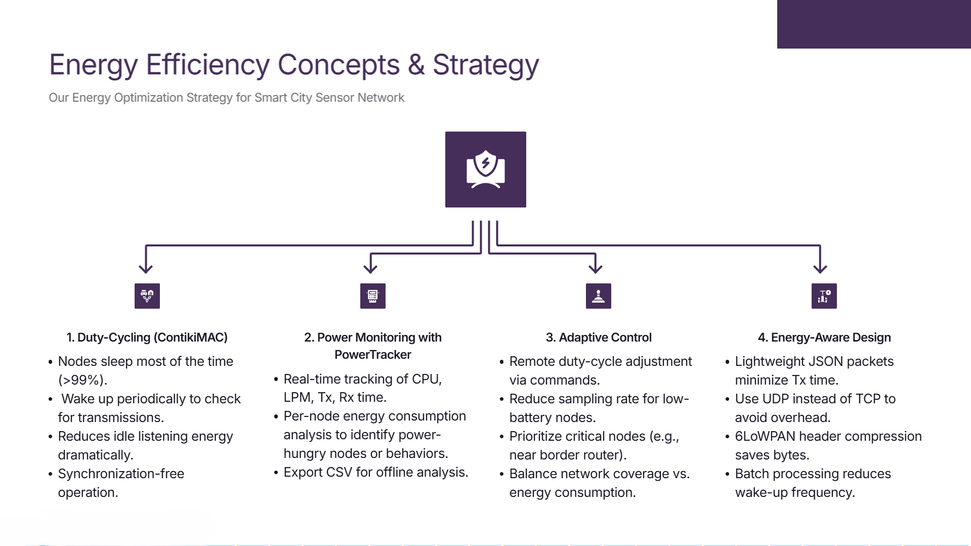
Energy Challenges in Wireless Sensor Networks:
Limited Battery Life,Radio Dominates Power,Network Lifetime

Slide 17

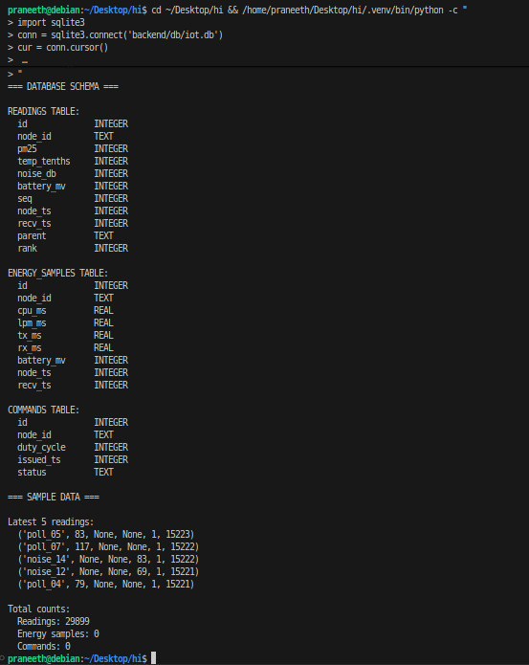
READINGS TABLE:
node_id: Unique identifier for each sensor node
(e.g., poll_03, temp_09, noise_12)
pm25: Particulate matter 2.5 air quality measurement (pollution level)
temp_tenths: Temperature in tenths of degrees (e.g., 250 = 25.0°C)
noise_db: Noise level in decibels
battery_mv: Battery voltage in millivolts (indicates remaining power)
seq: Sequence number for packet ordering and loss
detectionnode_ts: Timestamp from sensor node (node's local time)
recv_ts: Receive timestamp on server (when packet arrived)
parent: RPL parent node ID (routing topology)
rank: RPL rank metric (distance from border router in routing tree)
ENERGY_SAMPLES TABLE:
cpu_ms: CPU active time in milliseconds (processing energy)
lpm_ms: Low Power Mode time in milliseconds (sleep energy)
tx_ms: Radio transmission time in milliseconds (sending energy)
rx_ms: Radio receive/listen time in milliseconds (receiving energy)

Slide 18
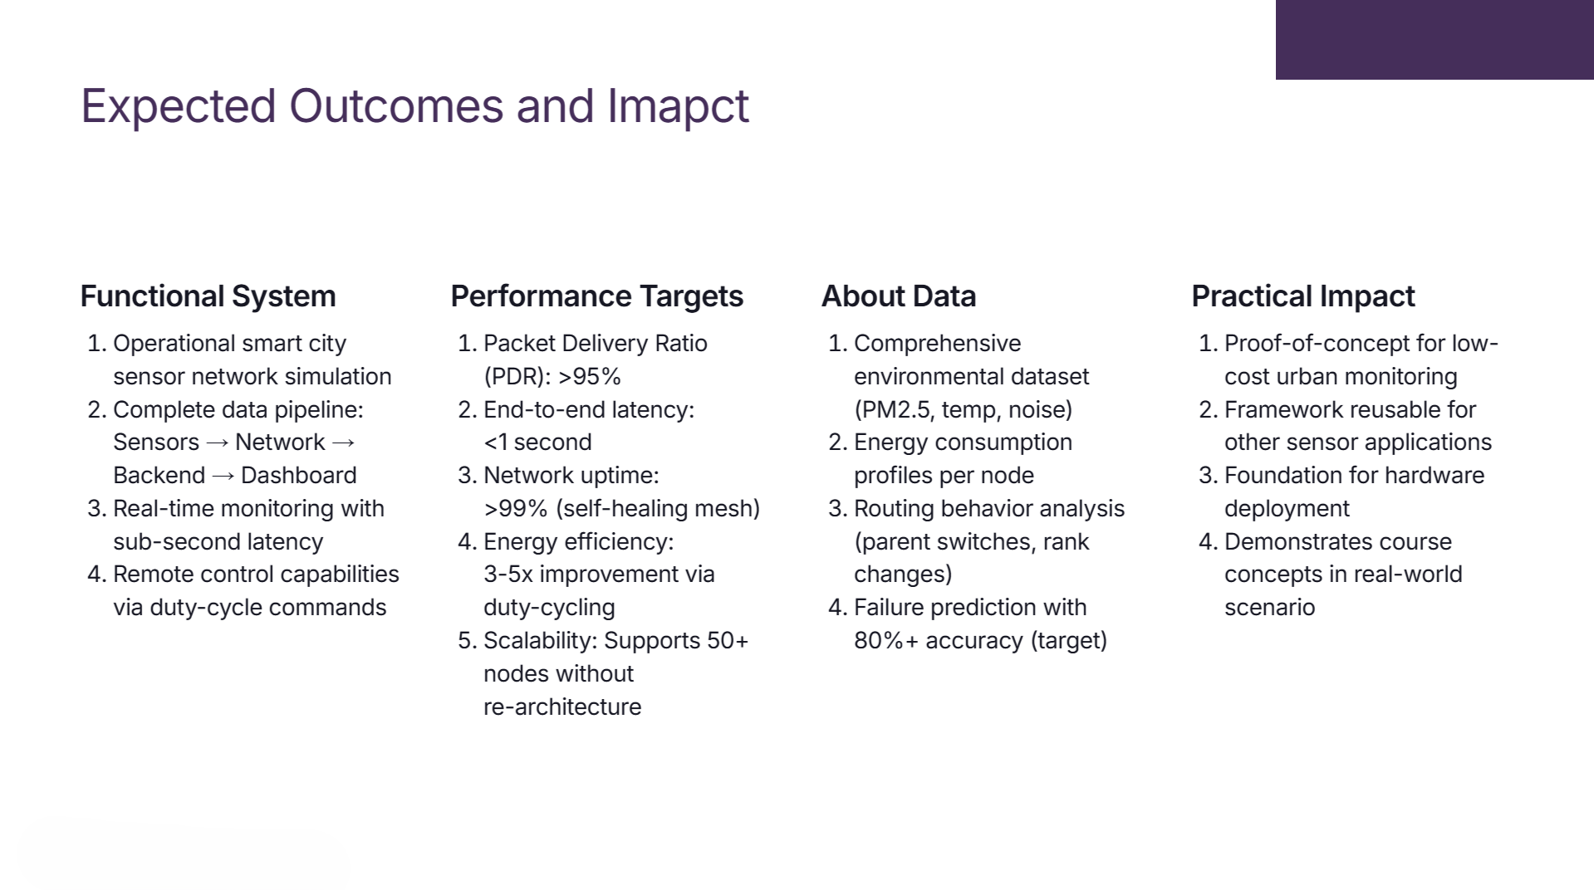

Slide 19
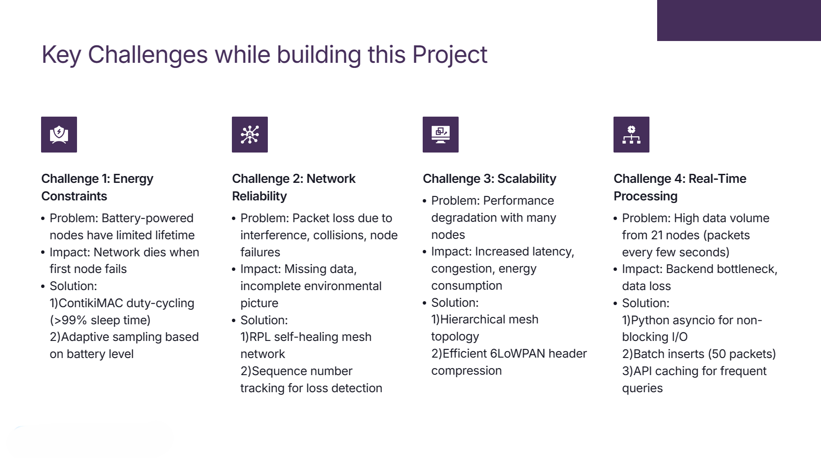

Slide 20
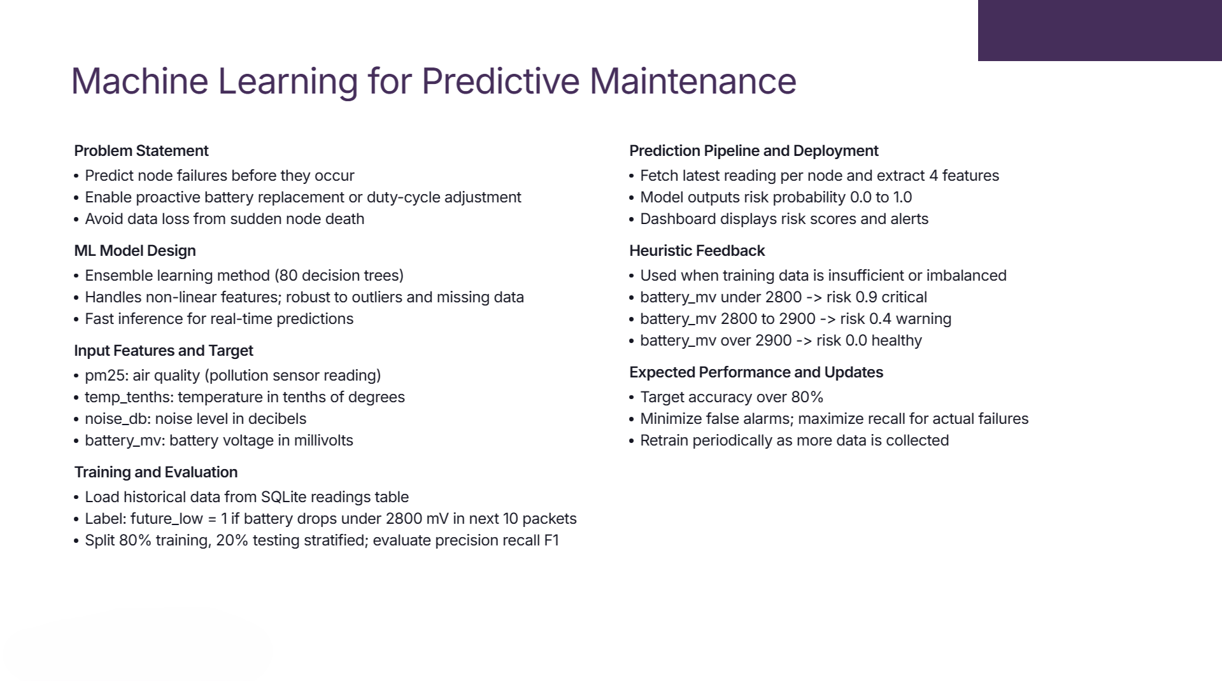

Slide 21
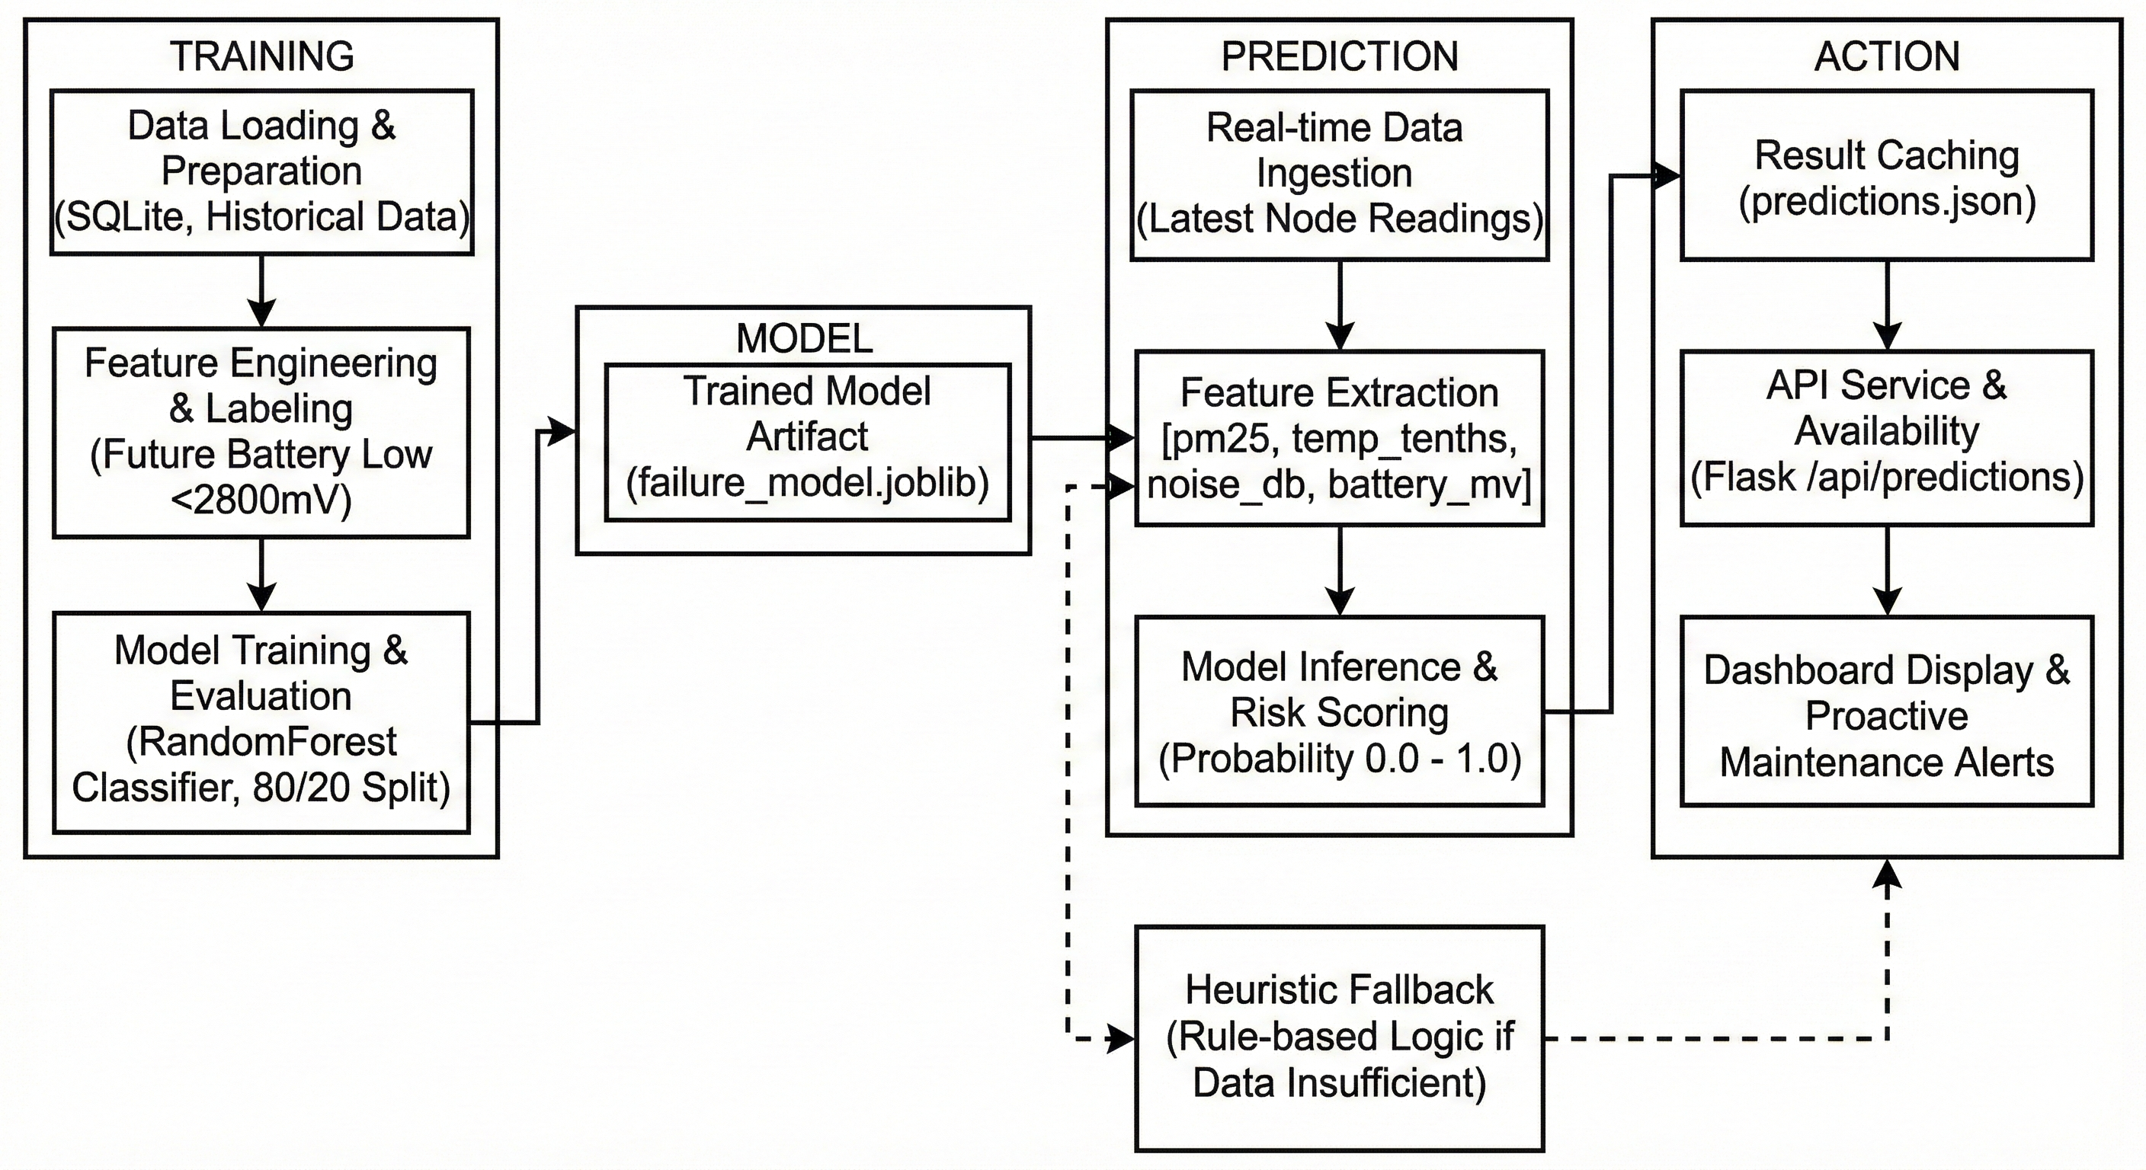

Slide 22
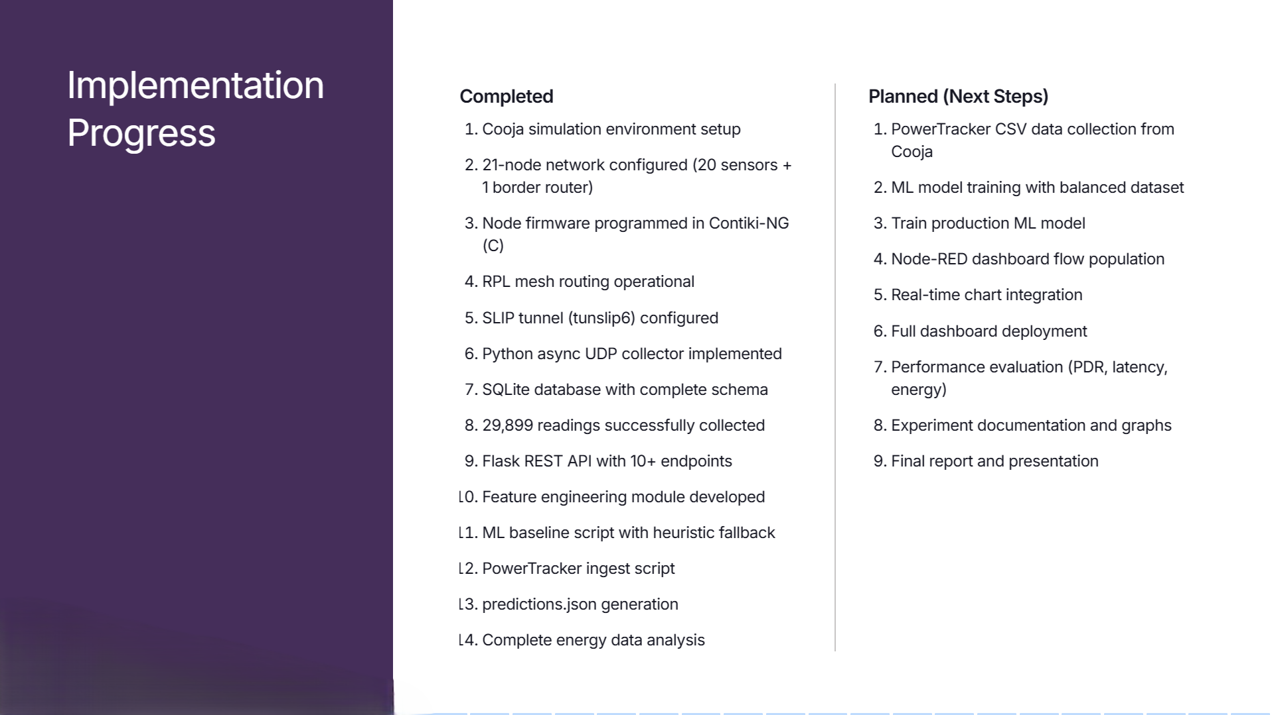

Slide 23
