Slide 1
Online shopping funnel Analysis
Team – 10
Harini -CB.SC.U4AIE24010
Pratheep -CB.SC.U4AIE24021
Bhavesh -CB.SC.U4AIE24034
Gnanasri -CB.SC.U4AIE24064

Slide 2
Problem Statement
Online shopping platforms often work in separate parts. Customers face difficulty finding products easily, sellers struggle to manage stock and orders, and admins cannot get clear business insights. There is no single place that combines shopping, selling, and detailed analysis of how customers move from viewing products to buying and reviewing them. Existing difficulties Customers leave without buying because the process is complicated Sellers cannot track product performance properly Admins lack clear data on sales, revenue, and customer behavior No proper tracking of the full customer journey (browse → cart → order → payment → review) Why the system is needed A unified platform is required that supports customers, sellers, and admins together, while also providing clear funnel analysis to improve sales and user experience.

Slide 3
Objectives
Develop a unified e-commerce platform for customers, sellers, and admins Allow customers to register, browse products, add to cart, place orders, make payments, and give reviews Enable sellers to add, update, and manage products, and process orders Provide an admin dashboard to monitor overall platform performance Perform Customer Purchase Funnel Analysis to track the full journey from browsing to review Support data-driven decisions through interactive dashboards and reports on sales, revenue, and customer behavior

Slide 4
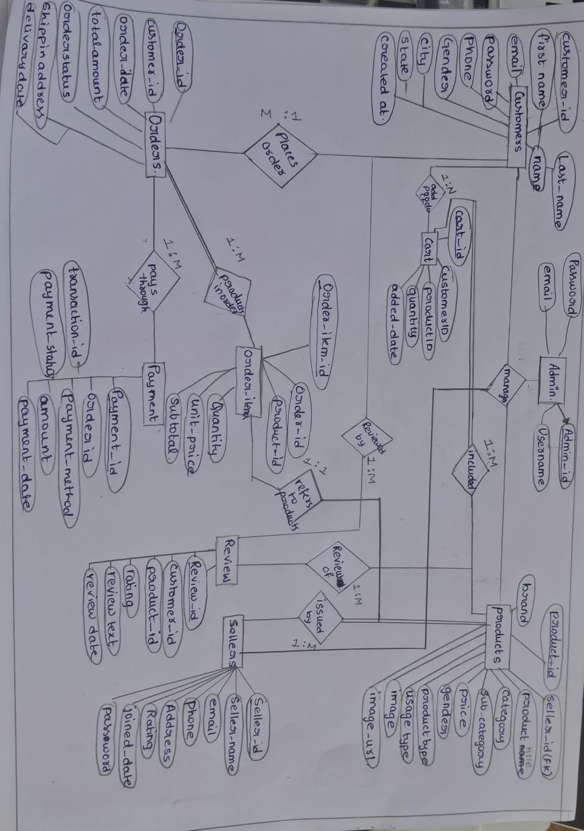
ER Diagram

Slide 5
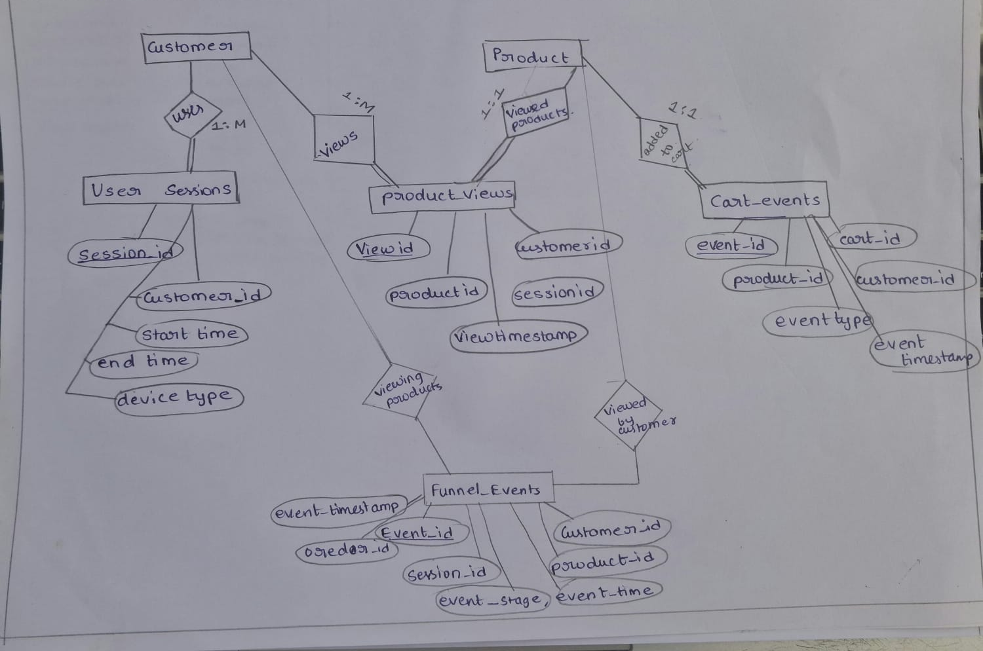

Slide 6
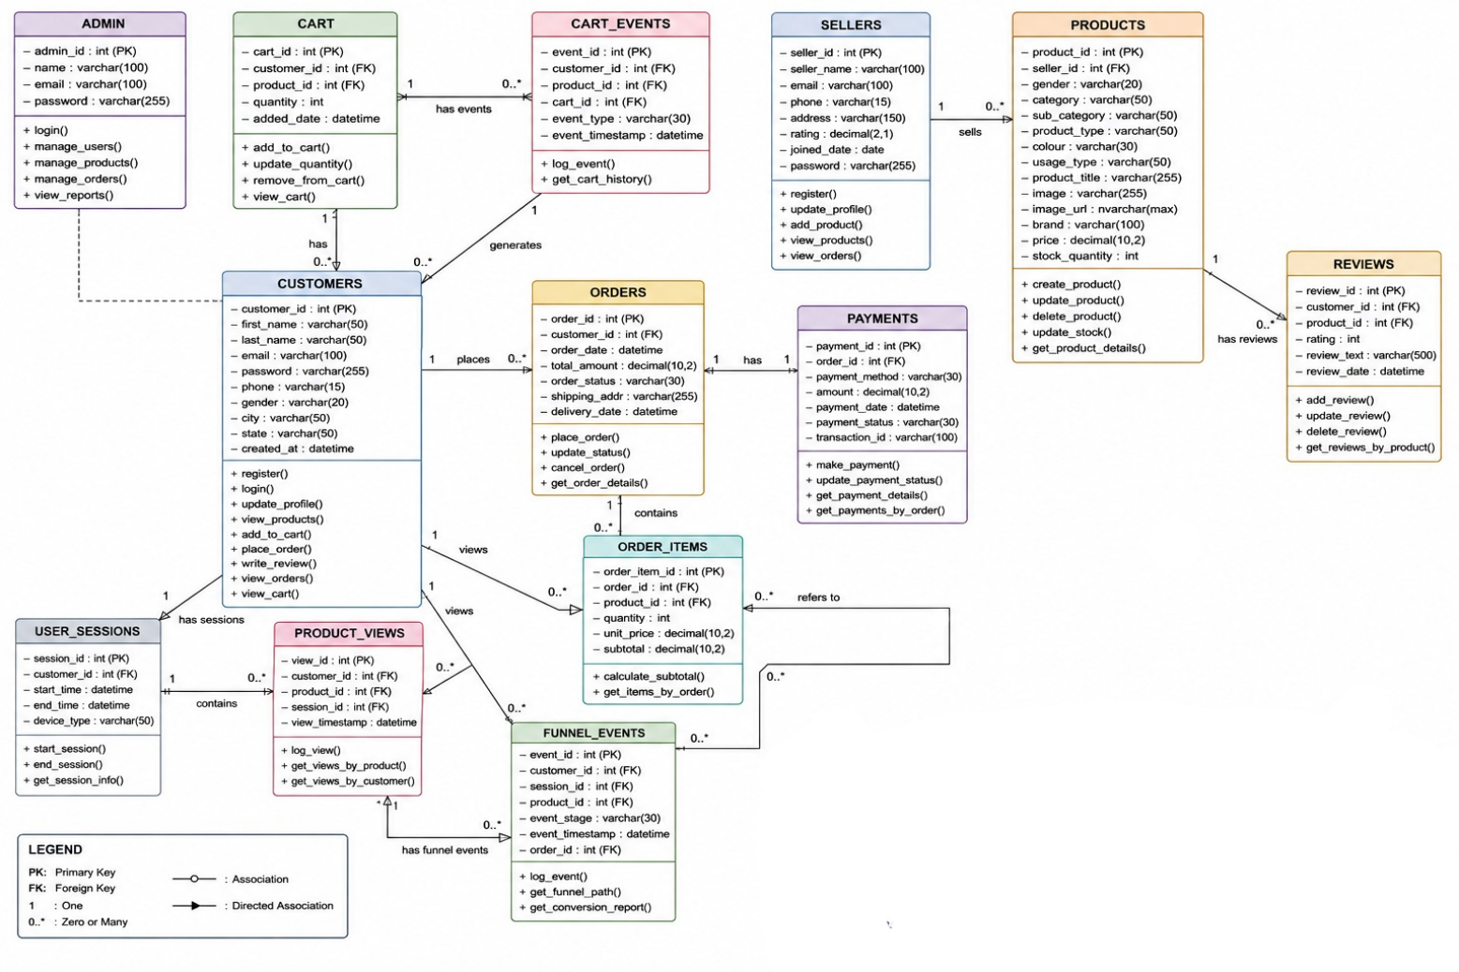
UML
Unified Modeling Language

Slide 7
Users / Actors
Customer
Registers and logs in
Browses and searches products
Adds items to cart
Places orders and makes payments
Submits product reviews
Seller
Registers and manages own profile
Adds, updates, and deletes products
Views and processes orders
Monitors own sales and product performance
Admin
Manages the entire platform
Monitors customers, sellers, products, and orders
Views business reports and dashboards
Analyses sales, revenue, and customer purchase funnel

Slide 8
Relational Schema
Admin (admin_id (PK) ,name, email, password )
CUSTOMERS(customer_id (PK), first_name, last_name, email, password, phone, gender, city,state, created_at)
SELLERS(seller_id PK, seller_name, email, phone, address, rating, joined_date, password)
CART(cart_id PK, customer_id FK, product_id FK, quantity, added_date)
ORDER_ITEMS(order_item_id PK, order_id FK, product_id FK, quantity, unit_price, subtotal)
ORDERS(order_id PK, customer_id FK, order_date, total_amount, order_status, shipping_addr, delivery_date)
PAYMENTS(payment_id PK, order_id FK, payment_method, amount, payment_date, payment_status, transaction_id)

Slide 9
PRODUCTS(product_id PK, seller_id FK, gender, category, sub_category, product_type, colour,usage_type, product_title, image, image_url, brand, price, stock_quantity)
REVIEWS(review_id PK, customer_id FK, product_id FK, rating, review_text, review_date)
USER_SESSIONS(session_id PK, customer_id FK, start_time, end_time, device_type
CART_EVENTS(event_id PK, customer_id FK, product_id FK, cart_id FK, event_type,event_timestamp)
PRODUCT_VIEWS(view_id PK, customer_id FK, product_id FK, session_id FK, view_timestamp)
USER_SESSIONS(session_id PK, customer_id FK, start_time, end_time, device_type)
Funnel_Events(event_id (PK),customer_id (FK → Customers),session_id (FK → User_Sessions),product_id (FK → Products),event_stage, event_timestamp,order_id (FK → Orders)

Slide 10
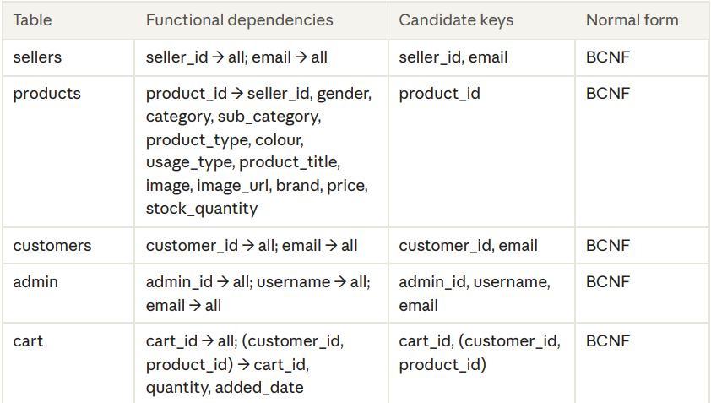

Slide 11
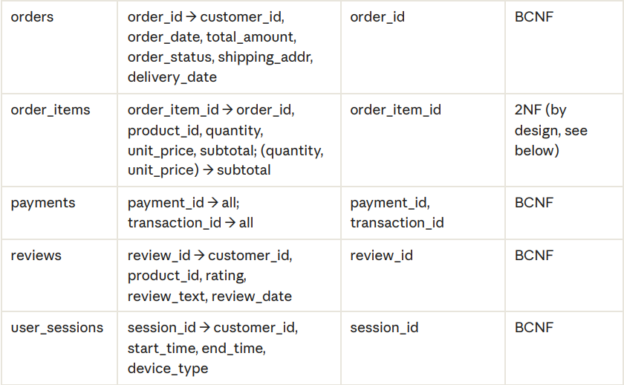

Slide 12
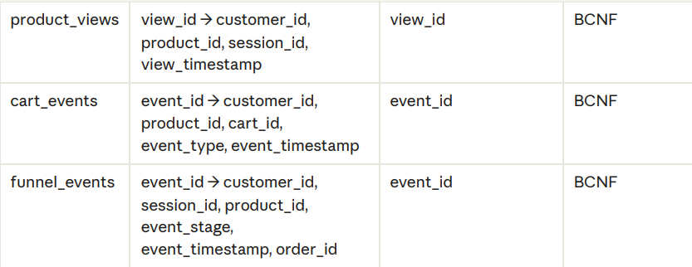

Slide 13
Functional Blocks / Modules
User Management
Handles registration and login for Customer, Seller, and Admin
Manages user profiles
2. Product Management
Sellers can add, update, and delete products
Customers can browse and search products
3. Cart
Customers can add, update, and remove items from cart
Tracks cart events for funnel analysis
4. Order & Payment
Customers place orders
Handles payment processing
Updates order status
5. Review Module
Customers submit ratings and reviews for products
6. Analytics & Funnel Module
Tracks customer journey (views, cart events, orders, payments, reviews)
Generates purchase funnel analysis
Provides dashboards for Admin and Sellers
7. Admin Dashboard Module
Monitors overall platform performance
Views sales, revenue, customer behavior, and seller performance

Slide 14
Funnel Analysis
The funnel tracks the customer journey in these stages:
Product View
Add to Cart
Place Order
Make Payment
Submit Review
Step-by-step process using the tables:
Step 1: Customer starts browsing
A new record is created in User_Sessions table when the customer logs in or starts visiting the site.
Step 2: Customer views a product
A record is inserted into Product_Views table
This marks the first stage of the funnel
Step 3: Customer adds product to cart
A record is inserted into Cart_Events table
Also recorded in Funnel_Events table

Slide 15
Step 4: Customer places an order
Data goes into Orders and Order_Items tables
A record is added in Funnel_Events
Step 5: Customer makes payment
Data goes into Payments table
A record is added in Funnel_Events
Step 6: Customer submits review
Data goes into Reviews table
A record is added in Funnel_Events
How the Funnel is Calculated (using SQL)
Using the Funnel_Events table, we can calculate:
How many customers reached each stage
Conversion rate between stages
Drop-off percentage at each stage
1. Conversion Rate from one stage to next
(Customers in next stage ÷ Customers in current stage) × 100

Slide 16
2. Drop-off Rate
100% – Conversion Rate
3. Overall Funnel Conversion
(Customers who completed Review ÷ Customers who Viewed) × 100
Finally calculate:
View → Cart conversion %
Cart → Order conversion %
Order → Payment conversion %
Payment → Review conversion %

Slide 17
CRUD Operations Across Project Modules
Page | CREATE | READ | UPDATE | DELETE
Customer Management | Add customer | View customers | Edit customer | -
Seller Management | Add seller | View sellers | - | Delete seller
Product Management | Seller adds product | View products | Edit product | Delete product
Cart | Add to cart | View cart | Increase/decrease quantity | Remove item
Orders | Place order | View orders | - | -
Reviews | Add review | View reviews | - | -

Slide 18
THANK YOU

