Slide 1

Extreme Programming
Prepared By:
Aashish Tamrakar
Asim Aryal
Niroj Bajracharya
Sudip Gyawali

Slide 2
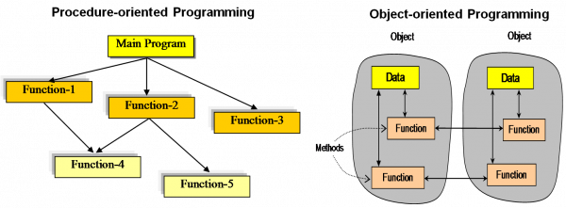
Rise of Extreme Programming
In 1990s, Object Oriented Programming replaced procedural programming.
Notes:
START OF AASHISH! (RISE OF CONCEPT)

Slide 3
Rise of Extreme Programming
Internet changed the business requirement to rapidly changing.
KENT BECK
Dot Com Bubble
↑ Internet rose
Development
Time ↓

Slide 4
Extreme Programming - Introduction

Slide 5
eXtreme Programming (XP) - Introduction
Software development model
Waterfall model
Iterative model
Agile model
RAD model
Incremental model
V model
Spiral model
XP
Extreme Programming
Agile model
FDD
Feature Driven Development
ASD
Adaptive Software Development

Slide 6
Extreme Programming (XP) - Introduction
Extreme Programming can be defined as: software development model intended to improve software quality & responsiveness to changing software requirements.
In XP, there are shorter software development cycles where checkpoints can be incorporating new software requirements.

Slide 7
Extreme Programming (XP) - Diagram
Planning
Analysis
Design
Implementation
XP
New Change
Repeating
Many times

Slide 8
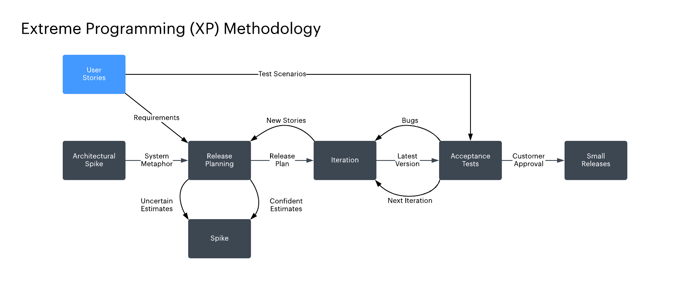
Extreme Programming (XP) - Diagram

Slide 9
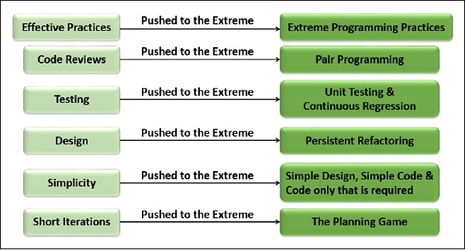
Why Name “Extreme Programming”?
Notes:
END OF AASHISH! (Why XP?)

Slide 10
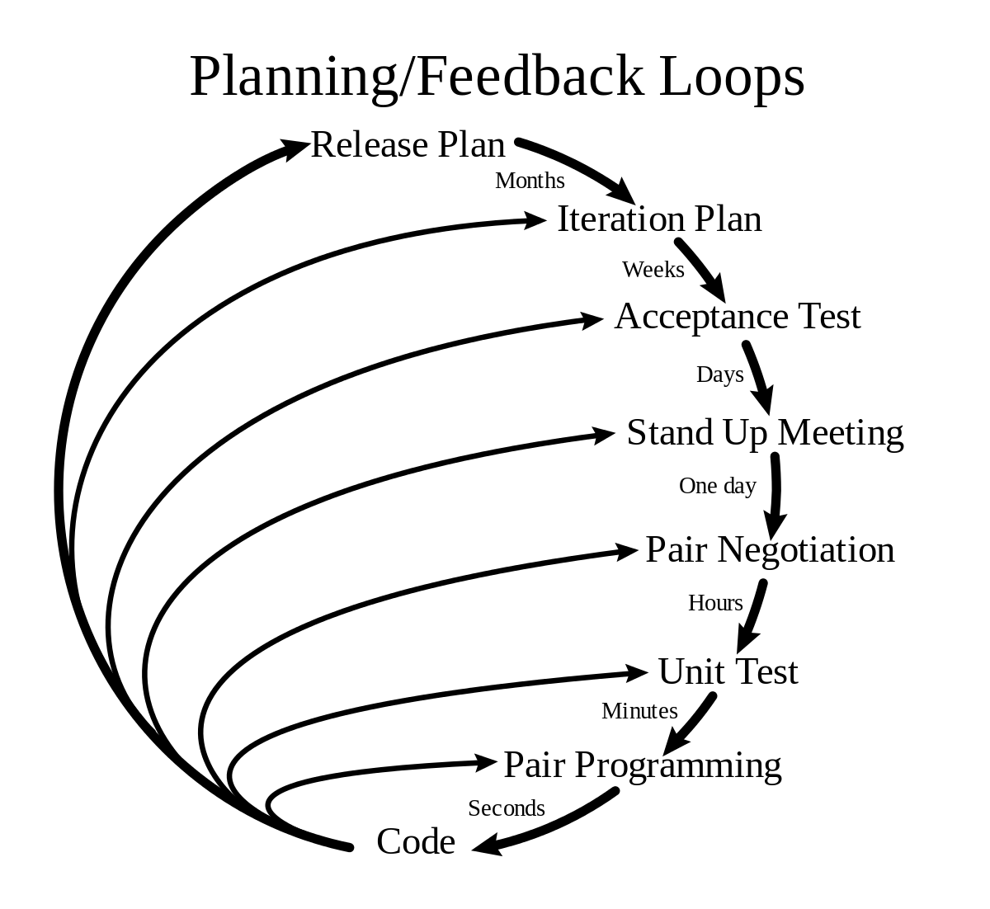
Features of XP
Pair programming
Code review
Testing
Quick Releases
Refactoring
Metaphor

Slide 11
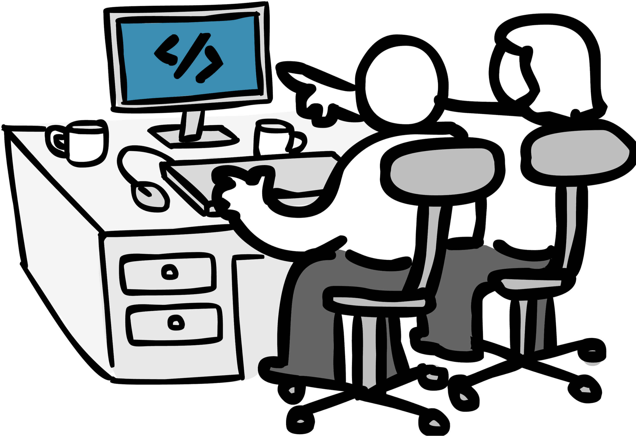
Pair Programming
Two people working in the same computer.
Less time , less error (efficient)
Navigator directs overall
objective of the program.
Knowledge is shared.
Expert and novice pairing.

Slide 12
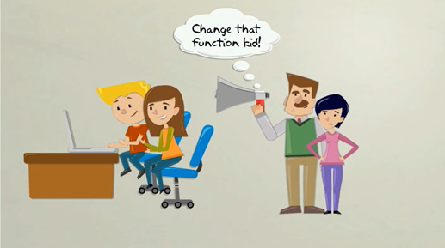
Code Review
To improve the code or find error.
Continuous process of improvement.
Clean and Efficient code.
Helps in quality control.

Slide 13
Testing
code2
code1
Code 3
code4
Unit Testing
Unit Testing
Unit Testing
Unit Testing
testedcode2
testedcode1
testedcode3
testedcode4
Acceptance Testing
Unified Code

Slide 15
Values
Communication
Feedback
Simplicity
Courage
Respect

Slide 16
Uses
System requiring constant system changes.
No risk of low acceptance of the final product.
Projects in rush
Risky projects

