Slide 1

Extreme Programming
Prepared By:
Aashish Tamrakar
Asim Aryal
Niroj Bajracharya
Sudip Gyawali

Slide 2
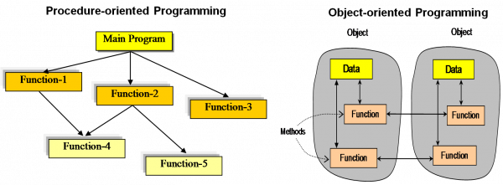
Rise of Extreme Programming
In 1990s, Object Oriented Programming replaced procedural programming.
Notes:
START OF AASHISH! (RISE OF CONCEPT)

Slide 3
Rise of Extreme Programming
Internet changed the business requirement to rapidly changing.
KENT BECK
Dot Com Bubble
↑ Internet rose
Development
Time ↓

Slide 4
Extreme Programming - Introduction

Slide 5
eXtreme Programming (XP) - Introduction
Software development model
Waterfall model
Iterative model
Agile model
RAD model
Incremental model
V model
Spiral model
XP
Extreme Programming
Agile model
FDD
Feature Driven Development
ASD
Adaptive Software Development

Slide 6
Extreme Programming (XP) - Introduction
Extreme Programming can be defined as: software development model intended to improve software quality & responsiveness to changing software requirements.
In XP, there are shorter software development cycles where checkpoints can be incorporating new software requirements.

Slide 7
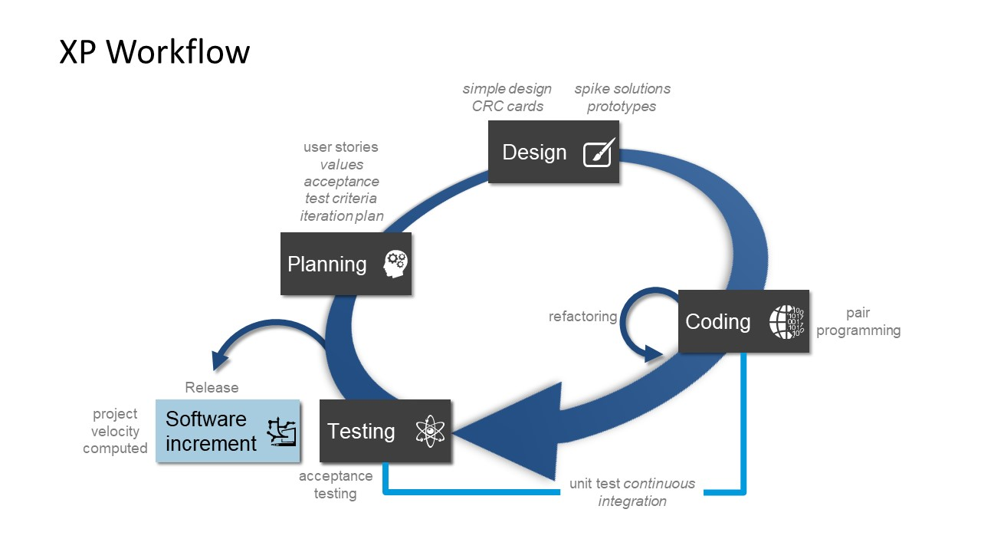
Extreme Programming (XP) - Diagram

Slide 8
Individually, it doesn’t make sense
Managing
Planning
Designing
Coding
Testing

Slide 9
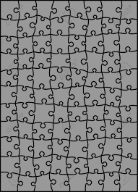
Combined, it makes XP
X
e
treme
Programming

Slide 10
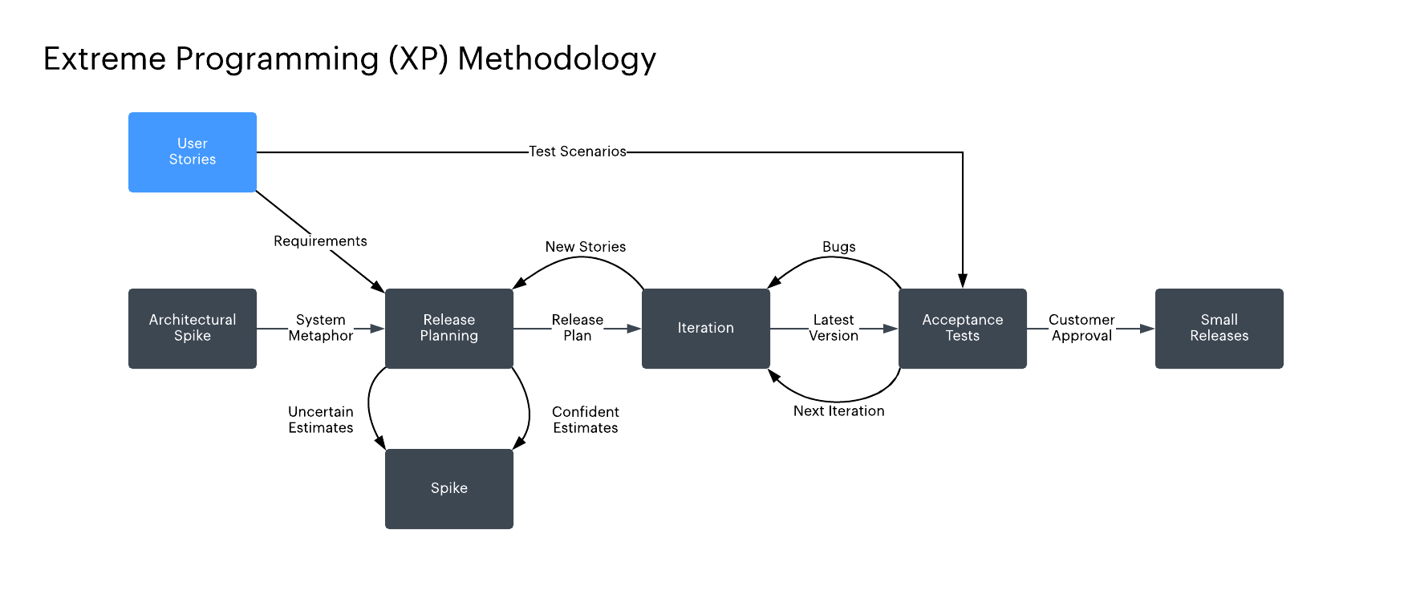
Extreme Programming (XP) - Diagram

Slide 11
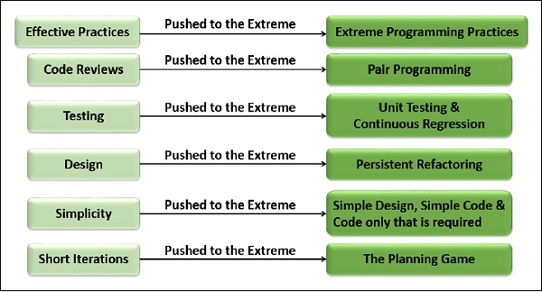
Why Name “Extreme Programming”?
Notes:
END OF AASHISH! (Why XP?)

Slide 12


