Slide 1
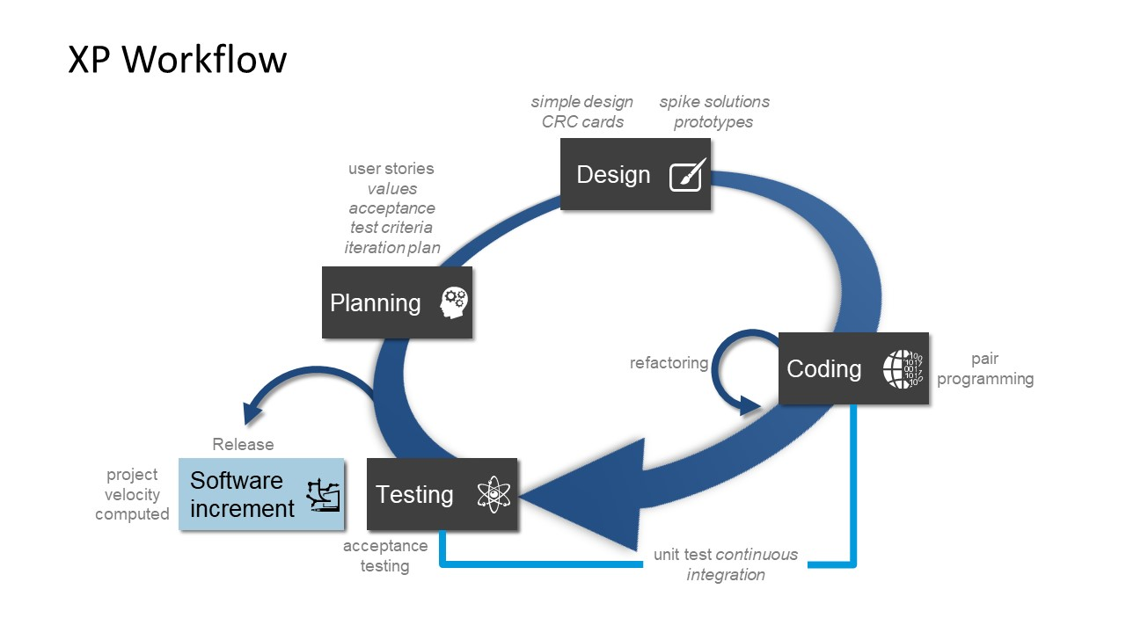
Extreme Programming working process

Slide 2
1. Planning Works in three phases:
On-site customers
The Planning Game
Small Release
2. Designing
Works in three phases:
Simple Design
System Metaphor
Refactoring

Slide 3

3. Coding
Coding Standard
Pair Programming
40-hour work-week
Continuous Integration

Slide 4
4. Testing
Unit testing
Acceptance Test
5.Listening (Release)

Slide 5
Advantages of Extreme Programming
Disadvantages of Extreme Programming
Fewer documentation required
Collaboration with customers
Easy to manage
Higher-quality code
Fast delivery of result
Is focused only on code rather than design
Does not work best in bigger project
Depends heavily on customer interaction
Requires much user input

