Slide 1

Extreme Programming
Prepared By:
Aashish Tamrakar
Asim Aryal
Niroj Bajracharya
Sudip Gyawali

Slide 2
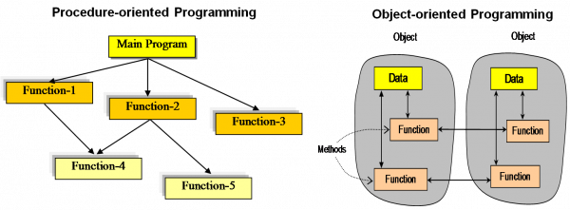
Rise of Extreme Programming
In 1990s, Object Oriented Programming replaced procedural programming.
Notes:
START OF AASHISH! (RISE OF CONCEPT)

Slide 3
Rise of Extreme Programming
Internet changed the business requirement to rapidly changing.
KENT BECK
Dot Com Bubble
↑ Internet rose
Development
Time ↓

Slide 4
eXtreme Programming (XP) - Introduction
Software development model
Waterfall model
Iterative model
Agile model
RAD model
Incremental model
V model
Spiral model
XP
Extreme Programming
Agile model
FDD
Feature Driven Development
ASD
Adaptive Software Development

Slide 5
Extreme Programming - Introduction

Slide 6
Extreme Programming (XP) - Introduction
Extreme Programming can be defined as: software development model intended to improve software quality & responsiveness to changing software requirements.
In XP, there are shorter software development cycles where checkpoints can be incorporating new software requirements.

Slide 7
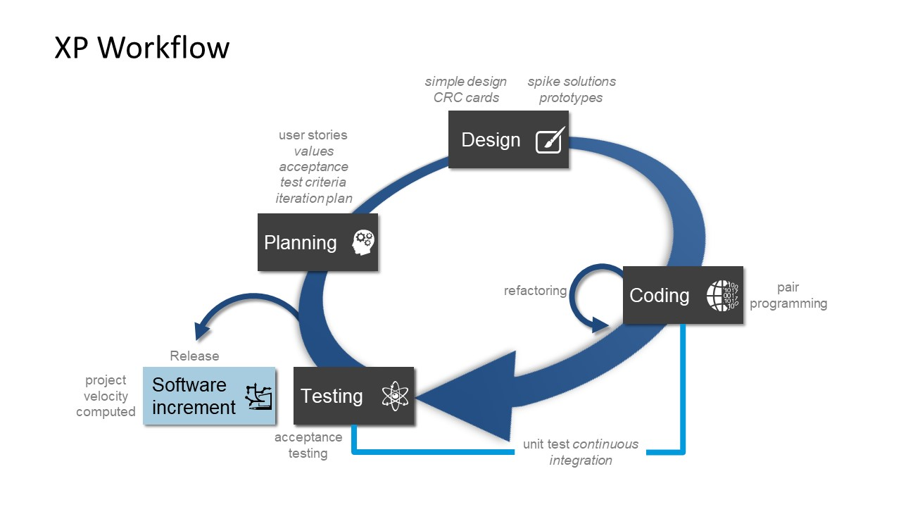
Extreme Programming (XP) - Diagram

Slide 8
Individually, it doesn’t make sense
Managing
Planning
Designing
Coding
Testing

Slide 9

Combined, it makes XP
X
e
treme
Programming

Slide 10
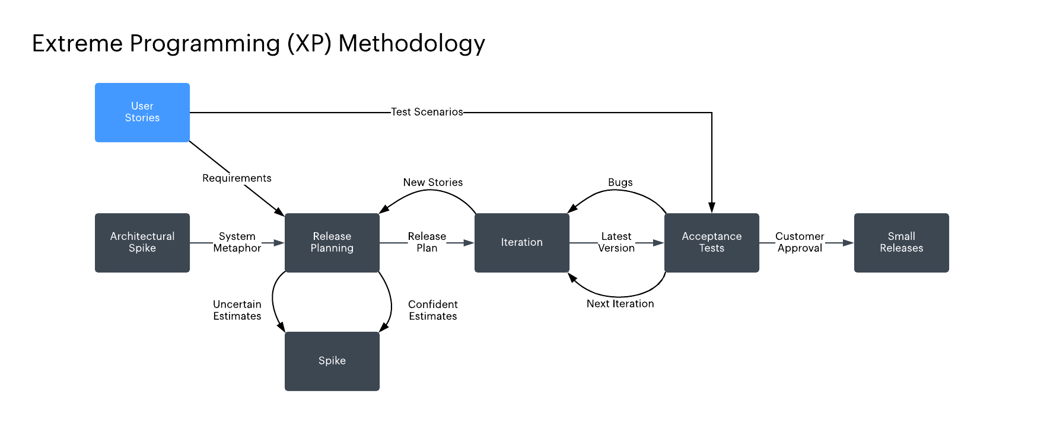
Extreme Programming (XP) - Diagram

Slide 11
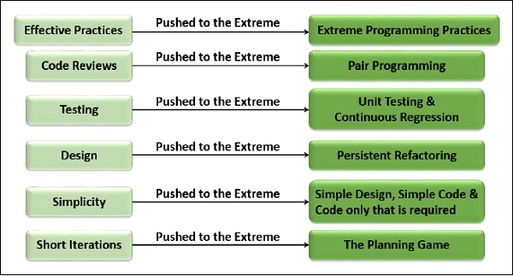
Why Name “Extreme Programming”?
Notes:
END OF AASHISH! (Why XP?)

Slide 12


Slide 13
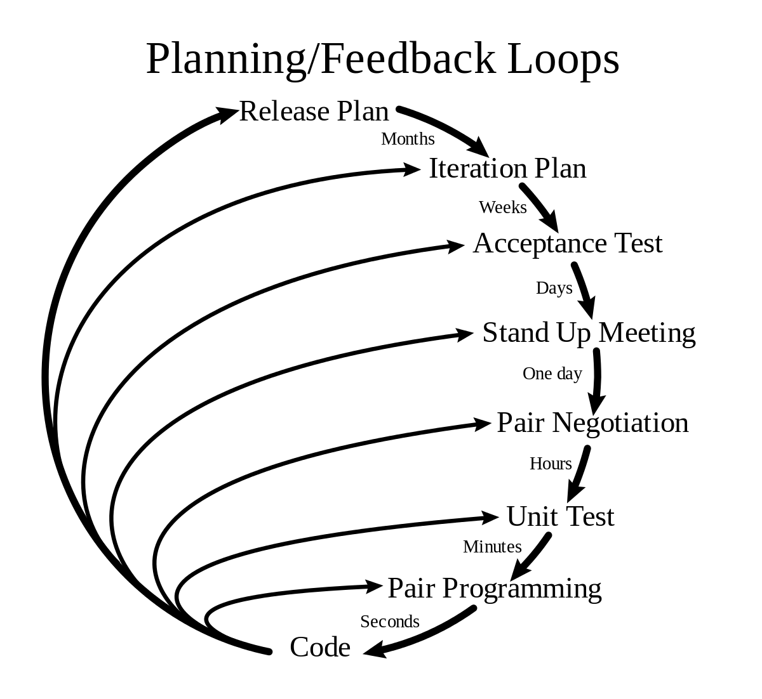
Features of XP
Pair programming
Code review
Testing
Quick Releases
Refactoring
Metaphor

Slide 14

Pair Programming
Two people working in the same computer.
Less time , less error (efficient)
Navigator directs overall
objective of the program.
Knowledge is shared.
Expert and novice pairing.

Slide 15

Code Review
To improve the code or find error.
Continuous process of improvement.
Clean and Efficient code.
Helps in quality control.

Slide 16
Testing
code2
code1
Code 3
code4
Unit Testing
Unit Testing
Unit Testing
Unit Testing
testedcode2
testedcode1
testedcode3
testedcode4
Acceptance Testing
Unified Code

Slide 17
Values
Communication
Feedback
Simplicity
Courage
Respect

Slide 18
Uses
System requiring constant system changes.
No risk of low acceptance of the final product.
Projects in rush
Risky projects

Slide 19
ADVANTAGES
Fewer documentation required
Fast delivery
Higher-quality code
Easy to manage
Collaboration with customer

Slide 20
DISADVANTAGES
Focused only on code
Requires much user input
Depends on customer interaction
Works only in smaller project

Slide 21
cirticisms
Lack of structure and necessary documentation
Requires too much cultural changes to adopt
Works with senior-level developers

Slide 22
When applicable xp
Dynamically changing software requirements
Risks caused by fixed time project
Small co-located extended development team
Technology are using allows for automated

Slide 23
Controversy around xp
Design documentation makes XP controversial.
Face to face communication
Self-organising teams
Collaboration between programmers and business experts

Slide 24




Roles
DEVELOPER
MANAGER
COACH
CUSTOMER

Slide 25
Customer
Source of problems
What to program
Give every bit of your idea to your developer
Develop positive attitude
Functional testing

Slide 26


Functional Testing
I will have the test ride.

Slide 27
Developer’s Skills
Pair Programming
Communication
Code only what is required.
Maintain simplicity
Collective Ownership
Perform unit testing
Refactor

Slide 28
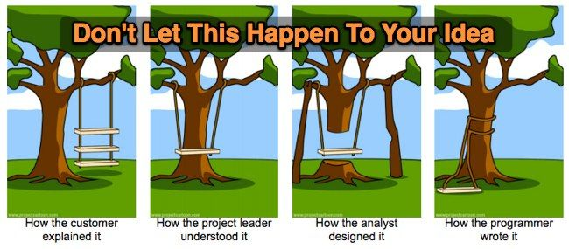
Need of understanding

Slide 29

Manager’s Task
Monitor the project, fix any deviations, modify the rules if and when required.
Tracking the time spent
Looking after developer team

Slide 30
Coach
New teams need coach.
Understanding whole idea of project.
Remain calm even when everyone else is panicking.
Be ready to help.
Be the shadow for team.

Slide 31
THANK YOU!

