Slide 1
Roles:
Customer
Developer
Manager
Coach

Slide 2
Customer
Source of problems
What to program
Give every bit of your idea to your developer
Develop positive attitude
Functional testing

Slide 3


I will have the test ride.

Slide 4
Developer’s Skills
Pair Programming
Communication
Code only what is required.
Maintain simplicity
Collective Ownership
Perform unit testing
Refactor

Slide 5
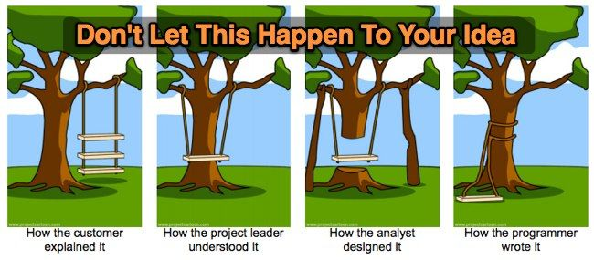
Need of understanding

Slide 6

Manager’s Task
Looking after developer team
Tracking the time spent
Monitor the project, fix any deviations, modify the rules if and when required.

Slide 7
Coach
New teams need coach.
Understanding whole idea of project.
Remain calm even when everyone else is panicking.
Be ready to help.
Be the shadow for team.

