Slide 1
ADVANTAGES
Fewer documentation required
Fast delivery
Higher-quality code
Easy to manage
Collaboration with customer

Slide 2
DISADVANTAGES
Focused only on code
Requires much user input
Depends on customer interaction
Works only in smaller project

Slide 3
cirticisms
Lack of structure and necessary documentation
Requires too much cultural changes to adopt
Works with senior-level developers

Slide 4
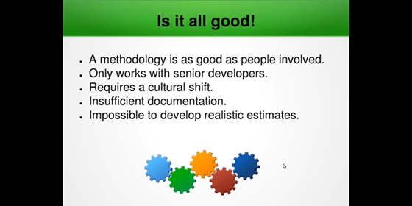

Slide 5
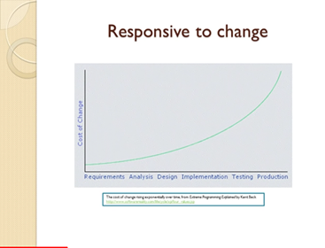

Slide 6
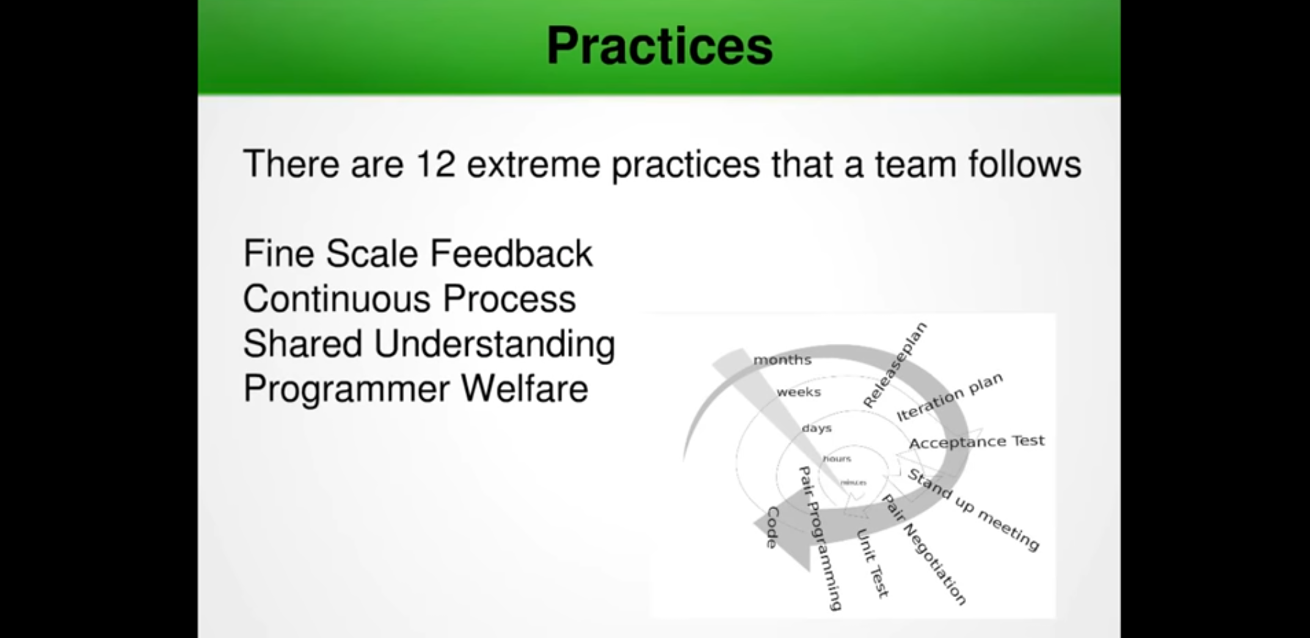

Slide 7
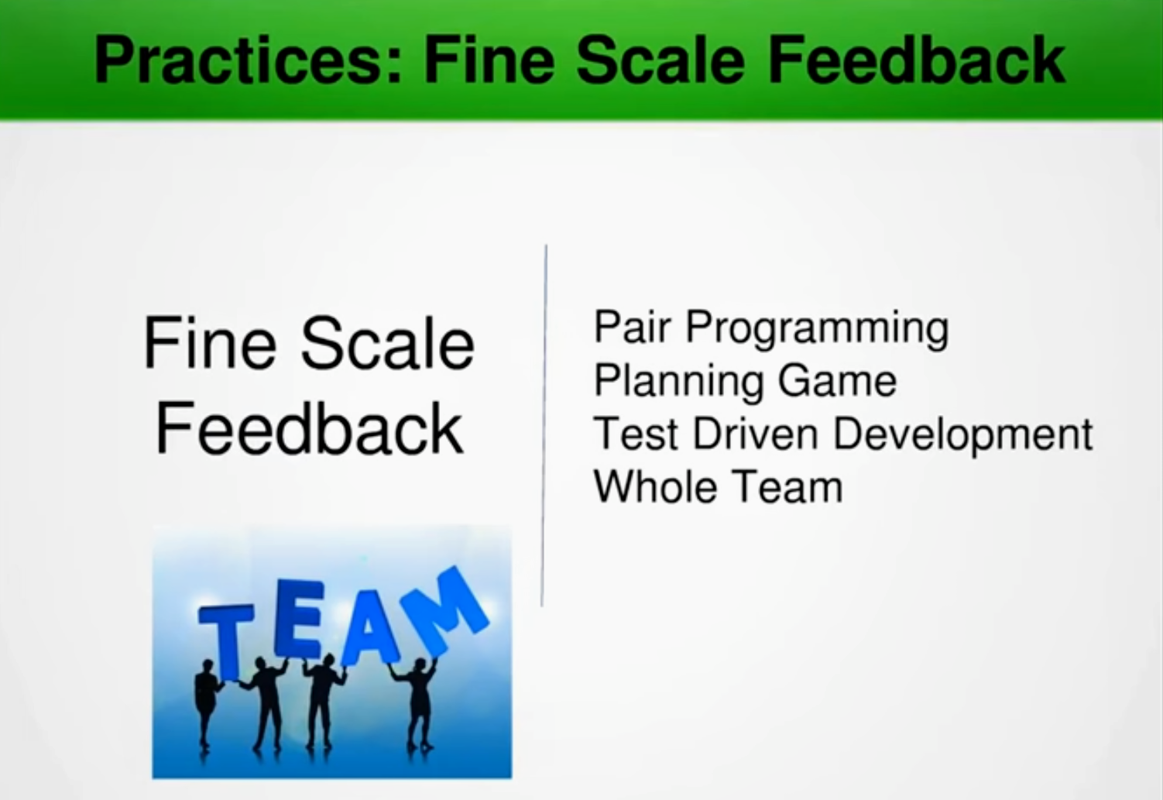

Slide 8
When applicable xp
Dynamically changing software requirements
Risks caused by fixed time project
Small co-located extended development team
Technology are using allows for automated

Slide 9
Controversy around xp
Design documentation makes XP controversial.
Face to face communication
Self-organising teams
Collaboration between programmers and business experts

