Slide 1
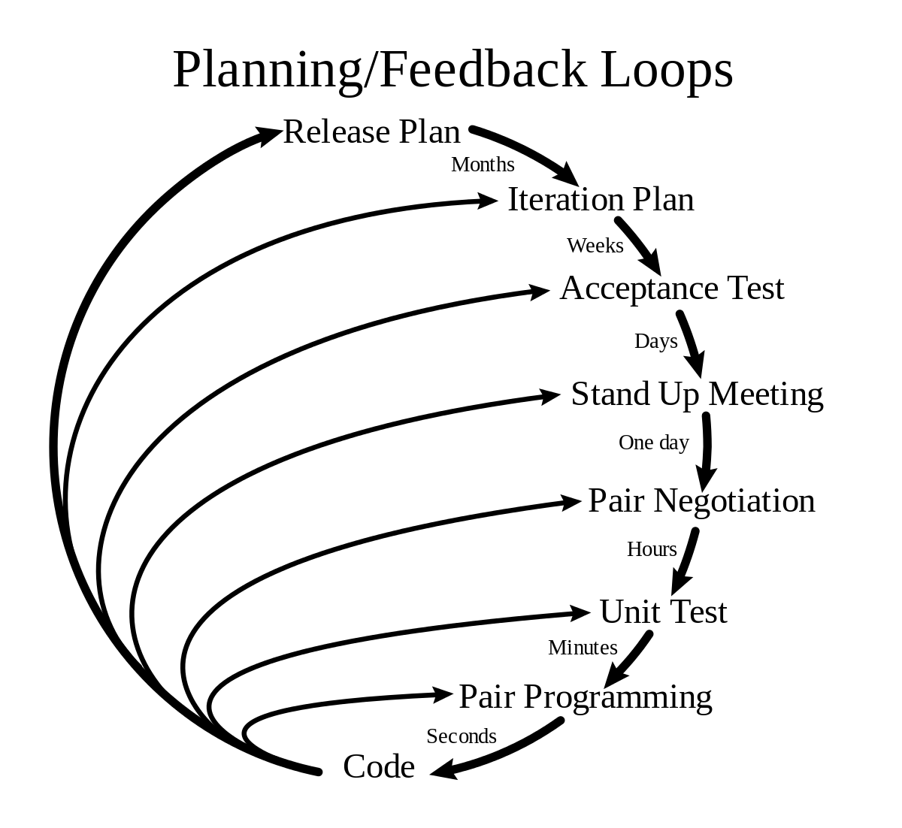
Features of XP
Pair programming
Code review
Testing
Quick Releases
Refactoring
Metaphor

Slide 2

Pair Programming
Two people working in the same computer.
Less time , less error (efficient)
Navigator directs overall
objective of the program.
Knowledge is shared.
Expert and novice pairing.

Slide 3
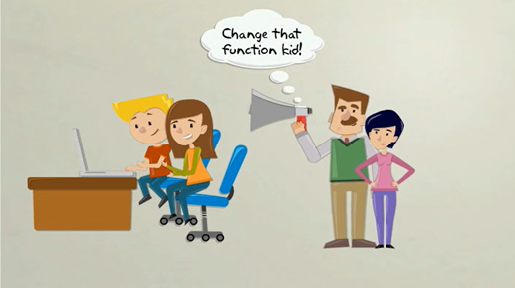
Code Review
To improve the code or find error.
Continuous process of improvement.
Clean and Efficient code.
Helps in quality control.

Slide 4
Testing
code2
code1
Code 3
code4
Unit Testing
Unit Testing
Unit Testing
Unit Testing
testedcode2
testedcode1
testedcode3
testedcode4
Acceptance Testing
Unified Code

Slide 6
Values
Communication
Feedback
Simplicity
Courage
Respect

Slide 7
Uses
System requiring constant system changes.
No risk of low acceptance of the final product.
Projects in rush
Risky projects

