Slide 1

Developer’s Skills
Pair Programming
Communication
Code only what is required.
Maintain simplicity
Collective Ownership
Perform unit testing
Refactor

Slide 2
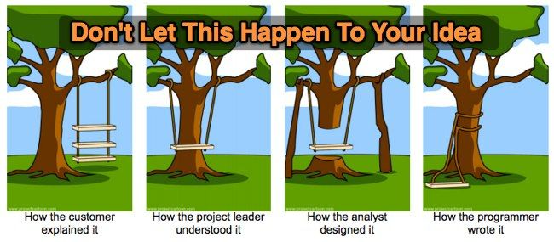
Need of understanding

Slide 3


Manager’s Task
Monitor the project, fix any deviations, modify the rules if and when required.
Tracking the time spent
Looking after developer team

Slide 4

Coach
New teams need coach.
Understanding whole idea of project.
Remain calm even when everyone else is panicking.
Be ready to help.
Be the shadow for team.

