Slide 1
Growth of Functions & Big O Notation
By Aashish Tamrakar & Asim Aryal

Slide 2
Growth of Functions
Basically, shows efficiency of algorithms.
Study of behavior of Large Algorithms.
Efficiency
Running Time
Space Usage

Slide 3
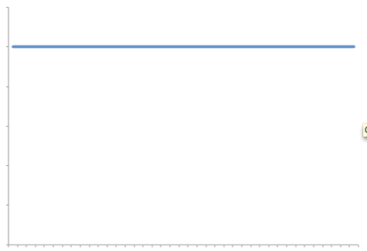
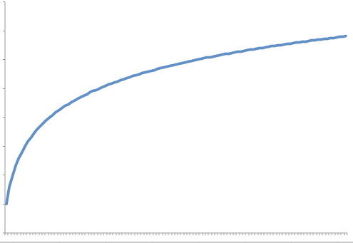
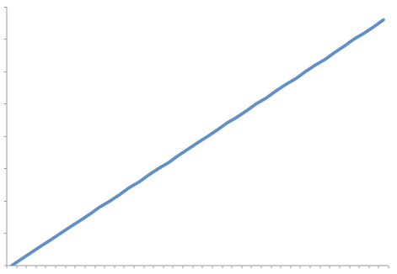
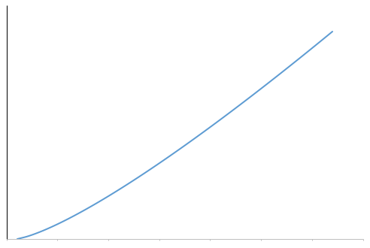
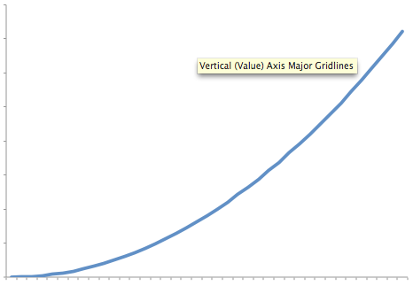
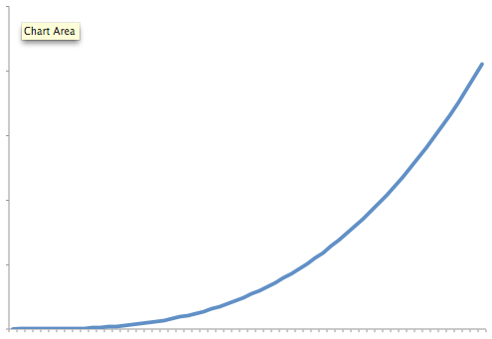
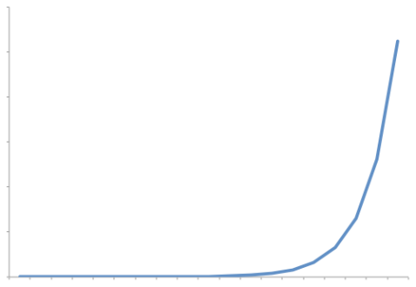
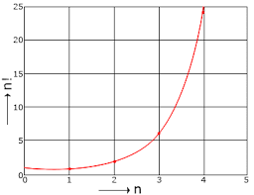
Common Growth of Functions/Rates
Name | Notation
Constant | c
Logarithmic | logn
Linear | n
Log-Linear | nlogn
Quadratic | n²
Cubic | n³
Exponential | b^{n}
Factorial | n!
Constant
Logarithmic
Linear
Log-Linear
Quadratic
Cubic
Exponential
Factorial

Slide 4
Visualization of Growth Functions
n\f(n) | c=1 | logn | n | nlogn | n² | n³ | 2^{n} | n!
5 | 1 | 3 | 5 | 15 | 25 | 125 | 32 | 120
10 | 1 | 4 | 10 | 40 | 100 | 10³ | 10³ | 3.6×10⁶
100 | 1 | 7 | 100 | 700 | 10⁴ | 10⁶ | 10³⁰ | 9.33×10¹⁵⁷
1000 | 1 | 10 | 10³ | 10⁴ | 10⁶ | 10⁹ | 10³⁰⁰ | 4.023×10²⁵⁶⁸

Slide 5
Different Asymptotic Notations
Big-O(Oh)
Little-O(Oh)
Big-Theta
Big-Omega
Little-Omega

Slide 6
Importance of Asymptotic Notation/Growth Functions
Program needs to be user friendly, modular, secure, maintainable.
Can be attained only with the help of good performance of that program.
Important to study, analyze & improve the performance of a program/algorithm.

Slide 7
Big-O(Oh) Notation
States the growth of resource needs of an algorithm.
Let f and g be the functions from natural numbers from real numbers.
g asymptotically dominates f
Read as, f is big-O of g.
if there are positive constants C and k such that
f(x)≤C|g(x)| for x≥k.
Eg: 5 x + 10 is big-oh of x², because 5 x + 10 < 5 x² + 10 x² = 15 x² for x > 1 . Hence for C = 15 and k = 1 , | 5x + 10 | k | x² | .
denoted by f(x)=O(g(x)).
a rating system for algorithms (like movie ratings).

Slide 8

Theorems
Theorem 1:
If $\lim_{x→∞}{\frac{|f(x)|}{|g(x)|}=L}$, where L≥0, then f∊O(g).
Theorem 2:
If $\lim_{x→∞}{\frac{|f(x)|}{|g(x)|}=∞}$, then f is not O(g) (f∉(O(g)).

Slide 9
Significance
allows us to analyze algorithms in terms of overall efficiency and scalability.
focuses on the inherent efficiency of the algorithm and how it varies according to the size of the input.

Slide 10
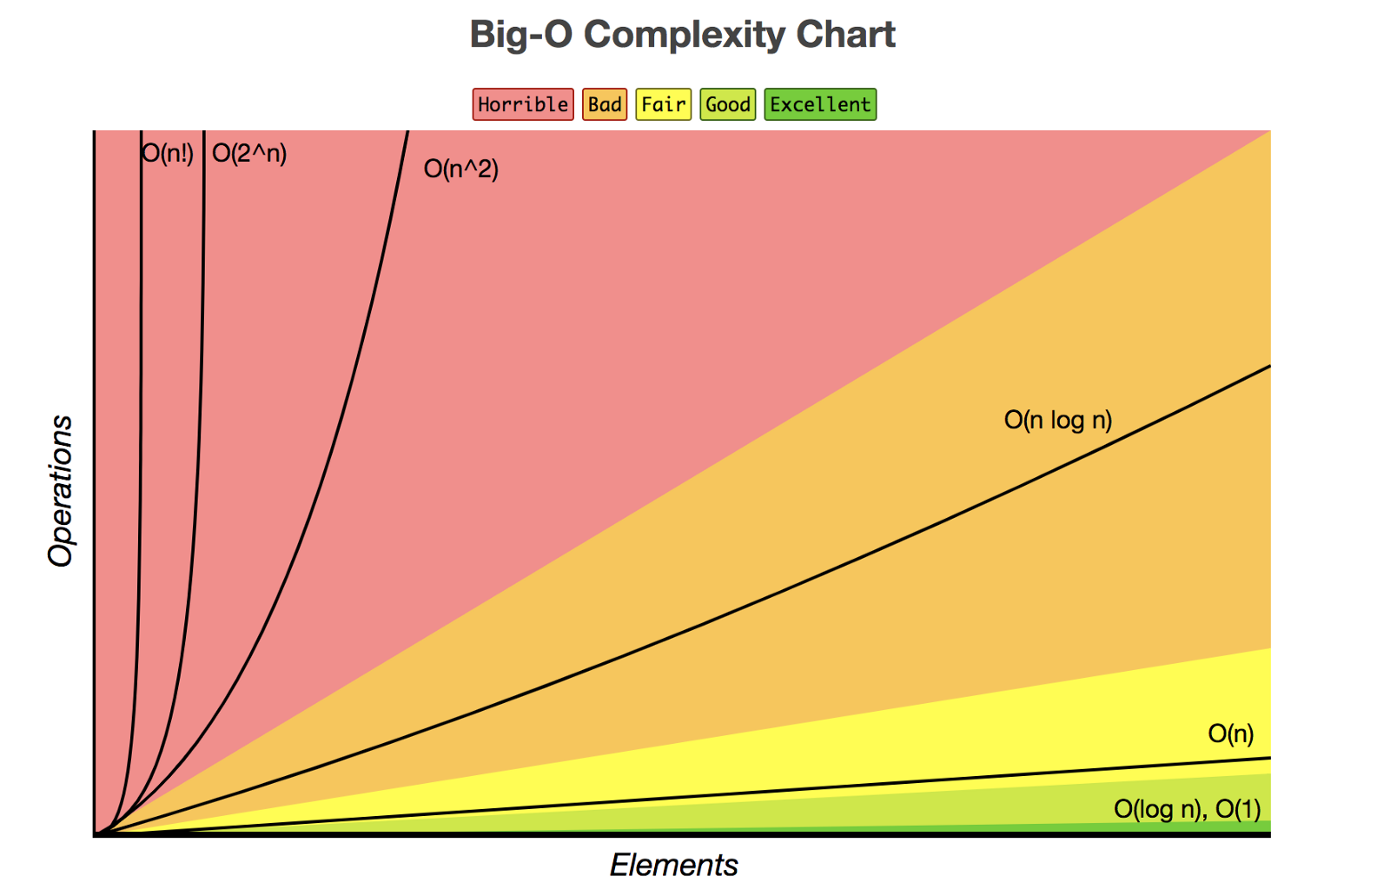
Curve

Slide 11
THANK YOU

