Slide 1
B Tree
By Ashish Tamrakar and Asim Aryal

Slide 2
Properties of B-Tree
100
155
226
48
50
79
128
140
168
200
270
290
Multiway tree allow node to have more than two children.
Nodes can carry multiple keys.
Each node can have n children for n-1 keys

Slide 3
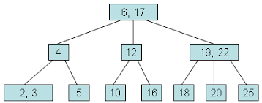
The tree maintain all keys at same level.
Each non root and each non leaf node have at least n/2 nonempty children.
A non root node has between n-1 and 2n-1 nodes.
All the keys in the node is sorted.

Slide 4
Basic Operations
SEARCHING
In B tree we start to search from root node and compare the value.
Determine which pointer to follow based on the value of key and the value of node.
Follow the appropriate pointer until it finds the node or it reaches the child node.

Slide 5
INSERTION
While inserting the value in the node we search for the position and insert the value.
If value is already present process stops.
If the node is already full we split the node in two halves and the middle value moves to the root node.
If the root node is also full it also split into two halves and the middle key is the root node.

Slide 6
DELETION
In this process we search for the value to be deleted.
if value is not present process ends
If value is found , we delete it and move the next value to its place.

Slide 7
THANK YOU!!

