Slide 1
Growth of Functions & Big O Notation
By Aashish Tamrakar & Asim Aryal

Slide 2
Growth of Functions
Basically, shows efficiency of algorithms.
Study of behavior of Large Algorithms.
Efficiency
Running Time
Space Usage

Slide 3
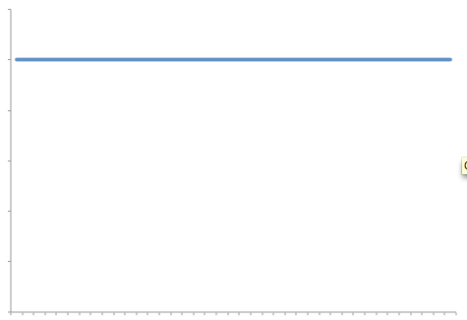
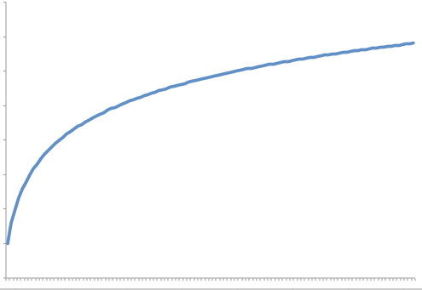
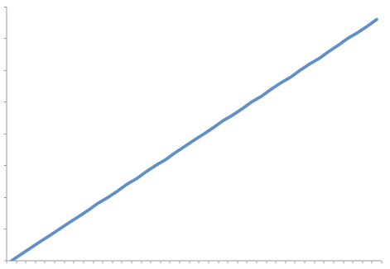
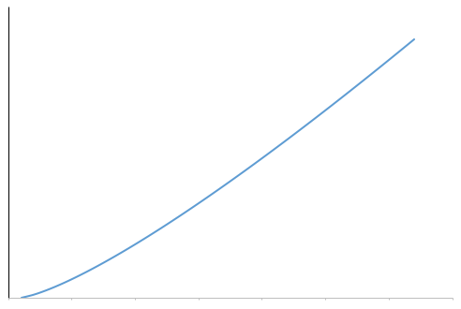
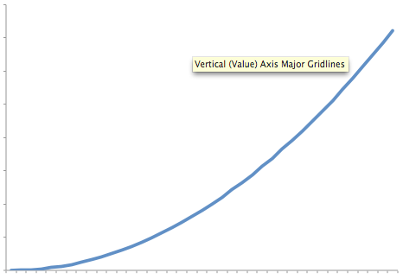
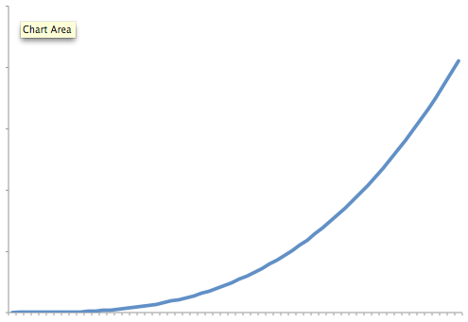
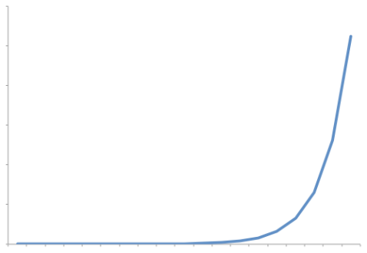
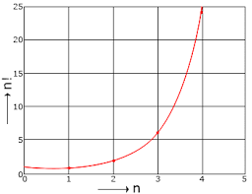
Common Growth of Functions/Rates
Name | Notation
Constant | c
Logarithmic | logn
Linear | n
Log-Linear | nlogn
Quadratic | n²
Cubic | n³
Exponential | b^{n}
Factorial | n!
Constant
Logarithmic
Linear
Log-Linear
Quadratic
Cubic
Exponential
Factorial

Slide 4
Visualization of Growth Functions
n\f(n) | c=1 | logn | n | nlogn | n² | n³ | 2^{n} | n!
5 | 1 | 3 | 5 | 15 | 25 | 125 | 32 | 120
10 | 1 | 4 | 10 | 40 | 100 | 10³ | 10³ | 3.6×10⁶
100 | 1 | 7 | 100 | 700 | 10⁴ | 10⁶ | 10³⁰ | 9.33×10¹⁵⁷
1000 | 1 | 10 | 10³ | 10⁴ | 10⁶ | 10⁹ | 10³⁰⁰ | 4.023×10²⁵⁶⁸

Slide 5
Different Asymptotic Notations
Big-O(Oh)
Little-O(Oh)
Big-Theta
Big-Omega
Little-Omega

Slide 6
Importance of Asymptotic Notation/Growth Functions
Program needs to be user friendly, modular, secure, maintainable.
Can be attained only with the help of good performance of that program.
Important to study, analyze & improve the performance of a program/algorithm.

Slide 7
Big-O(Oh) Notation
States the growth of resource needs of an algorithm.
Let f and g be the functions from natural numbers from real numbers.
g asymptotically dominates f
Read as, f is big-O of g.
if there are positive constants C and k such that
f(x)≤C|g(x)| for x≥k.
Eg: 5 x + 10 is big-oh of x², because 5 x + 10 < 5 x² + 10 x² = 15 x² for x > 1 . Hence for C = 15 and k = 1 , | 5x + 10 | k | x² | .
denoted by f(x)=O(g(x)).
a rating system for algorithms (like movie ratings).

Slide 8

Theorems
Theorem 1:
If $\lim_{x→∞}{\frac{|f(x)|}{|g(x)|}=L}$, where L≥0, then f∊O(g).
Theorem 2:
If $\lim_{x→∞}{\frac{|f(x)|}{|g(x)|}=∞}$, then f is not O(g) (f∉(O(g)).

Slide 9
Significance

