Slide 1
Double Hashing
By Aashish Tamrakar & Asim Aryal

Slide 2
Double Hashing - Introduction
a collision resolving technique in Open Addressed Hash tables.
very efficient hashing technique.
uses the idea of applying a second hash function to key when a collision occurs.
implemented in many popular libraries.
Hash1
Hash2
COLLISION SOLVED.
Collision

Slide 3
Process
First hash function is typically hash1(key) = key % TABLE_SIZE
A popular second hash function is : hash2(key) = PRIME – (key % PRIME) where PRIME is a prime smaller than the TABLE_SIZE.
A good second Hash function is:
It must never evaluate to zero
Must make sure that all cells can be probed

Slide 4
Main Hash Function
[Hash1(key)+i*(Hash2(key)]%TABLE_SIZE
Where, i is no. of iteration, i=0 at first
Hash1(key) is the linear probing function.
Hash2(key) is the new double hash function.

Slide 5
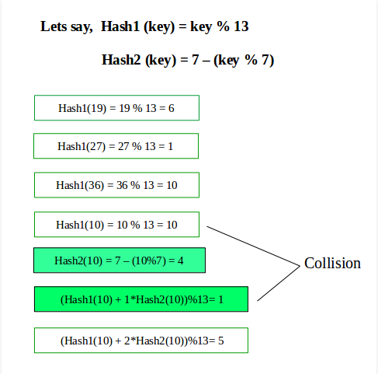
Depiction

Slide 6
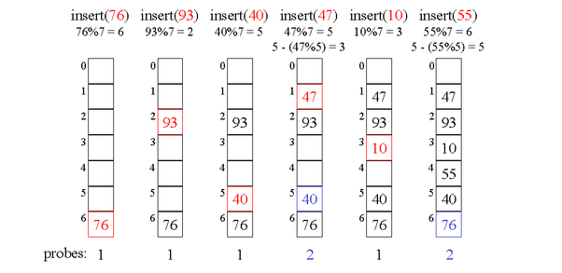
Example

Slide 7
THANK YOU

