Slide 1
Double Hashing & Shell Sort
By Aashish Tamrakar & Asim Aryal

Slide 2
Double Hashing - Introduction
a collision resolving technique in Open Addressed Hash tables.
uses the idea of applying a second hash function to key when a collision occurs.
implemented in many popular libraries.
Hash1
Hash2
COLLISION SOLVED.
Collision

Slide 3
Process
First hash function is typically hash1(key) = key % TABLE_SIZE
A popular second hash function is : hash2(key) = PRIME – (key % PRIME) where PRIME is a prime smaller than the TABLE_SIZE.
A good second Hash function is:
It must never evaluate to zero
Must make sure that all cells can be probed

Slide 4
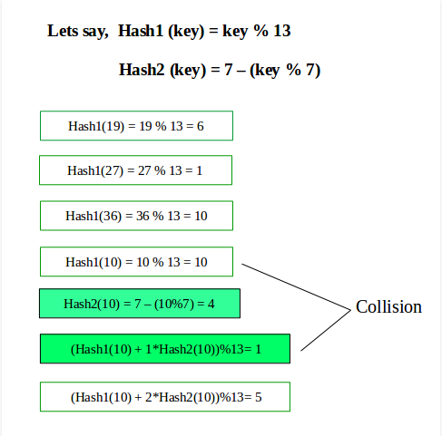
Depiction

Slide 5
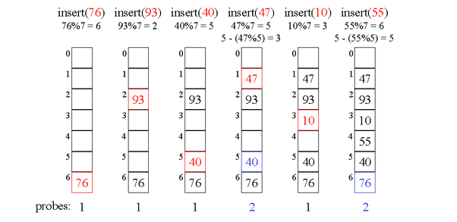
Example

Slide 6
Shell Sort - Introduction
a highly efficient sorting algorithm, similar to insertion sort
avoids large shifts
sorts less widely spaced elements in interval.
Interval
h = h * 3 + 1
where, h is the interval with initial value 1.
(Knuth’s Formulae)

Slide 7
Algorithm
Step 1 − Initialize the value of h
Step 2 − Divide the list into smaller sub-list of equal interval h
Step 3 − Sort these sub-lists using insertion sort
Step 4 − Repeat until complete list is sorted

Slide 8
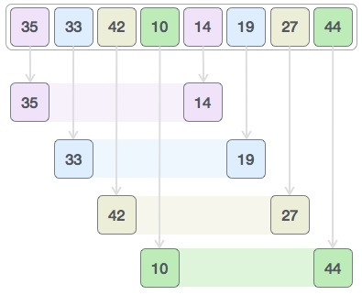
Example
We should use the Knuth’s formula to sort the given data set.:

Slide 9

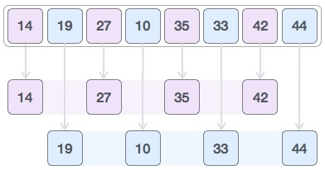
We take the two sorted set again
Then, we take interval of 1 and
this gap generates two sub-lists - {14, 27, 35, 42}, {19, 10, 33, 44}

Slide 10
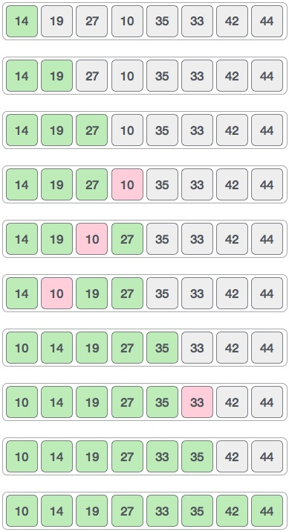
We compare and swap if necessary.

Slide 11
THANK YOU

