Slide 1
Shell Sort
By Aashish Tamrakar & Asim Aryal

Slide 2
Shell Sort - Introduction
a highly efficient sorting algorithm, similar to insertion sort
avoids large shifts
sorts less widely spaced elements in interval.
Interval
h = h * 3 + 1
where, h is the interval with initial value 1.
(Knuth’s Formulae)

Slide 3
Algorithm
Step 1 − Initialize the value of h
Step 2 − Divide the list into smaller sub-list of equal interval h
Step 3 − Sort these sub-lists using insertion sort
Step 4 − Repeat until complete list is sorted

Slide 4
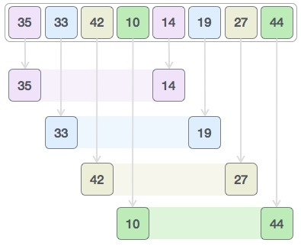
Example
We should use the Knuth’s formula to sort the given data set.:

Slide 5

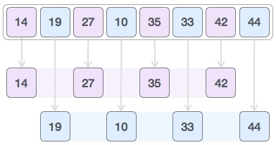
We take the two sorted set again
Then, we take interval of 1 and
this gap generates two sub-lists - {14, 27, 35, 42}, {19, 10, 33, 44}

Slide 6
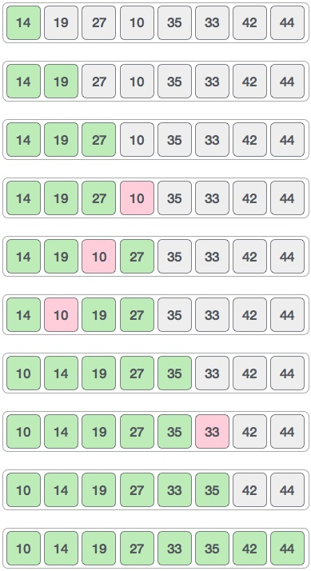
We compare and swap if necessary.

Slide 7
THANK YOU

